Slide 1
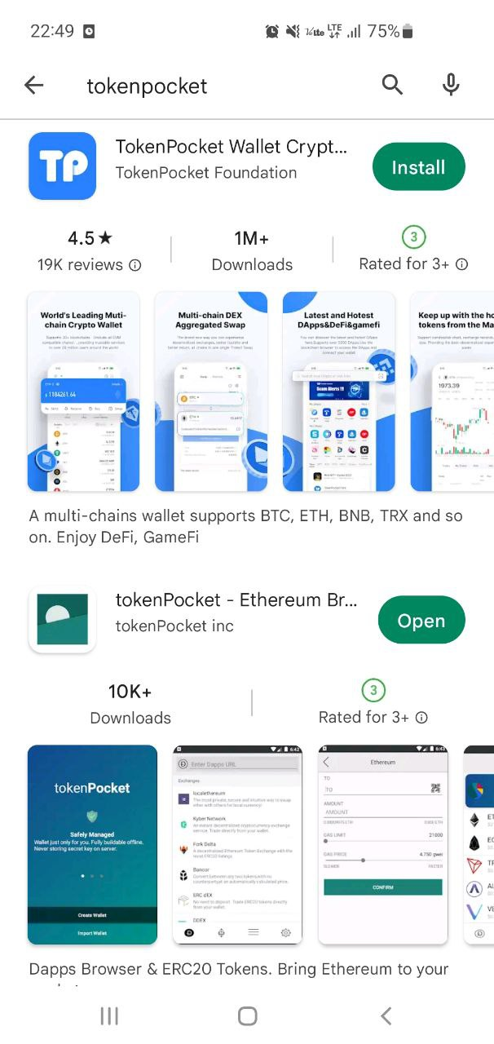
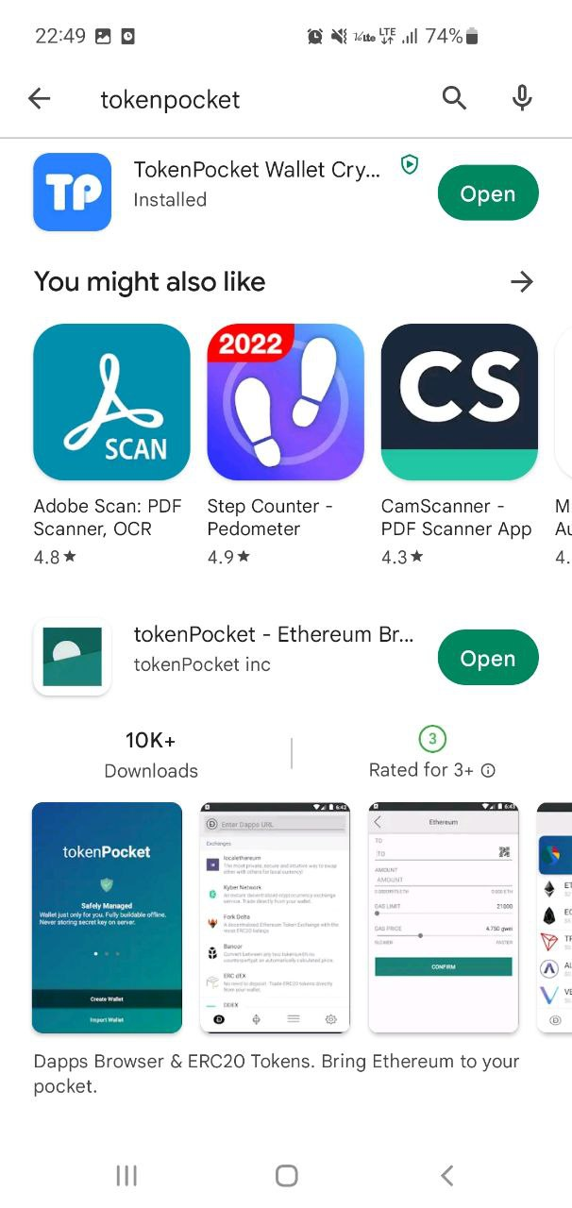
TokenPocket Manual
1. Install TokenPocket
Search“Token Pocket”in“Play Store/Apple Store”and“Install”.
2. Open Token Pocket
After installation is complete, click“Open”on TokenPocket to begin.

Slide 2
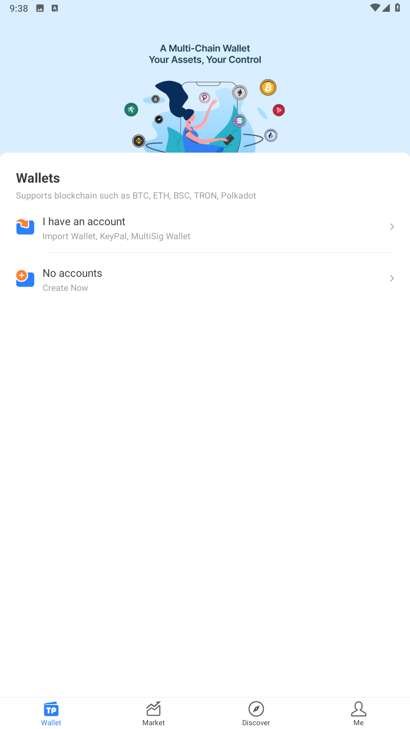
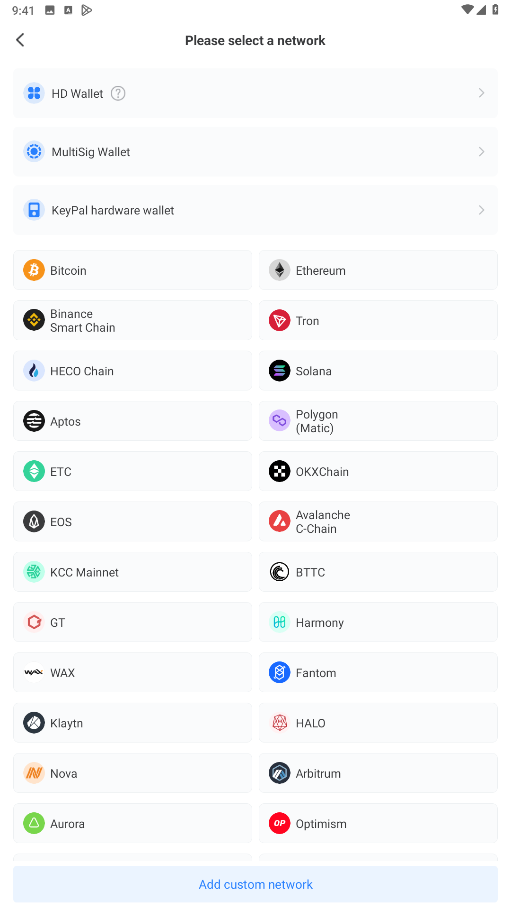
TokenPocket Manual
3. Create an account
Click“No account”at the bottom.
4. Select wallet network
Click on the“Polygon (Matic)”network to select it.

Slide 3
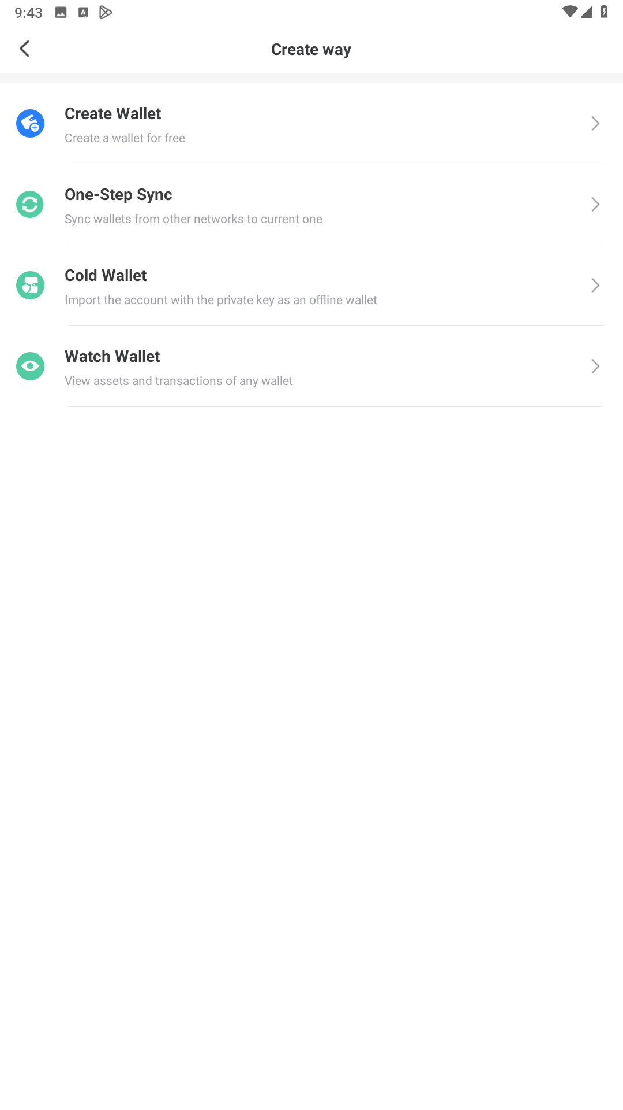
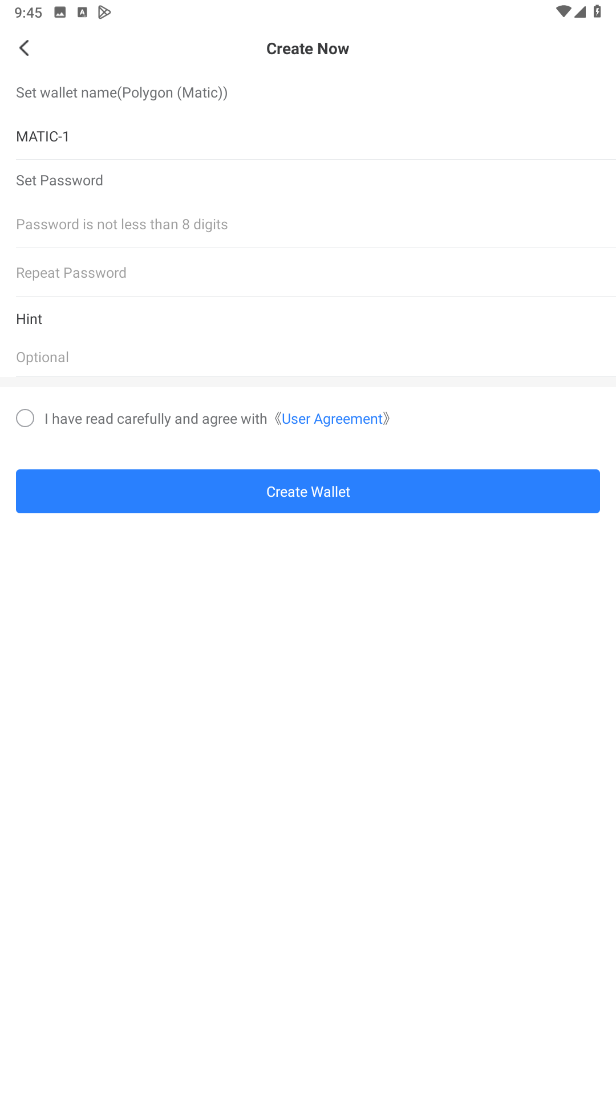
TokenPocket Manual
5. Choose create way
Click“Create Wallet”at the top.
6. Create an accoun
Set a nickname and password for your account.

Slide 4
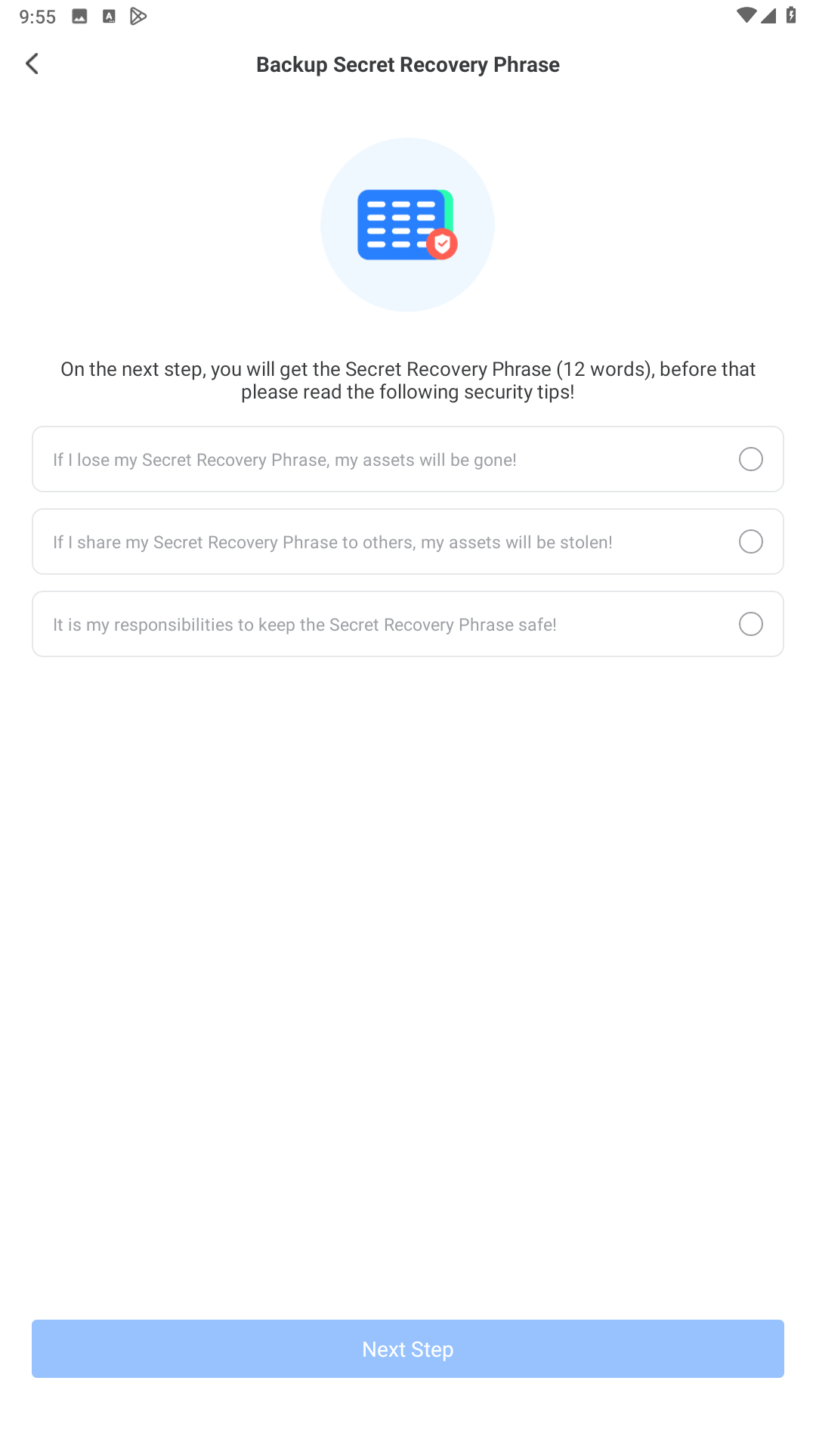
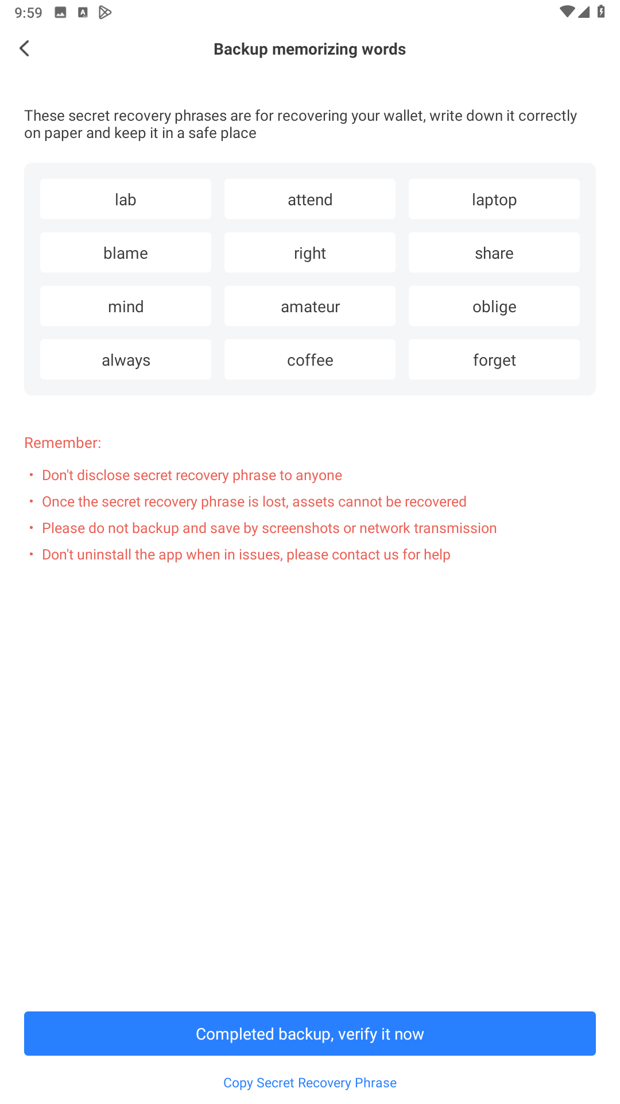
TokenPocket Manual
7. Account backup
Agree to the terms and conditions and click“Next step”.
8. Mnemonic backup
Read the Terms of Use and safely back up your mnemonic.

Slide 5
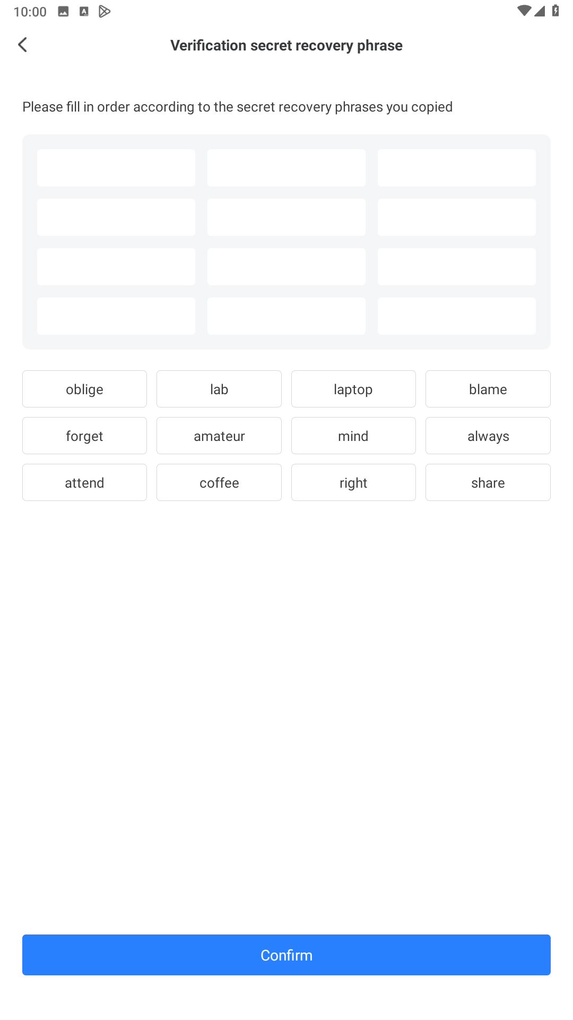
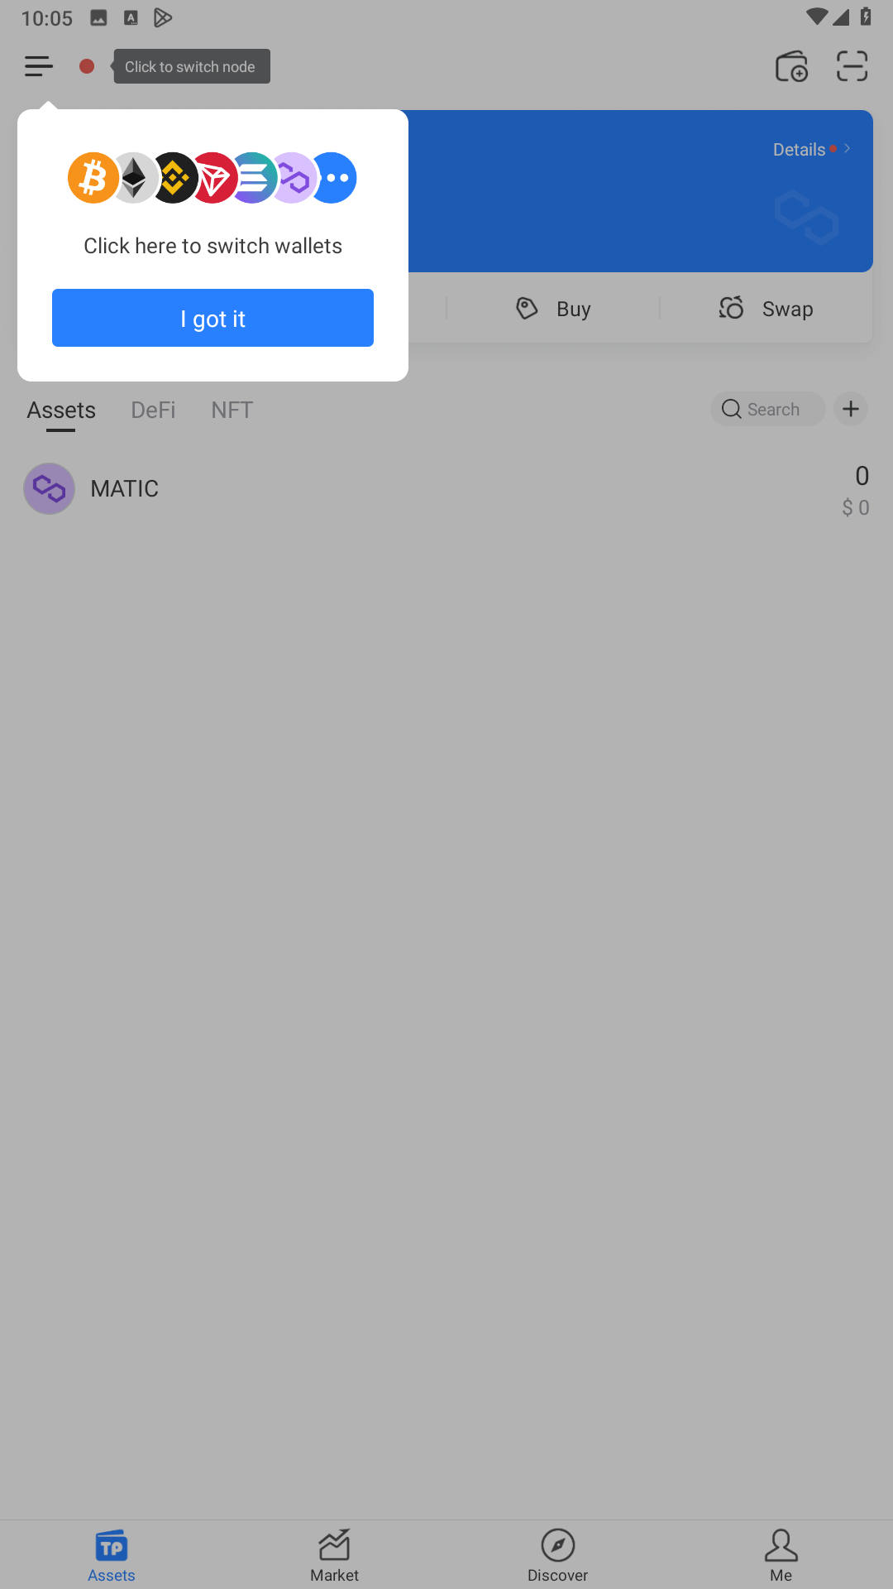
TokenPocket Manual
9. Mnemonic authentication
Enter the backed up mnemonics in order and click“Confirm”.
10. Complete
Creation of the selected network wallet address is complete.

Slide 6
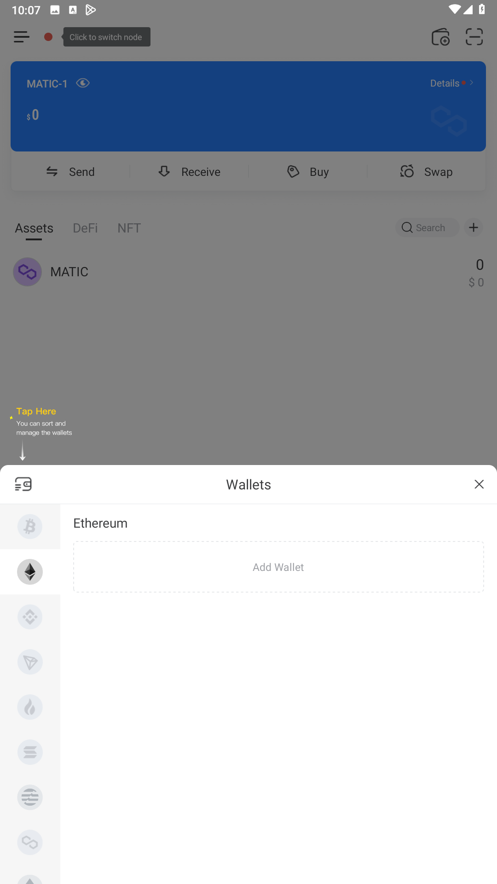
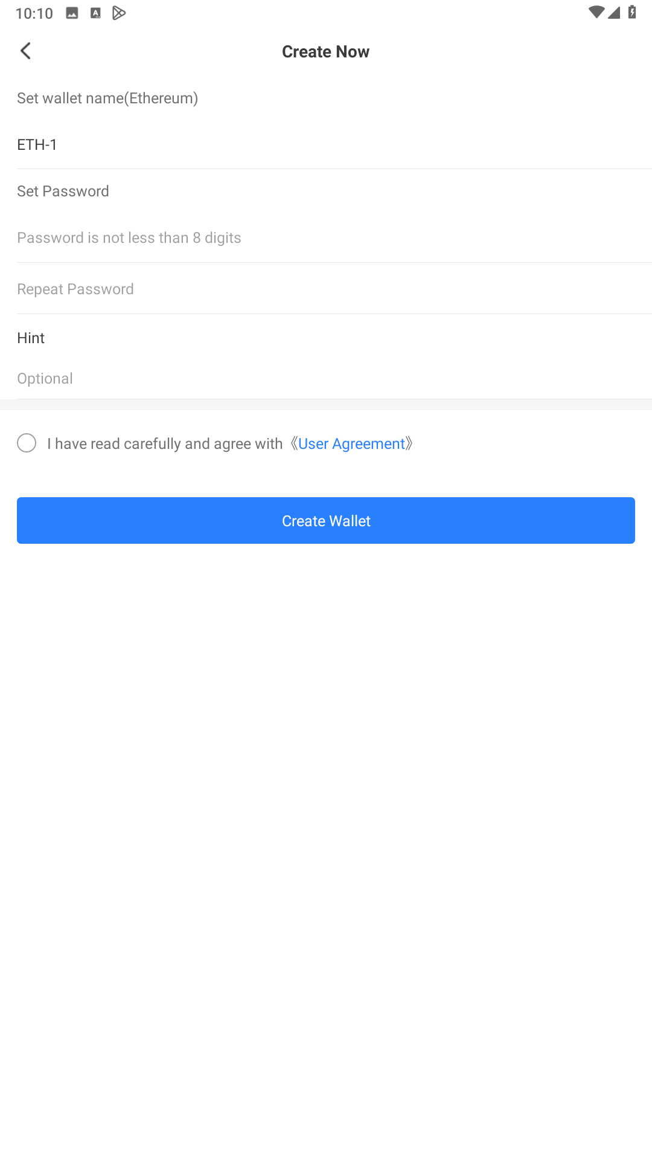
TokenPocket multi-Chain
1. Add multi network
Select other networks and click “Add Wallet”
2. Create other network accounts
See the process path on Pages 3 to 5.

Slide 7
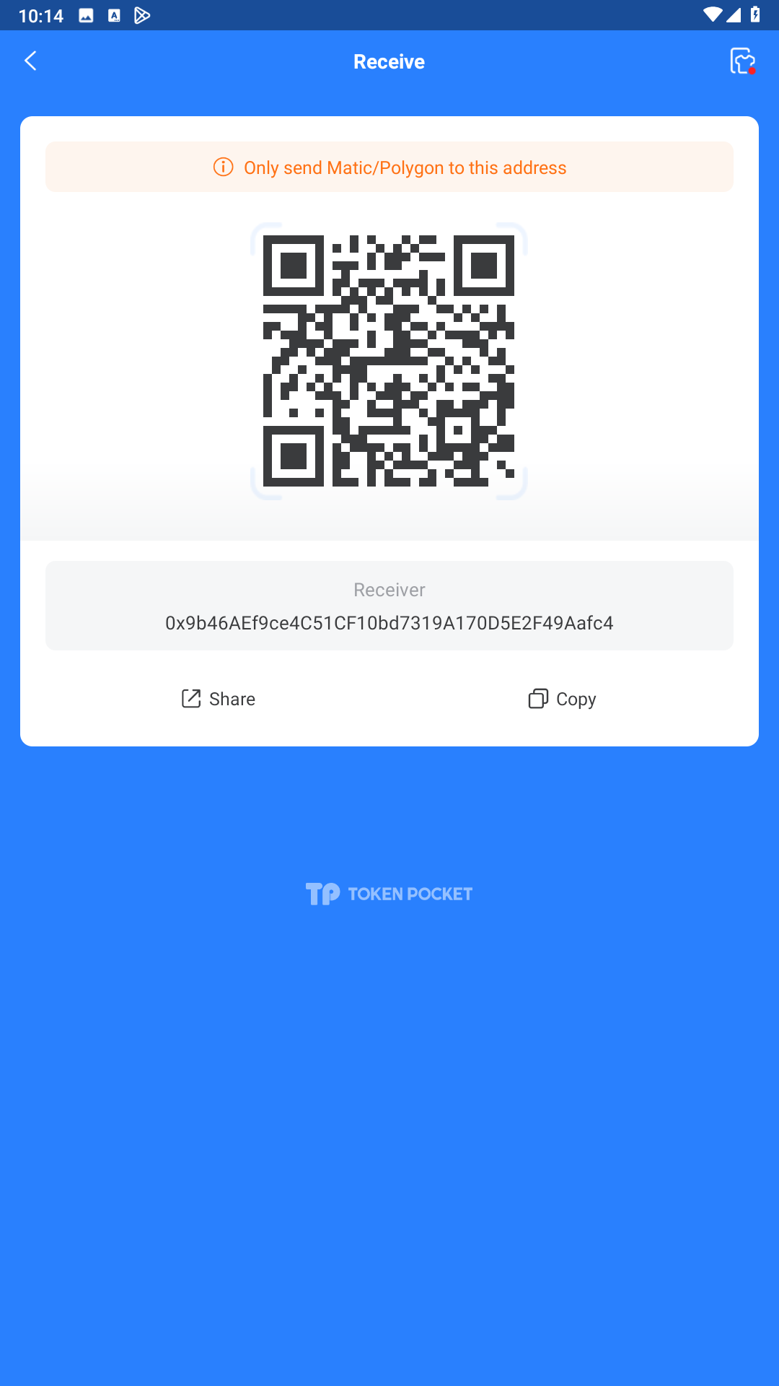
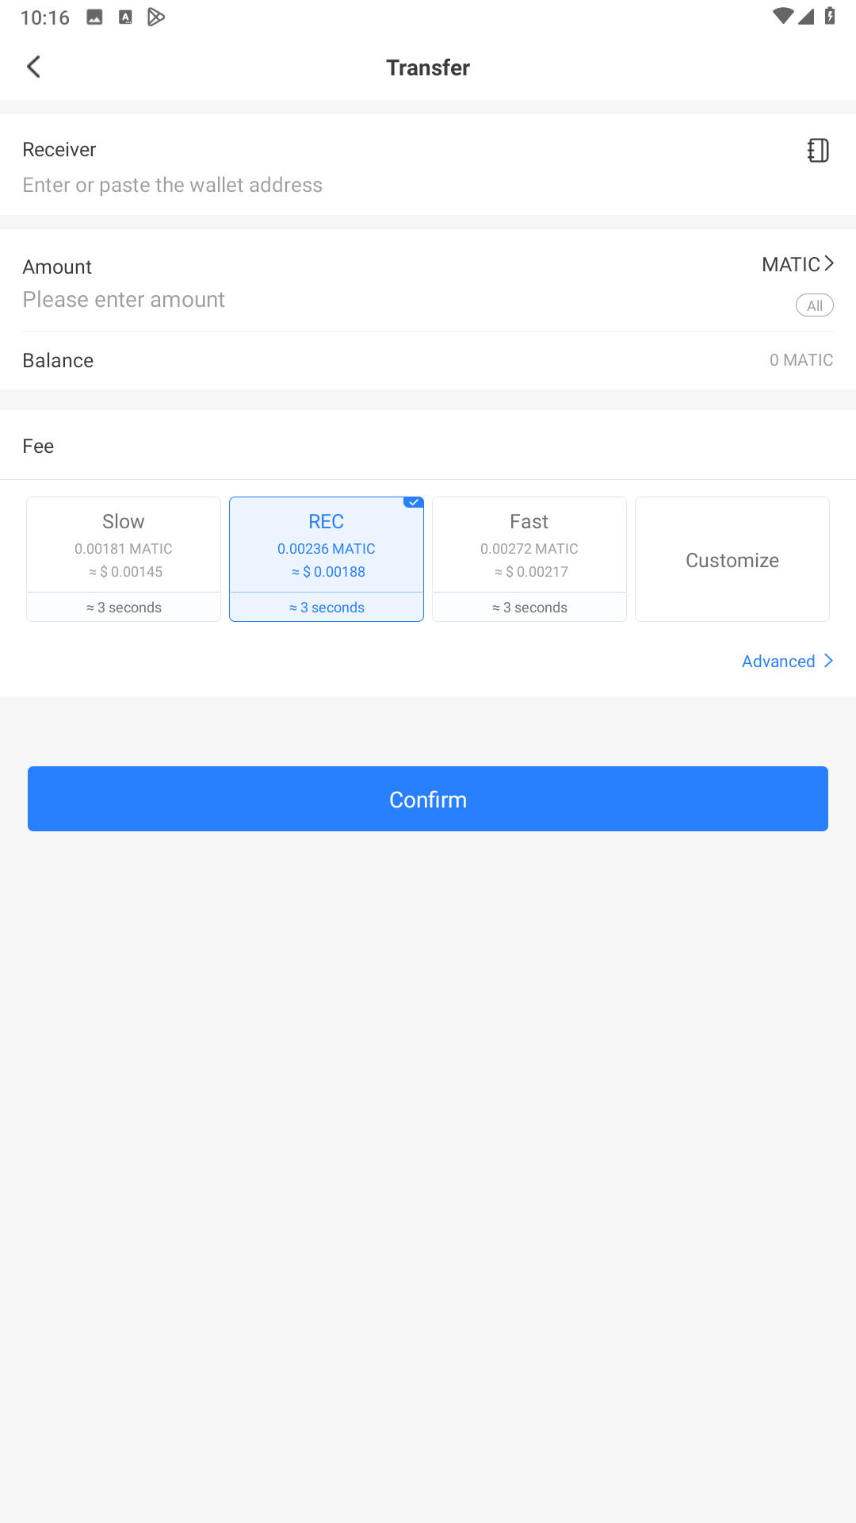
TokenPocket Transfer/Receive
1. Deposit
Send the wallet address or QR code to the coin sender.
2. Withdraw
“Confirm”after entering the address to be transferred
and the amount of coins to be transferred.

