Slide 1
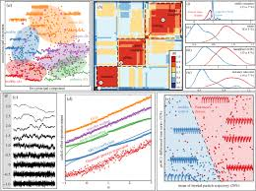
Introduction to Time series Analysis
Usha Rengaraju
Bangalore R users group(BRUG)

Slide 2
Time series Data
Time series is a set of observations that a variable takes at different times
Such a data can be collected at regular time intervals such as monthly ,weekly , quarterly(GDP) and annually(Government Budget)
Time series are used in statistics , econometrics , mathematical finance, weather forecasting and earthquake forecasting etc

Slide 3
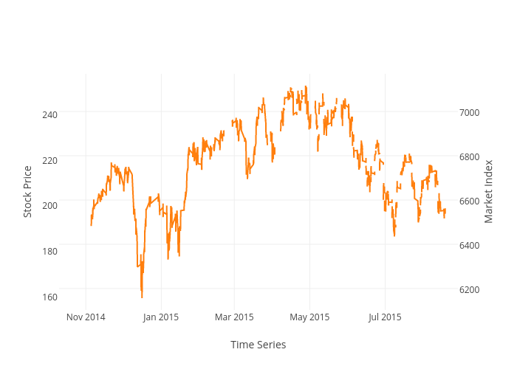

Slide 4
Univariate Time series
Univariate time series consists of time series observations recorded over regular time intervals
Eg : Monthly stock prices

Slide 5
Cross sectional Data
Type of data which is collected by observing many subjects
(individuals , firms , countries or regions) at the same point of time or during same time period

Slide 6
Patterns in Time series Data
Increasing slope
Decreasing slope
Constant slope
Patterns around the increasing slope

Slide 7
Components of Time Series Data
Trend
A long term relatively smooth pattern that usually persists for more than a year
Seasonal
A pattern appears in a regular interval wherein the frequency of occurrence is within a year or shorter
Eg ) GDP data series of India

Slide 8
Cyclical :
The repeated pattern that appears in a time series but beyond the frequency of a year
Eg ) Business cycles that record economic recession and inflation
Random :
The component of a time series that is obtained after these three component has been extracted from the time series is a random component

Slide 9
Applications of Univariate forecasting of Time series
Forecasting jewel or silver prices by the silver merchant
Housing finance companies may want to forecast mortgage interest rates and demand for housing loans
Firms may be interested in the demand for their product or market share of their product

Slide 10
Stationarity of a Time series
A series is said to be strictly stationary if the joint distribution of the series is same and exhibits the following characteristics
Constant mean
Constant variance
Constant autocovariance
Weakly stationary : same as above + autocovariance depends on lag k

Slide 11
Different Time series Process
White Noise
A series is said to be white noise if it is purely random in nature and exhibits the following characteristics
Zero mean
Constant variance
Uncorrelated ( covariance is zero)
No pattern and hence forecasting is not possible

Slide 12
Autoregressive Model
Autoregressive model is the one which depends only on its own past values
A Common representation of autoregressive model will be AR(p) model .

Slide 13
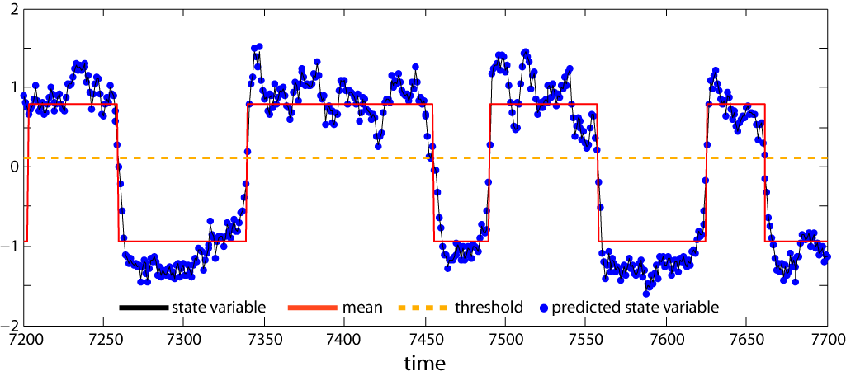

Slide 14
Moving Average Model
Moving average models is one when the data point depends on the random error terms which follows the white noise process

Slide 15
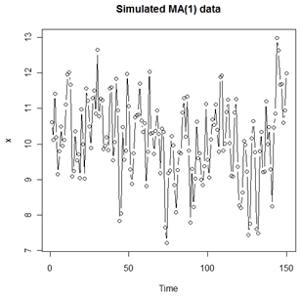

Slide 16
Auto regressive Moving average model
Combination of AR and MA model
A general form of time series model which depends on its own past values and the past values of white noise disturbances

Slide 17
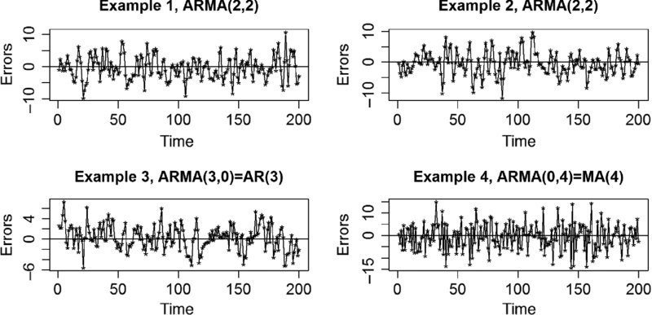

Slide 18
Thank You

