Slide 1

Welcome
To
Bengaluru R UseR Group (BRUG)

Slide 2


Slide 3
1
https://hacktoberfest.digitalocean.com/

Slide 4
2
Identify your Project

Slide 5
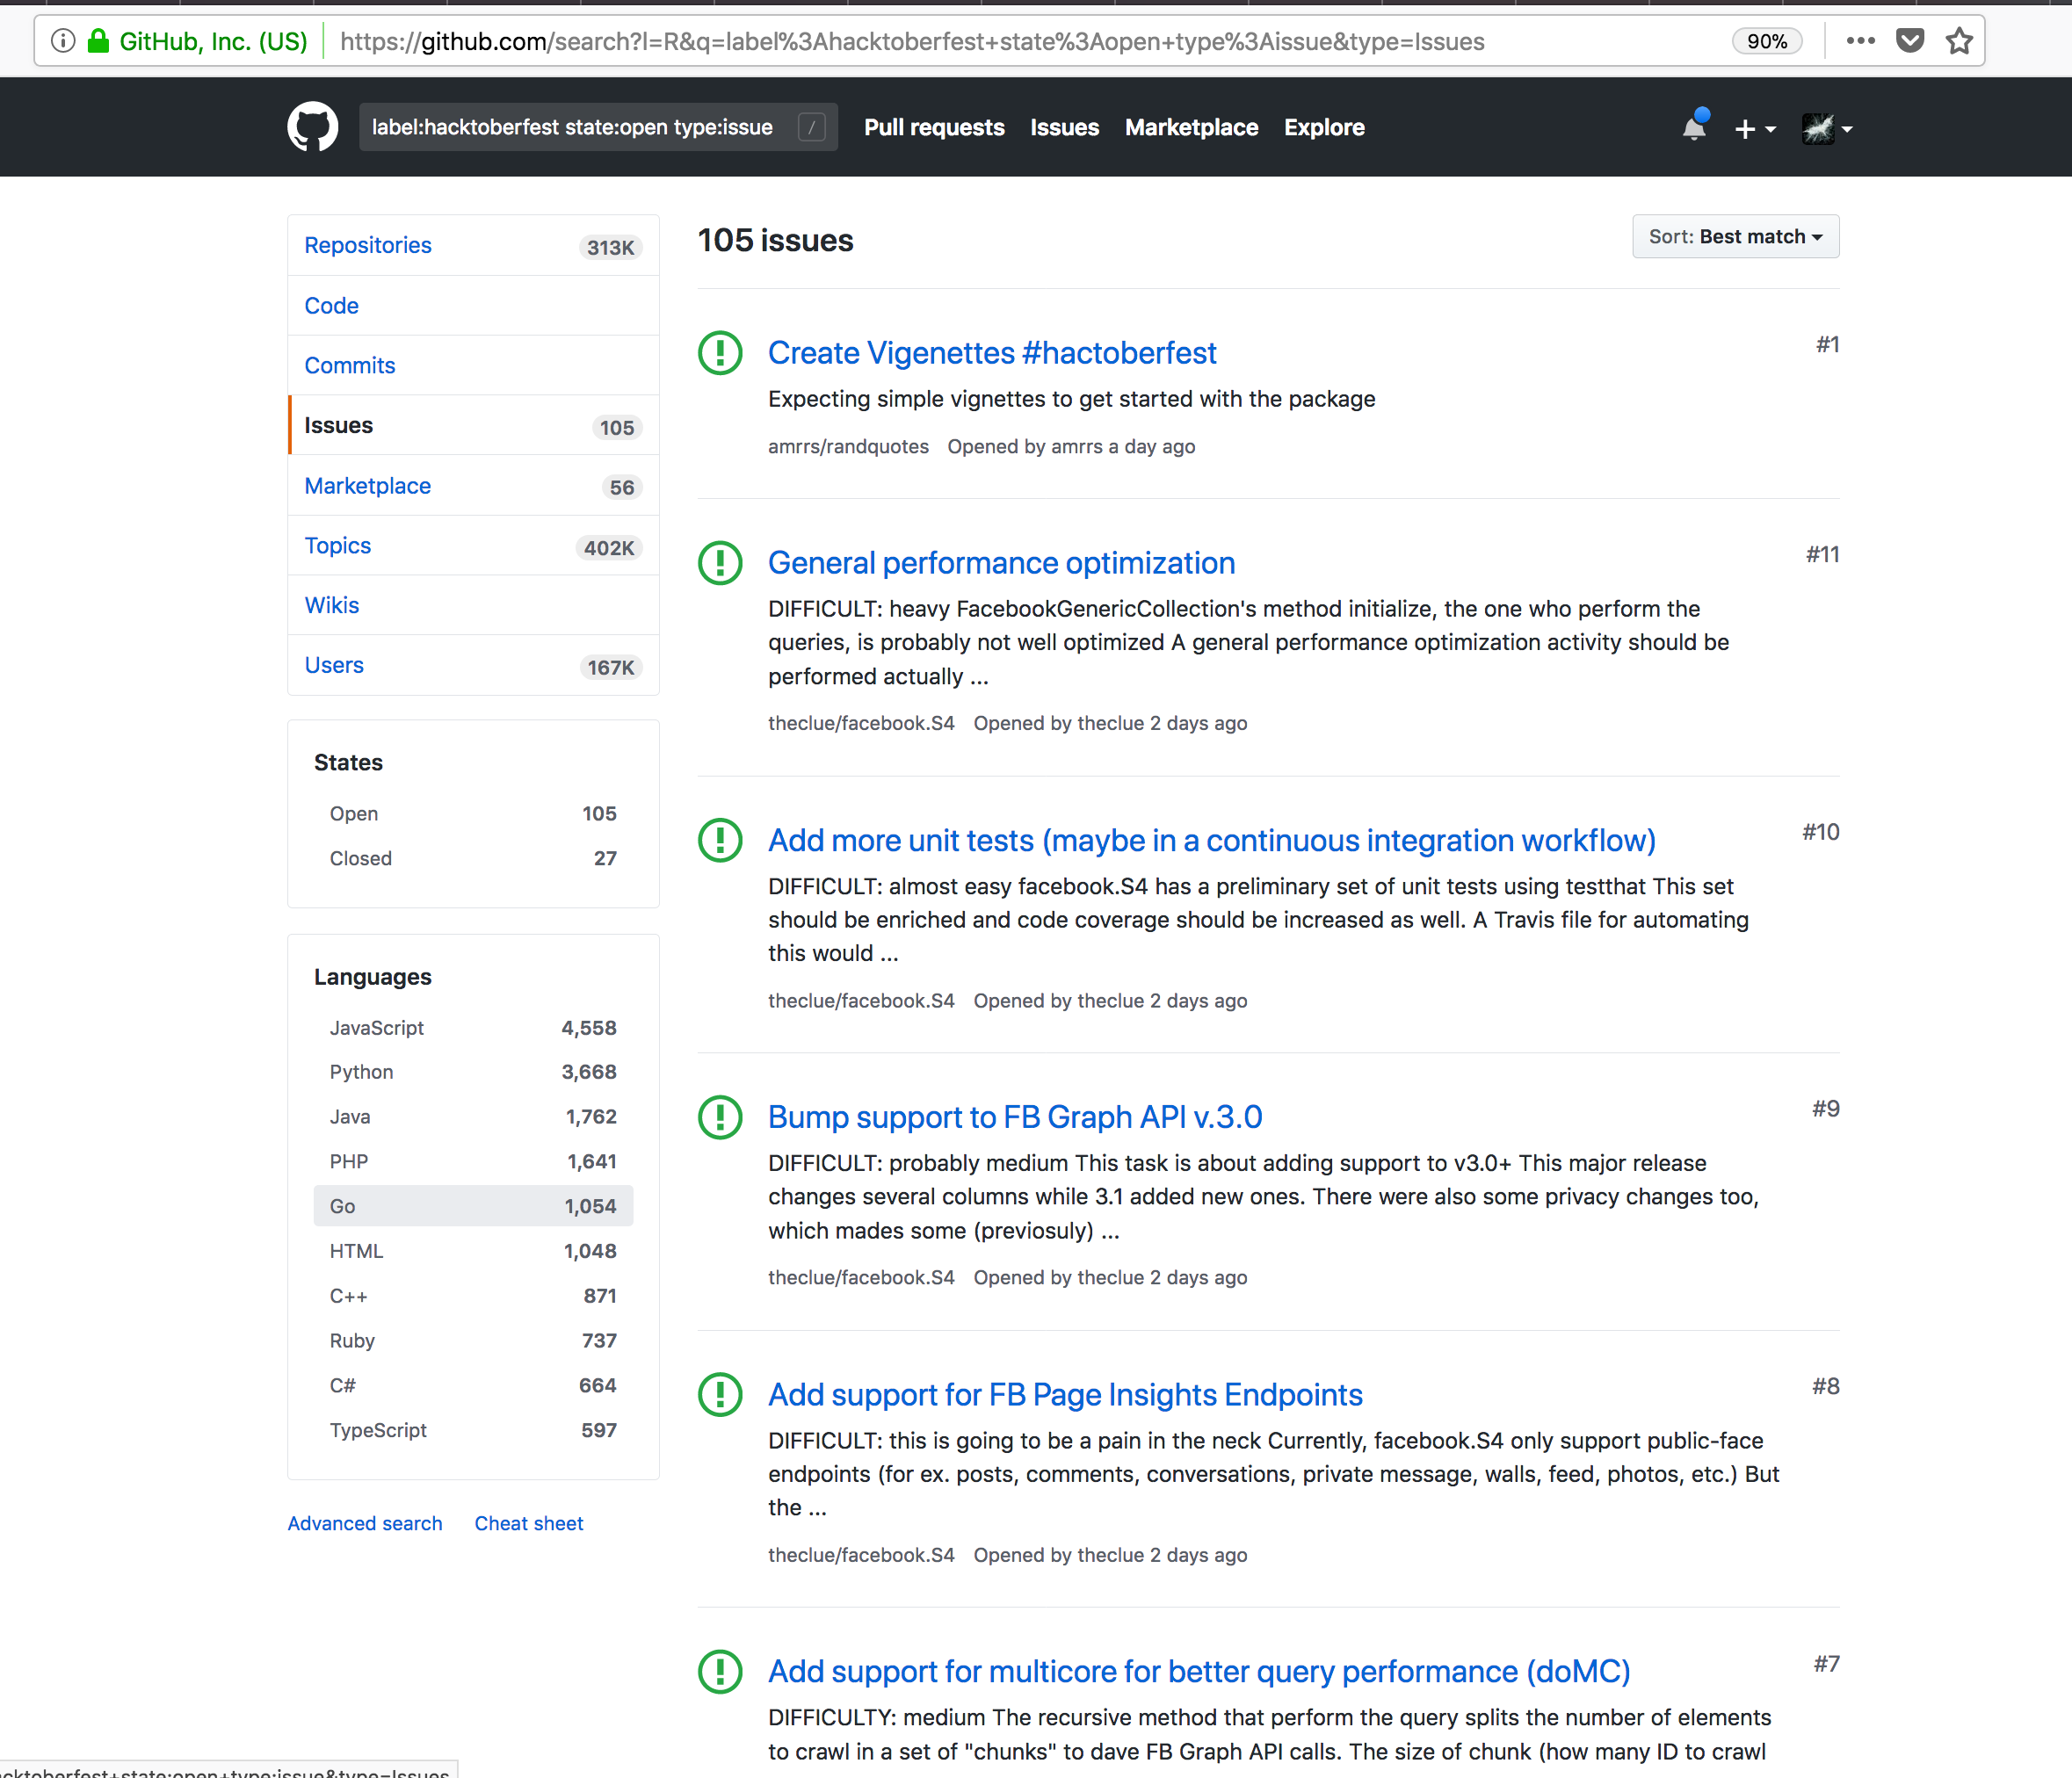

Slide 6
3
Fork

Slide 7
4
Fix / Edit

Slide 8
5
Submit PR

