Slide 1
Workspace tokens that stop at the workspace
HEXA-1775 MIGRATION PLAN DRAFT — FOR DISCUSSION
OPENING
01 / 15

Slide 2
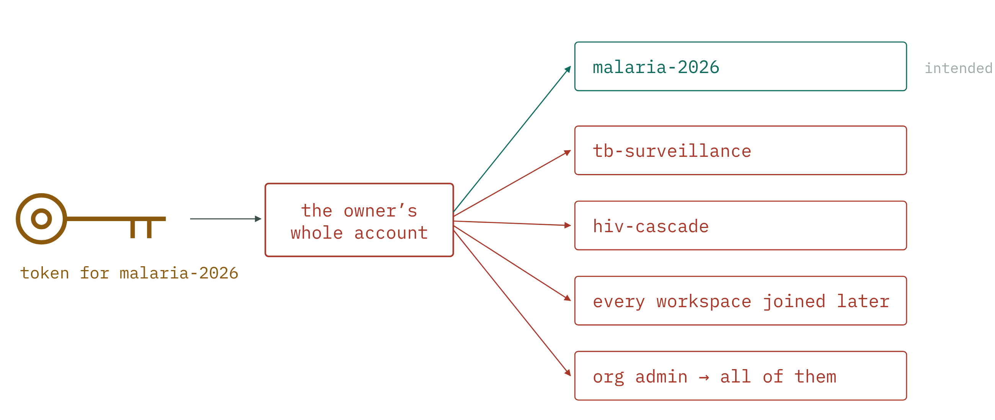
WHAT WE HAVE · 01
A token is issued for a workspace. It isn’t limited to one.
One key, every door its owner can open — today’s doors and tomorrow’s.
WHAT WE HAVE
02 / 15

Slide 3
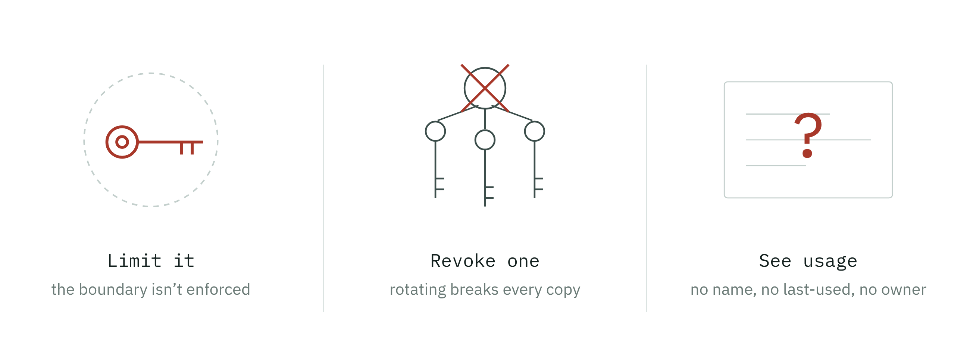
WHAT WE HAVE · 02
Three things we cannot do today
Also true today: a token bypasses 2FA, and its secret is stored in the database in plaintext.
WHAT WE HAVE
03 / 15

Slide 4
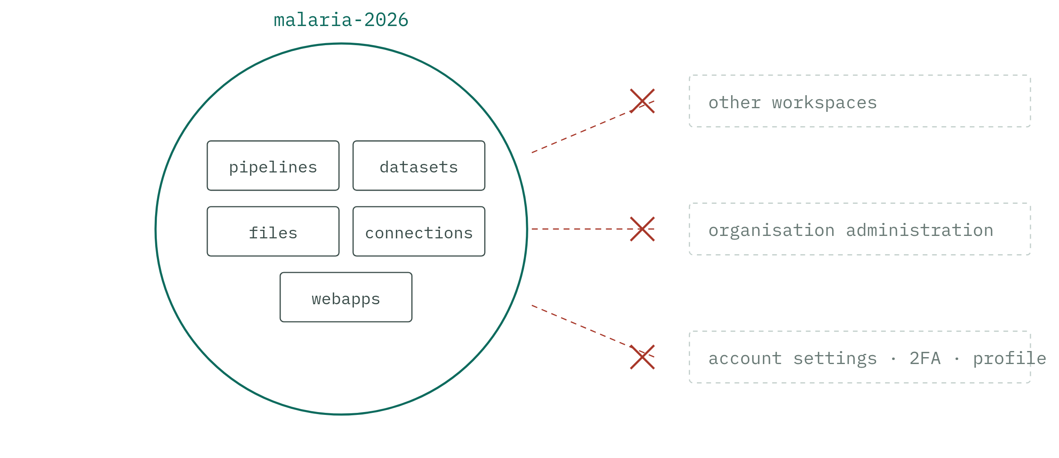
WHAT SCOPE MEANS · 03
Scope is a ring drawn around one workspace
A token acts as its owner, but only inside the ring. Superusers included — no wider than anyone else.
WHAT SCOPE MEANS
04 / 15

Slide 5
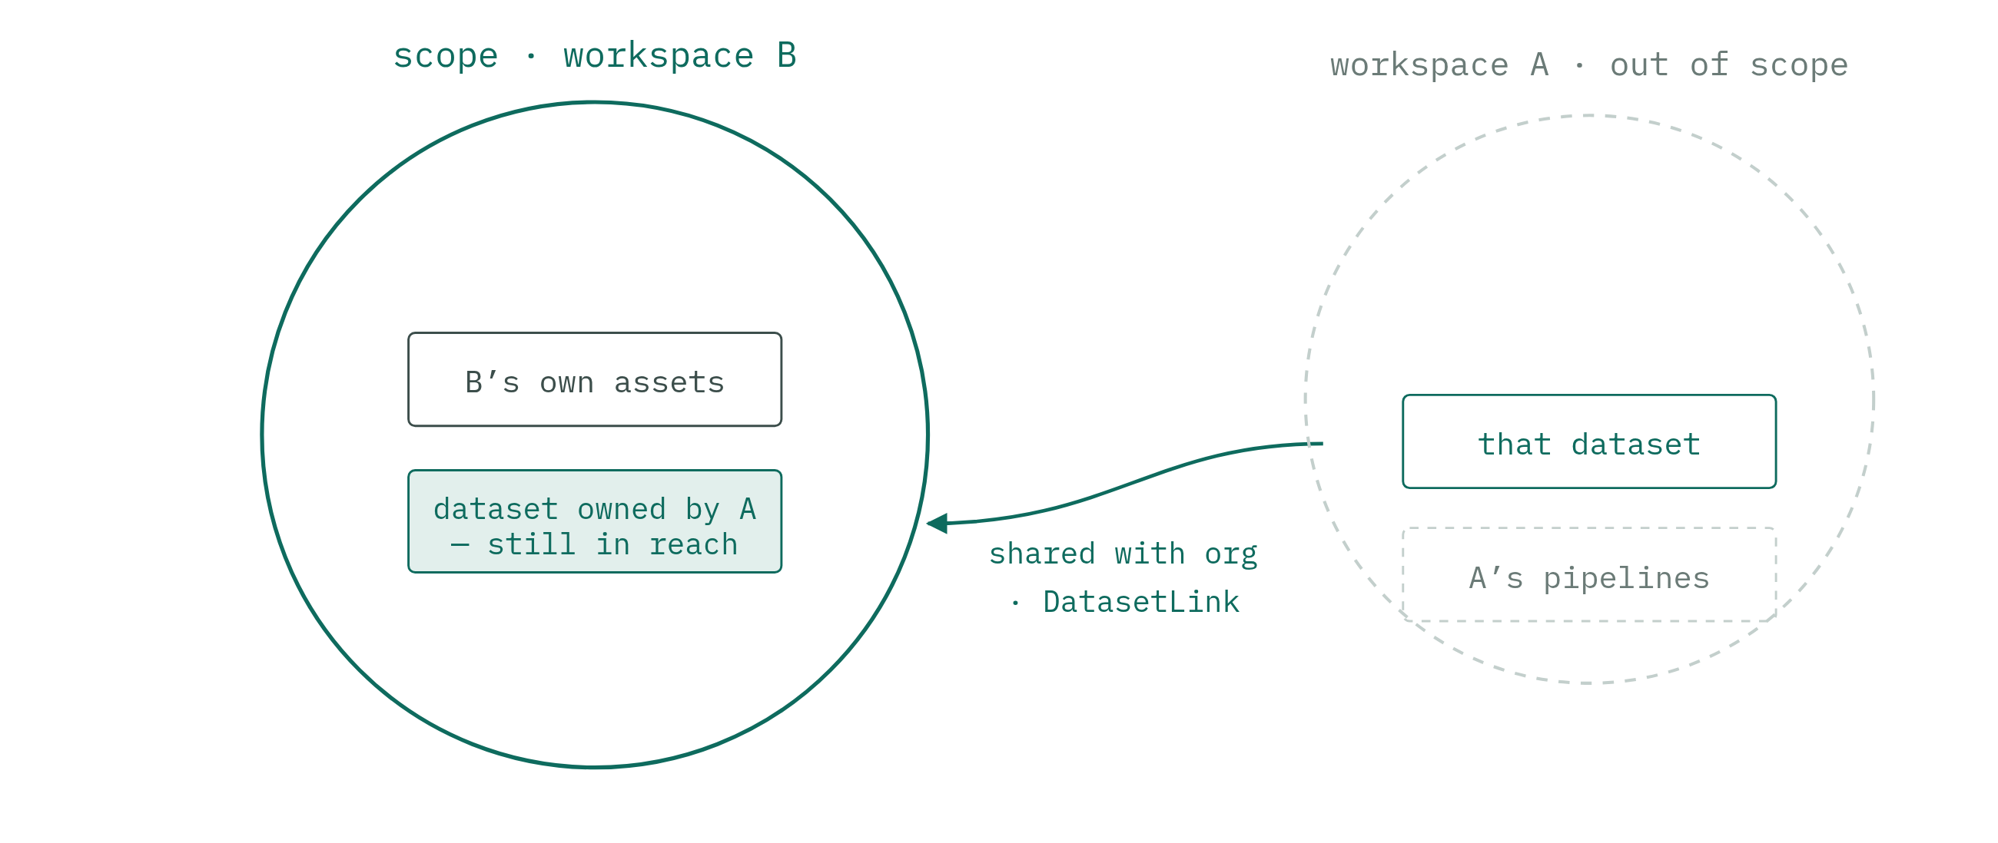
WHAT SCOPE MEANS · 04
The ring follows sharing, not ownership
A token for B reaches what B reaches. Get this wrong and we break sharing, not just tokens.
WHAT SCOPE MEANS · SEE A2
05 / 15
Notes:
Appendix: A2 → slide 17

Slide 6
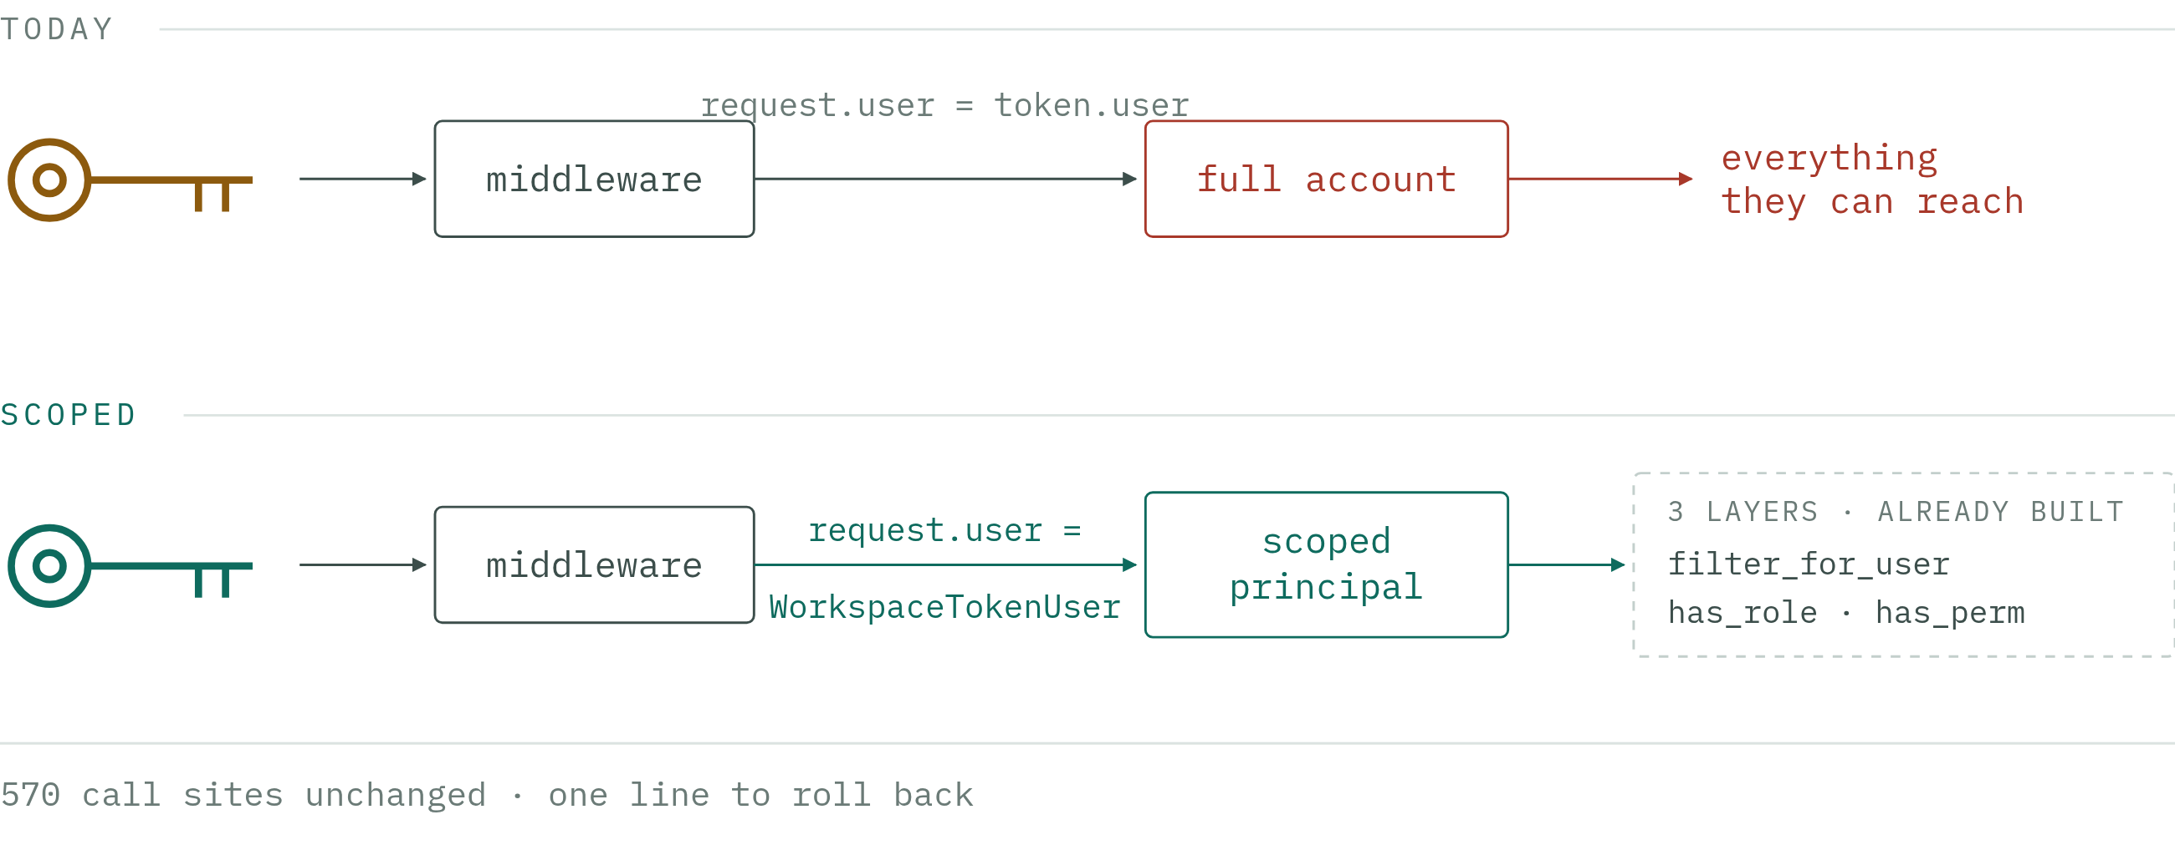
HOW IT WORKS · 05
Scoping is one line away
Every queryset already asks the principal. We hand it a narrower one.
HOW IT WORKS · SEE A1, A3, A7
06 / 15
Notes:
Appendix: A1 → slide 16 · A3 → slide 18 · A7 → slide 22

Slide 7
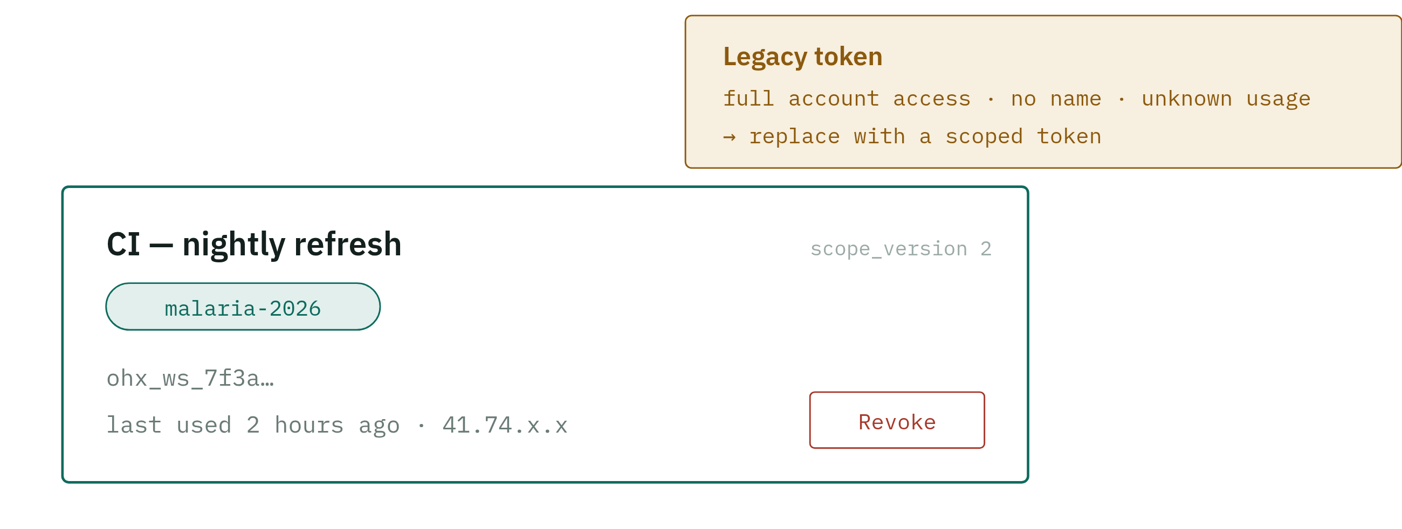
HOW IT WORKS · 06
A token becomes a thing you can see
Named, per-workspace, hashed, individually revocable — and it tells you if anything still uses it.
HOW IT WORKS · SEE A4
07 / 15
Notes:
Appendix: A4 → slide 19

Slide 8
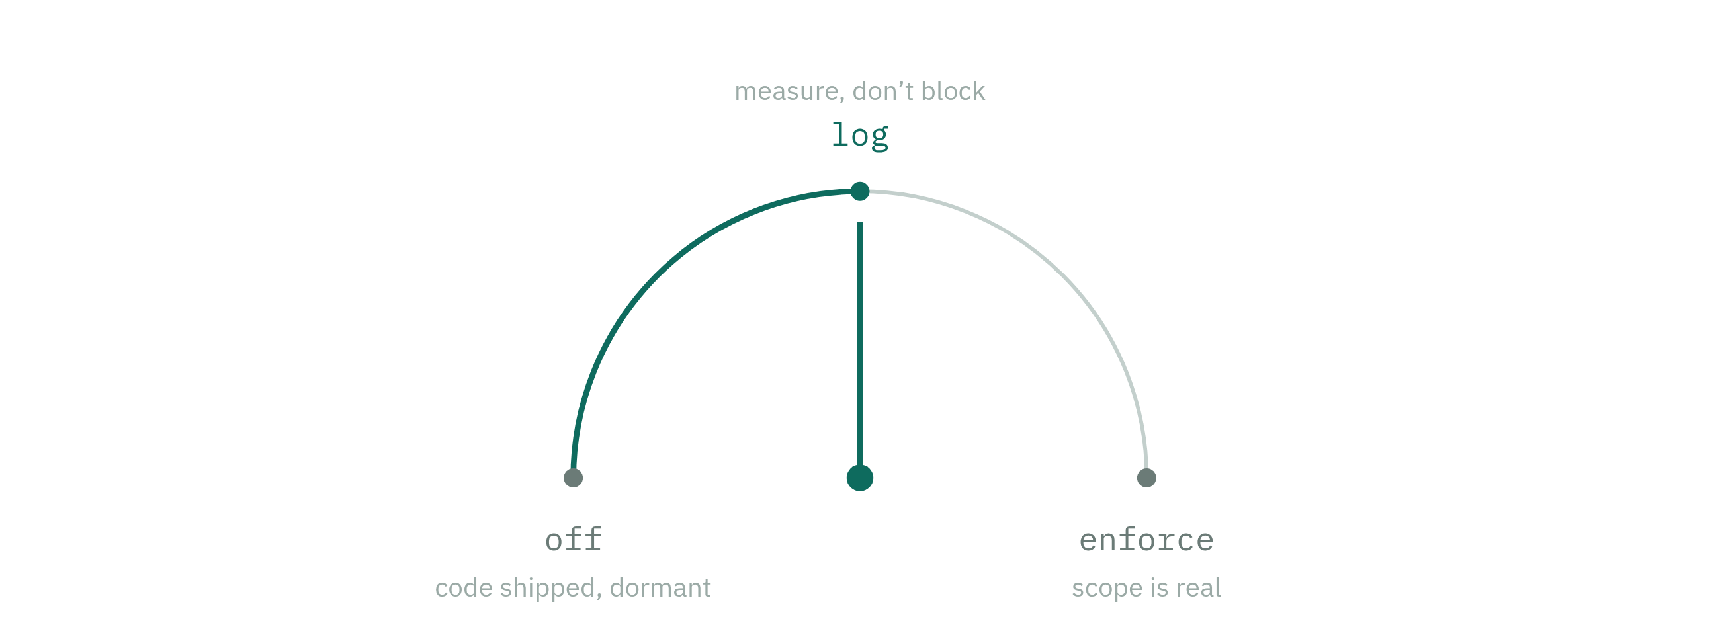
HOW IT WORKS · 07
And a switch with three positions
The plan that follows is mostly this dial, turned one notch at a time — and reversible at every notch.
HOW IT WORKS
08 / 15

Slide 9
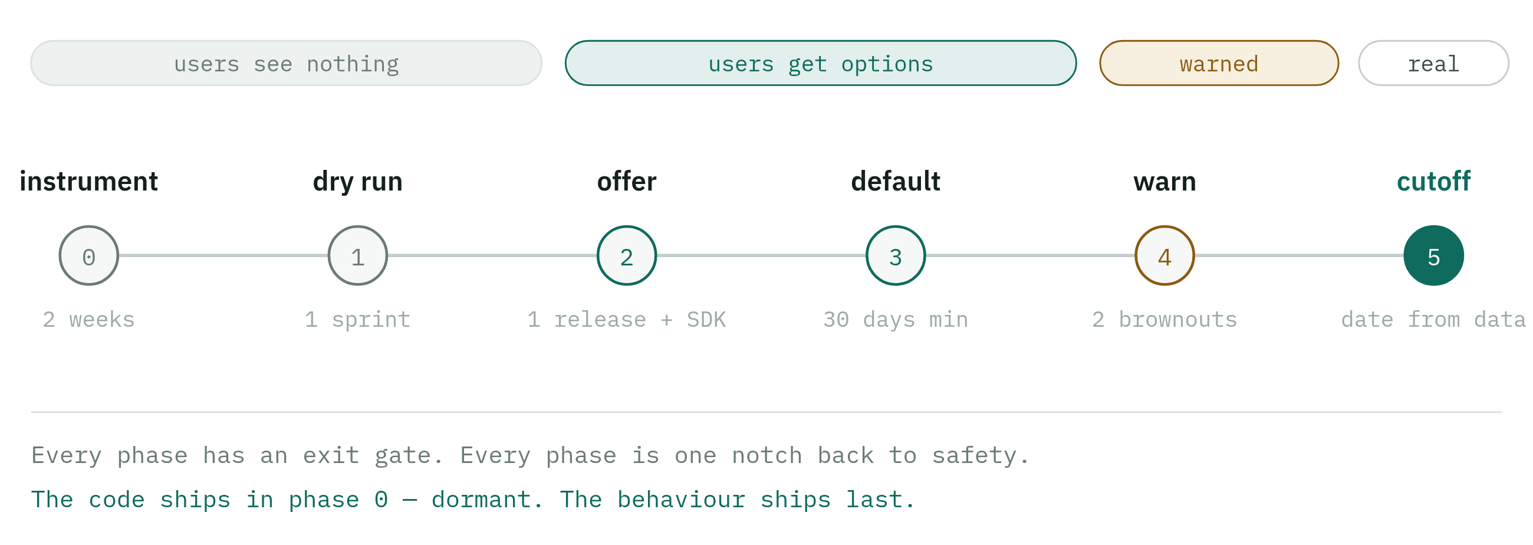
THE MIGRATION · 08
Six notches, and nobody finds out from a broken pipeline
Durations are relative on purpose: phase 0’s data is what sets the cutoff date.
THE MIGRATION · SEE A6
09 / 15
Notes:
Appendix: A6 → slide 21

Slide 10
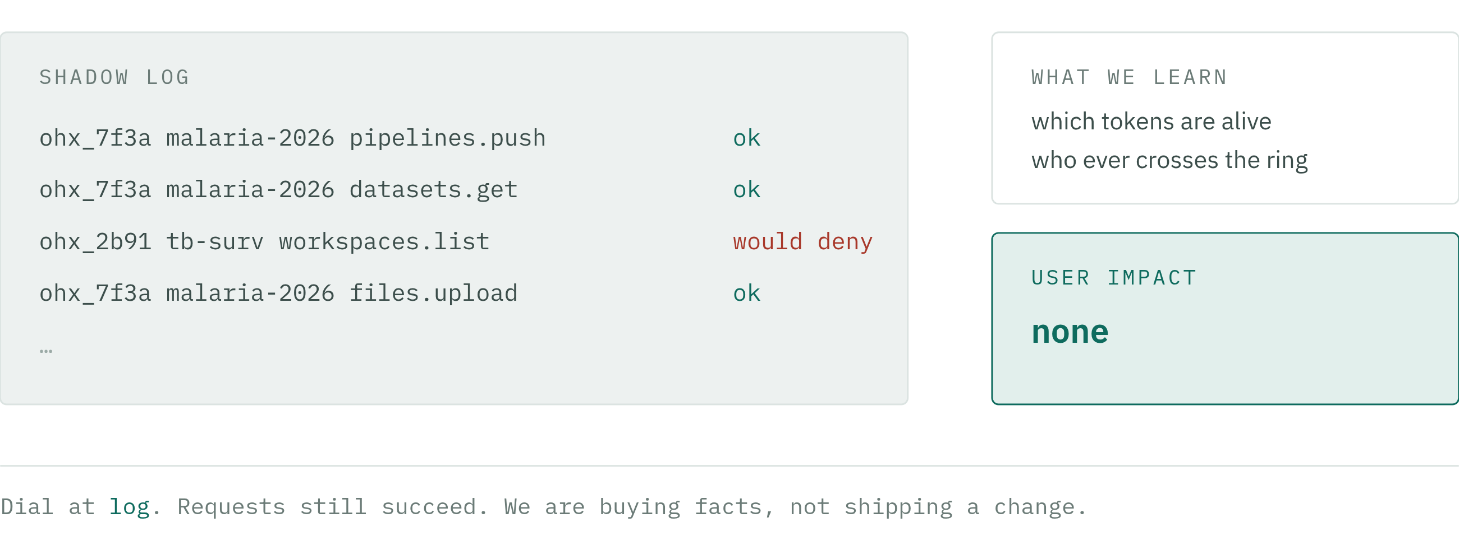
PHASE 0 – 1 · 09
First we watch. Nothing changes for anyone.
Two weeks of this replaces every guess about how much breakage there is.
THE MIGRATION
10 / 15

Slide 11
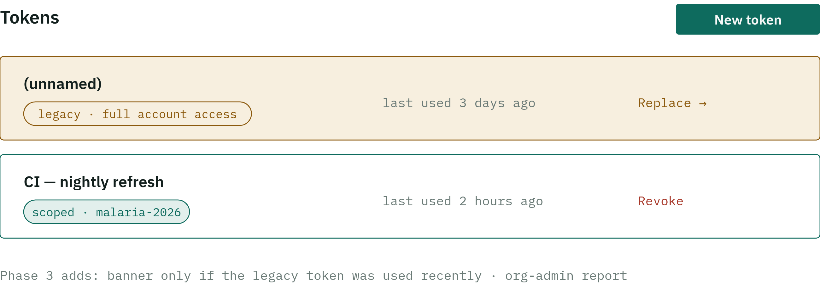
PHASE 2 – 3 · 10
Then we offer — and only later make it the default
Creating a scoped token never invalidates the old one. Migration happens one integration at a time.
THE MIGRATION
11 / 15

Slide 12
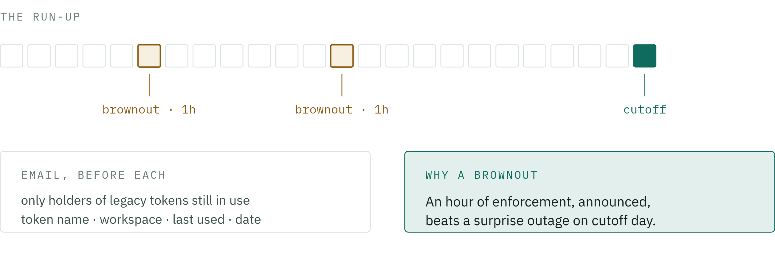
PHASE 4 · 11
Then we warn, twice, with the lights on
Windows are picked against the real pipeline schedule — not against our timezone.
THE MIGRATION · SEE A9, A5
12 / 15
Notes:
Appendix: A9 → slide 24 · A5 → slide 20

Slide 13
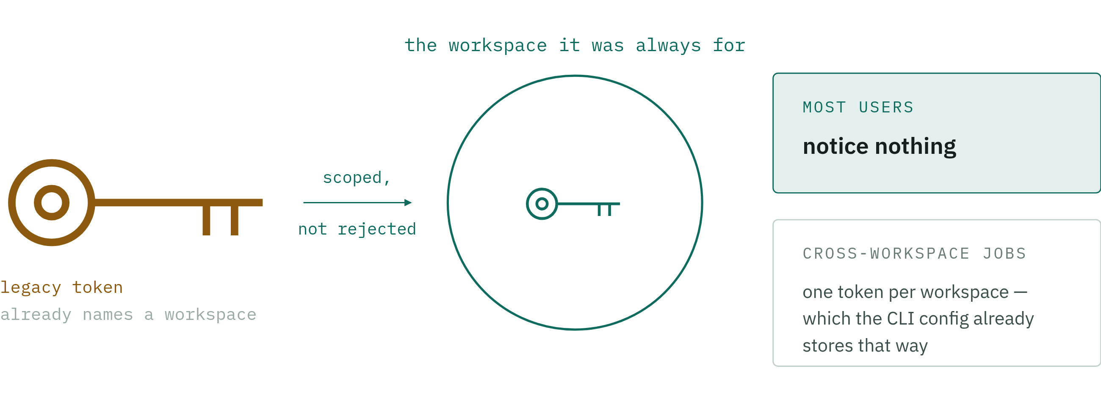
PHASE 5 · 12
At cutoff, old tokens get scoped — not revoked
Verified against the SDK, not assumed. Plus a one-shot grace extension per org, with a hard expiry.
THE MIGRATION
13 / 15

Slide 14
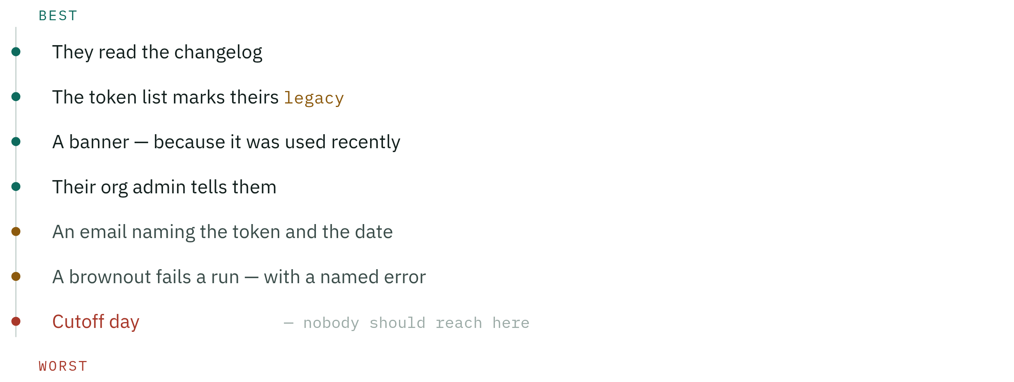
THE USER’S SIDE · 13
Seven ways to find out. We want the top of the list.
Every rung above the last one is cheaper than the support ticket it prevents.
CLOSING
14 / 15

Slide 15
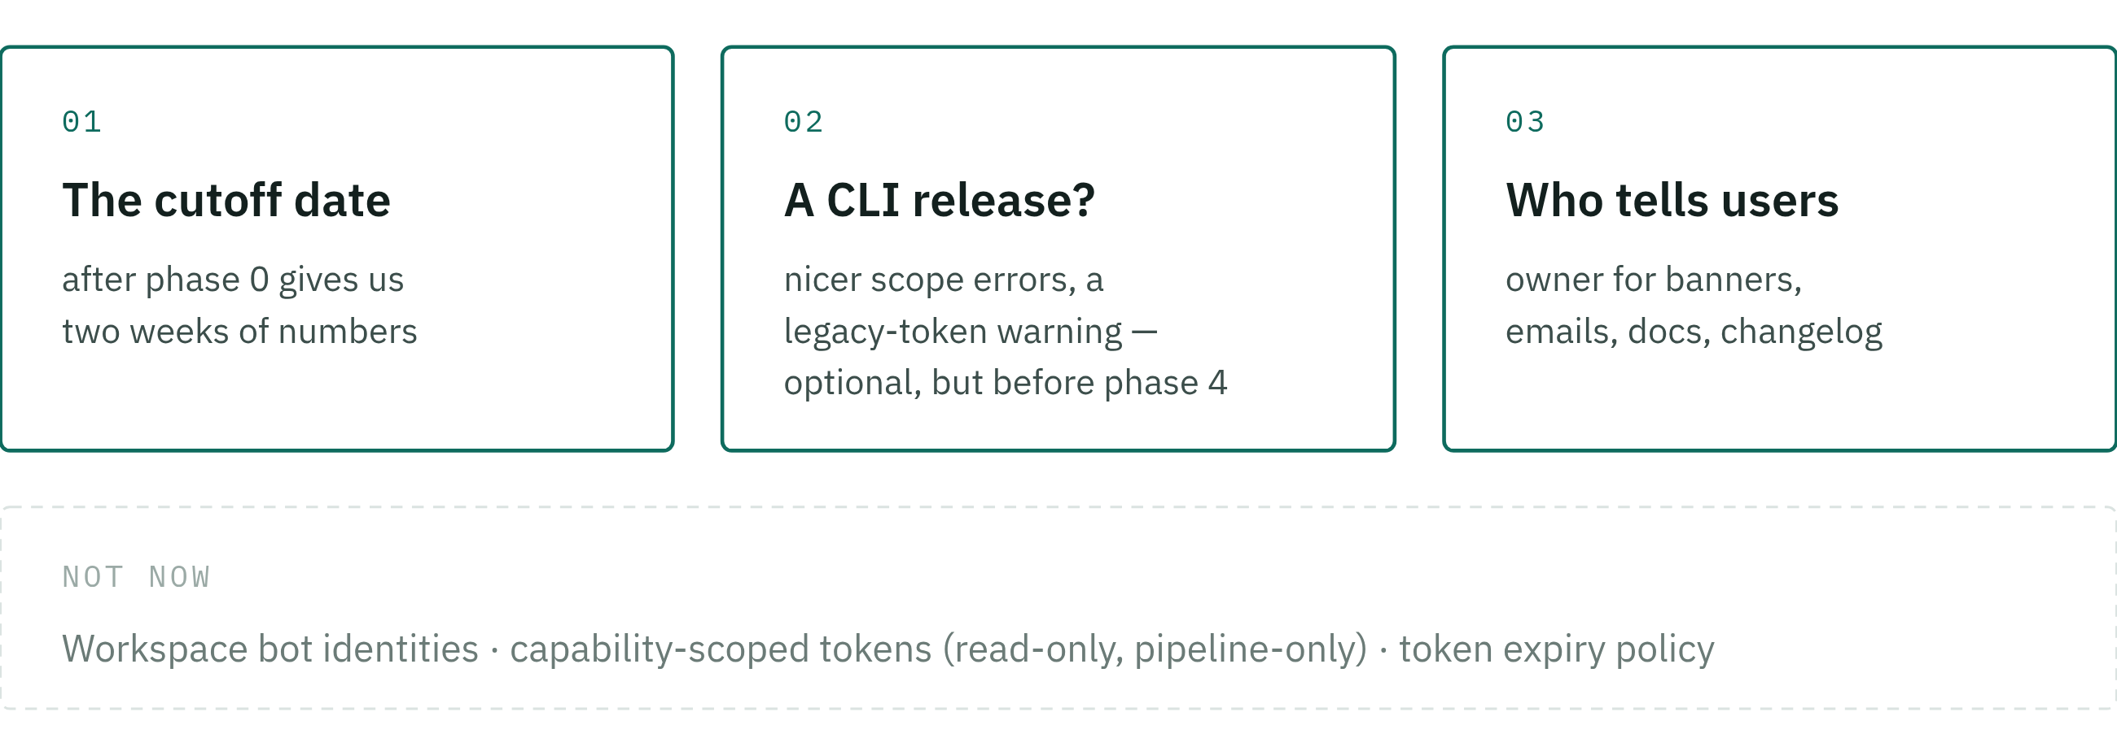
CLOSING · 14
What we need to decide
Checked against the SDK: already one token per workspace, and nothing enumerates workspaces.
CLOSING · SEE A10, A8
15 / 15
Notes:
Appendix: A10 → slide 25 · A8 → slide 23

Slide 16
APPENDIX A1 · FROM SLIDE 05
Three layers, three different questions
LAYER | QUESTION | MECHANISM
visibility | What rows exist for me? | WorkspaceQuerySet._scoped(), applied after every branch — so it also clamps the self.all() superuser shortcuts. Cascades to every model whose filter_for_user funnels through Workspace.objects.filter_for_user.
authority | May I act on this row? | Workspace.get_membership() returns None off-scope, so every permission built on has_role() collapses to False — about thirty checks, one method.
guard | Did something reach an object out of band? | WorkspaceTokenUser.has_perm() refuses objects outside the scope. Redundant on purpose — it catches the check somebody writes by hand next quarter.
The has_role() refactor is what makes this possible: it replaced ~30 hand-rolled membership queries with one method. Without it, scoping would need thirty correct edits and would regress on the thirty-first.
APPENDIX
A1 / A10

Slide 17
APPENDIX A2 · FROM SLIDE 04
Reach, not rows — the full map
In scope, even when the row belongs elsewhere
• Datasets shared organisation-wide. filter_for_user admits shared_with_organization datasets from any workspace in an org you belong to.
• Linked datasets. DatasetLink is the cross-workspace mechanism — scoping must respect links, not undo them.
• The organisation, as the boundary those shares are evaluated against — but only the one the scoped workspace belongs to.
• Pipeline templates from other workspaces, as far as a member of the scoped workspace already sees them.
• The SDK has a caller for this: get_dataset(…, source_workspace_slug=…) resolves datasetLinkBySlug against the source workspace.
Out of scope, always
• Other workspaces and their memberships, connections, pipelines, webapps, saved queries.
• Every account-level mutation — profile, 2FA, org membership, creating workspaces, accepting invitations.
• The superuser shortcut. A superuser’s token is no wider than anyone else’s.
Organization.filter_for_user narrows through the relation (workspaces__id), not by dereferencing the workspace — so org-shared reach survives while org administration doesn’t.
APPENDIX
A2 / A10

Slide 18
APPENDIX A3 · FROM SLIDE 05
Why the principal, and not request.workspace
The authorization API has two shapes, and neither takes a request:
And it wouldn’t cover everything. filter_for_user is also called with no request at all — query_runner.py, workspace_copier, core/search.py, the connector credential modules. A request-based scope is silently absent there, and absent means unscoped.
What we keep request.workspace for: telemetry. It is the natural key for the shadow log and the scope-error metric. It just isn’t the enforcement mechanism.
The cost: request.user is no longer plainly a User. Proxy identity shows up in audit logs, and per-user caches need the scope in their key.
Model.objects.filter_for_user(user) 210 sites
user.has_perm(perm, obj) 363 sites
has_perm routes through Django’s auth backend, whose signature is fixed at (user_obj, perm, obj). The request is not in scope there and never will be.
So a request-based scope means either threading an argument through ~570 call sites, or ambient thread-local state the model layer reads implicitly.
APPENDIX
A3 / A10

Slide 19
APPENDIX A4 · FROM SLIDE 06
The token record
WorkspaceAccessToken
workspace FK → Workspace the scope, immutable
user FK → User the identity it acts as
name str "CI — nightly refresh"
prefix str indexed shown in UI, greppable
token_hash str sha256, shown once
scope_version int 1 legacy · 2 scoped
expires_at dt null
last_used_at dt null throttled write
last_used_ip str null
revoked_at dt null
revoked_by FK → User null
Why not keep membership.access_token: one token per member per workspace, no name, no usage record, and revocation that breaks every copy. It can’t carry the migration, the UI, or the measurement.
Hash, don’t store. Today the secret is recoverable from the database. Hashing means a DB dump is not a token dump.
Prefix the string (ohx_ws_…) so secret scanning spots leaks, and so support can identify a token from a log line without ever seeing it.
scope_version on the record, not inferred from payload shape, is what makes the rollout measurable and reversible per token.
APPENDIX
A4 / A10

Slide 20
APPENDIX A5 · FROM SLIDE 11
The error is part of the migration
Out of scope today gives WORKSPACE_NOT_FOUND, an empty list, or a bare PERMISSION_DENIED. To a user that reads as “the platform lost my workspace” — and becomes a ticket. What we return instead:
TOKEN_SCOPE_EXCEEDED
This token is scoped to workspace malaria-2026 and cannot
access tb-surveillance. Create a token for that workspace
in Account settings → Tokens.
The SDK and CLI surface it verbatim and link the migration page. Every occurrence is logged with the token prefix — which is what lets the org-admin report say “three of your tokens hit scope errors this week”.
And it must not be UNAUTHENTICATED. The CLI collapses that code into InvalidTokenError (cli/api.py:213-215) — the user would be told their token is invalid and would regenerate it. The wrong fix, applied confidently.
On disclosure: the holder already knows their own workspace list, so we reveal nothing they couldn’t learn by logging in.
APPENDIX
A5 / A10

Slide 21
APPENDIX A6 · FROM SLIDE 08
Risk register
RISK | LIKELIHOOD | IMPACT | MITIGATION · DETECTION
Org-shared or linked datasets cut off by over-eager scoping | HIGH | HIGH | “Reach, not rows” semantics · tests assert presence and absence
Cross-workspace automation breaks at cutoff | MEDIUM | HIGH | Phase 0 names who · brownouts · shadow logs
A permission check bypasses has_role() | MEDIUM | HIGH | Guard layer catches it · test forbidding role queries outside the choke point
A new model is added later without scoping | OVER TIME | MEDIUM | SCOPED_MODELS guard test in CI
MCP server enumerates workspaces | MEDIUM | MEDIUM | Audit its operations before phase 3 · shadow logs by user agent
Ops scripts using superuser tokens break | MEDIUM | MEDIUM | Intentional — give ops an audited path, not a wide token
Rollout stalls at “legacy still in use” forever | MEDIUM | MEDIUM | Announced dates · brownouts · one-shot grace extension
APPENDIX
A6 / A10

Slide 22
APPENDIX A7 · FROM SLIDE 05
Alternatives, and why not
OPTION | WHY NOT
Per-request workspace header — token stays wide, client declares intent | Client-declared scope isn’t a security boundary; a leaked token just omits the header
JWT with claims instead of signed opaque payloads | Real benefits, bigger change, and no revocation without a denylist. The signed-payload strategy is adequate once the token table gives us revocation
Capability tokens now (read-only, pipeline-only) | Doubles the permission surface while the primary hole is still open. Ship workspace scoping; keep the extension point
Enforce in each resolver | ~200 resolvers, every one a chance to forget, unreviewable, and no single rollback switch
Hard cut in one release | Fastest to a clean codebase, and the one option guaranteed to break users without warning
Do nothing, document the risk | The token is an account credential in a place users treat as a project credential. That gap doesn’t stay theoretical
APPENDIX
A7 / A10

Slide 23
APPENDIX A8 · FROM SLIDE 14
Where the branch stands
Built
• WorkspaceScopedPrincipal marker, with ServicePrincipal inheriting from it
• WorkspaceTokenUser — the User proxy narrowed to one workspace
• Workspace.has_role(), replacing ~30 hand-rolled membership queries
• _scoped() post-filter on the workspace queryset, including superuser shortcuts
• test_visibility_scoping.py — the matrix, run for a member and a superuser holder
Left to do
• Wire the middleware (one line) behind the three-state flag
• Scope as a constructor argument, not a mutated class attribute
• Ask the principal, not isinstance, from core/models/base.py
• Registry dispatch on a payload version, replacing the if/elif
• Guard test so a new model can’t skip SCOPED_MODELS
• Decide bypass_two_factor for tokens
• Tests for org-shared and linked datasets — the likeliest quiet break
APPENDIX
A8 / A10

Slide 24
APPENDIX A9 · FROM SLIDE 11
How a brownout actually works
Why do it
• Emails get ignored. A failed run at 10:00 on an announced Tuesday does not.
• Failure is recoverable — a nightly pipeline can be re-run the same day. The identical failure on cutoff day is an outage with no fallback.
• It rehearses the enforce path in production before it is permanent.
• It turns “we think a few tokens still cross workspaces” into a list of names.
What it costs to build: nearly nothing. A brownout is a schedule, not a feature — and the lever exists: Feature / FeatureFlag (user_management/models.py:840-865), with force_activate as a global switch in Django admin. No deploy, no restart.
• has_feature_flag is an uncached query per call — memoise it before the auth path.
• A boolean can’t express off / log / enforce: use a mode plus an enforce_from/until window, so brownouts run themselves.
• No scheduler in settings/base.py — a timed flip means a CronJob, or a person.
Blast radius is bounded by construction: only token-authenticated requests are affected. Everyone in the web UI sees nothing.
The hard parts aren’t code: the hour (real pipeline schedules, many timezones), the comms, no auto-retry, and someone watching the metric.
APPENDIX
A9 / A10

Slide 25
APPENDIX A10 · FROM SLIDE 14
What the CLI and SDK actually do
FINDING | WHERE
Config is already one token per workspace — [workspaces] maps slug → token, and access_token returns the current workspace’s | cli/settings.py:82,117
workspaces list / activate / rm are local only — no API call | cli/cli.py:141-160
workspaces add validates with getWorkspace(slug) — singular, the token’s own workspace | cli/api.py:225
Nothing calls me, the plural workspaces, or organizations — present in the generated client, unused | grep of cli/ + sdk/
Every runtime call names its workspace explicitly | sdk/workspaces/current_workspace.py
User-Agent is versioned — Phase 0 measures the client version spread for free | cli/api.py:194
No token-format validation anywhere — ohx_ws_… works on every installed client | cli/api.py:193
The one exposure: get_dataset(…, source_workspace_slug=…) is an explicit cross-workspace read. It survives under “reach, not rows” — but the scoping fixture only builds a private link in the other workspace, so nothing protects it yet.
APPENDIX
A10 / A10

