Slide 1



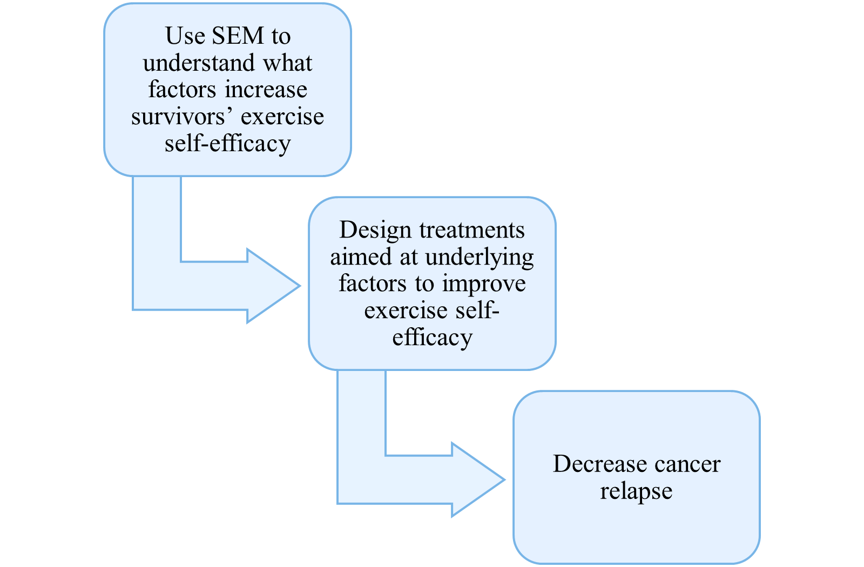
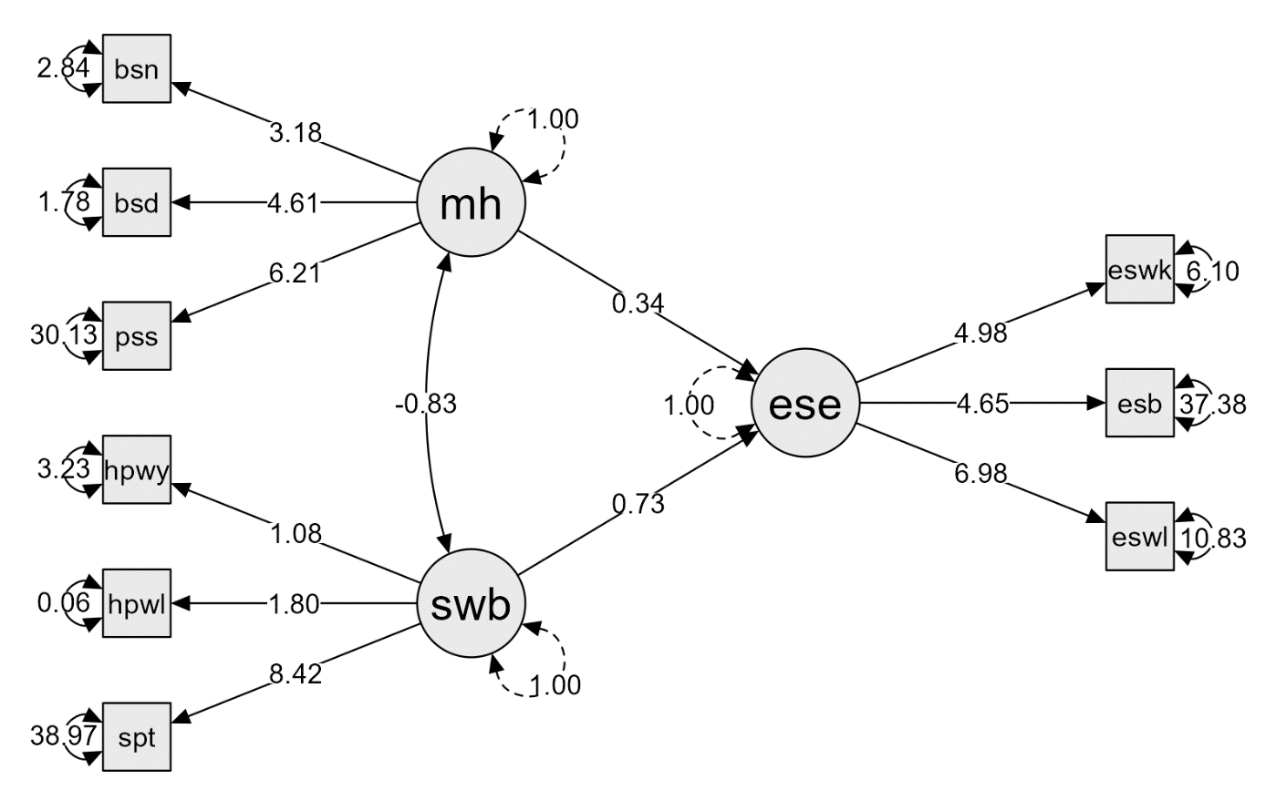
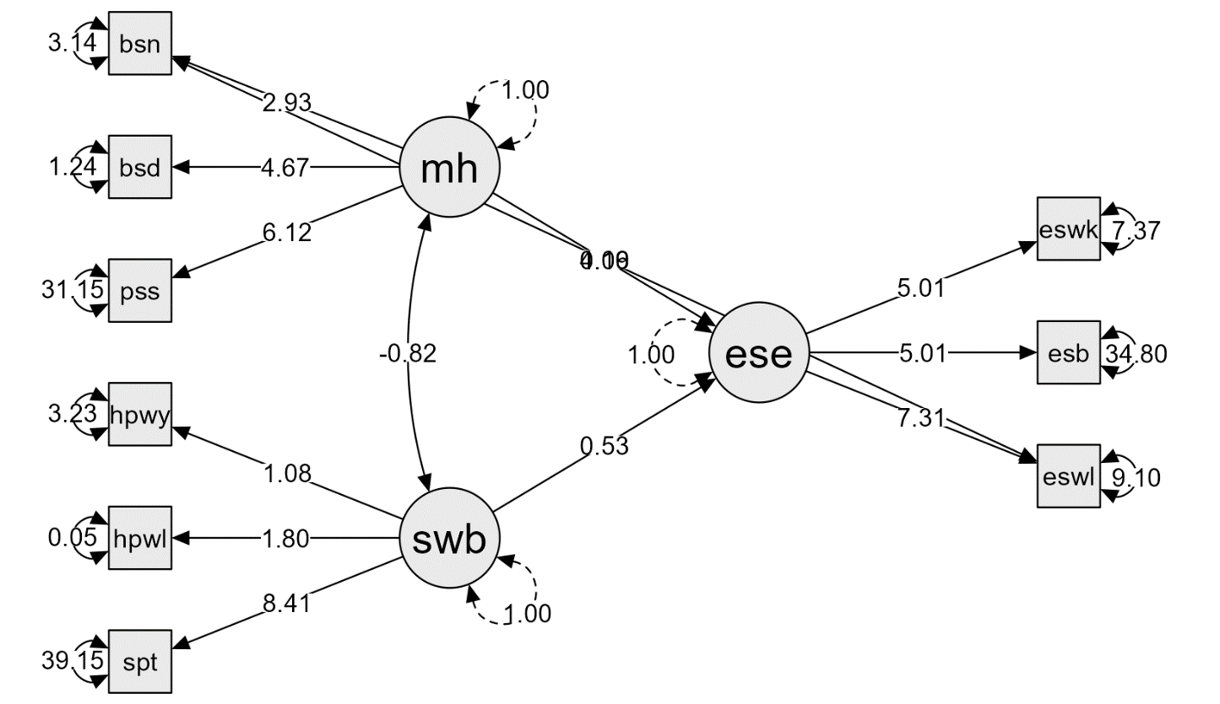
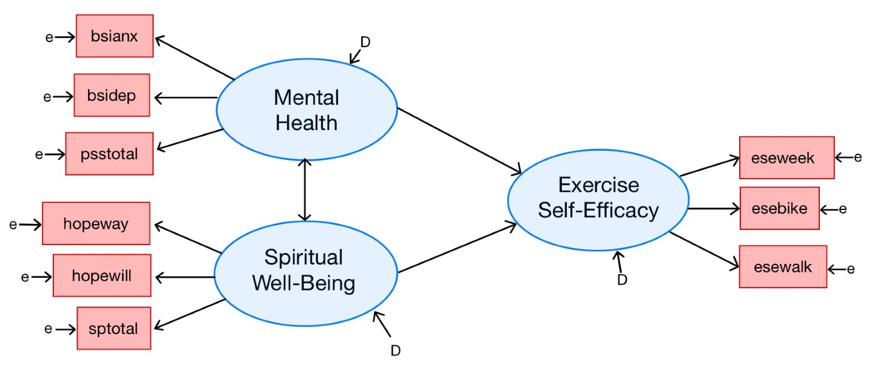
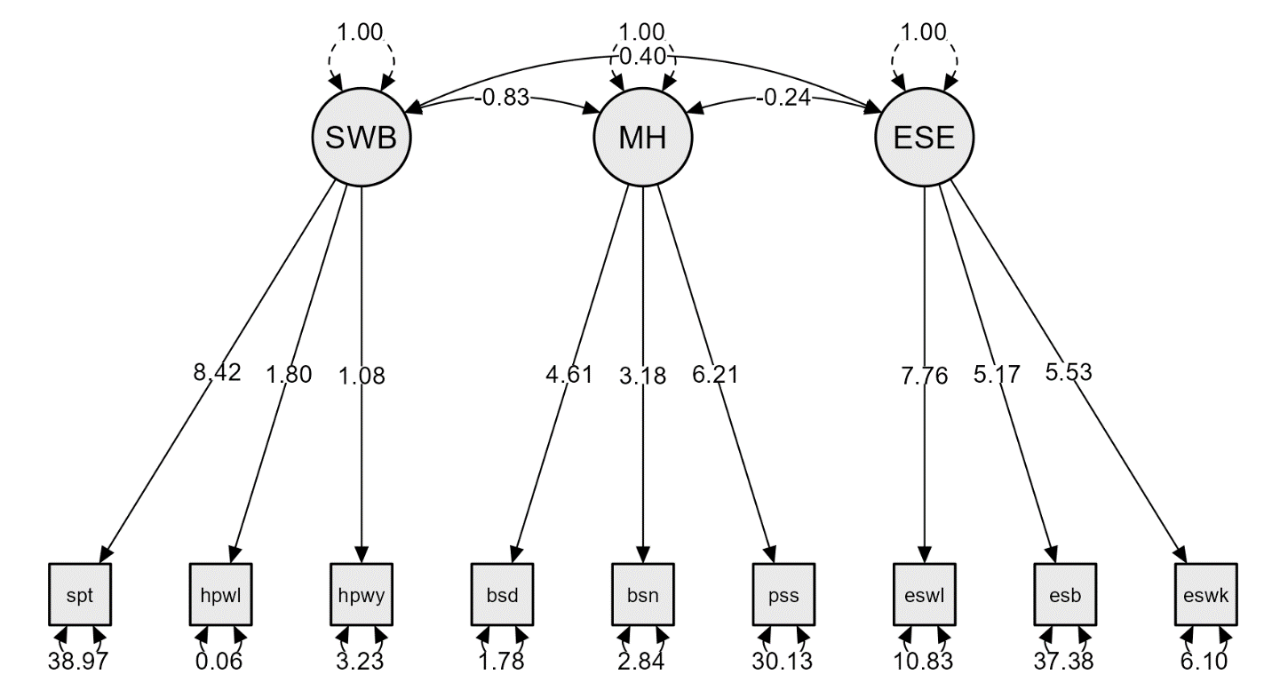

Exercise Self-Efficacy in Latina Cancer Survivors
Bryanna Scheuler, MS,¹ Joseph Houpt, PhD, ¹ Daniel Hughes, PhD ²
¹The University of Texas Health at San Antonio
²The University of Texas Health Science Center at San Antonio
Introduction
Structural Equation Modeling
One of the many challenges cancer survivors face is relapse prevention. There is substantial research illustrating that exercise is a crucial component of preventing cancer relapse (Magné et al., 2011). The necessity for exercise might be exacerbated in the Latino community, as the American Cancer Society (2021) reported that Hispanic/ Latino individuals were 9-11% more likely to be overweight, which was directly linked to the development of 13 types of cancer. To lower diagnosis and relapse rates, it is crucial that we are cognizant of what components can help a cancer patient or survivor exercise, despite the side effects of treatment. In this project, we used structural equation modeling to assess what factors influenced cancer survivors’ exercise self-efficacy in a secondary analysis of pilot data.
● Model 1 Fit
  - Chi-Square: X²(24, N = 29) = 33.17, p = 0.10
  - CFI: 0.95
  - RMSEA: 0.12 (0.00, 0.20)
  - SRMR: 0.09
● 19% of the variance in exercise self-efficacy was explained by the model
● There was significant covariance between spiritual well-being and mental health
● The direct effect of spiritual well-being on exercise self-efficacy approached significance, but this trend did not hold for mental health and exercise self-efficacy
● Could the model fit be improved?
Model 1
The Pilot Study
In the pilot study, the HEAL lab assessed multiple aspects of health-related quality-of-life in 29 adult cancer survivors. Despite the complications of COVID-19, 23 of these cancer survivors completed a complex intervention that included therapeutic yoga and psycho-social support. Not only was this study unique in it’s holistic approach, it was groundbreaking as an intervention that served the Latino community. By incorporating this underrepresented population, the pilot study took an important step in bridging the gap in exercise and health care differences. In the current study, we analyzed the baseline assessments, to determine what components influenced the participants belief in their own capacity to exercise, despite cancer side-effects.
Alternative Model
● Based on the highest modification index in JASP
● In this suggestion, the model accounted for residual covariance between ‘esewalk’ and ‘bsianx’
● If this adjustment significantly improved the model, we would need to consider the theoretical implications
● Model 2 Fit
  - Chi-Square: X²(23, N = 29) = 25.93, p = 0.30
  - CFI: 0.98
  - RMSEA: 0.07 (0.00, 0.17)
  - SRMR: 0.08
● 14% of the variance in exercise self-efficacy was explained by the model
● Covariance and direct effects remained nearly the same
Measurements
● Functional Assessment of Chronic Illness Therapy- Spiritual Wellbeing
● Adult Hope Scale
- Willpower subscale
- Waypower subscale
● Perceived Stress Scale
● Brief Symptom Inventory-18
- Depression subscale
- Anxiety subscale
X Somatization subscale
● Exercise Self-Efficacy Scale
Model 2
Proposed Model
Discussion
● But which model is preferred?
~ ∆X²(1, N = 29) = 7.24, p = 0.007
~ BF₂₁ = 6.96 (from BICs)
● Is the increased model fit worth the loss of degrees of freedom?
● There is also a trade-off between model fit and explained variance in exercise self-efficacy
● Most importantly, there is no theoretical basis for including a residual covariance between the ESE-walk subscale and BSI-anxiety subscales
Note: For item means, standard deviations, and reliability, as well as assumption checks (e.g., Bartlett’s test and KMO measures), please see the online supplemental material.
Confirmatory Factor Analysis
Future Directions
● There are many potential next steps for this project:
- Utilizing a larger sample size
- Including additional factors, such as social
support, cognitive impairment, and access to exercise facilities
- Exploring different measurement tools for the factors, including in combination with the current measures
- Performing a longitudinal analysis during an
intervention
● For references, syntax, and more,
please see QR code.
● The model fit in the confirmatory factor analysis was sufficient for performing SEM (see supplemental material)
● There was significant covariance between mental health and spiritual well-being, but less evidence of covariance of each factor with exercise self-efficacy, so we proceeded with analysis
Support for the pilot study provided by Susan G. Komen ® Leadership Grant, SAC220227 (“Using Holistic Approaches to Optimize Outcomes for Latina Breast Cancer Survivors.”)

