Slide 1

Trading the Tractor for a Spade: A Psychometric Approach to Cancer-Related Cognitive Decline Assessment
Bryanna Scheuler

Slide 2
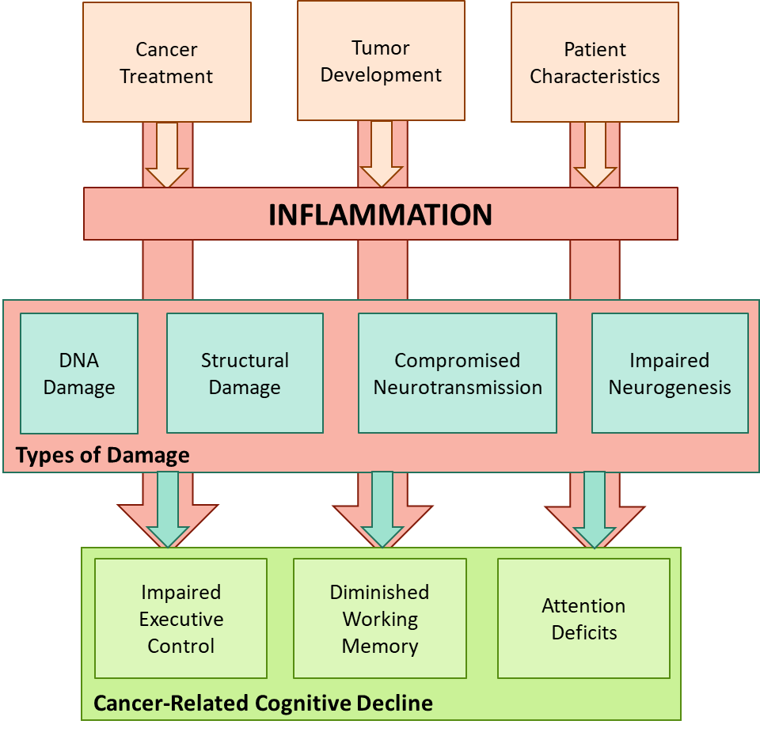
Cancer-Related Cognitive Decline
Words
Slide 1 of X

Slide 3
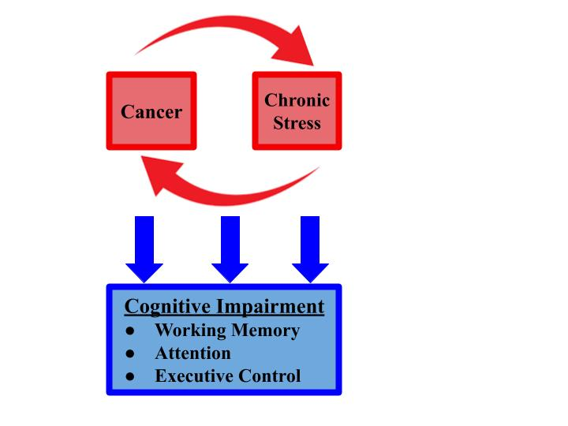
CRCD and Stress
Explain similarity to inflammation
Slide 1 of X

Slide 4
Assessment Difficulties
Words
Slide 1 of X

Slide 5
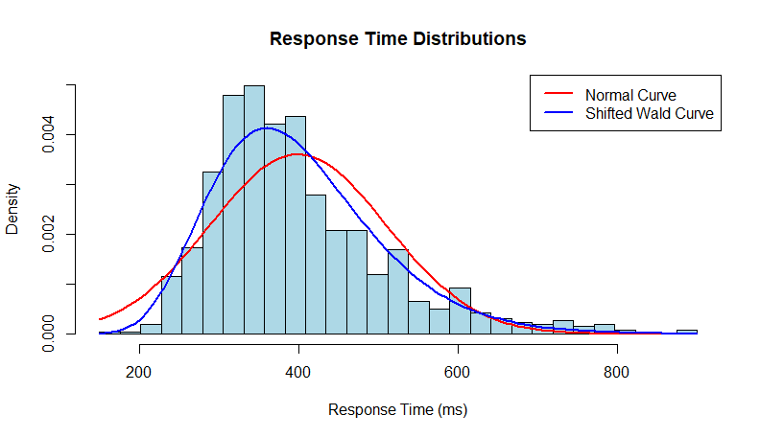
A Response-Time Modeling Approach
words
Slide 1 of X

Slide 6

The Moonshot Collaboration
words
Slide 1 of X

Slide 7
The Current Project
Fifteen undergrads
4-week*
End-of-semester stress
Perceived Stress Scale
Three cognitive response-time tasks
Slide 1 of X

Slide 8
The Cognitive Assessments and Models
Attention
Attention Network Test
Shrinking spotlight model
Executive Control
Open-Source Anticipated Response Inhibition Task (OSARI)
Bayesian Estimation of Ex-Gaussian Stop-Signal(BEESTS) model
Working Memory
Dual N-Back Task
Linear ballistic accumulator model and workload capacity
Slide 1 of X

Slide 9
Research Aim 1: Does the approach “work”?
Hypothesis 1. I hypothesize that response time distributions from the data will fall within a 66% highest density ratio (HDI) of the posterior predictive distribution.
Hypothesis 1_{A}: The response time distribution from the Attention Network Test data for each individual will fall in 66% of the posterior HDI based on the shrinking spotlight model.
Hypothesis 1_{B}: The response time distribution from the Dual N-Back Task data for each individual will fall in 66% of the posterior HDI based on the Linear Ballistic Accumulator model.
Hypothesis 1_{C}: The response time distribution from the Open-Source Anticipated Response Inhibition data for each individual will fall in 66% of the posterior HDI based on the BEESTS-CV model.
Slide 1 of X
Notes:
Aim 1: To assess the predictive accuracy of response time models when applied to neuropsychological assessments of attention, executive control, and working memory. This analysis aims to determine the ability of response time models to represent the processes underlying cognitive function.

Slide 10
Research Aim 2
words
Slide 1 of X

Slide 11
Research Aim 3
words
Slide 1 of X

Slide 12
Risks and Mitigations
words
Slide 1 of X

Slide 13
Possible Addition: Induce Acute Stress
words
Slide 1 of X

Slide 14

utsa.edu
Notes:
Add icons for each department.

