Slide 1

Trading the Tractor for a Spade: A Psychometric Approach to Cancer-Related Cognitive Decline Assessment
Bryanna Scheuler

Slide 2
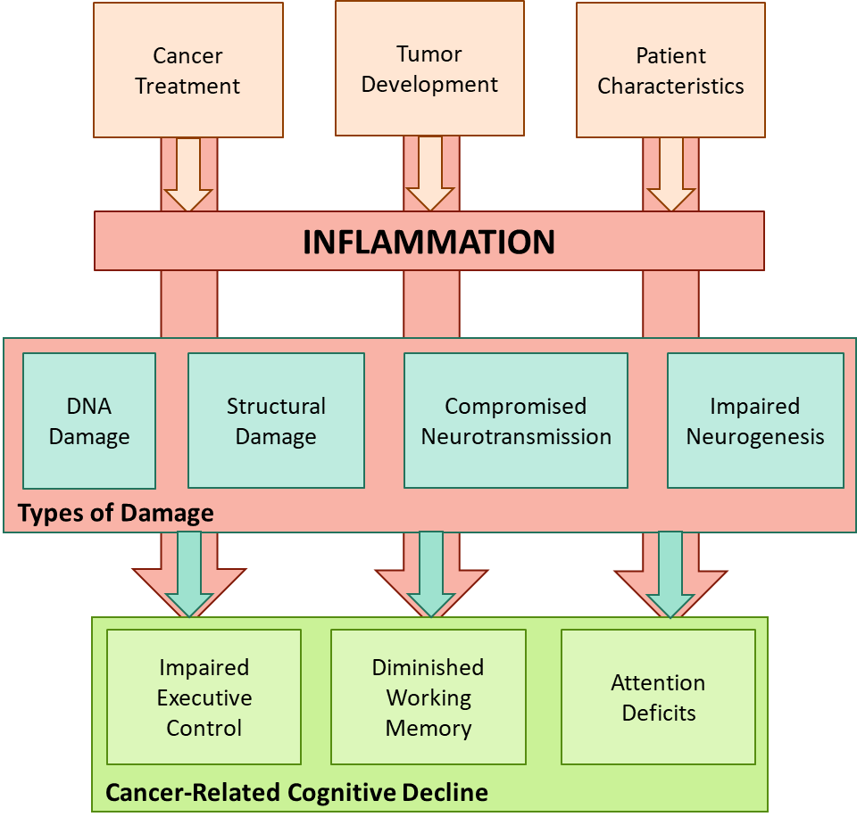
Cancer-Related Cognitive Decline
Deficits in attention, executive control, and working memory
Reported occurrence rates range between 15% and 75%
Strong theoretical rationale for the role of inflammation as a biological mechanism underlying CRCD
Slide 1 of 19

Slide 3
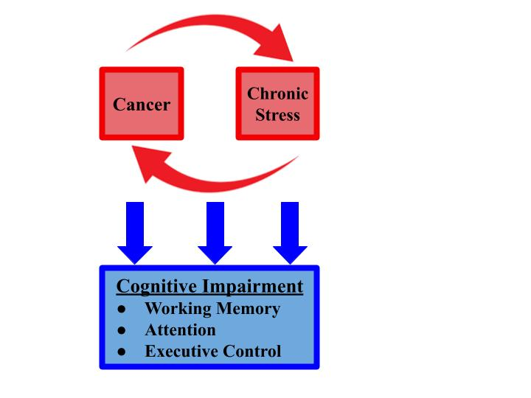
CRCD and Chronic Stress
DSM-IV and DSM-V have recognized that illnesses, like cancer, can be preceptors of PTSD
Chronic stress has been linked to tumorigenesis and cancer progression
Chronic stress triggers a consistent inflammatory response, disrupting the negative feedback loop of a healthy system
Slide 2 of 19

Slide 4
Assessment Difficulties
Across the 32 articles used for the literature review (that reported a cognitive task), 61 different assessments were used
Variety of research designs, time constraints, and measurement tools
The FACT-Cog is the most common assessment utilized
Mood and awareness vs cognitive impairment
Subjective and objective measures frequently lack correlation
International Cognition and Cancer Task Force recommend against using subjective measures
When objective measures have been used, they have relied on incorrect assumptions about linearity and normality
Slide 3 of 19
Notes:
-Research design differences: metastatic or CNS cancer exclusionary criteria, baseline included or not, how domains are measured

Slide 5
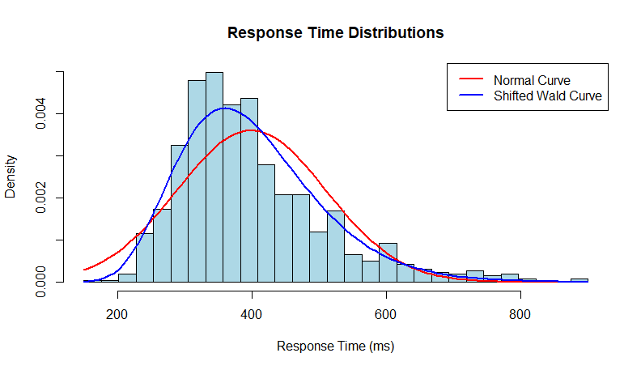
A Response-Time Modeling Approach
Provides a non-linear approach that is a reasonable representation of actual processes (based in theory), allowing us to capture meaningful changes
The ability of RT models to account for noise allow researchers to parcel out the changes in the cognitive processes, creating an approach that is very sensitive to slight changes
Limits the reverse-inference problem
Slide 4 of 19
Notes:
Always some modeling assumption made;
Focus on non-lin approach that is a reasonable repress of what actually going on capture meaningful changes White et al. (2010) – found changes in lexical decision task with RT modeling, when point-estimate approaches cannot

Slide 6
The Cognitive Assessments and Models
Attention
Task: Attention Network Test
Model: Shrinking spotlight model (White & Curl, 2018)
Executive Control
Task: Open-Source Anticipated Response Inhibition Task (OSARI)
Model: Bayesian Estimation of Ex-Gaussian Stop-Signal (BEESTS) model (He et al., 2022)
Working Memory
Task: Dual N-Back Task
Model: Linear ballistic accumulator model and workload capacity (Heathcote et al., 2015)
Slide 5 of 19
Notes:
Motivation for why each of these tasks
These tasks have RT models already established > not starting from scratch (but they are still new)
?Last 20 years has seen a shift where RT modeling has become more accessible (tech/ code sharing), so there are more models created specifically for tasks that are used in clinical scenarios, but they have not been extensively tested

Slide 7

The Moonshot Collaboration
A holistic approach to cancer survivor quality-of-life
A 6-month therapeutic yoga intervention that includes social support and dietary guidance
Plan to evaluate every sector of cancer survivor health
Will be the first time RT modeling is used in a longitudinal, clinical study (to the best of our current knowledge)
Slide 6 of 19
Notes:
Postponing has allowed us to take a step back, and shift from a translational approach to a basic approach

Slide 8
Aim 1
To assess the predictive accuracy of response time models when applied to neuropsychological assessments of attention, executive control, and working memory. This analysis aims to determine the ability of response time models to represent the processes underlying cognitive function.
Slide 7 of 19

Slide 9
Aim 1
Hypothesis 1. I hypothesize that response time distributions from the data will fall within a 66% highest density ratio (HDI) of the posterior predictive distribution.
Hypothesis 1_{A}: The response time distribution from the Attention Network Test data for each individual will fall in 66% of the posterior HDI based on the shrinking spotlight model.
Hypothesis 1_{B}: The response time distribution from the Dual N-Back Task data for each individual will fall in 66% of the posterior HDI based on the Linear Ballistic Accumulator model.
Hypothesis 1_{C}: The response time distribution from the Open-Source Anticipated Response Inhibition data for each individual will fall in 66% of the posterior HDI based on the BEESTS-CV model.
Slide 8 of 19
Notes:
Aim 1: To assess the predictive accuracy of response time models when applied to neuropsychological assessments of attention, executive control, and working memory. This analysis aims to determine the ability of response time models to represent the processes underlying cognitive function.* change to this

Slide 10
Aim 2
To utilize response time modeling to evaluate minute changes in the cognitive assessments of attention, executive control and working memory throughout the last four weeks of an academic semester. This analysis aims to capture how cognition changes when participants are experiencing increasing stress as the semester ends.
Slide 9 of 19

Slide 11
Aim 2
Hypothesis 2. I hypothesize that response time modeling will capture valid, ecological changes in participant cognition at the end of the semester, as measured by posterior estimates of the relevant coefficients having greater than 66% of the probability in the appropriate direction.
Hypothesis 2_{A}: There will be a 66% or higher posterior probability increase in the interference time parameter across the four weeks.
Hypothesis 2_{B}: There will be a 66% or higher posterior probability increase in the stop-signal reaction time parameter across the four weeks.
Hypothesis 2_{C}: There will be a 66% or higher posterior probability decrease in the workload capacity parameter across the four weeks.
Slide 10 of 19
Notes:
To utilize response time modeling to evaluate minute changes in the cognitive assessments of attention, executive control and working memory throughout the last four weeks of an academic semester. This analysis aims to capture how cognition changes when participants are experiencing increasing stress as the semester ends.

Slide 12
Aim 3
To evaluate the role of stress on performance for the attention, executive control, and working memory tasks. This analysis aims to evaluate how stress impairs cognitive ability.
Slide 11 of 19
Notes:
While the main biological mechanism of concern for CRCD in the HEAL collaboration is inflammation, the similarities to chronic stress provide a framework for RT modeling testing with in a healthy population

Slide 13
Aim 3
Hypothesis 3. I hypothesize that there will be strong evidence in favor of stress as a factor impacting cognition (as predicted by Bayes factors).
Hypothesis 3_{A}: The hierarchical mixed-effect model for interference time that includes stress scores will be at least three times more likely to explain the data than the model that does not include stress.
Hypothesis 3_{B}: The hierarchical mixed-effect model for stop-signal reaction time that includes stress scores will be at least three times more likely to explain the data than the model that does not include stress.
Hypothesis 3_{C}: The hierarchical mixed-effect model for workload capacity that includes stress scores will be at least three times more likely to explain the data than the model that does not include stress.
Slide 12 of 19
Notes:
“Model comparison be in favor of those that include stress”
To evaluate the role of stress on performance for the attention, executive control, and working memory. This analysis aims to evaluate how stress can act as the biological mechanism impairing cognitive ability.

Slide 14
The Current Project
Measuring cognition parameters and stress across the final four* weeks of the semester
The three cognitive response-time tasks and corresponding models from the HEAL study will be tested in a healthy population
Perceived Stress Scale will be completed at each time point
Participants will be given $15 gift cards for each time point. At the end of the study, participants who completed all four weeks will received an additional $20 gift card
Slide 13 of 19
Notes:
End-of-semester stress has been linked to shifts in inflammation and cognitive abilities, similar to CRCD studies with cancer survivors (Maes et al., 1998)

Slide 15
Method Section
15 participants
ANT T₁, T₂, T₃, T₄
-Model fit -Longitudinal -Stress
OSARI T₁, T₂, T₃, T₄
DNB T₁, T₂, T₃, T₄
-Model fit -Longitudinal -Stress
Recruitment
Data Collection
Analysis
-Model fit -Longitudinal -Stress
Slide 14 of 19

Slide 16
Risks and Mitigations
Potential for participant drop-out
$80 incentive
Use as much of the data as possible
As we are not directly manipulating stress, we can’t be certain that changes are driven by stress
Possible second study: induce acute stress
Slide 15 of 19

Slide 17
Possible Study 2: Induce Acute Stress
In the Spring 2025 semester, bring in a new group of students to induce stress in a single session
For each cognitive task, participants are split between a stress group and a control group
Participants in the stress group will complete a cold pressor task (submerging a non-fisted hand in ice water for three minutes)
Both groups will complete their designated cognitive task
Fit with cognitive models
Assess how acute stress impacts cognition
Slide 16 of 19
Notes:
Shields et al., 2019 used 50 people per group, based on their power analyses to detect a moderate effect

Slide 18
Projected Timelines
Timeframe | Longitudinal Study | Acute Stress Addition
Week of Nov 11 | IRB adjustments
Nov 18 – Dec 13 | Data collection
January (2025) | Data analysis | IRB submission
February | Data analysis | Data collection
March | Dissertation writing | Data analysis
April | Editing and defense | Dissertation writing
End of April |  | Editing and defense
Slide 17 of 19

Slide 19
Committee Questions
Shift the longitudinal study from four weeks to three weeks?
Induce acute stress study?
If yes, sample size?
Shields et al. (2019) utilized 50 participants per group
Slide 18 of 19
Notes:
Current study would have 300 participants ($4,500)

Slide 20
A Note To My Committee Members
Thank you for your continued guidance, patience, and support.
Slide 19 of 19

Slide 21

utsa.edu
Notes:
Add icons for each department.

