Slide 1

Trading the Tractor for a Spade: A Psychometric Approach to Cancer-Related Cognitive Decline Assessment
Bryanna Scheuler

Slide 2
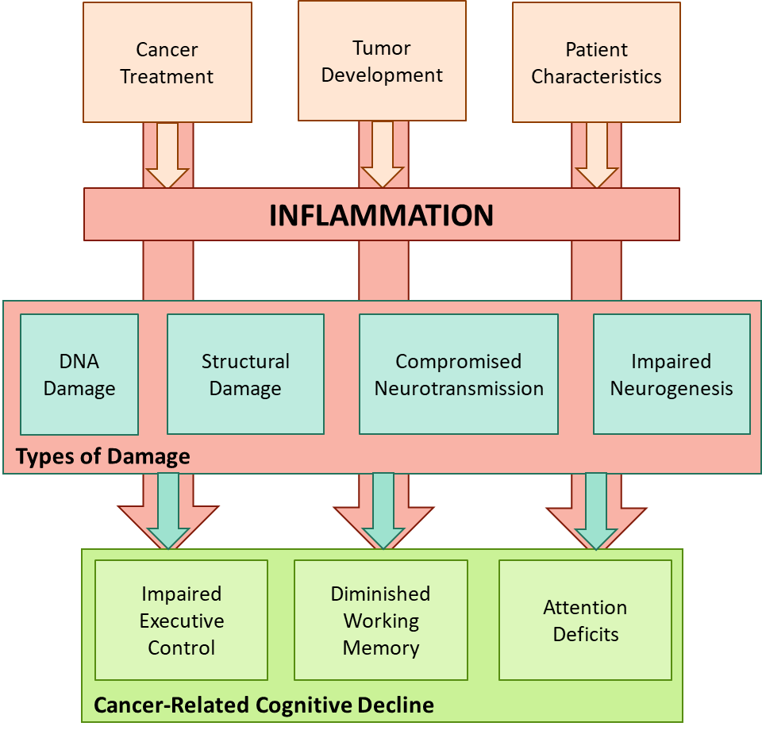
Cancer-Related Cognitive Decline
Words
Slide 1 of X

Slide 3
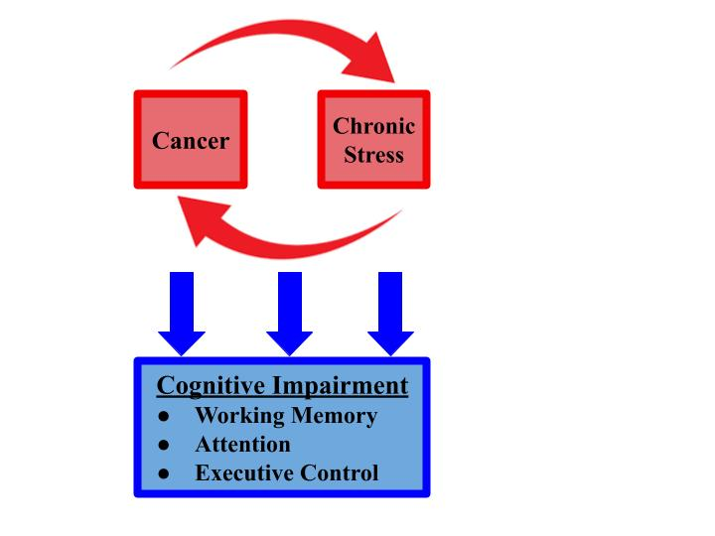
CRCD and Stress
Explain similarity to inflammation
Slide 1 of X

Slide 4
Assessment Difficulties
Words
Slide 1 of X

Slide 5
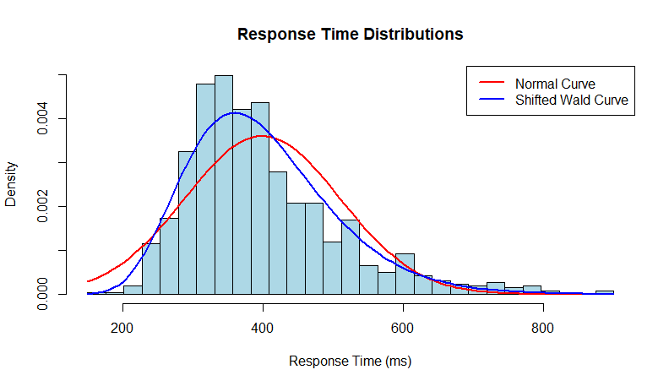
A Response-Time Modeling Approach
words
Slide 1 of X

Slide 6

The Moonshot Collaboration
A holistic approach to cancer survivor quality-of-life
A 6-month therapeutic yoga intervention that includes social support and dietary guidance
Slide 1 of X

Slide 7
The Current Project
Fifteen undergrads
4-week*
End-of-semester stress
Perceived Stress Scale
Three cognitive response-time tasks
Slide 1 of X

Slide 8
The Cognitive Assessments and Models
Attention
Attention Network Test
Shrinking spotlight model
Executive Control
Open-Source Anticipated Response Inhibition Task (OSARI)
Bayesian Estimation of Ex-Gaussian Stop-Signal(BEESTS) model
Working Memory
Dual N-Back Task
Linear ballistic accumulator model and workload capacity
Slide 1 of X

Slide 9
Aim 1: Does the approach “work”?
Hypothesis 1. I hypothesize that response time distributions from the data will fall within a 66% highest density ratio (HDI) of the posterior predictive distribution.
Hypothesis 1_{A}: The response time distribution from the Attention Network Test data for each individual will fall in 66% of the posterior HDI based on the shrinking spotlight model.
Hypothesis 1_{B}: The response time distribution from the Dual N-Back Task data for each individual will fall in 66% of the posterior HDI based on the Linear Ballistic Accumulator model.
Hypothesis 1_{C}: The response time distribution from the Open-Source Anticipated Response Inhibition data for each individual will fall in 66% of the posterior HDI based on the BEESTS-CV model.
Slide 1 of X
Notes:
Aim 1: To assess the predictive accuracy of response time models when applied to neuropsychological assessments of attention, executive control, and working memory. This analysis aims to determine the ability of response time models to represent the processes underlying cognitive function.

Slide 10
Aim 2: Can we capture longitudinal changes?
Hypothesis 2. I hypothesize that response time modeling will capture valid, ecological changes in participant cognition at the end of the semester, as measured by posterior estimates of the relevant regression coefficients having greater than 66% of the probability in the appropriate direction.
Hypothesis 2_{A}: There will be a 66% or higher posterior probability increase in the interference time parameter across the four weeks.
Hypothesis 2_{B}: There will be a 66% or higher posterior probability increase in the stop-signal reaction time parameter across the four weeks.
Hypothesis 2_{C}: There will be a 66% or higher posterior probability decrease in the workload capacity parameter across the four weeks.
Slide 1 of X
Notes:
To utilize response time modeling to evaluate minute changes in the cognitive assessments of attention, executive control and working memory throughout the last four weeks of an academic semester. This analysis aims to capture how cognition changes when participants are experiencing increasing stress as the semester ends.

Slide 11
Aim 3: Is stress driving cognitive changes?
Hypothesis 3. I hypothesize that the data will be at least three times more likely under hierarchical mixed-effect models including stress as a factor impacting cognition than under models that do not include stress (as predicted by Bayes factors).
Hypothesis 3_{A}: The hierarchical mixed-effect model for interference time that includes stress scores will be at least three times more likely to explain the data than the model that does not include stress.
Hypothesis 3_{B}: The hierarchical mixed-effect model for stop-signal reaction time that includes stress scores will be at least three times more likely to explain the data than the model that does not include stress.
Hypothesis 3_{C}: The hierarchical mixed-effect model for workload capacity that includes stress scores will be at least three times more likely to explain the data than the model that does not include stress.
Slide 1 of X
Notes:
To evaluate the role of stress on performance for the attention, executive control, and working memory. This analysis aims to evaluate how stress can act as the biological mechanism impairing cognitive ability.

Slide 12
Risks and Mitigations
words
Slide 1 of X

Slide 13
Possible Addition: Induce Acute Stress
words
Slide 1 of X

Slide 14

utsa.edu
Notes:
Add icons for each department.

