Slide 1
California Housing Price Prediction
Using Linear Regression
Machine Learning Assignment Summary
EDA | Model | Performance | Insights

Slide 2
Linear Regression Model
Dataset Overview
Model & Training
Dataset: California Housing Dataset (sklearn.datasets)
Target Variable: Median House Value (MedHouseVal)
Features (8):
MedInc, HouseAge, AveRooms, AveBedrms, Population, AveOccup, Latitude, Longitude
Samples: 20,640 California census block groups
Preprocessing:
StandardScaler for feature normalization
Train-test split: 80% / 20%
No major missing-value issues detected during EDA.
Algorithm: Ordinary Least Squares Linear Regression (scikit-learn)
Objective: Minimize the sum of squared residuals between predicted and actual house values
Training Process:
Load and explore the dataset
Scale features using StandardScaler
Split into training (80%) and test (20%) sets
Fit Linear Regression model on training data
Generate predictions on the test set
Evaluate using MAE, MSE, RMSE, and R²
Assumption: Linear relationship between features and target variable

Slide 3
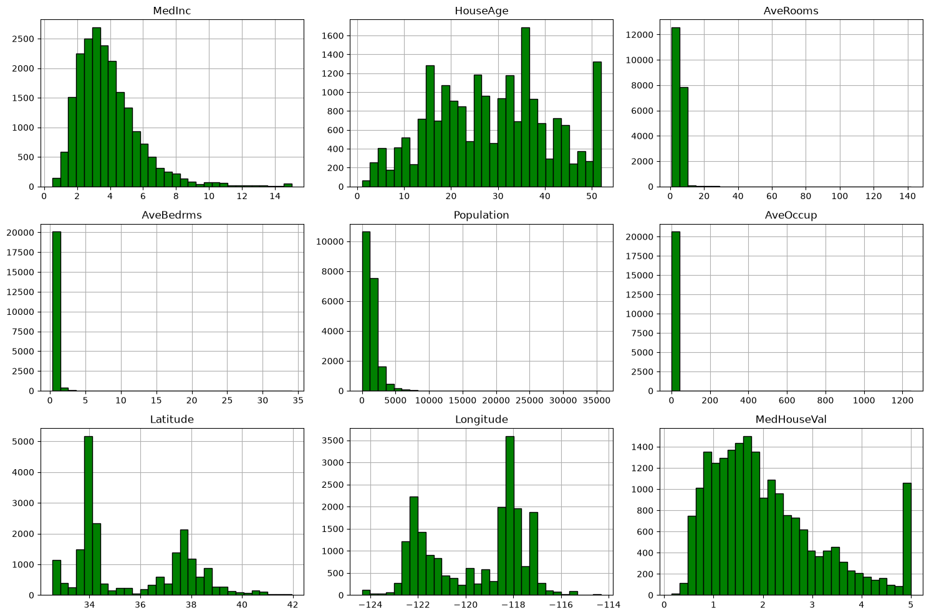
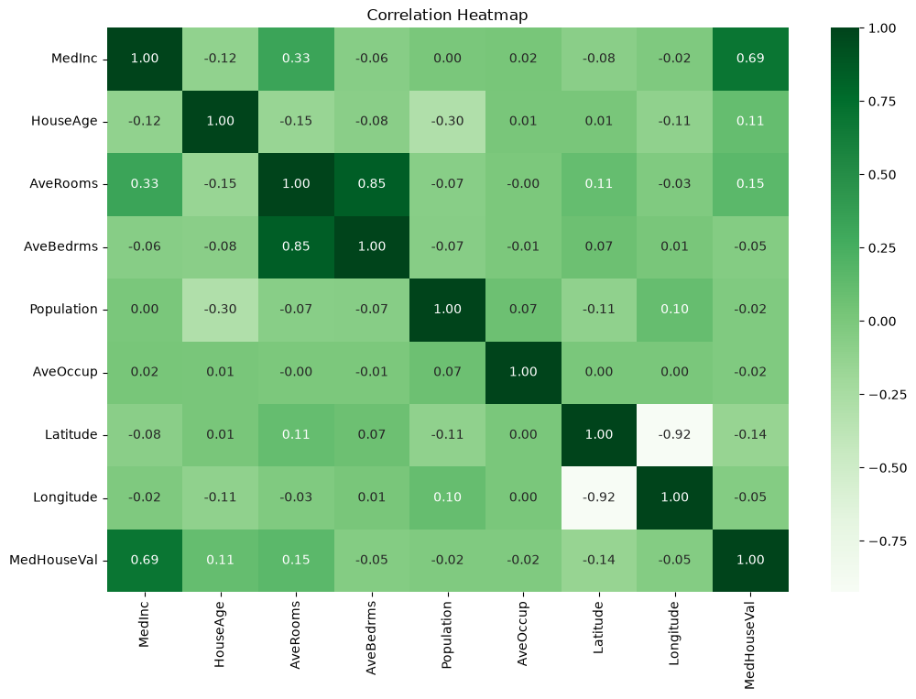
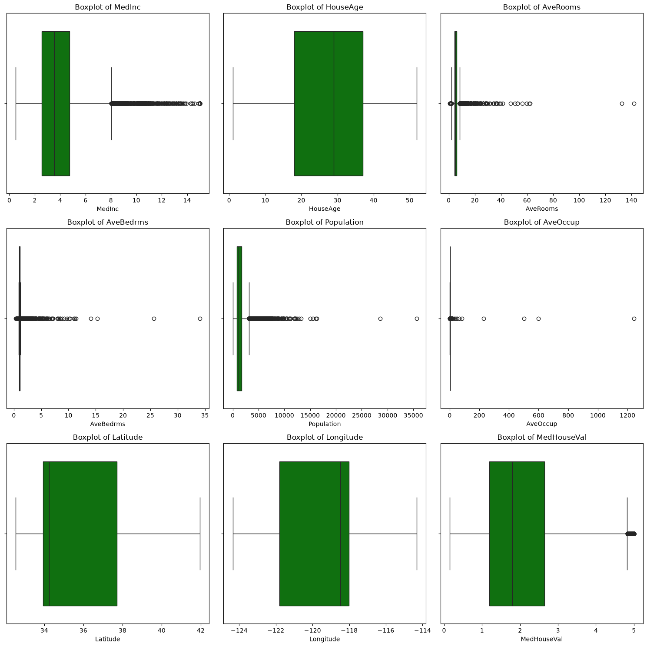
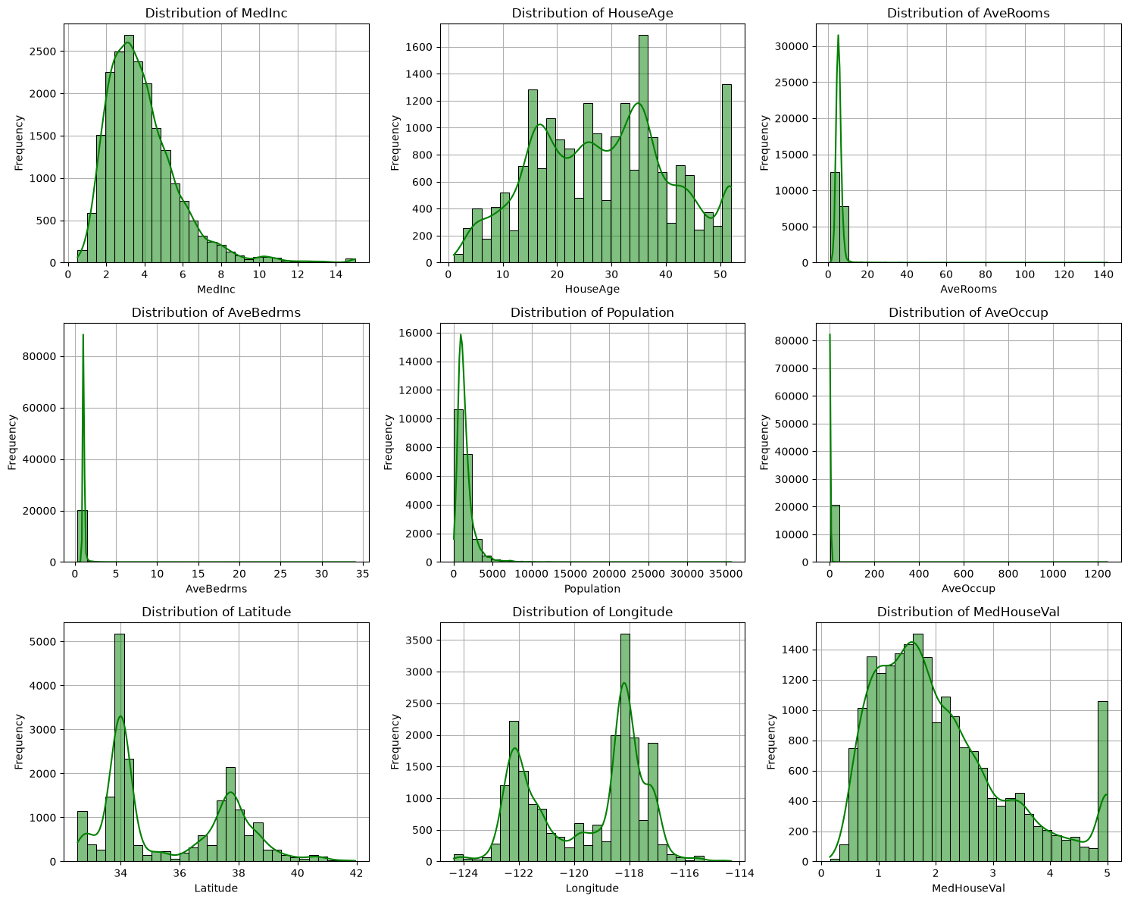
Exploratory Data Analysis (EDA)
Fig.1 — Feature Histograms
Fig.2 — Correlation Heatmap
Fig.1 — Feature Boxplots
Fig.3 — Distribution Plots with KDE
Key Observations
MedInc shows right skew; HouseAge is multimodal. AveRooms, AveBedrms, Population, AveOccup are heavily right-skewed with significant outliers. Correlation heatmap: MedInc is the strongest predictor of MedHouseVal (r = 0.69). Latitude and Longitude correlate at -0.92, confirming geographic clustering. No major missing-value issues observed.

Slide 4
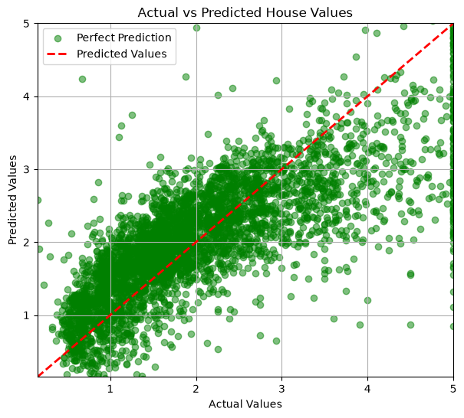
Model Performance
Performance Metrics
Metric | Value
Mean Absolute Error (MAE) | 0.5332
Mean Squared Error (MSE) | 0.5559
Root Mean Squared Error (RMSE) | 0.7456
R-squared (R²) | 0.5758
Performance Summary
MAE = 0.5332 — relatively low average prediction error.
RMSE = 0.7456 — moderate prediction deviations; larger errors penalized more heavily.
R² = 0.5758 — the model explains ~57.6% of the variance in housing prices.
The model provides a reasonable baseline for predicting California house prices, with clear opportunities for improvement through advanced techniques.
Fig.4 — Actual vs. Predicted House Values
The scatter plot shows moderate alignment between actual and predicted values. Points cluster around the ideal prediction line, but significant spread indicates room for improvement.

Slide 5
Improvement Ideas & Conclusion
Improvement Ideas
Conclusion
Feature Engineering
Create polynomial features and interaction terms to capture non-linear relationships between variables.
Polynomial Regression
Extend the linear model with squared and higher-order terms to fit curved patterns in the data.
Ensemble Methods
Random Forest, Gradient Boosting, and XGBoost can model complex feature interactions more effectively.
Hyperparameter Tuning
Grid search or random search with K-fold cross-validation for robust, optimized model evaluation.
Successfully implemented a Linear Regression model for California housing price prediction.
Conducted comprehensive EDA to understand feature distributions, correlations, and data quality.
Evaluated the model using MAE, MSE, RMSE, and R² metrics.
The model achieved R² = 0.5758, indicating moderate predictive performance.
More advanced regression models and additional feature engineering can further improve accuracy.
California Housing Price Prediction | Machine Learning Assignment

