Slide 1
StoryBoard for NFL Draft Application
Brandon Labat
CST-105
March 03, 2018

Slide 2
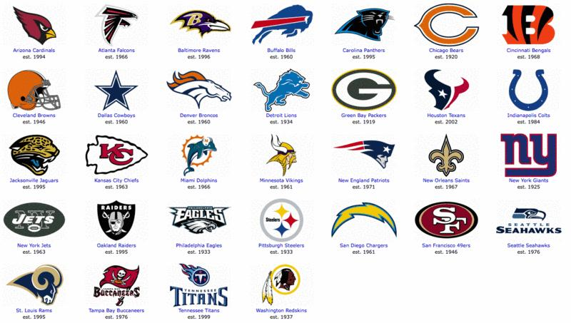
Scene 1
This screen will have the list of NFL teams that the user can click on to bring up the players in that team.
The user can click on any NFL team to see players from that team

Slide 3
Scene 2
Asks the user if they want to view every player within the team or by offensive and defensive
View Offensive Players
View Defensive Players
View All Players
User Decides how they would like to search for Players
Back

Slide 4
Scene 4
Once the user decides how they would like to search for players, they can now select players and see their stats.
Can go back to previous screen
Shows the user what screen they are on
Offensive Players
For The New York Jets
# | Name | POS | HT | WT | AGE | EXP | College
11 | Anderson, Robby | WR | 6-3 | 190 | 24 | 2 | Temple
81 | Enunwa, Quincy | WR | 6-2 | 225 | 25 | 3 | Nebraska
3 | Estime, Brisly | WR | 5-9 | 186 | 25 | R | Syracuse
User Can select Player

Slide 5
Scene 5
Once the user selects player they can view stats, add them to their roster or go back to previous screen.
Go back to previous screen
Shows the player the user is currently viewing
Estime, Brisly
User can see season stats of Players
Games | Receiving | Rushing | Fumbles
User can add players to their Roster
Add Player

Slide 6
Scene 6
Once the user adds a player, they can view their roster. They can add more players and delete players.
Can go back to add more players from the same team
Shows the user they are viewing their roster
My Roster
Player’s roster
Estime , Brisly
This will take user back to Scene 2, where they can search based on their criteria
Delete Player from User’s roster
Delete Player
Add Player

