Slide 1
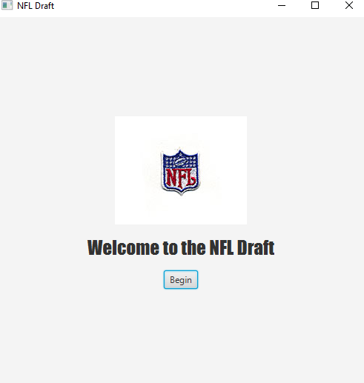
Opening Scene
LOGO
Start the Application

Slide 2
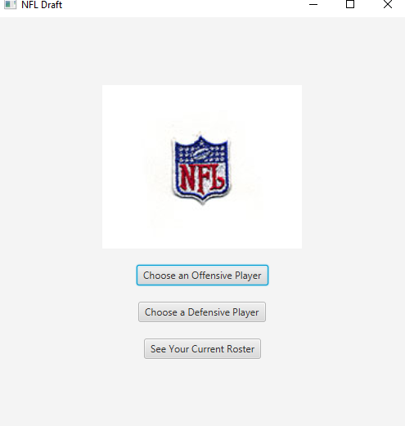
Scene 2
Main Menu
Logo
Choose a player by offensive or Defensive Position

Slide 3
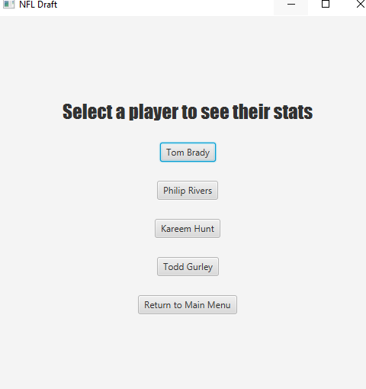
Scene 3
Offensive Player List
List of Offensive Players
Return to Main Menu

Slide 4
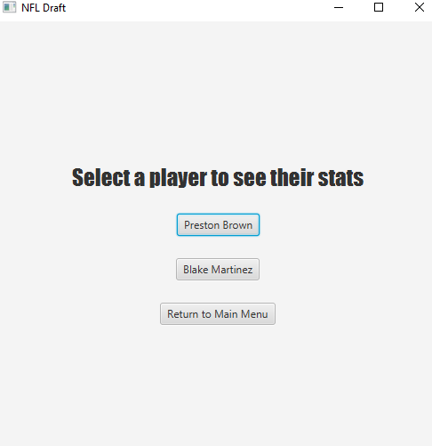
Scene 4
Defensive Players
List of Defensive Players
Return to Main Menu

Slide 5
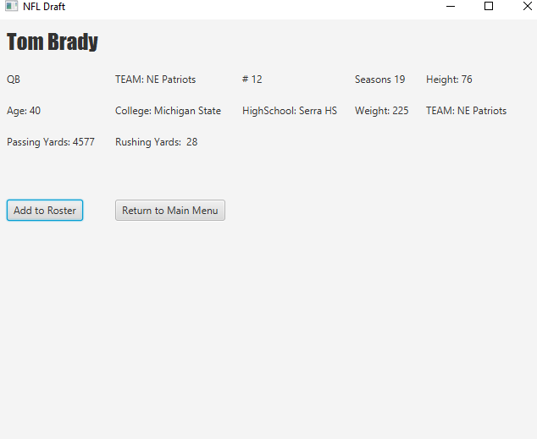
Scene 6
Player Scene
Player Stats
Add Player to Roster
Return to Main Menu

Slide 6
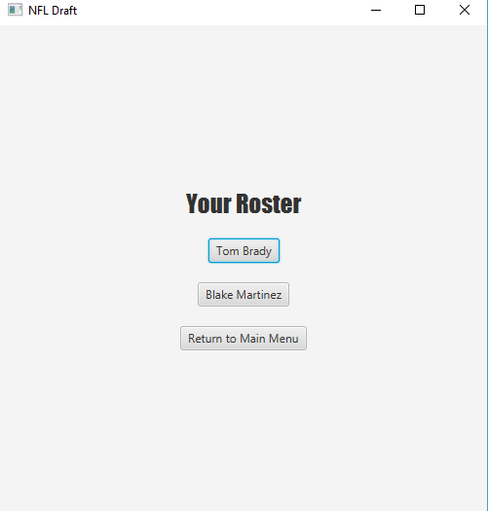
Scene 7
Roster
List of Players, able to click on them to see stats
Return To Main Menu

Slide 7
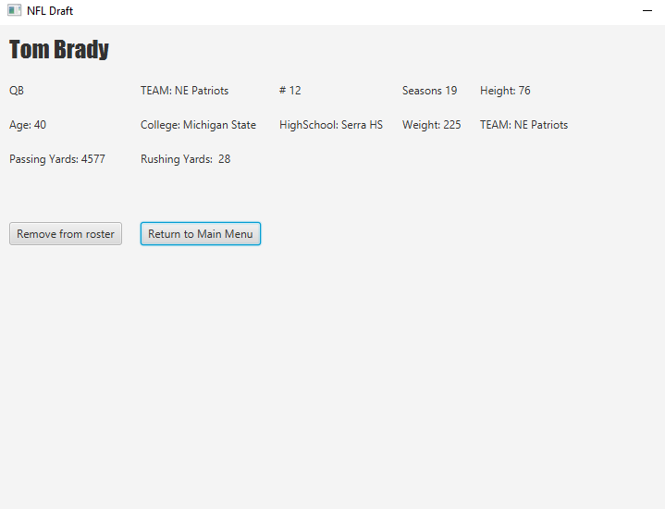
Scene 8
Once a Player is already in the roster
Return to Main Menu
Can Remove Player from Roster

