Slide 1
HACKATHON 2026 • SUPPLY CHAIN AI TRACK
NetworkIQ
AI Inventory Optimization
Optimizing Inventory Across Multiple Warehouses Using AI

Slide 2
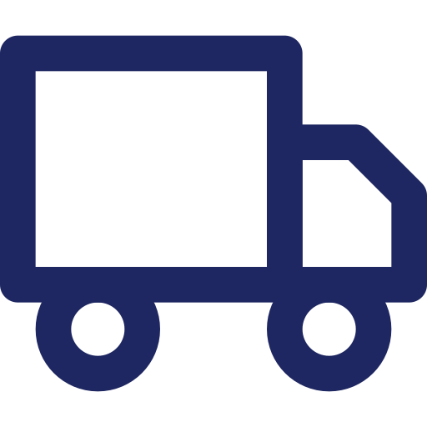



GOAL
Objective
Develop an AI system that recommends the best inventory placement and stock transfers across multiple warehouses.
WHY IT MATTERS
Faster product delivery
Lower inventory cost
Better product availability
Improved customer satisfaction
NetworkIQ | AI Inventory Optimization
2

Slide 3





THE CHALLENGE
Problem Statement
Products stored in the wrong warehouse
High transportation cost
Slow product delivery
Stock shortage in high-demand areas
Loss of sales and customer satisfaction
NetworkIQ | AI Inventory Optimization
3

Slide 4
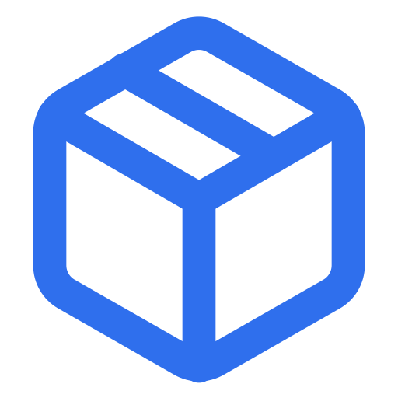




OUR APPROACH
Our Solution
AI-Based Inventory Optimization
Our AI analyzes six key inputs to recommend the best inventory placement and transfers:
Customer Demand
Current Inventory
Warehouse Capacity
Historical sales & demand forecast
Stock available at each location
Storage space & capacity limits
Transfer Cost
Delivery Time
Product Details
Cost to move stock between locations
Time to transfer and deliver stock
Category, size, perishability, velocity
NetworkIQ | AI Inventory Optimization
4

Slide 5
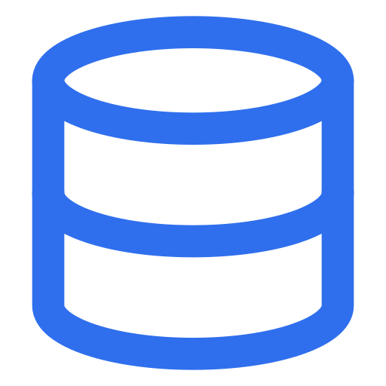




HOW IT WORKS
AI Workflow
Right Product, Right Place, Right Time
1
2
3
4
5
Input Data
→
AI Analysis
→
Recommendation
→
Planner Approval
→
Execution
Demand, inventory, capacity & cost data collected
AI evaluates demand, cost, and capacity together
Best warehouse & transfer plan generated
Planner reviews and approves the plan
Transfers executed & results tracked
BUSINESS IMPACT:
Higher Product Availability • Faster Delivery • Lower Transfer Cost • Higher Profitability
NetworkIQ | AI Inventory Optimization
5

Slide 6


WHAT IT DOES
Features
Demand Prediction
Inventory Optimization
Warehouse Capacity Check
Transfer Recommendation
Cost Analysis
Planner Approval
Dashboard & Reports
NetworkIQ | AI Inventory Optimization
6

Slide 7




LOOKING AHEAD
Results & Future Scope
Expected Results
Future Scope
Faster delivery
Real-time inventory tracking
Better product availability
Live warehouse integration
Lower inventory cost
Lower transfer cost
Advanced AI forecasting
Improved customer satisfaction
Thank You
NetworkIQ | AI Inventory Optimization
7

