Slide 1
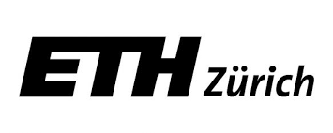
Understanding Public Opinion Dynamics Using Twitter Sentiment Analysis Case Study: French Presidential Election 2017
Andreas Psimopoulos - Barthélémy Launet

Slide 2
Introduction
June 2016: UK EU Membership Referendum
Even last weeks before referendum polls predicted “Bremain”
Porcaro & Müller (2016), in cooperation with Dortmund Center for data-based Media Analysis, predicted the Brexit result with Twitter sentiment analysis
November 2016: US Presidential Election
Many polls predicted a win of Hilary Clinton
Social media analysts could predict Donald Trump’s win using sentiment analysis (Perez, 2016).
April & May 2017: French Presidential Election
Our challenge: Apply sentiment analysis on Twitter posts to predict the final result

Slide 3
Goals of our Research
Social networks: how well can they inform us about public opinion dynamics?
Develop an algorithm for election results prediction
Opportunity to test it in our case study
Q: Is it possible to predict election results through social media?
Many application areas (marketing, other types of voting, etc.)
Build a mechanism for giving feedback to the politicians
Support for political strategy optimization
Idea: Correct your rhetoric according to the findings

Slide 4
Data Pipeline
How to extract useful information from Twitter Stream ?

Slide 5
1 – Data Collection
Twitter
From March 20 to May 7
List of keywords for each of the 11 candidates
Raw input
47 days collection
4518 files of raw text
150 GB

Slide 6
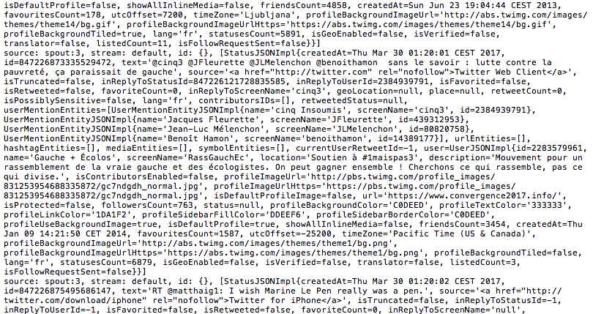
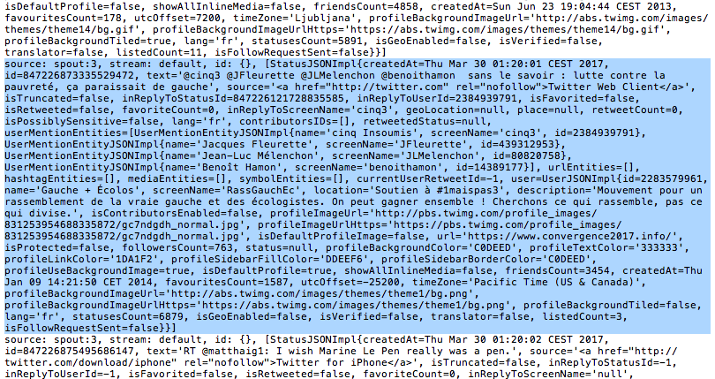
Input example

Slide 7
2 - Formatting
Twitter
Raw input
47 days collection
4518 files of raw text
150 GB
Formatting
- Keeping only relevant fields
- Saving retweets as originals

Slide 8
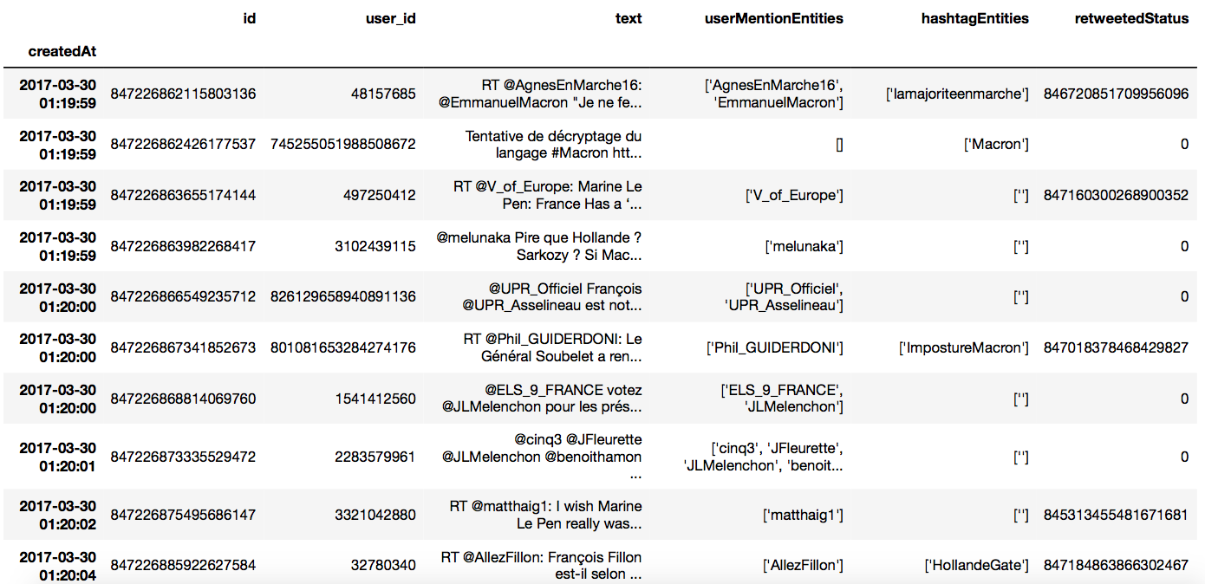
Table example
Not all the fields are displayed

Slide 9
2 - Formatting
Twitter
Raw input
47 days collection
4518 files of raw text
150 GB
Formatting
Tabulated tweets
Filtered information
47 M tweets
22 GB

Slide 10
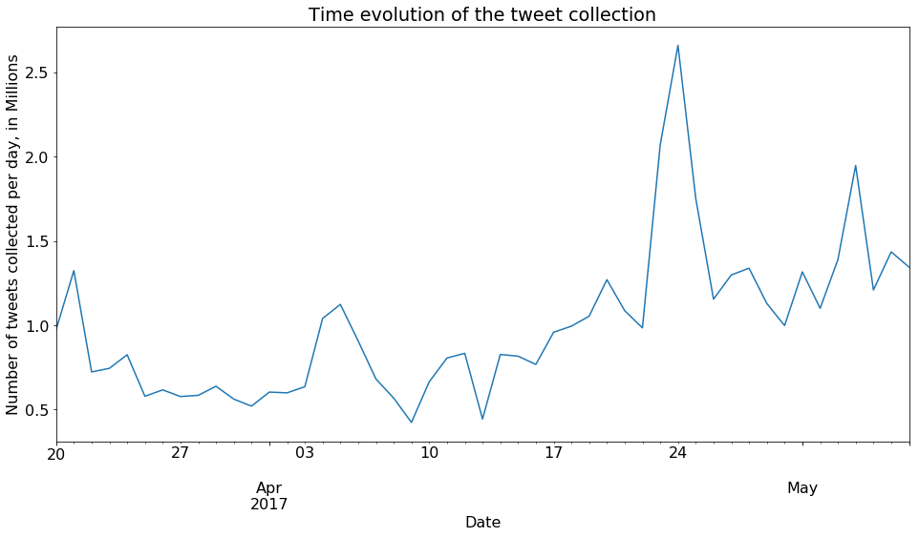
Collection timeline

Slide 11
3 - Processing
Twitter
Raw input
47 days collection
4518 files of raw text
150 GB
Formatting
Tabulated tweets
Filtered information
47 M tweets
22 GB
Processing
- Candidate
- Score
- Relevant Words

Slide 12
Scoring
Dictionary of 14000 scored lemmas
TreeTagger to transform text
==> Need for clean & correct input
Removing emojis, hashtags, mentions, numbers, dates, links…
Correction of misspellings (detected via HunSpell)
Typos (accents, duplicated letters) by permutation
SMS-like language with online translator
==> 290 000 words corrected, efficiency 11%
Word | Tag | Lemma
préférai | VER:sim | préférer
bonnes | ADJ | bon

Slide 13
Final State
Twitter
Raw input
47 days collection
4518 files of raw text
150 GB
Formatting
Tabulated tweets
Filtered information
47 M tweets
22 GB
Processing
Scored tweets
3 days of computing on ETH supercluster
21 M tweets
1 file – 2.5 GB

Slide 14
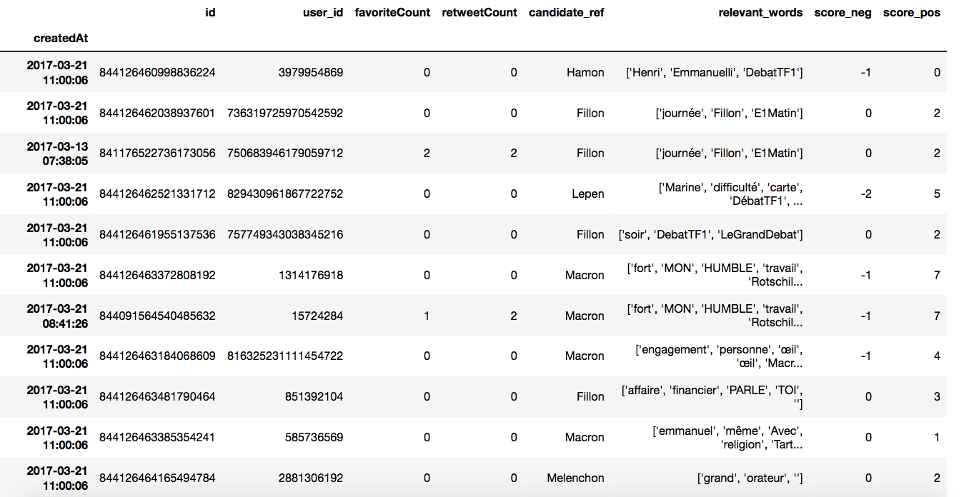
Scored table example

Slide 15
Analysis
Now, let’s play with it !

Slide 16
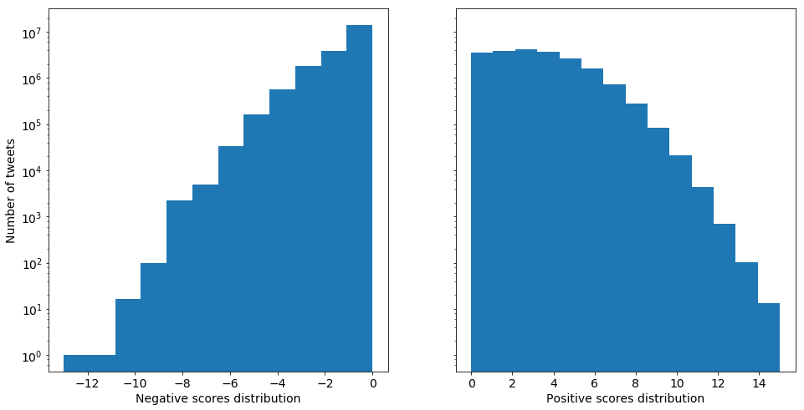
Definition of Positiveness
Problem: too many positive (?!) tweets… Sarcasm??

Slide 17
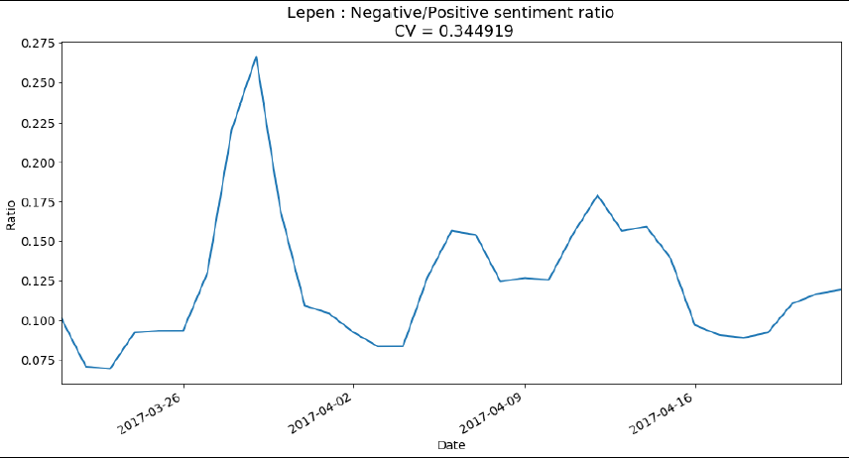
Definition of Positiveness
Negative/Positive ratio: ~15% regardless the candidate
Variability is small too

Slide 18
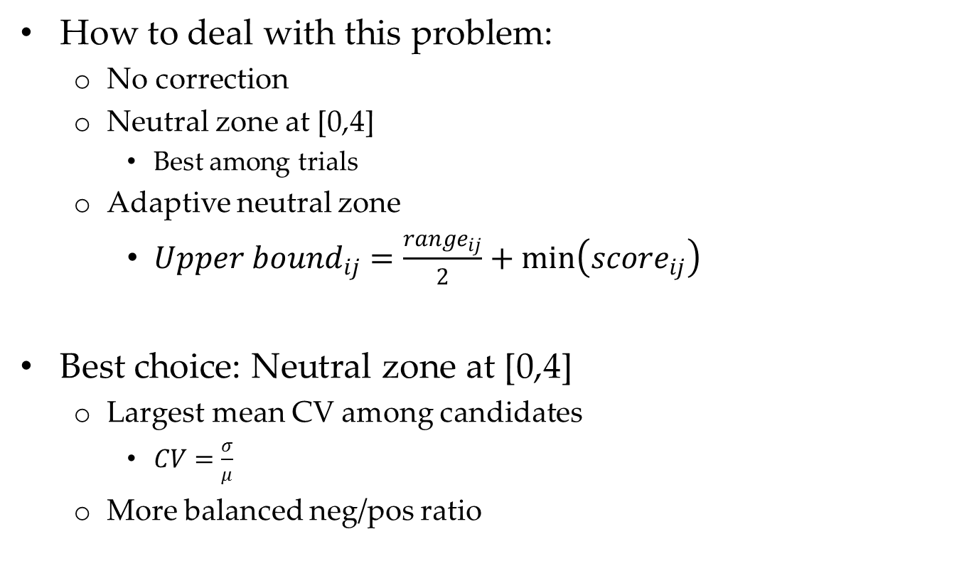
Definition of Positiveness
How to deal with this problem:
No correction
Neutral zone at [0,4]
Best among trials
Adaptive neutral zone
${Upper bound}_{ij}=\frac{{range}_{ij}}{2}+min\left({score}_{ij}\right)$
Best choice: Neutral zone at [0,4]
Largest mean CV among candidates
$CV=\frac{σ}{μ}$
More balanced neg/pos ratio
Notes:
i: day, j: candidate

Slide 19
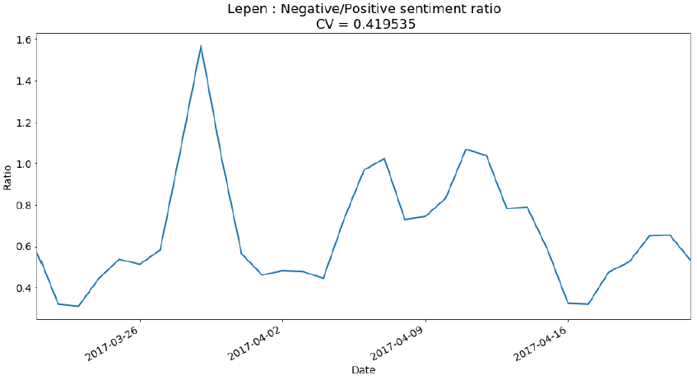
Definition of Positiveness
After correction:

Slide 20
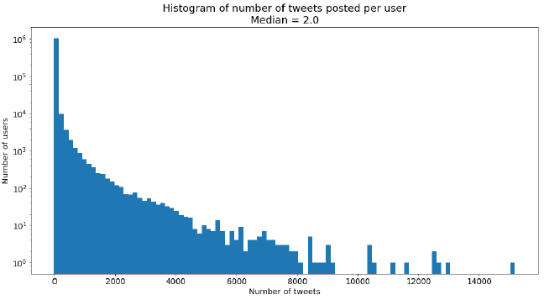
Vote Intention Forecasting
Keep only the last tweet from each user
Everything at [0,4]: neutral
< 0 → negatives
> 4 → positives
Vote intention – 1st round: Count only positives
Vote intention – 2nd round: Count positives + inverse the negatives

Slide 21
Metrics and Measurements
Metric 1: Chi-square test
Predictions vs Real results
One test for all the candidates
Measure for the general predictability
Metric 2: Marascuillo Procedure
Confidence intervals for the absolute difference
One test for each candidate
A candidate-specific measure
H₀: Difference between forecasts and election results is not statistically significant

Slide 22
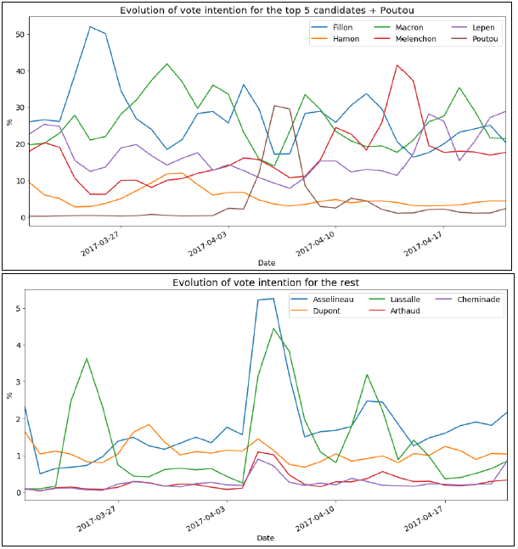
Results
Notes:
Moving average: 2-day window | Up 22/4@00:00 |

Slide 24
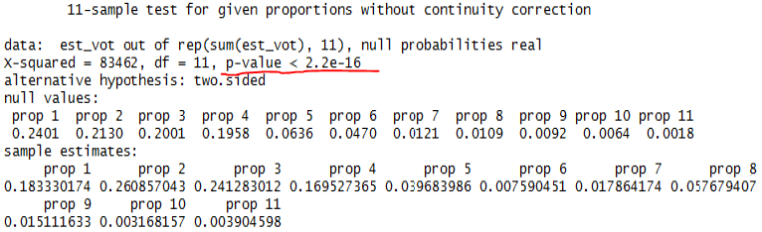
Results
Chi-square test
H₀ rejected → our method didn’t predict the result well as a whole

Slide 25

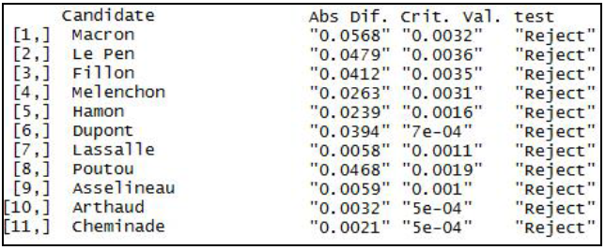
Results
Marascuillo Procedure:
Always reject, but MP is too strict due to the population size (over 36 million people)
Also sample size (counted tweets) is big: 274,292
Notes:
r{i,j}: critical values

Slide 26
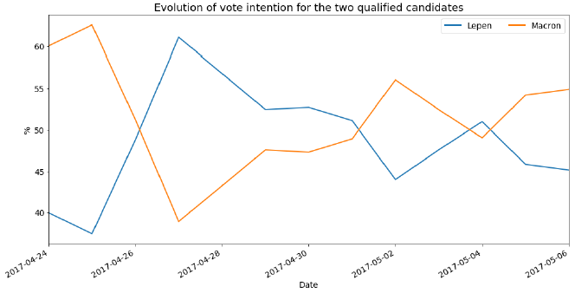
Results

Slide 28
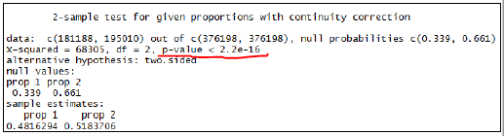
Results
Chi-square test for the result of the second round:
Clearly, such a difference could not be predicted

Slide 29
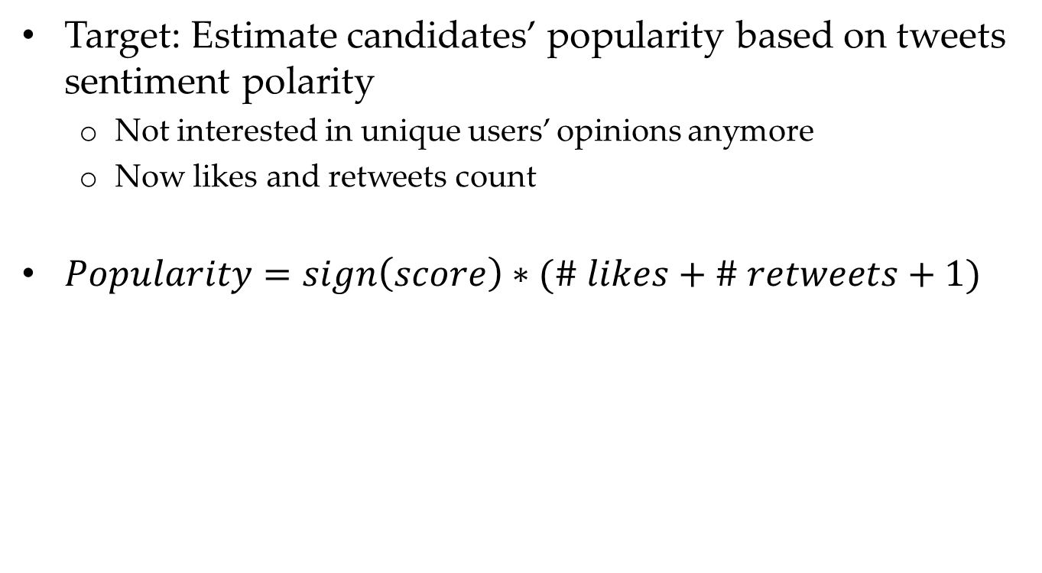
Progress of popularity
Target: Estimate candidates’ popularity based on tweets sentiment polarity
Not interested in unique users’ opinions anymore
Now likes and retweets count
$Popularity=sign\left(score\right)∗(\# likes+\# retweets+1)$

Slide 30
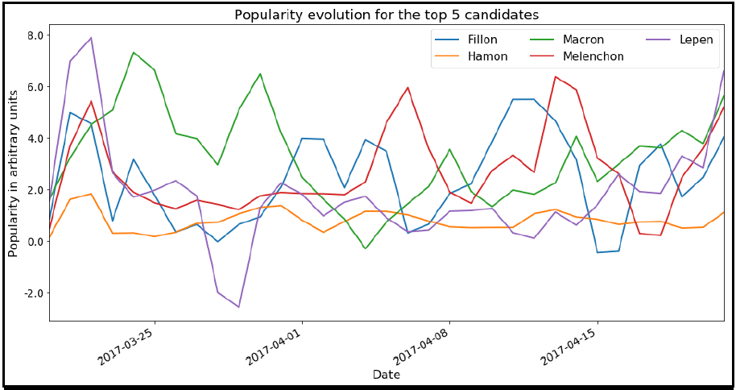
Progress of popularity

Slide 31
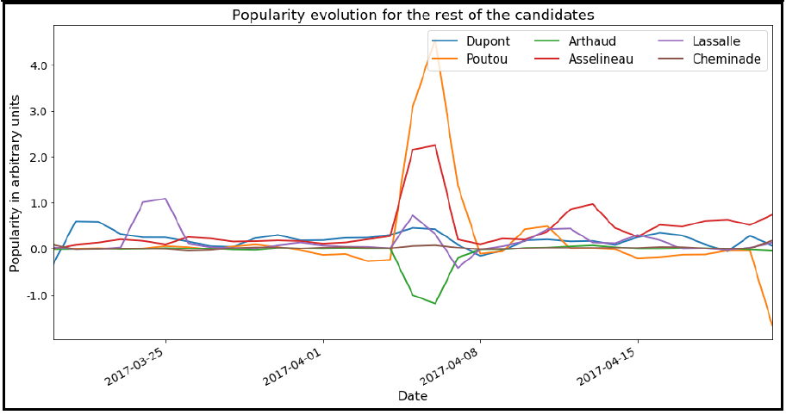
Progress of popularity

Slide 32
Giving feedback to the politician
Time to make some money… ;)

Slide 33
Political Strategy Optimization
Idea: Give feedback to the politician after a peak or dropdown of his/her popularity
Leap from quantitative analysis to qualitative
Quantitative questions: When? How much? For how long? …
Qualitative questions: Why? Any hidden facts? …
Qualitative information can be extracted by looking at the meaning of tweets
How to do it massively?
Word clouds
Word networks

Slide 34
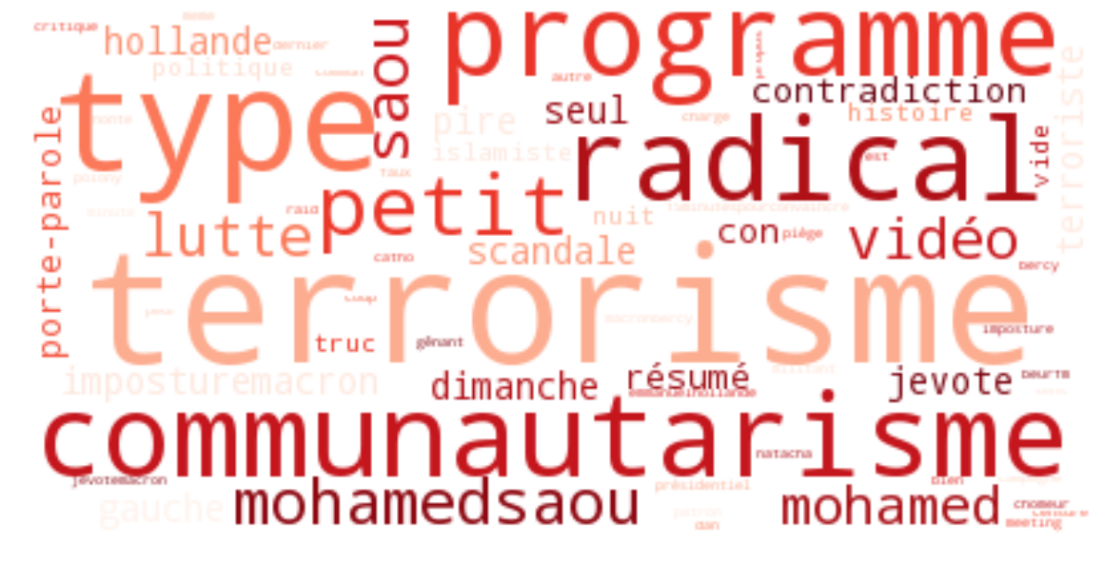
Macron most frequent words in negative tweets

Slide 35
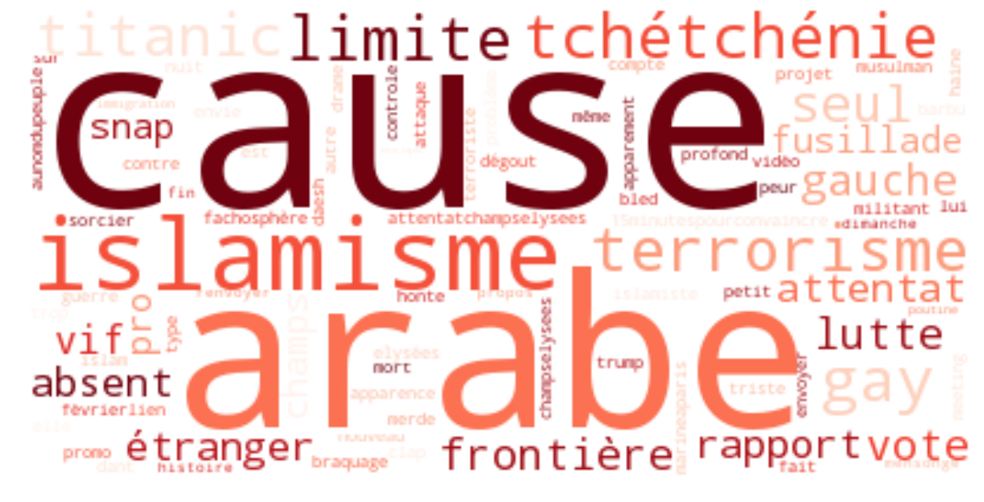
Le Pen most frequent words in negative tweets

Slide 36
Words networks
See how these frequent words are linked together
Weight: their co-appearance in the same tweet
Display using the Fruchterman – Reingold algorithm
Bigger weight → Closer distance
Meaningful (?) clusters

Slide 37
Le Pen negativity network

Slide 38
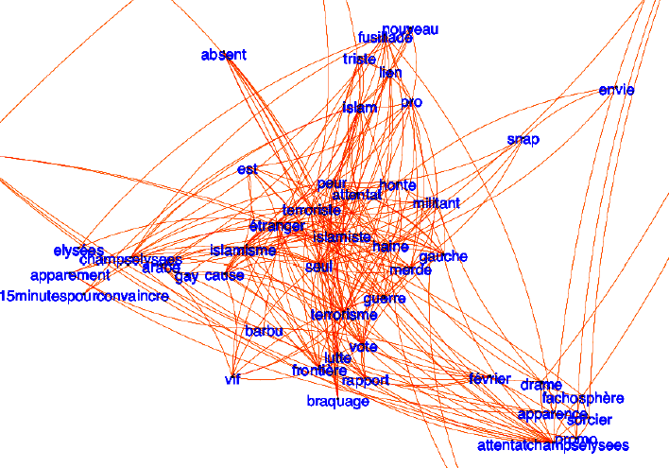

Slide 39
Conclusions
Q: Is it possible to predict election results through social media?
A: Accurate prediction not possible.
Sarcasm effect introduces biases
Maybe dictionaries introduce biases
Known bias: Twitter’s specific demographics
Multiple-candidates mentions ignored
What about political strategy optimization?
Unable to use that in practice (so far…!)
BUT: clear differentiation among candidates and between positive and negative tweets
Interesting facts come on the front through word clouds and word networks

