Slide 1
Git:
Fetch, Pull
Rebase, Merge
Lauren Billington
Legislative Information Services
Colorado State Legislature

Slide 2
Part 1: Rebase vs Merge

Slide 3
The Classic Visualization
“HEAD”
Linked
Nodes
Git Version Control
is basically a
Singly Linked List
The most up-to-date Dot is always named “Head”

Slide 4
Your code is actually a Linked List
Your Shiny New Code

Slide 5
Commit
Saved Changes
Saved Changes
Your Shiny New Code
Also Saved
Changes
Saved Changes
Saved Changes

Slide 6
1 Commit =
1 copy of the whole codebase
including your new changes

Slide 7
The simplest use case
Your last Commit
is the new HEAD!
Your Shiny New Code
Previous versions of Master

Slide 8
Rebasing vs Merge
Rebasing
Forces us to treat integration like a Singly Linked List

Slide 9
Rebasing vs Merge
Merging
Attempts one of 6 merging strategies:
Fast Forward
Recursive
Ours
Octopus
Resolve
Subtree

Slide 10
‘git merge’ing Your Code
running ‘git merge’ all by itself could result in…
Mix-N-Matched Code
Git might favor code based on write-time rather than merge-time
Git might make ‘undesirable choices’ when two branches don’t have a common parent commit.
Trouble with Merge Conflicts
Sometimes Git doesn’t think there’s a conflict (so Devs aren’t even prompted)

Slide 11
REBASE:
Changes for 4 files in your Master branch
Your Shiny New Code!
Coworker’s Shiny Older Code!
Newest
File A, Last Changed: Date/Time, WhoDunnit
File B, Last Changed: Date/Time, WhoDunnit
File C, Last Changed: Date/Time, WhoDunnit
File D, Last Changed: Date/Time, WhoDunnit
File A, Last Changed: Date/Time, WhoDunnit
File B, Last Changed: Date/Time, WhoDunnit
File C, Last Changed: Date/Time, WhoDunnit
File D, Last Changed: Date/Time, WhoDunnit
File A, Last Changed: Date/Time, WhoDunnit
File B, Last Changed: Date/Time, WhoDunnit
File C, Last Changed: Date/Time, WhoDunnit
File D, Last Changed: Date/Time, WhoDunnit
File A, Last Changed: Date/Time, WhoDunnit
File B, Last Changed: Date/Time, WhoDunnit
File C, Last Changed: Date/Time, WhoDunnit
File D, Last Changed: Date/Time, WhoDunnit
File A, Last Changed: Date/Time, WhoDunnit
File B, Last Changed: Date/Time, WhoDunnit
File C, Last Changed: Date/Time, WhoDunnit
File D, Last Changed: Date/Time, WhoDunnit
File A, Last Changed: Date/Time, WhoDunnit
File B, Last Changed: Date/Time, WhoDunnit
File C, Last Changed: Date/Time, WhoDunnit
File D, Last Changed: Date/Time, WhoDunnit
Oldest
File A, Last Changed: Date/Time, WhoDunnit
File B, Last Changed: Date/Time, WhoDunnit
File C, Last Changed: Date/Time, WhoDunnit
File D, Last Changed: Date/Time, WhoDunnit

Slide 12
The following is inspired by real events.

Slide 13
MERGE
Changes for 4 files in your Master branch
My Shiny New Code!
Coworker’s Shiny Older Code!
File A, Last Changed: Date/Time, WhoDunnit
File B, Last Changed: Date/Time, WhoDunnit
File C, Last Changed: Date/Time, WhoDunnit
File D, Last Changed: Date/Time, WhoDunnit
File A, Last Changed: Date/Time, WhoDunnit
File B, Last Changed: Date/Time, WhoDunnit
File C, Last Changed: Date/Time, WhoDunnit
File D, Last Changed: Date/Time, WhoDunnit
File A, Last Changed: Date/Time, WhoDunnit
File B, Last Changed: Date/Time, WhoDunnit
File C, Last Changed: Date/Time, WhoDunnit
File D, Last Changed: Date/Time, WhoDunnit
File A, Last Changed: Date/Time, WhoDunnit
File B, Last Changed: Date/Time, WhoDunnit
File C, Last Changed: Date/Time, WhoDunnit
File D, Last Changed: Date/Time, WhoDunnit
File A, Last Changed: Date/Time, WhoDunnit
File B, Last Changed: Date/Time, WhoDunnit
File C, Last Changed: Date/Time, WhoDunnit
File D, Last Changed: Date/Time, WhoDunnit
File A, Last Changed: Date/Time, WhoDunnit
File B, Last Changed: Date/Time, WhoDunnit
File C, Last Changed: Date/Time, WhoDunnit
File D, Last Changed: Date/Time, WhoDunnit
File A, Last Changed: Date/Time, WhoDunnit
File B, Last Changed: Date/Time, WhoDunnit
File C, Last Changed: Date/Time, WhoDunnit
File D, Last Changed: Date/Time, WhoDunnit

Slide 14
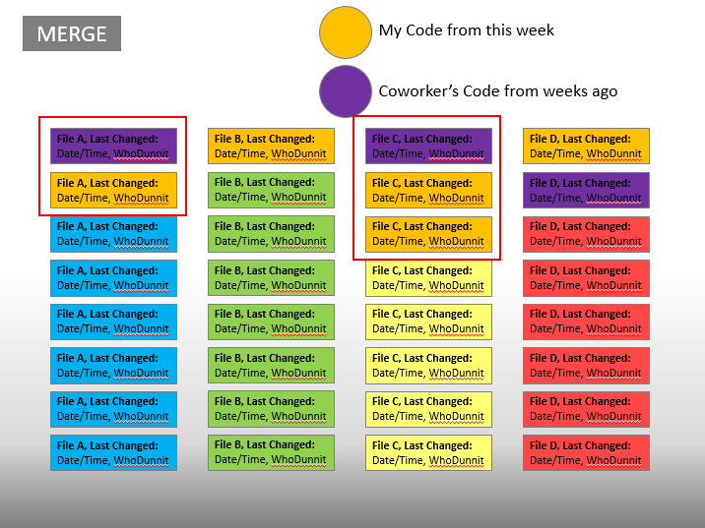
So what happened?
Pull happened.

Slide 15
git pull == git merge
“In its default mode, git pull is shorthand for
‘git fetch’ followed by ‘git merge FETCH_HEAD’.”
- Git Documentation

Slide 16
Fetch, Pull
Rebase, Merge
…And also team communication…
I hope you know a bit more
than you did before

