Slide 1
Git ‘er Done!
Four Git Commands: merge, rebase, pull, & fetch
Part 2: Merge vs. Rebase

Slide 2

Git ‘er Done!
What Git Is, and Is Not
Visualizing How Git Works
Integration Strategies (merge, rebase)
Update Strategies (pull, fetch)

Slide 3
Integration Strategies!
‘git merge’
‘git rebase’

Slide 4
Rebasing vs Merge
Rebasing
  Forces us to treat commits like a Singly Linked List
Merging
  We ask Git to be Psychic and guess what we want
  Attempts one of 6 other merging functions:
    Fast Forward
    Recursive
    Ours
    Octopus
    Resolve
    Subtree

Slide 5
The simplest use case
Your last Commit
is the new HEAD!
Your Shiny New Code
Previous versions of Master

Slide 6
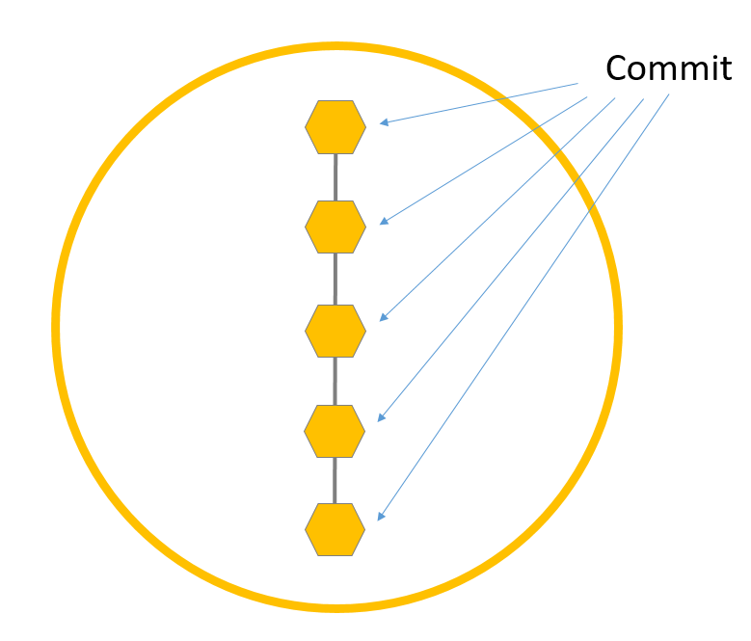
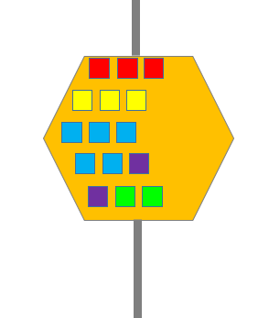
It’s hardly ever the simple use case
We need a different visualization
Billy’s Copy
New Master!
Lauren’s Copy
Kim’s Copy
FAIL
Mehran’s Copy

Slide 7
1 Commit =
  1 copy of the whole codebase
  +
  your new changes
Each commit has a
checksum hash (SHA*)
so you can identify/use it
*SHA = Secure Hash Algorithm

Slide 8
Stored History of Changes to 4 Files in Master
File A
File B
File C
File D
File A, Last Changed: Date/Time, WhoDunnit
File B, Last Changed: Date/Time, WhoDunnit
File C, Last Changed: Date/Time, WhoDunnit
File D, Last Changed: Date/Time, WhoDunnit
File A, Last Changed: Date/Time, WhoDunnit
File B, Last Changed: Date/Time, WhoDunnit
File C, Last Changed: Date/Time, WhoDunnit
File D, Last Changed: Date/Time, WhoDunnit
File A, Last Changed: Date/Time, WhoDunnit
File B, Last Changed: Date/Time, WhoDunnit
File C, Last Changed: Date/Time, WhoDunnit
File D, Last Changed: Date/Time, WhoDunnit
File A, Last Changed: Date/Time, WhoDunnit
File B, Last Changed: Date/Time, WhoDunnit
File C, Last Changed: Date/Time, WhoDunnit
File D, Last Changed: Date/Time, WhoDunnit
File A, Last Changed: Date/Time, WhoDunnit
File B, Last Changed: Date/Time, WhoDunnit
File C, Last Changed: Date/Time, WhoDunnit
File D, Last Changed: Date/Time, WhoDunnit
File A, Last Changed: Date/Time, WhoDunnit
File B, Last Changed: Date/Time, WhoDunnit
File C, Last Changed: Date/Time, WhoDunnit
File D, Last Changed: Date/Time, WhoDunnit
File A, Last Changed: Date/Time, WhoDunnit
File B, Last Changed: Date/Time, WhoDunnit
File C, Last Changed: Date/Time, WhoDunnit
File D, Last Changed: Date/Time, WhoDunnit

Slide 9
REBASE
Your Shiny New Code!
File A, Last Changed: Date/Time, WhoDunnit
File B, Last Changed: Date/Time, WhoDunnit
File C, Last Changed: Date/Time, WhoDunnit
File D, Last Changed: Date/Time, WhoDunnit
File A, Last Changed: Date/Time, WhoDunnit
File B, Last Changed: Date/Time, WhoDunnit
File C, Last Changed: Date/Time, WhoDunnit
File D, Last Changed: Date/Time, WhoDunnit
File A, Last Changed: Date/Time, WhoDunnit
File B, Last Changed: Date/Time, WhoDunnit
File C, Last Changed: Date/Time, WhoDunnit
File D, Last Changed: Date/Time, WhoDunnit
File A, Last Changed: Date/Time, WhoDunnit
File B, Last Changed: Date/Time, WhoDunnit
File C, Last Changed: Date/Time, WhoDunnit
File D, Last Changed: Date/Time, WhoDunnit
File A, Last Changed: Date/Time, WhoDunnit
File B, Last Changed: Date/Time, WhoDunnit
File C, Last Changed: Date/Time, WhoDunnit
File D, Last Changed: Date/Time, WhoDunnit
File A, Last Changed: Date/Time, WhoDunnit
File B, Last Changed: Date/Time, WhoDunnit
File C, Last Changed: Date/Time, WhoDunnit
File D, Last Changed: Date/Time, WhoDunnit
File A, Last Changed: Date/Time, WhoDunnit
File B, Last Changed: Date/Time, WhoDunnit
File C, Last Changed: Date/Time, WhoDunnit
File D, Last Changed: Date/Time, WhoDunnit
File A, Last Changed: Date/Time, WhoDunnit
File B, Last Changed: Date/Time, WhoDunnit
File C, Last Changed: Date/Time, WhoDunnit
File D, Last Changed: Date/Time, WhoDunnit

Slide 10
REBASE
Your Shiny New Code!
Bob’s Shiny New Code!
File A, Last Changed: Date/Time, WhoDunnit
File B, Last Changed: Date/Time, WhoDunnit
File C, Last Changed: Date/Time, WhoDunnit
File D, Last Changed: Date/Time, WhoDunnit
File A, Last Changed: Date/Time, WhoDunnit
File B, Last Changed: Date/Time, WhoDunnit
File C, Last Changed: Date/Time, WhoDunnit
File D, Last Changed: Date/Time, WhoDunnit
File A, Last Changed: Date/Time, WhoDunnit
File B, Last Changed: Date/Time, WhoDunnit
File C, Last Changed: Date/Time, WhoDunnit
File D, Last Changed: Date/Time, WhoDunnit
File A, Last Changed: Date/Time, WhoDunnit
File B, Last Changed: Date/Time, WhoDunnit
File C, Last Changed: Date/Time, WhoDunnit
File D, Last Changed: Date/Time, WhoDunnit
File A, Last Changed: Date/Time, WhoDunnit
File B, Last Changed: Date/Time, WhoDunnit
File C, Last Changed: Date/Time, WhoDunnit
File D, Last Changed: Date/Time, WhoDunnit
File A, Last Changed: Date/Time, WhoDunnit
File B, Last Changed: Date/Time, WhoDunnit
File C, Last Changed: Date/Time, WhoDunnit
File D, Last Changed: Date/Time, WhoDunnit
File A, Last Changed: Date/Time, WhoDunnit
File B, Last Changed: Date/Time, WhoDunnit
File C, Last Changed: Date/Time, WhoDunnit
File D, Last Changed: Date/Time, WhoDunnit

Slide 11
MERGE
Your Shiny New Code!
File A, Last Changed: Date/Time, WhoDunnit
File B, Last Changed: Date/Time, WhoDunnit
File C, Last Changed: Date/Time, WhoDunnit
File D, Last Changed: Date/Time, WhoDunnit
File A, Last Changed: Date/Time, WhoDunnit
File B, Last Changed: Date/Time, WhoDunnit
File C, Last Changed: Date/Time, WhoDunnit
File D, Last Changed: Date/Time, WhoDunnit
File A, Last Changed: Date/Time, WhoDunnit
File B, Last Changed: Date/Time, WhoDunnit
File C, Last Changed: Date/Time, WhoDunnit
File D, Last Changed: Date/Time, WhoDunnit
File A, Last Changed: Date/Time, WhoDunnit
File B, Last Changed: Date/Time, WhoDunnit
File C, Last Changed: Date/Time, WhoDunnit
File D, Last Changed: Date/Time, WhoDunnit
File A, Last Changed: Date/Time, WhoDunnit
File B, Last Changed: Date/Time, WhoDunnit
File C, Last Changed: Date/Time, WhoDunnit
File D, Last Changed: Date/Time, WhoDunnit
File A, Last Changed: Date/Time, WhoDunnit
File B, Last Changed: Date/Time, WhoDunnit
File C, Last Changed: Date/Time, WhoDunnit
File D, Last Changed: Date/Time, WhoDunnit
File A, Last Changed: Date/Time, WhoDunnit
File B, Last Changed: Date/Time, WhoDunnit
File C, Last Changed: Date/Time, WhoDunnit
File D, Last Changed: Date/Time, WhoDunnit
File A, Last Changed: Date/Time, WhoDunnit
File B, Last Changed: Date/Time, WhoDunnit
File C, Last Changed: Date/Time, WhoDunnit
File D, Last Changed: Date/Time, WhoDunnit

Slide 12
MERGE
Your Shiny New Code!
Bob’s Shiny New Code!
File A, Last Changed: Date/Time, WhoDunnit
File B, Last Changed: Date/Time, WhoDunnit
File C, Last Changed: Date/Time, WhoDunnit
File D, Last Changed: Date/Time, WhoDunnit
File A, Last Changed: Date/Time, WhoDunnit
File B, Last Changed: Date/Time, WhoDunnit
File C, Last Changed: Date/Time, WhoDunnit
File D, Last Changed: Date/Time, WhoDunnit
File A, Last Changed: Date/Time, WhoDunnit
File B, Last Changed: Date/Time, WhoDunnit
File C, Last Changed: Date/Time, WhoDunnit
File D, Last Changed: Date/Time, WhoDunnit
File A, Last Changed: Date/Time, WhoDunnit
File B, Last Changed: Date/Time, WhoDunnit
File C, Last Changed: Date/Time, WhoDunnit
File D, Last Changed: Date/Time, WhoDunnit
File A, Last Changed: Date/Time, WhoDunnit
File B, Last Changed: Date/Time, WhoDunnit
File C, Last Changed: Date/Time, WhoDunnit
File D, Last Changed: Date/Time, WhoDunnit
File A, Last Changed: Date/Time, WhoDunnit
File B, Last Changed: Date/Time, WhoDunnit
File C, Last Changed: Date/Time, WhoDunnit
File D, Last Changed: Date/Time, WhoDunnit
File A, Last Changed: Date/Time, WhoDunnit
File B, Last Changed: Date/Time, WhoDunnit
File C, Last Changed: Date/Time, WhoDunnit
File D, Last Changed: Date/Time, WhoDunnit
File A, Last Changed: Date/Time, WhoDunnit
File B, Last Changed: Date/Time, WhoDunnit
File C, Last Changed: Date/Time, WhoDunnit
File D, Last Changed: Date/Time, WhoDunnit

Slide 13
‘git merge’ing Your Code
Git’s code is pretty brilliant, but… it’s not magic or psychic
Git might favor code based on datetimes

Slide 14
‘git merge’ing Your Code
Git’s code is pretty brilliant, but… it’s not magic or psychic
Git might favor code based on datetimes
Git might get confused when two branches don’t have a common ‘parent’ commit.
  branches off branches
  cherry picks and headless branches
  lots of employees at different stages
  lines of code that exists only in Prod

Slide 15
‘git merge’ing Your Code
The trouble due to “Merge Conflicts”
Human Error
  A developer resolving merge conflicts may not know which code to favor if they didn’t write it.

Slide 16
‘git merge’ing Your Code
The trouble due to “Merge Conflicts”
Human Error
  A developer resolving merge conflicts may not know which code to favor if they didn’t write it.
Sometimes Git doesn’t think there’s a conflict
  Developers might not be prompted

Slide 17
REBASE
Using ‘git rebase -i’ always produces the expected results:
Git treats the commits like a Linked List
Developer is prompted about all code differences
The final commit becomes the new Head
Latest Team-Approved Code
The previously integrated code
File A, Last Changed: Date/Time, WhoDunnit
File B, Last Changed: Date/Time, WhoDunnit
File C, Last Changed: Date/Time, WhoDunnit
File D, Last Changed: Date/Time, WhoDunnit
File A, Last Changed: Date/Time, WhoDunnit
File B, Last Changed: Date/Time, WhoDunnit
File C, Last Changed: Date/Time, WhoDunnit
File D, Last Changed: Date/Time, WhoDunnit
File A, Last Changed: Date/Time, WhoDunnit
File B, Last Changed: Date/Time, WhoDunnit
File C, Last Changed: Date/Time, WhoDunnit
File D, Last Changed: Date/Time, WhoDunnit
File A, Last Changed: Date/Time, WhoDunnit
File B, Last Changed: Date/Time, WhoDunnit
File C, Last Changed: Date/Time, WhoDunnit
File D, Last Changed: Date/Time, WhoDunnit
File A, Last Changed: Date/Time, WhoDunnit
File B, Last Changed: Date/Time, WhoDunnit
File C, Last Changed: Date/Time, WhoDunnit
File D, Last Changed: Date/Time, WhoDunnit

Slide 18
MERGE
Using ‘git merge’can sometimes have unwanted results:
Git attempts one of 6 strategies
Git may not choose what you wanted
Human Errors
Latest Team-Approved Code
Git tries to guess what you want
File A, Last Changed: Date/Time, WhoDunnit
File B, Last Changed: Date/Time, WhoDunnit
File C, Last Changed: Date/Time, WhoDunnit
File D, Last Changed: Date/Time, WhoDunnit
File A, Last Changed: Date/Time, WhoDunnit
File B, Last Changed: Date/Time, WhoDunnit
File C, Last Changed: Date/Time, WhoDunnit
File D, Last Changed: Date/Time, WhoDunnit
File A, Last Changed: Date/Time, WhoDunnit
File B, Last Changed: Date/Time, WhoDunnit
File C, Last Changed: Date/Time, WhoDunnit
File D, Last Changed: Date/Time, WhoDunnit
File A, Last Changed: Date/Time, WhoDunnit
File B, Last Changed: Date/Time, WhoDunnit
File C, Last Changed: Date/Time, WhoDunnit
File D, Last Changed: Date/Time, WhoDunnit
File A, Last Changed: Date/Time, WhoDunnit
File B, Last Changed: Date/Time, WhoDunnit
File C, Last Changed: Date/Time, WhoDunnit
File D, Last Changed: Date/Time, WhoDunnit

Slide 19
Why doesn’t everyone Rebase?
New to Git
Habit
Never noticed trouble with ‘git merge’
Fear - mistakes in a rebase session
  But there are easy ways around it
(but the most common is…)

Slide 20
“bbbbUT yOU’rE reWritINg HiStoRyyyYYyYYYyyyy!!!111!one1!”
- Many Interwebs People

Slide 21
“bbbbUT yOU’rE reWritINg HiStoRyyyYYyYYYyyyy!!!11!one1!”
Many Intelligent Interwebs People
So What?

Slide 22
‘git rebase’ing Your Code
Does Chronological Git History Matter?
Your team needs to look at the pros and cons

Slide 23
‘git rebase’ing Your Code
Which is more important to your team?
A dependable and accurate method of integrating code changes, but the timestamps are limited to the time it was actually integrated
…OR
A body of code where you can depend on the absolute accuracy of the timestamps, but you can’t depend on the accuracy of the code

Slide 24
‘git rebase’ing Your Code
For many seasoned developers
rebasing is the better choice.
Prevent mistakes that waste time/money/frustration
Interrupts work in multiple departments
Delays delivery
Lose confidence in co-workers
Increases individual and team stress
Users lose confidence in Product
Developers
QA
Uh-Oh’s
BA
Managers

Slide 25
Git ‘er Done!
What Git Is, and Is Not
Visualizing How Git Works
Integration Strategies
Update Strategies

Slide 26
Update Strategies!
‘git pull’
‘git fetch’
Which is the best strategy
to get new code
or update the code you started with?

Slide 27
git pull == git merge
“In its default mode, git pull is shorthand for
‘git fetch’ followed by ‘git merge FETCH_HEAD’.”
- Git Documentation

Slide 28
git pull == git merge
“In its default mode, git pull is shorthand for
‘git fetch’ followed by ‘git merge FETCH_HEAD’.”
- Git Documentation
git fetch == (just get the code)
git fetch + git reset
Re-sets the branch to start with a perfect copy

Slide 29
git pull and git fetch…
… TO BE CONTINUED!

Slide 30
Git ‘er Done Good!

Slide 31
Pull vs Fetch
You probably have an old version of Master
New Master!
Before you can get started on new code, you need to pull or fetch Master
Mehran’s Copy

Slide 32
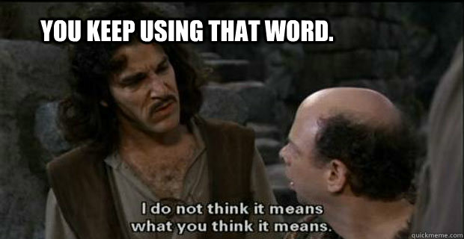
Pull.

Slide 33
git pull == git merge
“In its default mode, git pull is shorthand for
‘git fetch’ followed by ‘git merge FETCH_HEAD’.”
- Git Documentation

Slide 34
git pull == git merge
Whatif…
You have staged or unstaged changes you forgot about?
Whatif…
You’re pulling in a Prod environment,
and there are changes that haven’t been reintroduced
into the main branch?

Slide 35
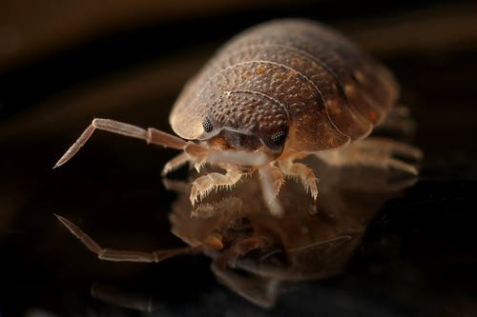

Slide 36
‘git fetch’ing
Getting your code and Updating your code
takes 2 steps
‘git pull’ starts with ‘git fetch’, then git merge
‘git fetch’ gets your code from the repo
‘git reset’ resets a branch to use the fetched copy

Slide 37
‘git fetch’ing
These commands ensure that the code in your branch is an exact copy of what’s in the Repo.
This is good for starting new features.
This is Perfect for PROD!
git fetch upstream/master
&&
git reset –hard upstream/master

Slide 38
Why does Prod matter so much?
Prod should be the culmination of all the hard work your team put in:
Design & Style
User Stories & Acceptance Criteria
Unit tests, feature tests, integration tests
QA and bugfixes
… The ONLY code that should be loaded into Prod is the code that has been through all those steps

Slide 39
A Fetch & Rebase Workflow
Getting Started with a New Feature
Locally, checkout master
Make sure there are no uncommitted changes
Fetch master from upstream or origin
‘git reset –hard <SHA or branchname>
Checkout a new branch for your feature

Slide 40
A Fetch & Rebase Workflow
Integrating Your new feature
Commit and Push your branch to the Repo
Locally, checkout master
Make sure there are no uncommitted changes
Fetch master from upstream or origin
‘git reset –hard <SHA or branchname>
Checkout your branch again
‘git rebase master -i’ to start an interactive rebase
Force push changes in your branch to the Repo
Initiate a Pull Request from your branch to Master

Slide 41
A Fetch & Rebase Workflow
Updating Prod
Make sure you’re in the right branch (master)
Make sure there are no uncommitted changes
If there are config files that are unique to master, keep separate copies elsewhere
Fetch master from upstream or origin
‘git reset –hard <SHA or branchname>’
Copy any config files back, and run other commands as needed for your framework

Slide 42
Git ‘er Done Good!

Slide 43
The simplistic visualization of
Git Branches
It’s a
Singly Linked
List!
So Simple!

