Slide 1

NuGet Packages
Referencing .NET and Native Libraries
Notes:
I’m Brett Lesnau
I’ve been at TSC for close to 7 years
I was on the Snagit team for around 4 years, and then I went to Cloud team, and then back to the Snagit team
Now I don’t know what team I’m on

Slide 2
Summary
What is NuGet?
Why should you care?
What is a NuGet package?
What happens when you install a NuGet package?
Demos
Pros & Cons
Q&A
Notes:
Brief overview of the some of the main concepts in NuGet
Demos of creating and consuming NuGet packages
Finish with some summary information and questions

Slide 3
What is NuGet?

Slide 4
What is NuGet?
A Visual Studio extension
A package manager that helps manage external assembly references
It allows you to search for, install, uninstall, and update external references (NuGet Packages) in your solutions and projects

Slide 5
Why should you care?
Pretty much an industry standard, especially for .NET
Most Microsoft dev teams at TSC are already using NuGet.
We are currently moving most, if not all, of our Common code to NuGet packages

Slide 6
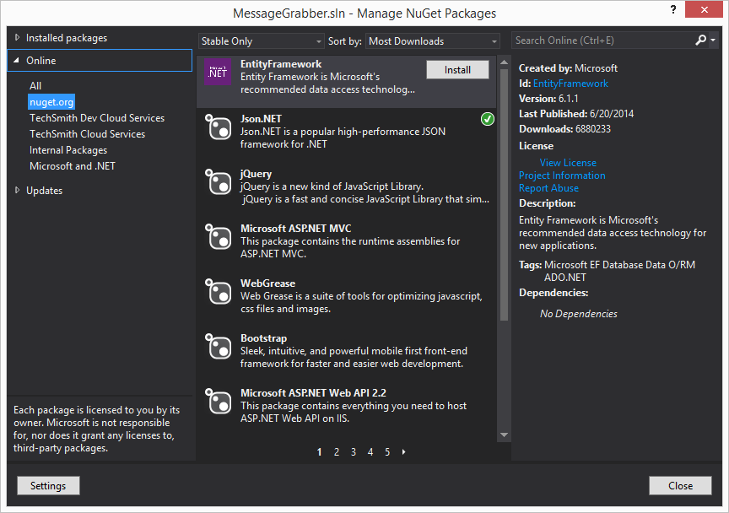
What does NuGet look like?

Slide 7
What is a NuGet package?
A .nupkg file
Mostly contains DLLs and metadata
Often contains source code and debug symbols

Slide 8
What happens when you install a NuGet package?
.NET
The package is downloaded to a “packages” folder next to your solution
References to the package’s DLLs are added to one or more projects automatically

Slide 9
What happens when you install a NuGet package? (cont.)
Native (C++)
The package is downloaded to a “packages” folder next to your solution
Project include directories, library directories, and .lib dependencies are set automatically at build / link time

Slide 10
Demos

Slide 11
Pros
One place to manage almost all of your referenced assemblies
You can clearly see which projects reference which packages
Dependencies are clearly shown
Notes:
Easier to wrap your head around what your projects actually depend on since it’s all in one place

Slide 12
Pros (cont.)
Updates are easy to see and install
You don’t get updates unless you explicitly choose to update
Dependencies are referenced automatically
Binaries don’t need to be in source control

Slide 13
Pros (cont.)
The solutions and projects control what versions of libraries they pull down instead of the build system
This makes setting up up builds way simpler
Less things to worry about when adding references
Most of the complicated or tedious things are done automatically

Slide 14
Cons
Initial dev work for a NuGet or rapid changes may be slightly inconvenient
Extra step to create NuGet package
C++ CLI projects cannot reference .NET NuGet packages
You can still add a reference manually
Referencing different versions of the same NuGet package can be confusing
Notes:
You need to build a package every time you want to test a change. Coming up with a way to test the package without integrating it into another solution helps. Like using test harnesses or unit tests
This is a feature a lot of people online have been asking for, but it doesn’t seem to be on anyone’s list right now. NuGet is open source so anyone could attempt it.
This is a problem even if you’re not using NuGet, but it’s one of the most common problems I’ve run into with NuGet. There are ways to make sure different parts of your code can reference different versions of a specific NuGet package, but the best option is to make sure all of your code uses the same version of a specific NuGet package.

Slide 15
Other comments
Always manage packages from the solution level
Packages can include a PowerShell file that is executed on package installation
Notes:
This helps ensure that every project is using the same version of each NuGet package. Otherwise, you may update a NuGet package for only 1 project when 3 projects use it.
This file can do pretty much whatever you want, but people typically use it to add files to a project or add pre-build steps and post-build steps to a project automatically

Slide 16

Questions?

