Slide 1
SELT 2020 Card Game Simulator
Dennis Kurtz, Bailey Leuth, Ram Sajja, Mathew Seng, and Andrew Stjernberg
Department of Electrical Engineering, University of Iowa

Slide 2
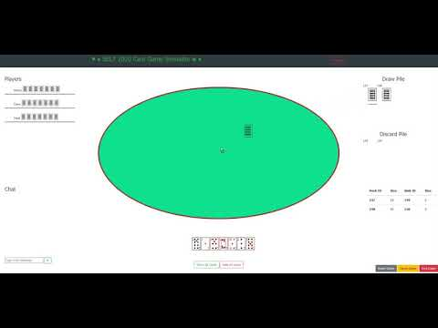

Slide 3
Live Demo

Slide 4
Design
Emphasized BDD
TDD was difficult
Notes:
Test-Driven development was something we struggled with in the latter half of our project. As we made progress on certain aspects of our application, we would decide that changes would need to be made to the design. In some scenarios, what we had planned to accomplish was not feasible. Other times we simply changed our design due to time constraints and sake of progress. Towards the beginning of our project, our TDD testing was solid as we were implementing things like user login and game code creation. The difficulties came when we were implementing our game functionality. Moving cards, flipping cards, and sending messages were difficult to write tests for prior to implementing the logic behind them. Our behavior driven design testing was very thorough throughout the duration of our project. We were sure to test functionality of our new implementations prior to moving onto new features.

Slide 5


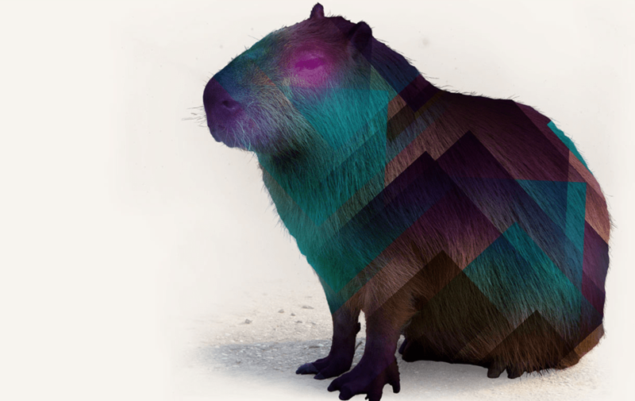
Testing
RSpec
Cucumber
Capybara
Notes:
In order to implement behavior driven design we made use of the ruby gems RSpec, Cucumber, and Capybara
We used RSpec in order to unit test our functionality. We unit tested most of our controller methods in the backend to ensure that our controller actions were implemented correctly. Due to the use of the Pusher gem and API we also had to make extensive use of RSpec mocking. This allowed us to only test our code and mock out the api calls so that way our tests weren’t contributing towards our API call limit.
We also made extensive use of Cucumber for behavior driven design purposes. Cucumber allows us to write acceptance tests that are easily readable and able to follow our user story format. Along with cucumber we used Capybara to simulate a user using the page. Using these two gems together we were able to create acceptance tests for all the different desired scenarios in the code We tried to implement a new cucumber test with each new feature that we added.
We have 92.2% coverage.

Slide 6
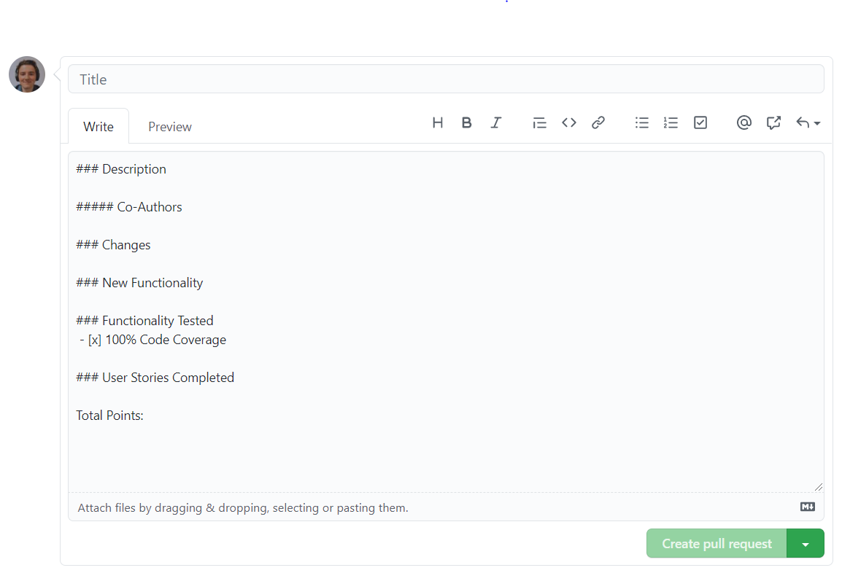
GitHub (PR Submissions, PR Reviews, Merge Conflicts)
PR Template
More detail as project progressed
Avoided merge conflicts
PR approvals
Rebased branches
Branches implemented specific features
Many branches open at once
Notes:
Our PR descriptions for Sprint 1 were vague and didn’t include completed user stories, the current sprint, file changes, new functionality, co-authors, and other important details
To solve this, we implemented a PR template that included all these details in Sprint 2
Improved group understanding of changes and identifying the PRs in which certain commits/features were added
We managed to avoid merge conflicts almost completely
PRs required at least 2 approvals to merge into the main branch
We consistently rebased branches to avoid merge conflicts or solve small conflicts before they progressed into significant conflicts
We tried our best to ensure that each branch implemented a specific feature
This wasn’t always the case; some branches designed for one feature added other features or revised past features
Made sure to document these cases
At one point, we had more than 8 branches open at once
This made the order of merging confusing
Had to create all the PR descriptions at once

Slide 7

Conflict Resolutions, Team Meetings, Sprint velocities, Wiki pages
Game page design conflicts
Obviously took the democratic way to resolve conflicts
Team Meetings
Stand up meetings every M, Tu, W, F
Work meetings for pair/group programming
Velocity: ~30 points per week
Wiki pages have all the information regarding that sprint
Work progress
Design changes
Additional Features added
Notes:
We had a lot of ideas coming from all the teammates for the game page and not everyone was agreeing on one thing. So we obviously took the democratic way to resolve these conflicts. We had a stand up meeting every Monday, Tuesday, Wednesday and Friday. And we have pair programming or group programming meetings when necessary. Out velocity is around 30 points per week. Our Wiki pages are comprehensive including the work progress, the design changes, and additional features we added.

Slide 8
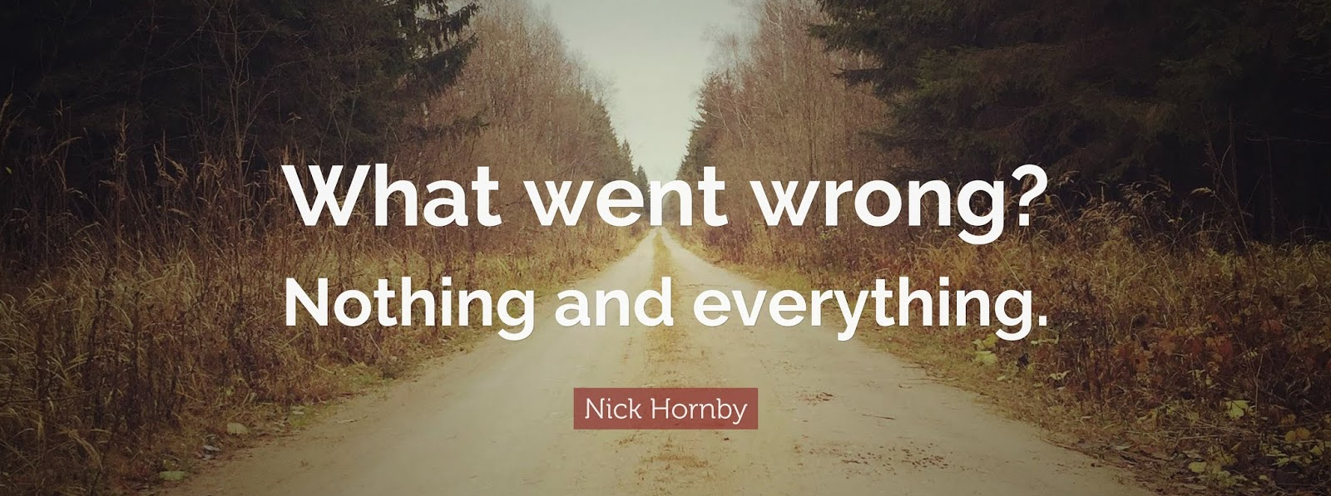
First attempt in Learning
Database Schema
Co-author tags for commits
AJAX integration
Notes:
Database schema, we didn’t think about all the columns we needed at the start. We had to add new columns as we were adding more features. We forgot to add co author tags for the first few commits and then had a formatting error in the other commits. We had trouble with ajax integration to reload a page on an action.

Slide 9
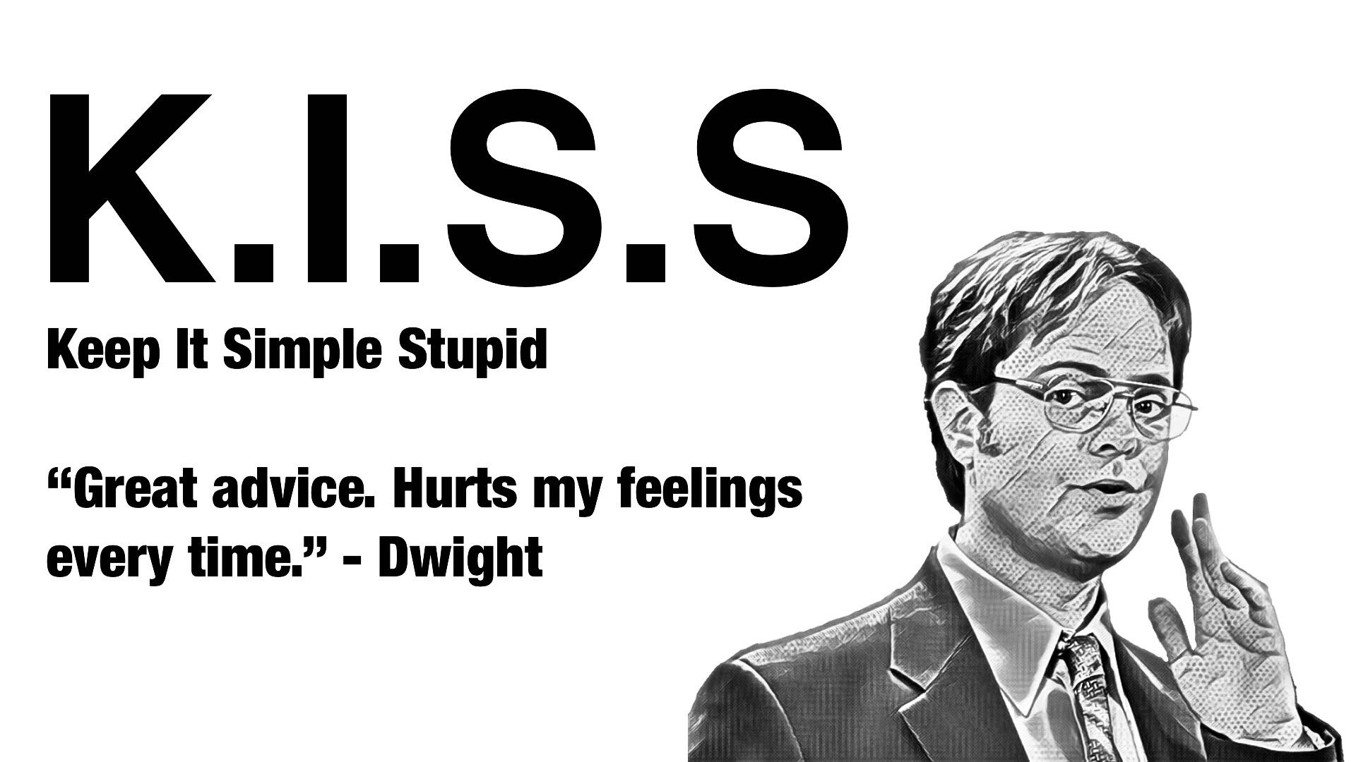
Lessons Learned
Thought-out Database Design
Framework Version
K.I.S.S.
Little Things Matter
Notes:
Thought-out Database Design – We designed a well thought out database but required additional columns overtime which made handling new functionality tedious.
Framework Version – Rails 4.0 presented problems that could have been easily solved in Rails 5.0. For future projects we would look to use a framework that is most up to date as Rail 4.0 is quite old.
K.I.S.S - While our design (we felt) did this exceptional, we found our actual code was more difficult
Little Things Matter – Comments, variable names and formatting made a large difference. Even something like color codes for our project turned out to make it overall much cleaner.

Slide 10

Questions?

