Slide 1
Email Spam Classification
Group 7: David Genfan, Brian Louie, Davin Yu

Slide 2

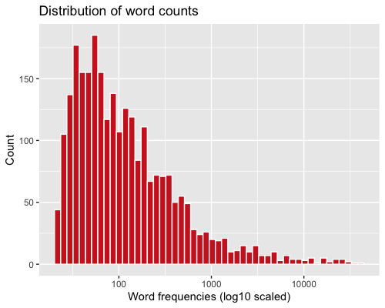
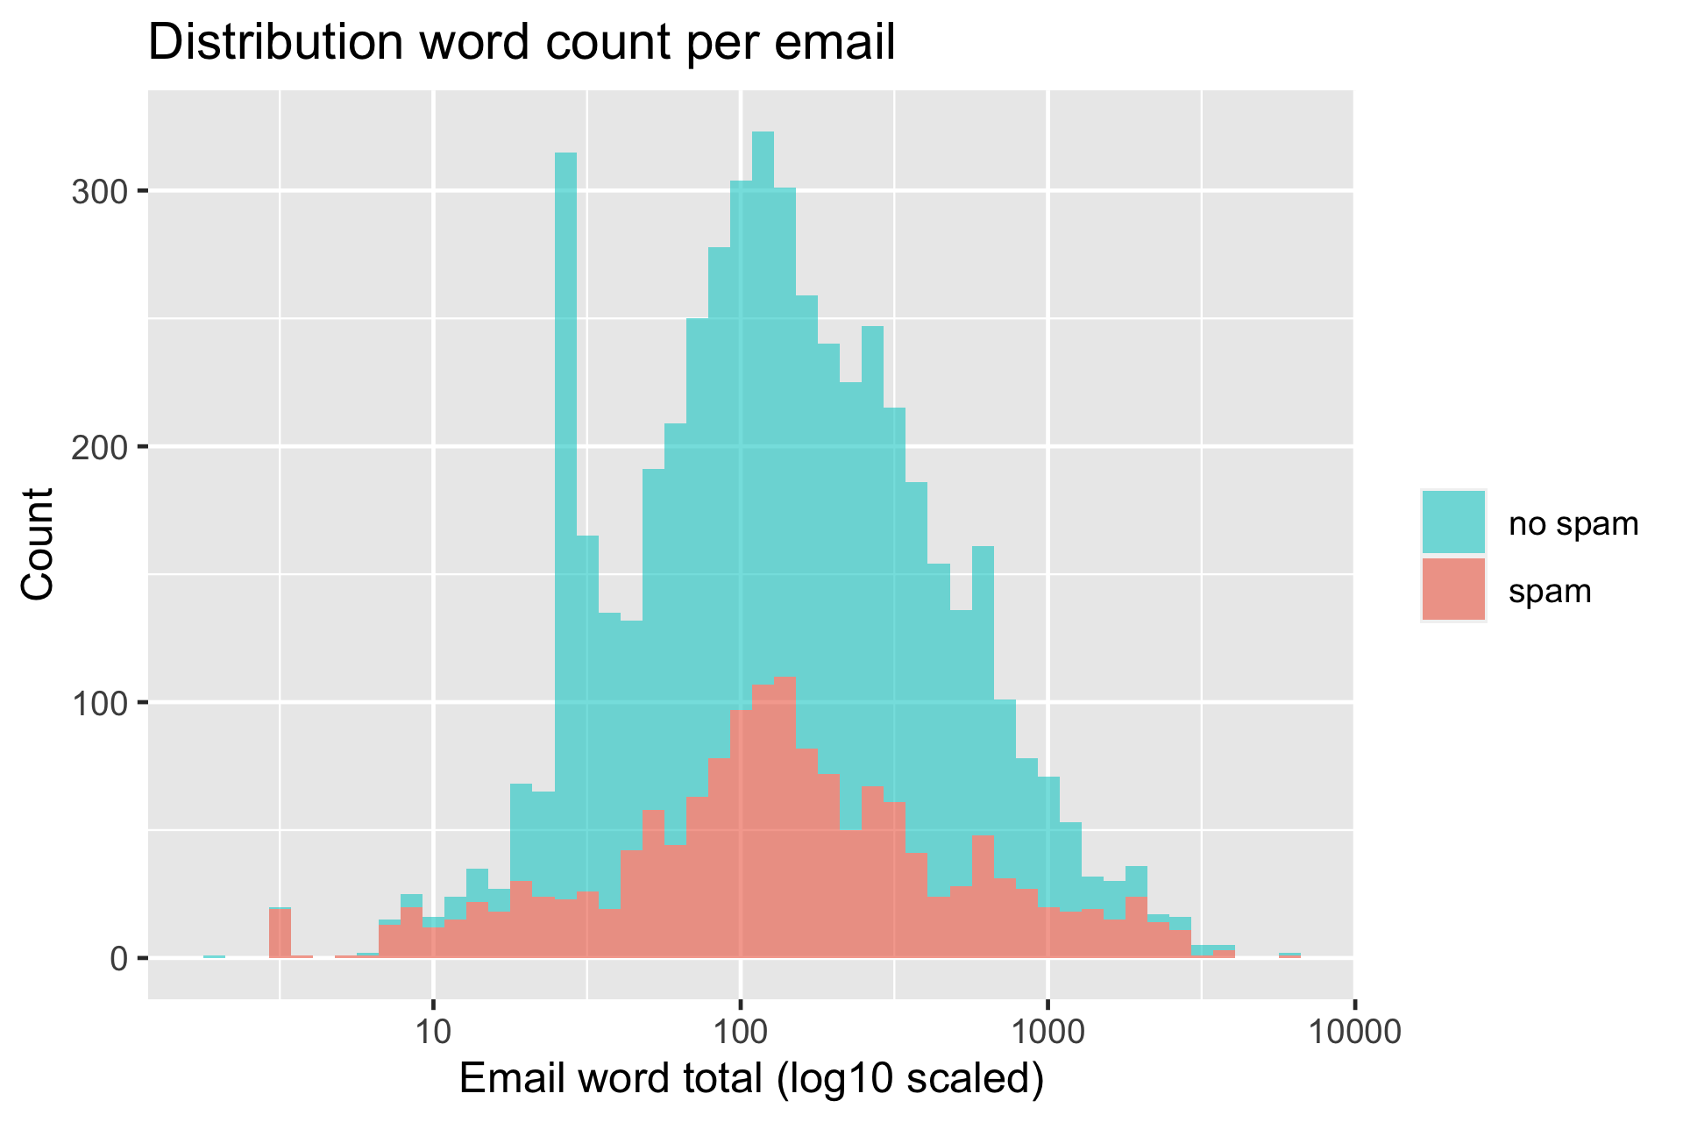
Overview
Data contains 5172 emails with the 3000 most commonly used words from all emails and a label if the email is spam (1) or not spam (0)
Removed stop words from the features (“and”, “most”, “very”, etc.)
Emails (n) = 5172, Words (P) = 2619
Imbalance ratio: n+/n- = 1500 / 3672
With this data set, we sought to determine if we could classify spam based on the composition of the email

Slide 3
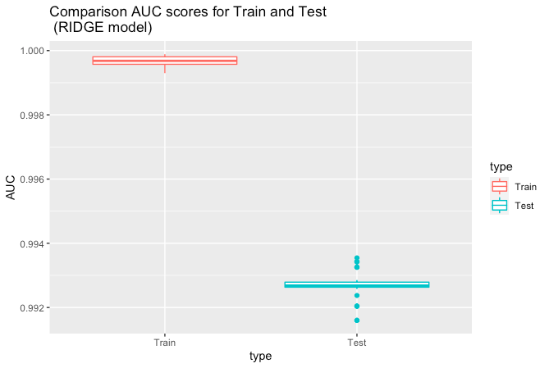
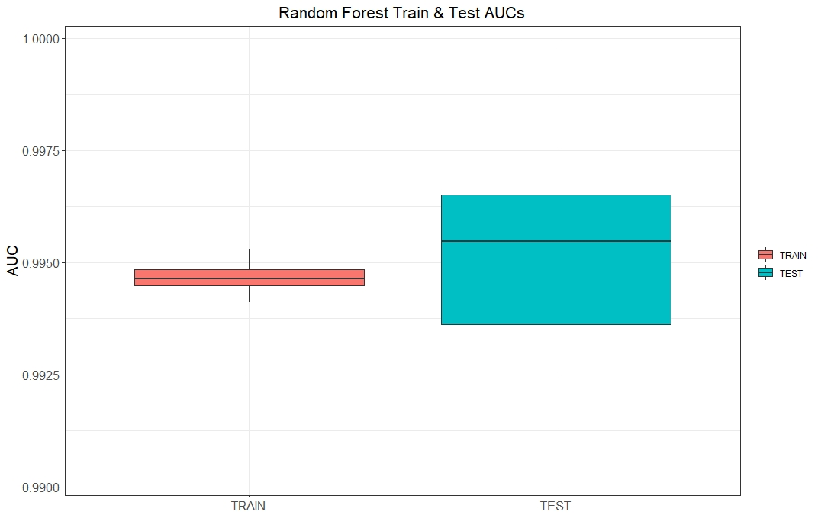
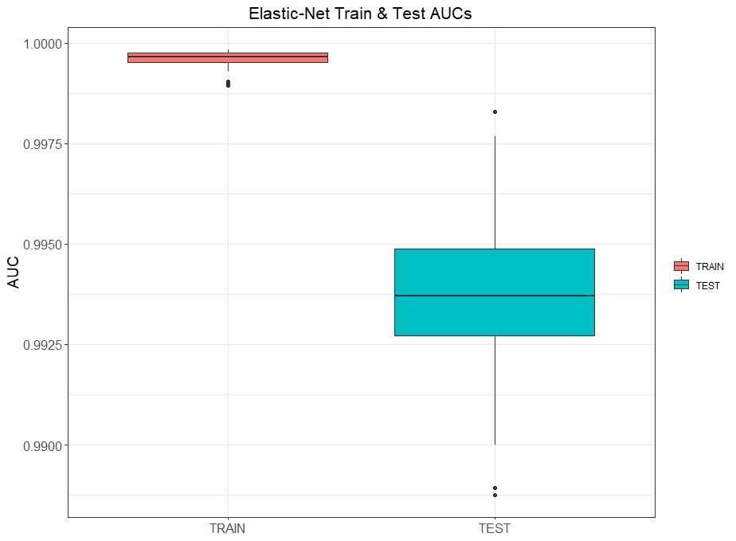
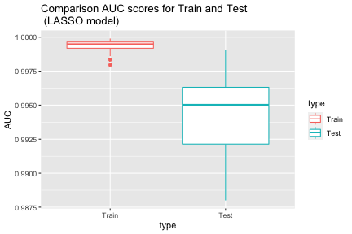
AUC's for D_{train} and D_{validation}

Slide 4
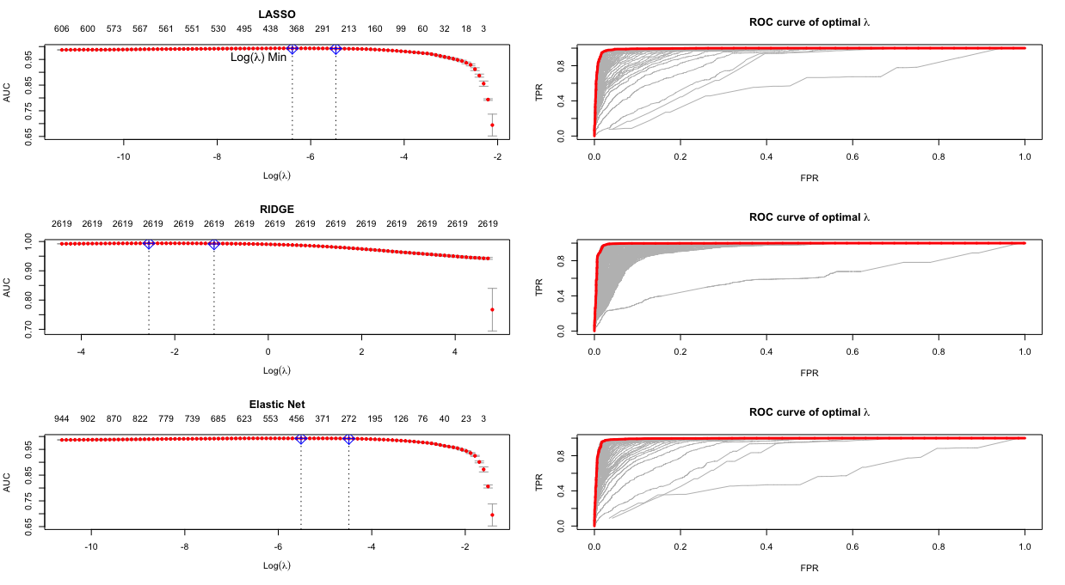

Slide 5
Method | Median test AUC | Time of single cross-validation | Time of full model fitting including cross-validating parameter tuning
Logistic Lasso | 0.99 | 2 min 4 sec | 4 min 45 sec
Logistic Ridge | 0.99 | 6 min 9 sec | 7 min 56 sec
Elastic Net | 0.99 | 2 min 46 sec | 3 min 4 sec
Random Forest | 0.99 | N/A | 16 min 28 sec

Slide 6
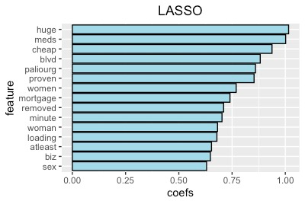
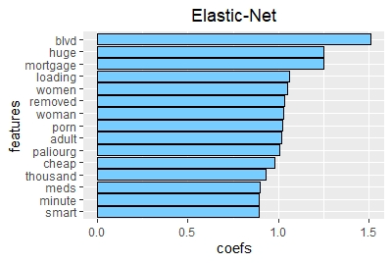
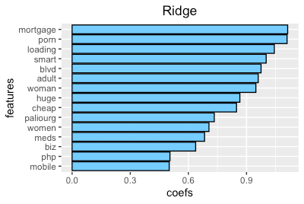
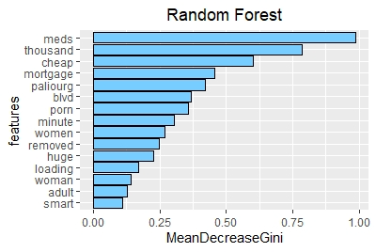
Top 15 Spam Features
Across all models, the most common features for spam emails were words such as "huge", "adult", "meds", typically associated with pornography

Slide 7
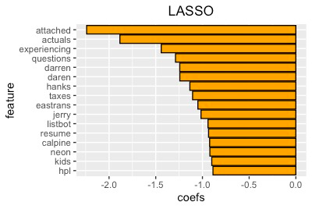
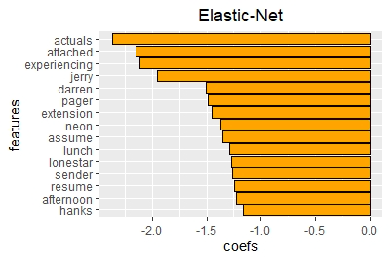
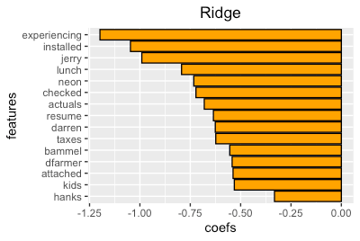
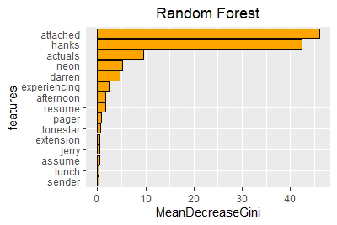
Top 15 Non-Spam Features
The top 15 non-spam features have more professional words such as "resume", "attached", "actuals".

Slide 8
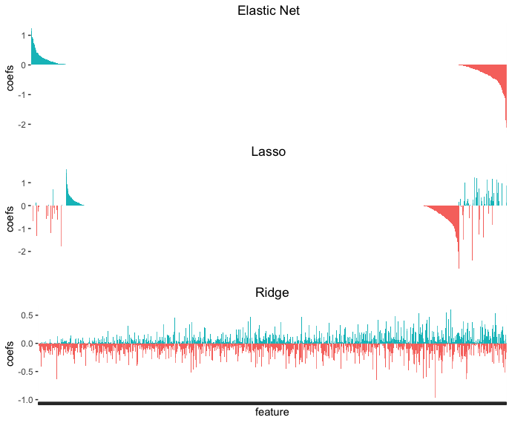
Updated Feature Importance

Slide 9
Conclusion
Performance is similar across all methods, with train AUCs being clustered closer to 1 and test AUCs hovering around 0.99
Longer training time does not always mean more accuracy in results. Sometimes, overfitting may be occurring which would require more analysis.
The top 15 Spam features were consistent across models, with words such as "adult", "mortgage", and "woman" included as spam triggers.

