Slide 1
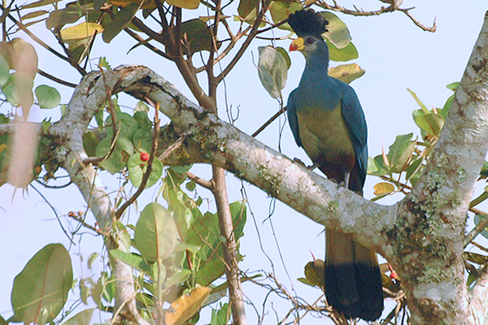
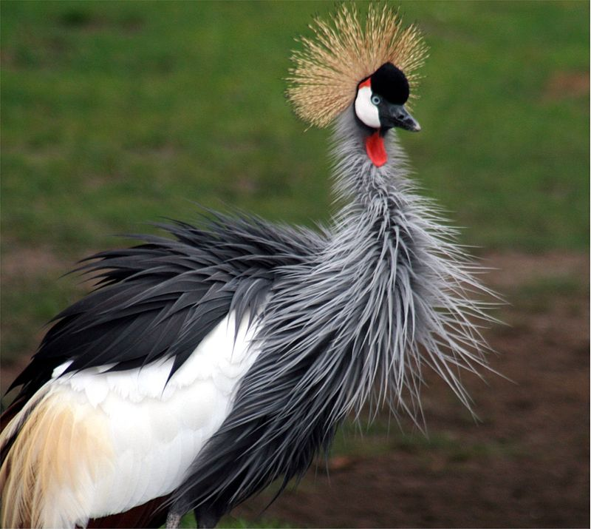
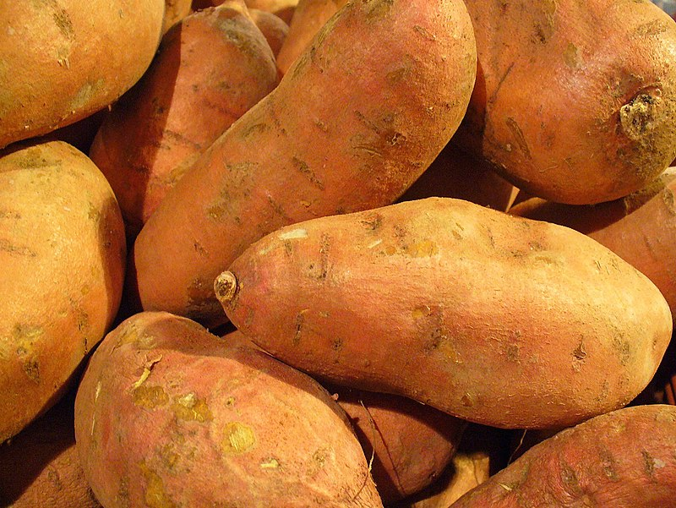
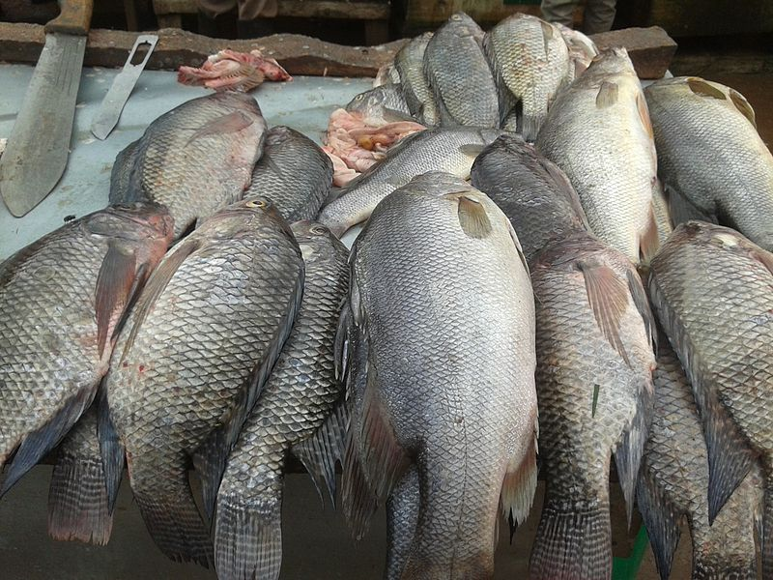
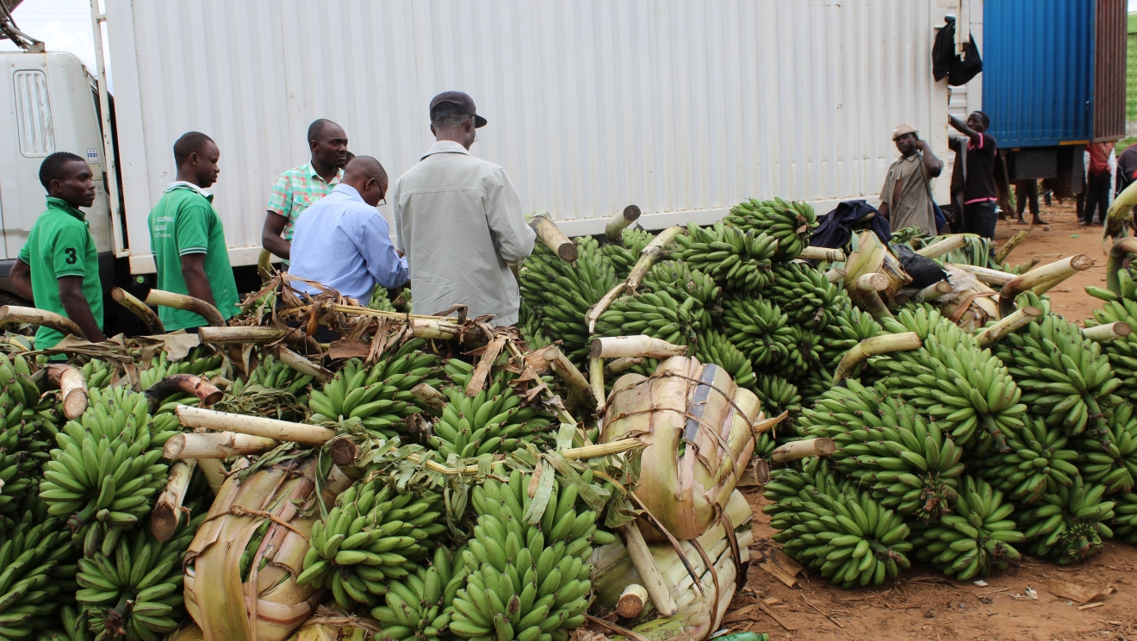
Uganda Is Rich In Term Of Natural Resources And Has A Variety Of Tourist Attractions.
You Will Never Be Disappointed Visiting The Pearl Of Africa
Ugandan sweet potatoes
Uganda Crested crane
The blue turaco
Ugandan Tilapia
Banana farming in Uganda

