Slide 1
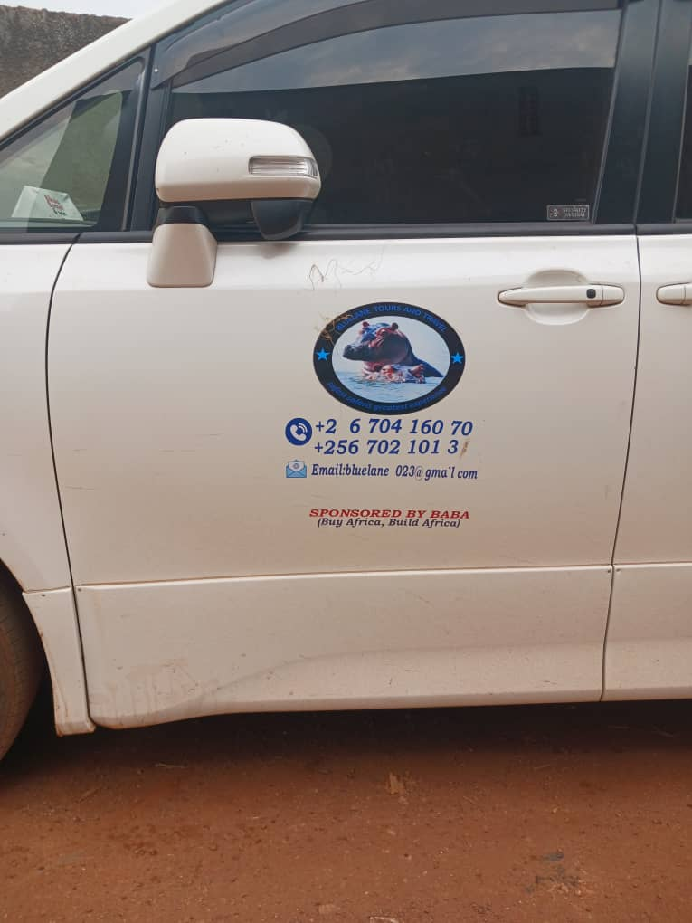
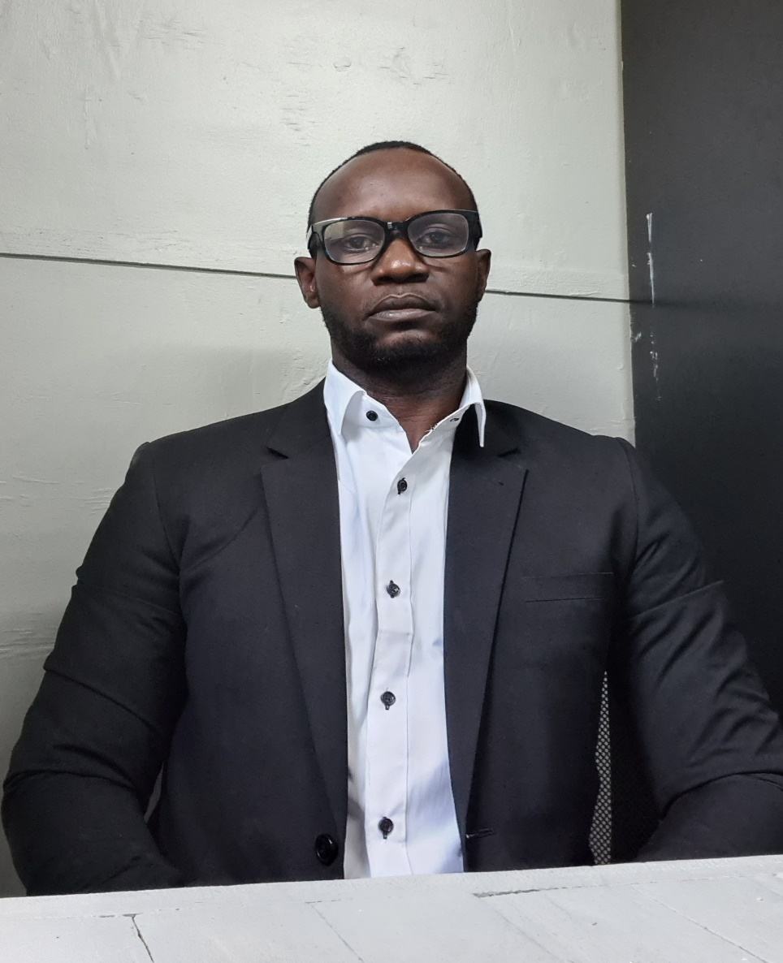

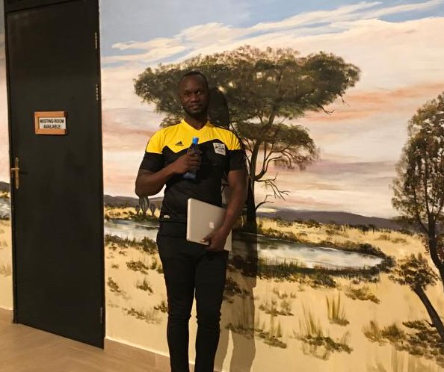
Bluelane Tours And Travel
Write To Us At Bluelane2023@gmail.Com
Whatsapp +256704160705/+256770491917
Www.Bluelane.Org

