Slide 1

Bi-Directional Attention Flow For Machine Comprehension
ICLR 2017
Minjoon Seo, Aniruddha Kembhavi, Ali Farhadi, Hananneh Hajishirzi
University of Washington, Allen Institute Artificial Intelligence

Slide 2
Index
1
Introduction(Abstract+Intro)
2
Model
3
Related work
4
Question Answering Experiment
5
Cloze test Experiment
6
Conclusion

Slide 3
Introduction
Machine comprehension (MC), answering a query about a given context paragraph, requires modeling complex interactions between the context and the query.
Recently, attention mechanisms have been successfully extended to MC

Slide 4
Introduction
So we need to know how Attention was originally used. The existing Attention can be classified into three uses.
Computed attention weights are often used to extract the most relevant information from the context for answering the question by summarizing the context into a fixed-size vector.
In the text domain, they are often temporally dynamic, whereby the attention weights at the current time step are a function of the attended vector at the previous time step.
They are usually uni-directional, wherein the query attends on the context paragraph or the image.

Slide 5
Introduction
Above methods has good performance, but there is a problem of information loss caused by not considering both front and back relationships.

Slide 6
Introduction
So in this paper, we present ways to solve it.
Our attention layer is not used to summarize the context paragraph into a fixed-size vector
- This reduces the information loss caused by early summarization.
We use a memory-less attention mechanism
- The attention at each time step is a function of only the query and the context paragraph at the current time step and does not directly depend on the attention at the previous time step.
3. We use attention mechanisms in both directions, query-to-context and context-to-query, which provide complimentary information to each other.

Slide 7
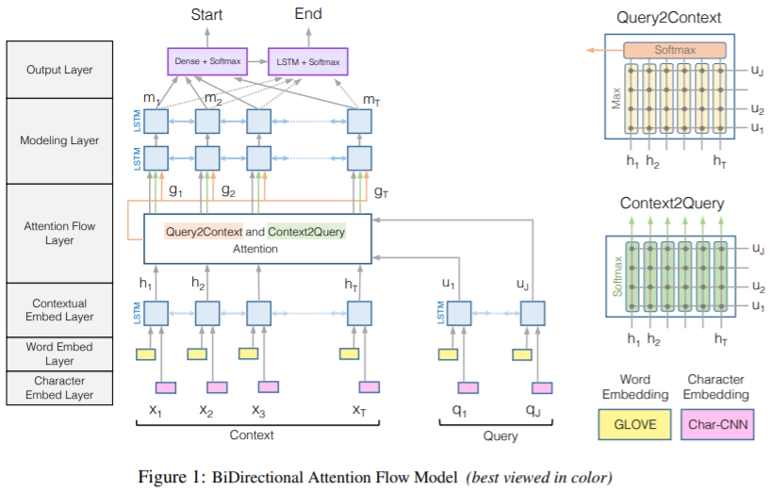
Model
Character Embedding Layer
- CharCnn을 사용하여 각 단어를 vector space에 mapping 한다.
Word Embed Layer
- pre-trained word embedding 모델을 사용하여 각 단어를 vector space에 mapping 한다.
Contextual Embedding Layer
- Target word의 주변 단어들을 통해 embedding을 정제한다. 처음 3개의 Layer에 대해서는 Query와 Context에 모두 적용된다.
Attention Flow Layer
- Context에 대해 Query-aware feature vector를 만들기 위해 query와 context를 쌍으로 묶어 Attention을 학습한다.
Modeling Layer
- RNN을 통해 Context를 탐색한다.
Output Layer
- Query에 대해 답을 생성한다.

Slide 8


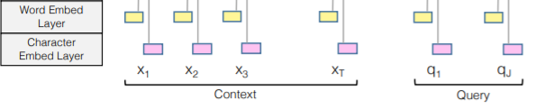

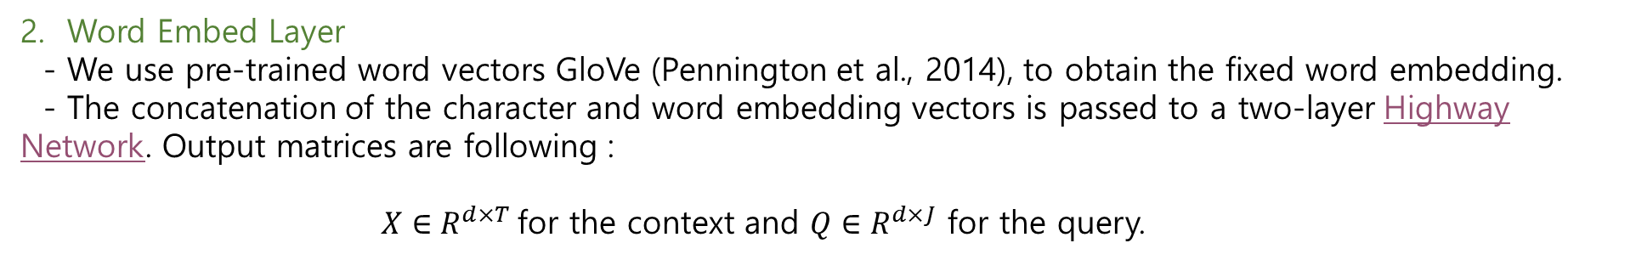
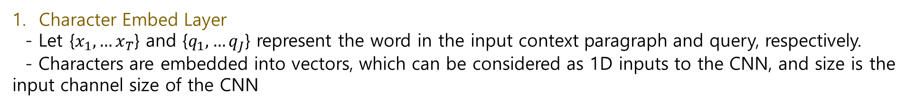
Model
Character Embed Layer
- Let {$x_{1},…x_{T}$} and {$q_{1},…q_{J}$} represent the word in the input context paragraph and query, respectively.
- Characters are embedded into vectors, which can be considered as 1D inputs to the CNN, and size is the input channel size of the CNN
2. Word Embed Layer
- We use pre-trained word vectors GloVe (Pennington et al., 2014), to obtain the fixed word embedding.
- The concatenation of the character and word embedding vectors is passed to a two-layer Highway Network. Output matrices are following :
$X∈R^{d×T}$for the context and $Q∈R^{d×J}$ for the query.

Slide 9
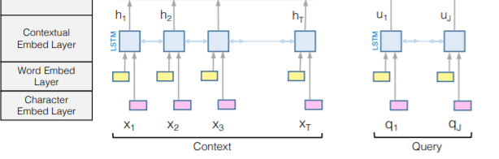
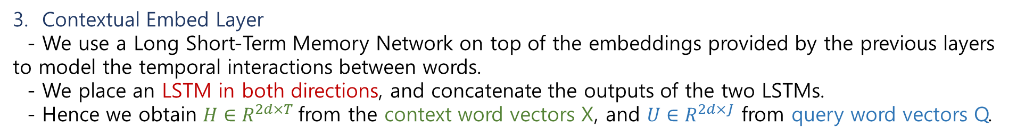
Model
3. Contextual Embed Layer
- We use a Long Short-Term Memory Network on top of the embeddings provided by the previous layers to model the temporal interactions between words.
- We place an LSTM in both directions, and concatenate the outputs of the two LSTMs.
- Hence we obtain $H∈R^{2d×T}$from the context word vectors X, and $U∈R^{2d×J}$ from query word vectors Q.

Slide 10
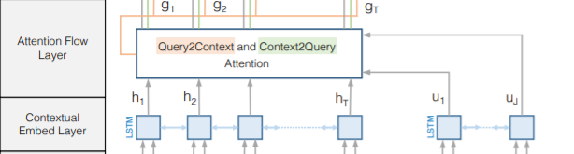
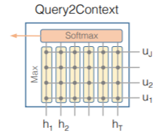
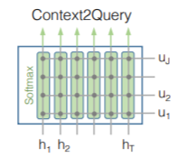
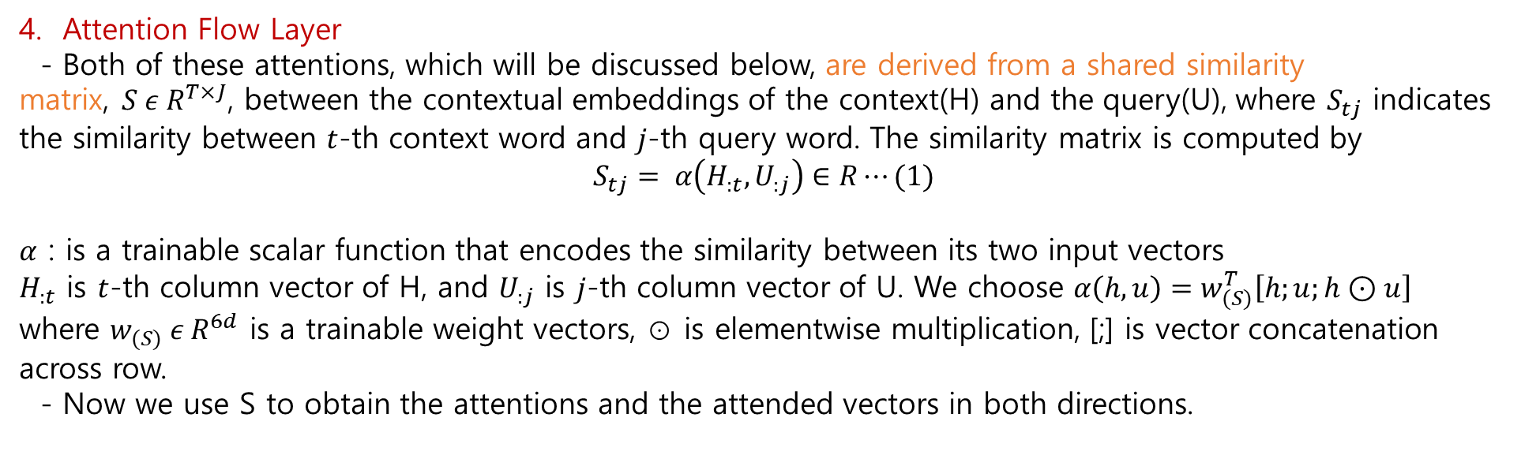
Model
4. Attention Flow Layer
- Both of these attentions, which will be discussed below, are derived from a shared similarity matrix,$S ε R^{T×J}$, between the contextual embeddings of the context(H) and the query(U), where $S_{tj}$ indicates the similarity between $t$-th context word and $j$-th query word. The similarity matrix is computed by
$$S_{tj}= α\left(H_{:t}, U_{:j}\right)∈R⋯(1)$$
$α$ : is a trainable scalar function that encodes the similarity between its two input vectors
$H_{:t}$ is $t$-th column vector of H, and $U_{:j}$ is $j$-th column vector of U. We choose $α\left(h, u\right)=w_{(S)}^{T}\left[h;u;h⊙u\right]$
where $w_{(S)} ε{ R}^{6d}$ is a trainable weight vectors, ⊙ is elementwise multiplication, [;] is vector concatenation across row. - Now we use S to obtain the attentions and the attended vectors in both directions.
4. Attention Flow Layer
- Associate a query with a context.
- Here, it goes in two directions. One is Query2Context, which is a process for learning which information of Context is related to Query, and the other is Context2Query, which is a process for learning which information of Query is related to Context. This is why Bi-Directional Attention Flow (BiDAF) is called.

Slide 11

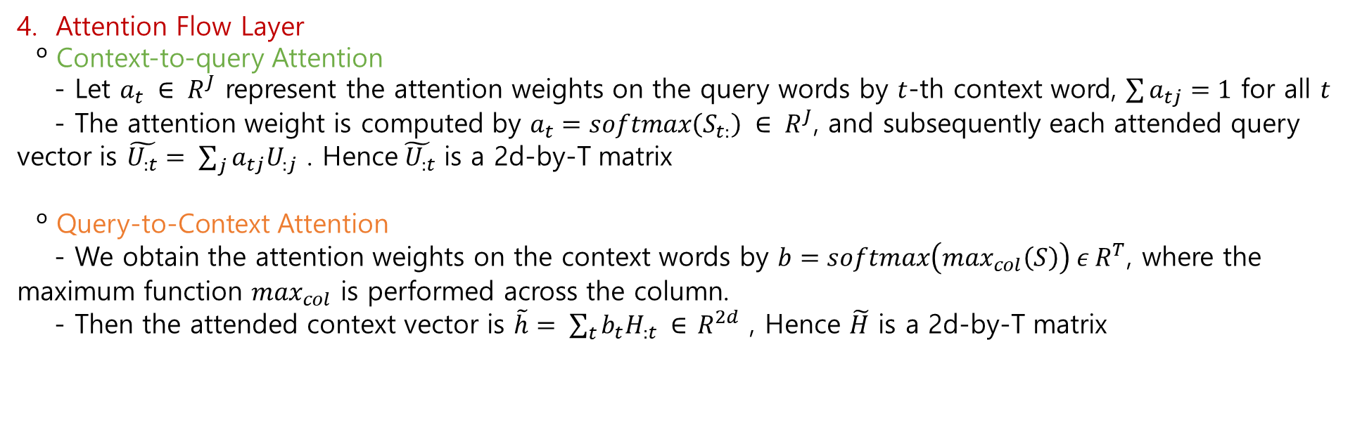
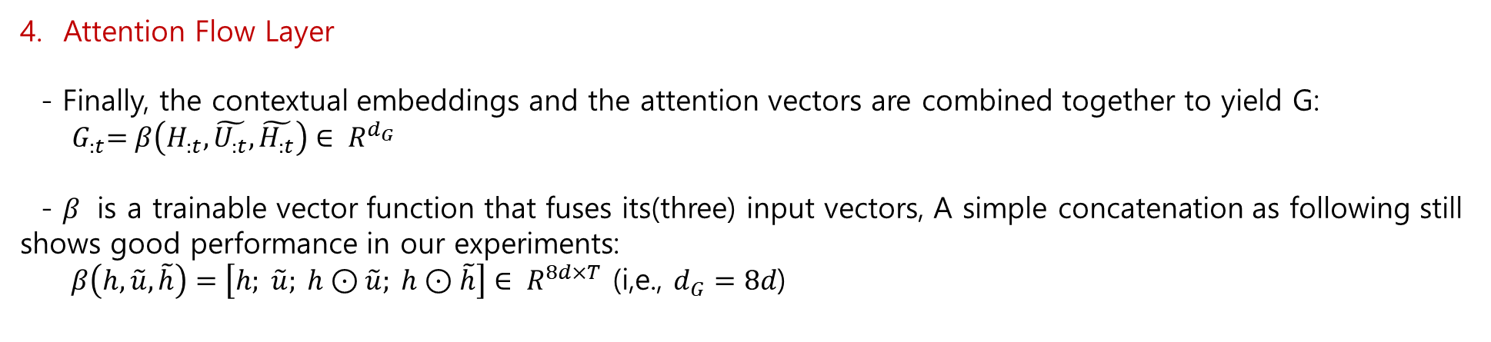

Model
$$\tilde{U}$$
$$\tilde{H}$$
4. Attention Flow Layer
º Context-to-query Attention
- Let $a_{t} ∈ R^{J}$ represent the attention weights on the query words by $t$-th context word, $\sum{a_{tj}=1}$ for all $t$
- The attention weight is computed by $a_{t}=softmax\left(S_{t:}\right) ∈ R^{J}$, and subsequently each attended query vector is $\tilde{U_{:t}}= \sum_{j}{a_{tj}U_{:j}}$ . Hence$\tilde{ U_{:t}}$ is a 2d-by-T matrix
º Query-to-Context Attention
- We obtain the attention weights on the context words by $b=softmax\left(\max_{col}\left(S\right)\right) ε R^{T}$, where the maximum function $\max_{col}$ is performed across the column.
- Then the attended context vector is $\tilde{h}= \sum_{t}{b_{t}H_{:t} ∈} R^{2d}$ , Hence $\tilde{H}$ is a 2d-by-T matrix
Attention Flow Layer
- Finally, the contextual embeddings and the attention vectors are combined together to yield G:
${ G}_{:t}=β\left(H_{:t}, \tilde{U_{:t}}, \tilde{H_{:t}}\right)∈ R^{d_{G}}$
- $β$ is a trainable vector function that fuses its(three) input vectors, A simple concatenation as following still shows good performance in our experiments:
$β\left(h, \tilde{u}, \tilde{h}\right)=\left[h; \tilde{u}; h⊙\tilde{u}; h⊙\tilde{h}\right]∈ R^{8d×T}$ (i,e., $d_{G}=8d$)

Slide 12
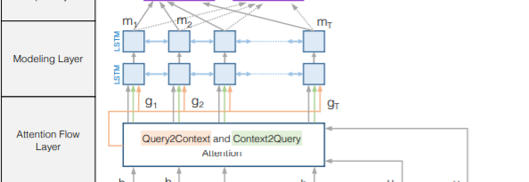
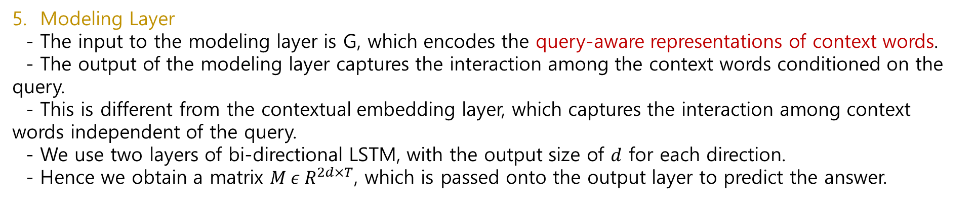
Model
5. Modeling Layer
- The input to the modeling layer is G, which encodes the query-aware representations of context words.
- The output of the modeling layer captures the interaction among the context words conditioned on the query.
- This is different from the contextual embedding layer, which captures the interaction among context words independent of the query.
- We use two layers of bi-directional LSTM, with the output size of $d$ for each direction.
- Hence we obtain a matrix $M ε R^{2d×T}$, which is passed onto the output layer to predict the answer.

Slide 13
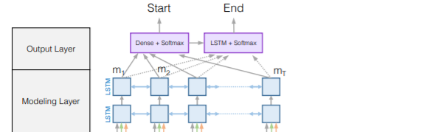
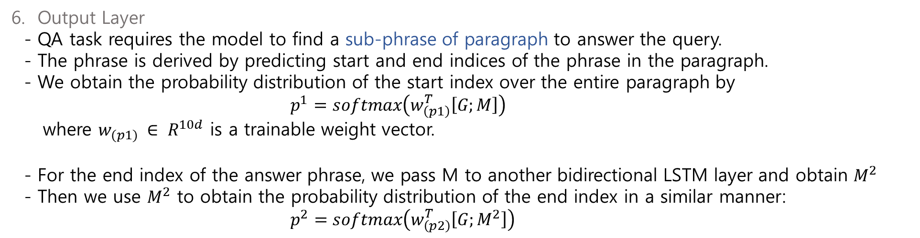
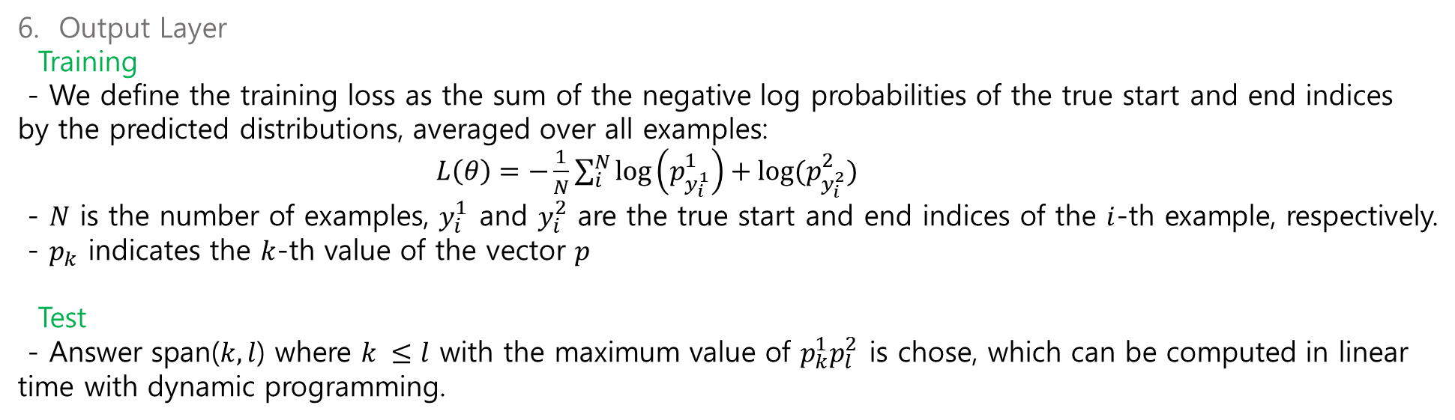
Model
6. Output Layer
Training
- We define the training loss as the sum of the negative log probabilities of the true start and end indices by the predicted distributions, averaged over all examples:
$L\left(θ\right)=−\frac{1}{N}\sum_{i}^{N}{\log\left(p_{y_{i}^{1}}^{1}\right)+log⁡(p_{y_{i}^{2}}^{2})}$
- $N$ is the number of examples, $y_{i}^{1}$ and $y_{i}^{2}$ are the true start and end indices of the $i$-th example, respectively.
- $p_{k}$ indicates the $k$-th value of the vector $p$
Test
- Answer span($k, l$) where $k ≤l$ with the maximum value of $p_{k}^{1}p_{l}^{2}$ is chose, which can be computed in linear time with dynamic programming.
6. Output Layer
- QA task requires the model to find a sub-phrase of paragraph to answer the query.
- The phrase is derived by predicting start and end indices of the phrase in the paragraph.
- We obtain the probability distribution of the start index over the entire paragraph by
$p^{1}=softmax\left(w_{\left(p1\right)}^{T}\left[G;M\right]\right)$
where $w_{(p1)} ∈ R^{10d}$ is a trainable weight vector.
- For the end index of the answer phrase, we pass M to another bidirectional LSTM layer and obtain $M^{2}$
- Then we use $M^{2}$ to obtain the probability distribution of the end index in a similar manner:
$p^{2}=softmax\left(w_{\left(p2\right)}^{T}\left[G;M^{2}\right]\right)$

Slide 14
Related work
Machine comprehension
Visual question answering

Slide 15
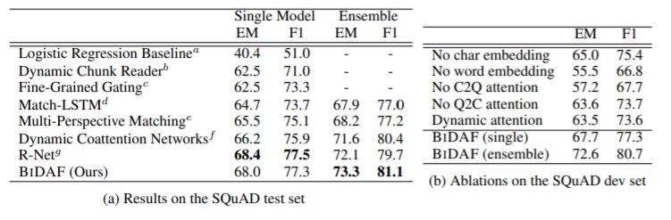
Question Answering Experiments
Data : 90k/10k
Optimizer : AdaDelta
Minibatch : 60
Learning rate : 0.5
Epoch : 12
Dropout : 0.2 for CNN, all LSTM
Training time : 20 hours on a single Titan X GPU

Slide 16
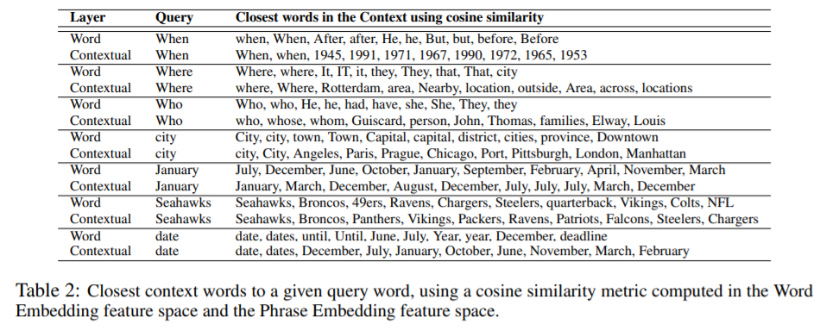
Question Answering Experiments

Slide 17
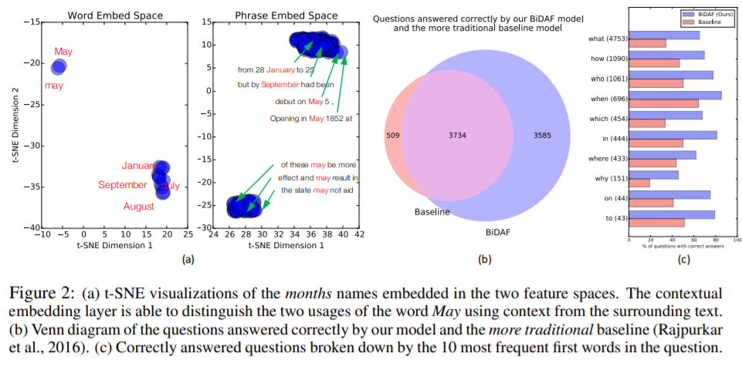
Question Answering Experiments

Slide 18
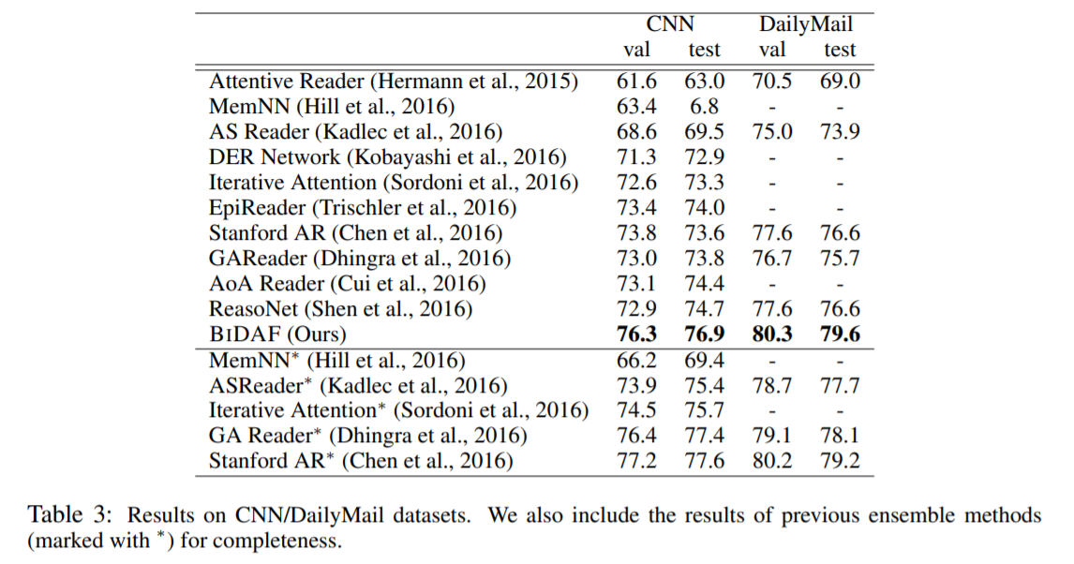
Cloze Test Experiments
Data : 300k/4k/3k (CNN), 879K/65K/53K (DailyMail)
Optimizer : AdaDelta
Minibatch : 48
Learning rate : 0.5
Epoch : 8
Dropout : 0.2 for CNN, all LSTM
Training time : 60 hours on eight Titan X GPU

Slide 19
Conclusion
The experimental evaluations show that our model achieves the state-of-the-art results in Stanford Question Answering Dataset (SQuAD) and CNN/DailyMail cloze test.
The ablation analyses demonstrate the importance of each component in our model.
The visualizations and discussions show that our model is learning a suitable representation for MC and is capable of answering complex questions by attending to correct locations in the given paragraph.

Slide 20
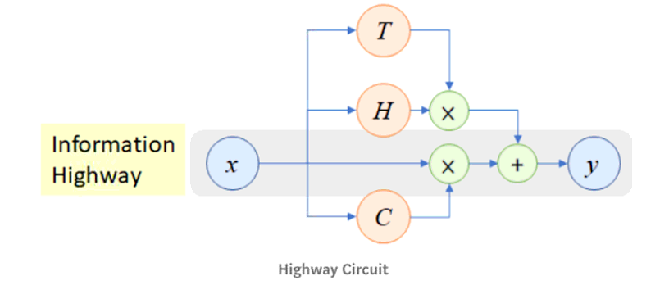
*Highway network
Highway Network는 2015년에 처음 소개된 기법으로, deep neural network를 보다 잘 학습 시키기 위해 제안되었다.
Gating function을 이용해서 인풋 신호를 변환시키거나, 통과시켜 네트워크가 더욱 깊어질 수 있도록 하는 기법이다. (LSTM예 영감을 받음)
식에서 T는 Transform Gate고, C는 Carry Gate이다. T와 C는 서로 “C = 1 – T” 의 관계를 갖는다.
T = 0 이면 인풋 값이 어떠한 변형 없이 바로 아웃풋 값으로 나온다.
T = 1 이면 네트워크에 의해 변형된 값이 아웃풋 값으로 나온다.

