Slide 1
Dependency Sensitive Convolutional Neural Networks for Modeling Sentences and Documents
NAACL2016
RuiZhang Department of EECS University of Michigan Ann Arbor, MI, USA
KHU NLP
KBM

Slide 2
Contents
Abstract
Introduction
Preliminaries
Model Architectures
Experiment
Conclusion

Slide 3
Abstract
DSCNN hierarchically builds textual representations by processing pretrained word embeddings via Long Short Term Memory networks and subsequently extracting features with convolution operators.
Compared with existing recursive neural models with tree structures, DSCNN does not rely on parsers and expensive phrase labeling, and thus is not restricted to sentence level tasks.

Slide 4
Abstract
Moreover, unlike other CNN based models that analyze sentences locally by sliding windows, our system captures both the dependency information within each sentence and relationships across sentences in the same document.

Slide 5
1. Introduction
The challenge for textual modeling is to capture features for different text units and to perform compositions over variable-length sequences (e.g., phrases, sentences, documents).
As a traditional method, the bag-of-words model treats
sentences and documents as unordered collections of words.
In this way, however, the bag-of-words model fails to encode word orders and syntactic structures.

Slide 6
1. Introduction
By contrast, order-sensitive models based on neural networks are becoming increasingly popular thanks to their ability to capture word order information.
Many prevalent order-sensitive neural models can be categorized into two classes: Recursive models and Convolutional Neural Networks (CNN) models.

Slide 7
1. Introduction
Recursive models can be considered as generalizations of traditional sequence-modeling neural networks to tree structures.
For example, (Socher et al., 2013) uses Recursive Neural Networks to build representations of phrases and sentences by combining neighboring constituents based on the parse tree.
CNN based models, as the second category, utilize convolutional ﬁlters to extract local features (Kalchbrenner et al., 2014; Kim, 2014) over embedding matrices consisting of pretrained word vectors

Slide 8
1. Introduction
However, despite their ability to account for word orders, order-sensitive models based on neural networks still suffer from several disadvantages.
First, recursive models depend on well-performing parsers, which can be difﬁcult for many languages or noisy domains (Iyyer et al., 2015; Ma et al., 2015).
Besides, since tree-structured neural networks are vulnerable to the vanishing gradient problem (Iyyer et al., 2015), recursive models require heavy labeling on phrases to add supervisions on internal nodes.

Slide 9
1. Introduction
In CNN models, convolutional operators process word vectors sequentially using small windows. Thus sentences are essentially treated as a bag of n-grams, and the long dependency information spanning sliding windows is lost.
이 관측은 이들에게 문장과 문서 input을 위한 파싱에 의존하지 않고 long-term-dependencies를 capture하는 textual 모델링 아키텍처를 설계하는데 동기를 줬다.

Slide 10
1. Introduction
DSCNN은 LSTM 네트워크위에 구축된 convolutional layer로 구성되어진다.
DSCNN은 입력에 따라 약간 다른 형태를 취하는데 single sentence에서, LSTM네트워크는 문장 안에서 long-distance dependencies를 캡쳐하기 위해 워드 임베딩을 순차적으로 처리한다.
문서 모델링과 관련하여, DSCNN은 먼저 각 하위에 독립적인 LSTM 네트워크를 적용한다. 그 다음 두 번째 LSTM layer은 first LSTM layer와 convolutional layer사이에 추가되어 서로 다른 문장 간에 종속성을 인코딩한다.

Slide 11
Related Work

Slide 12
3. Preliminaries
In this section, we describe two building blocks for our system.
We first discuss Long Short-Term Memory as a powerful network for modeling sequence data, and then formulate convolution and max-overtime pooling operators for the feature extraction over sequence inputs.

Slide 13
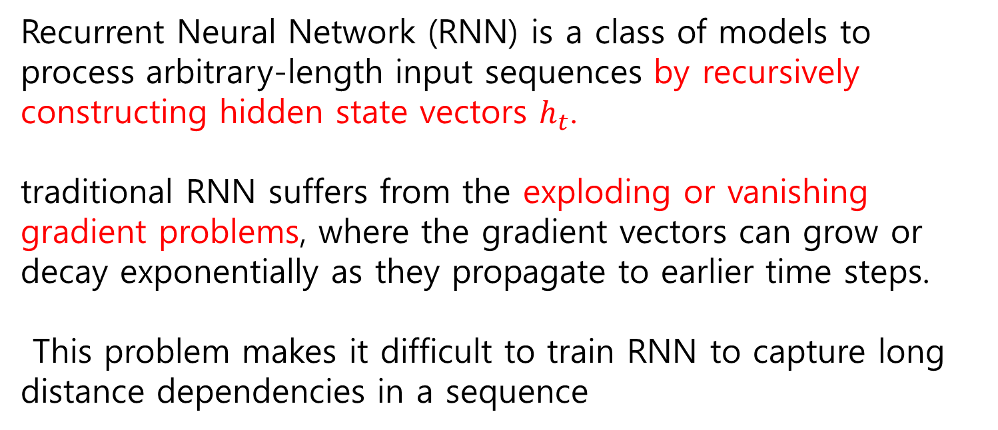
3.1 LSTM
Recurrent Neural Network (RNN) is a class of models to process arbitrary-length input sequences by recursively constructing hidden state vectors $h_{t}$.
traditional RNN suffers from the exploding or vanishing gradient problems, where the gradient vectors can grow or decay exponentially as they propagate to earlier time steps.
This problem makes it difficult to train RNN to capture long distance dependencies in a sequence

Slide 14
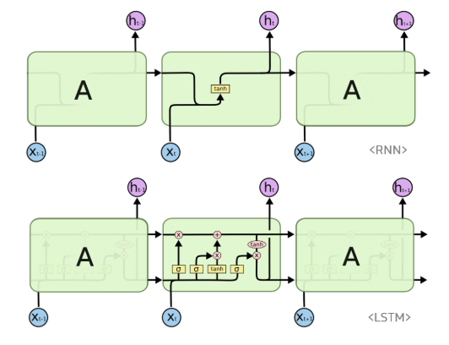
3.1 LSTM
이 문제를 극복하기 위해 고안된 것이 LSTM이다. LSTM은 RNN의 hidden state에 cell-state를 추가한 구조이다.

Slide 15
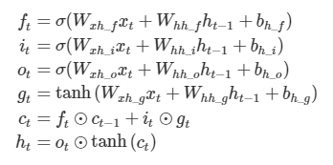
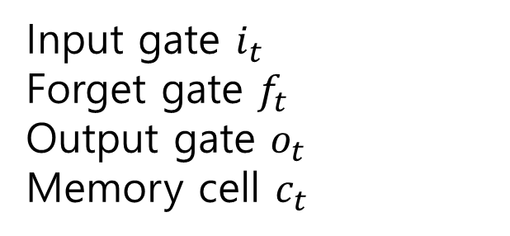
3.1 LSTM
Cell state는 일종의 컨베이어 벨트 역할을 한다. 덕분에 state가 꽤 오래 경과하더라고 그래디언트가 비교적 전파가 잘 된다. LSTM셀의 수식은 아래와 같고 ⊙는 요소별 곱셈을 뜻하는 Hadamard product 연산자이다.
Input gate $i_{t}$
Forget gate $f_{t}$
Output gate $o_{t}$
Memory cell $c_{t}$

Slide 16

3.2 Convolution, Max-over-time Pooling
Given an input sentence of length , convolution operators apply a number of ﬁlters to extract local features of the sentence.
In this work, we employ one-dimensional wide convolution described in(Kalchbrenneretal.,2014).
$$S:\left[w_{1},w_{2},…,w_{S}\right]$$

Slide 17
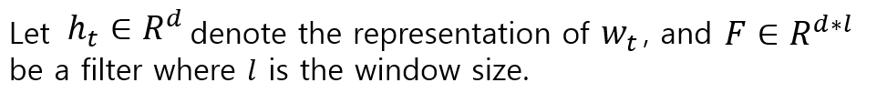

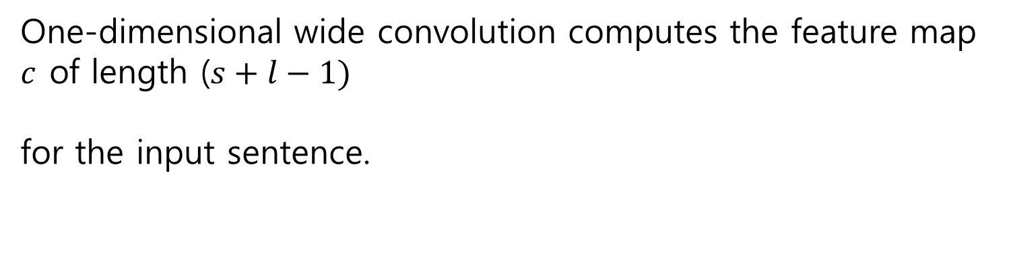
3.2 Convolution, Max-over-time Pooling
One-dimensional wide convolution computes the feature map $c$ of length ($s+l−1)$
for the input sentence.

Slide 18

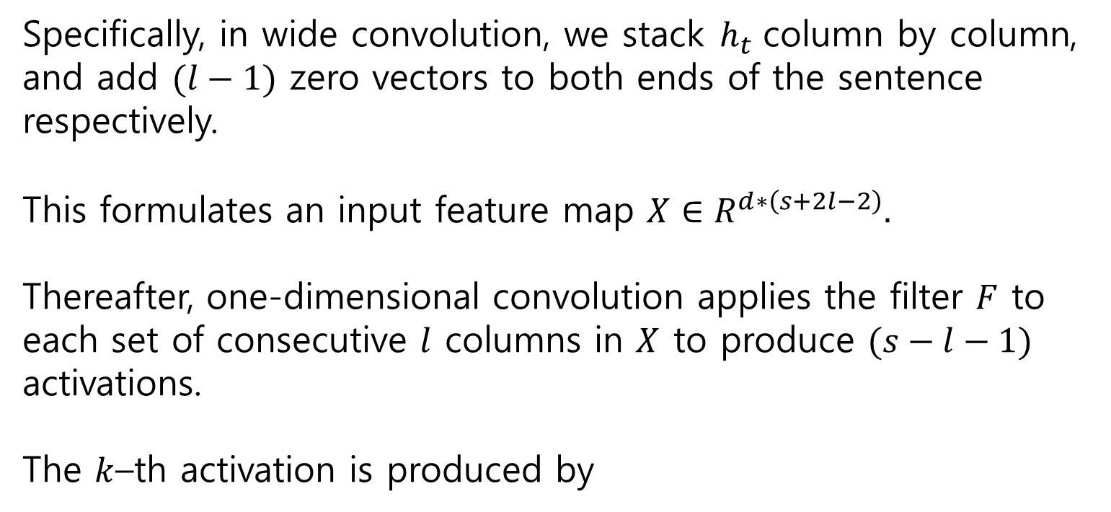
3.2 Convolution, Max-over-time Pooling
Specifically, in wide convolution, we stack $h_{t }$column by column, and add $(l−1)$ zero vectors to both ends of the sentence respectively.
This formulates an input feature map $X∈R^{d∗\left(s+2l−2\right)}.$
Thereafter, one-dimensional convolution applies the filter $F$ to each set of consecutive $l$ columns in $X$ to produce $(s−l−1)$ activations.
The $k$–th activation is produced by

Slide 19
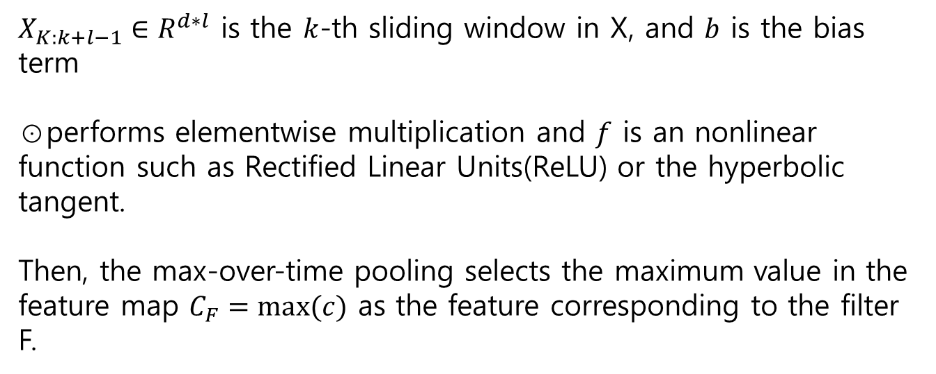
3.2 Convolution, Max-over-time Pooling
$X_{K:k+l−1}∈R^{d∗l}$ is the $k$-th sliding window in X, and $b$ is the bias term
⊙performs elementwise multiplication and $f$ is an nonlinear function such as Rectified Linear Units(ReLU) or the hyperbolic tangent.
Then, the max-over-time pooling selects the maximum value in the feature map $C_{F}=max⁡(c)$ as the feature corresponding to the filter F.

Slide 20
4. Model Architectures
CNN은 sentence modeling 과 classification에 state-of-the-art로 여겨져 왔다.
CNN이 order-sensitive model 임에도 불구하고, traditional convolution operators는 각각의 미리 설정된 사이즈의 필터를 통하여 단어의 possible window로부터 로컬 features를 추출한다.
그러므로, bag of n-grams 와 같이 효과적으로 sentence가 처리된다.

Slide 21
4. Model Architectures
To capture long-distance dependencies, much recent effort has been dedicated to building tree structured models from the syntactic parsing information.
3 problem
추가적 parser을 요구하고 parsing errors에 취약하다.
Tree-structured models은 vanishing gradient problems을 극복하기 위해 heavy supervisions를 요구한다.
Tree-structured models은 sentence level로 제한된다.

Slide 22
4. Model Architectures
Our model hierarchically builds text representations from input words without parsing information.
Only labels at the root level are required at the top softmax layer, so there is no need for labeling subphrases in the text.
The system is not restricted to sentence-level inputs:
the architecture can be restructured based on the sentence tokenization for modeling documents.

Slide 23
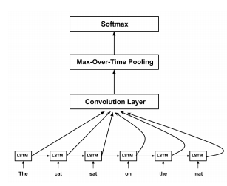
4.1 Sentence Modeling
Figure 1

Slide 24
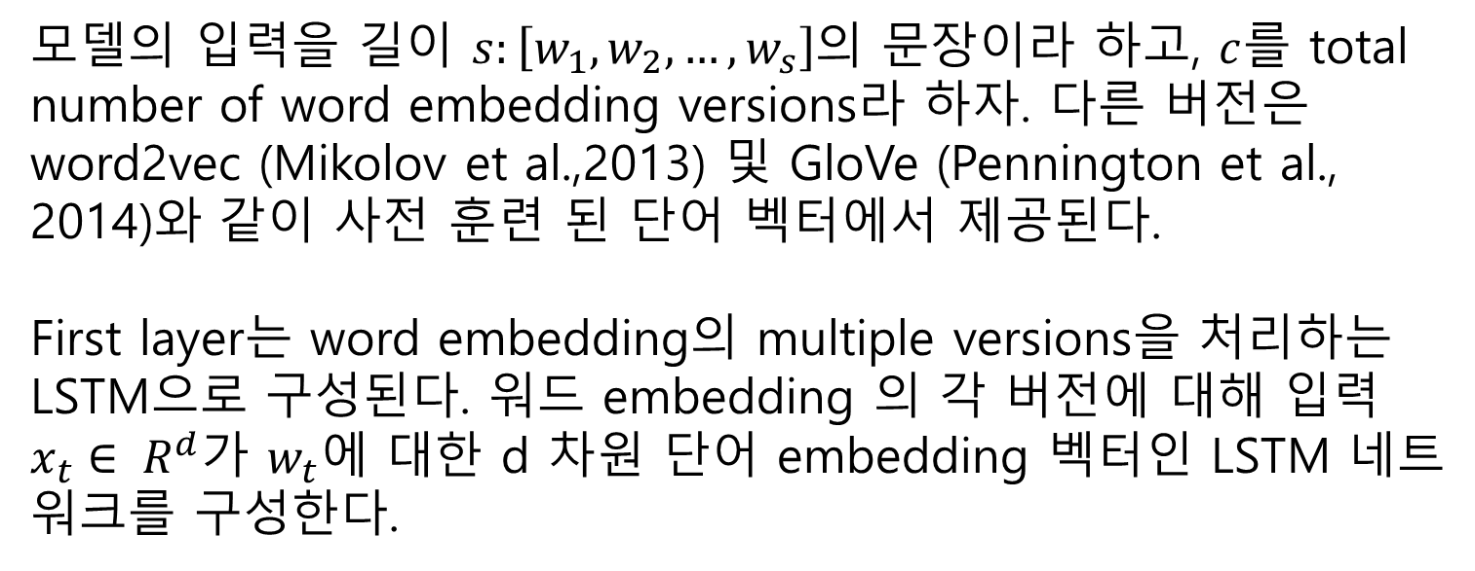
4.1 Sentence Modeling
모델의 입력을 길이 $s:\left[w_{1},w_{2},…,w_{s}\right]$의 문장이라 하고, $c$를 total number of word embedding versions라 하자. 다른 버전은 word2vec (Mikolov et al.,2013) 및 GloVe (Pennington et al., 2014)와 같이 사전 훈련 된 단어 벡터에서 제공된다.
First layer는 word embedding의 multiple versions을 처리하는 LSTM으로 구성된다. 워드 embedding 의 각 버전에 대해 입력 $x_{t}∈ R^{d}$가 $w_{t}$에 대한 d 차원 단어 embedding 벡터인 LSTM 네트워크를 구성한다.

Slide 25
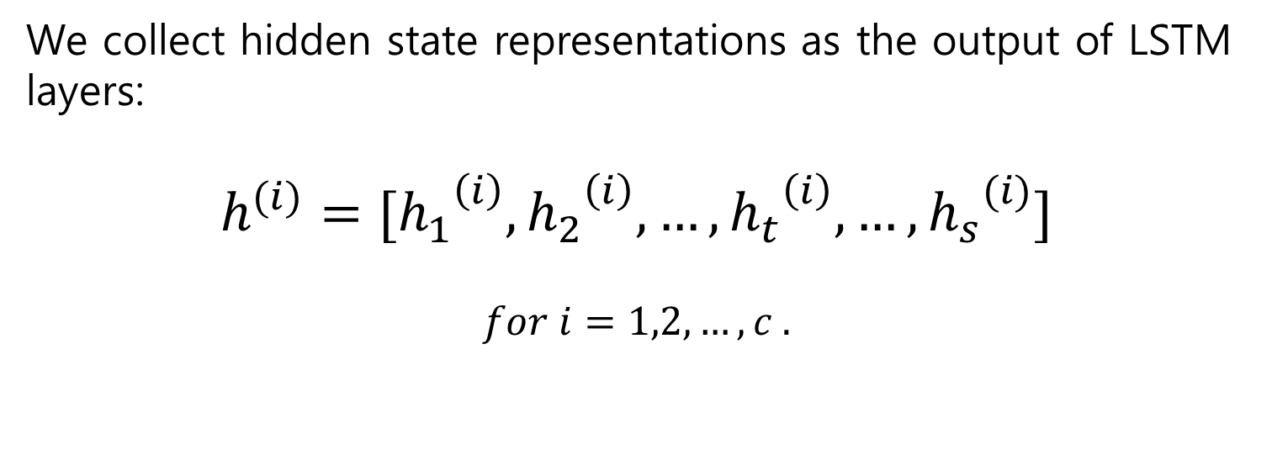
4.1 Sentence Modeling
We collect hidden state representations as the output of LSTM layers:
$$h^{(i)}=[{h_{1}}^{\left(i\right)},{h_{2}}^{\left(i\right)}, …,{h_{t}}^{\left(i\right)}, …,{h_{s}}^{(i)}]$$
$$for i=1,2,…,c .$$

Slide 26
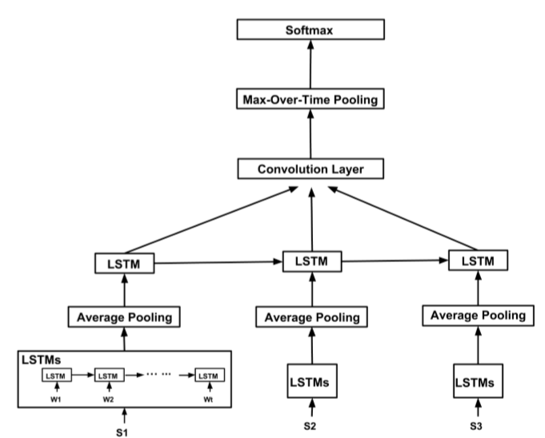
4.2 Document Modeling
Figure 2

Slide 27
4.2 Document Modeling
Now suppose that the input of our model is a document consisting of n subsentences: [s1, s2, ..., sn].
Subsentences can be obtained by splitting the document using punctuation (comma, period, question mark, and exclamation point) as delimiters.
We employ independent LSTM networks for each subsentence in the same way as the first layer of the sentence modeling architecture.
For each subsentence we feed-forward the hidden states of the corresponding LSTM network to the average pooling layer.

Slide 28





4.2 Document Modeling
Take the first sentence of the document as an example,
는 time step j의 첫 문장의 hidden state이고 은 첫 문장의 길이를 나타낸다. Averaging pooling layers 후에, subsentences에 대한 averaged hidden states로 구성된 representation sequence를 갖는다.

Slide 29
4.2 Document Modeling
Similar as sentence modeling, a convolutional layer is placed on top of the high-level LSTM for feature extraction.
Finally, a max-over-time pooling layer and a softmax layer follow to pool features and perform the classification task.

Slide 30
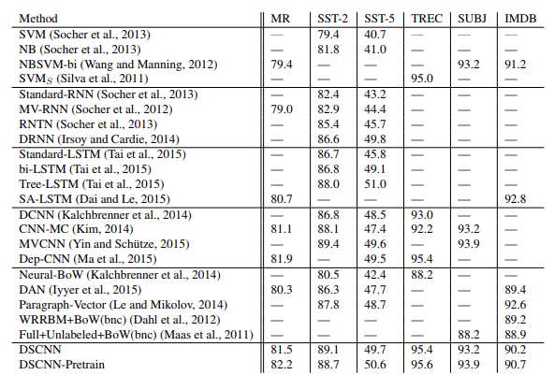
5.1 Experiments

Slide 31
5.2 Training Details and Implementation
We use two sets of 300-dimensional pre-trained embeddings, word2vec and GloVe, forming two channels for our network.
For all datasets, we use 100 convolution ﬁlters each for window sizes of 3, 4, 5. Rectiﬁed Linear Units (ReLU) is chosen as the nonlinear function in the convolutional layer.

Slide 32
5.3 Pretraining of LSTM
We experiment with two variants of parameter initialization of sentence level LSTMs. The ﬁrst variant (DSCNN in Table 1) initializes the weight matrices in LSTMs as random orthogonal matrices.
In the second variant(DSCNN-PretraininTable1), we ﬁrst train sequence auto encoders(DaiandLe,2015) which read input sentences at the encoder and reconstruct the input at the decoder.
The pretrained encoders are used to be the start points of LSTM layers for later supervised classiﬁcation tasks.

Slide 33
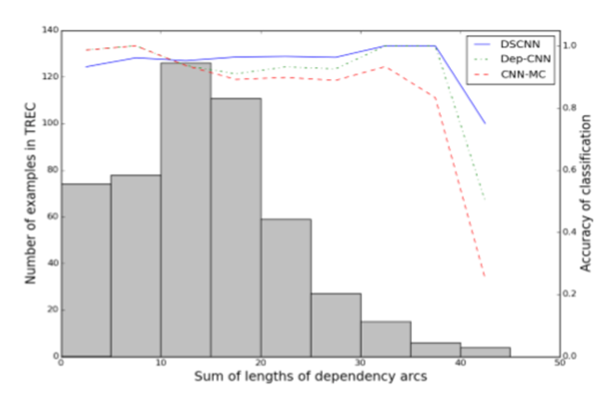
5.4.1 Sentence Modeling
Figure 3은 dependency 길이와 분류 정확도간의 상관관계를 보여준다. Dependency arc length의 합이 15보다 작으면 CNN-MC와 DSCNN은 유사하지만 DSCNN은 길고 복잡한 문장에 대한 의존성 길이가 커지면 명백한 이점을 얻는다. Dep-CNN 또한 CNN-MC보다 더 강력하다. 그러나 Dep-CNN은 긴 언어 구조를 모델링 하기 위해 dependency parser와 미리 정의된 패턴에 의존한다.
Figure 3

Slide 34
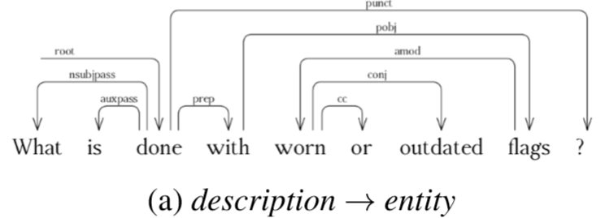
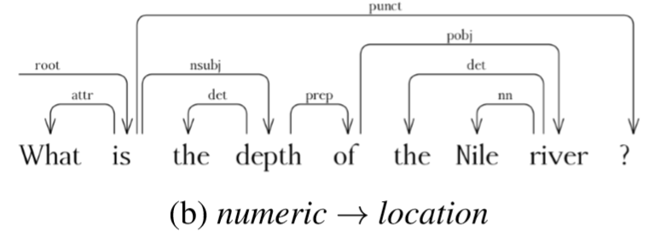
5.4.1 Sentence Modeling

Slide 35
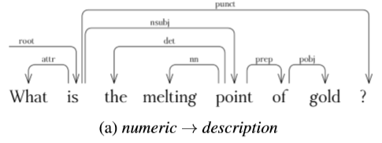
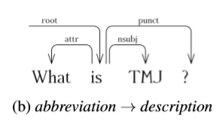
5.4.1 Sentence Modeling

Slide 36
5.4.2 Document Modeling

Slide 37
6. Conclusion
In this work, we present DSCNN, Dependency Sensitive Convolutional Neural Networks for purpose of text modeling at both sentence and document levels.
DSCNN captures long-term inter-sentence and intra-sentence dependencies by processing word vectors through layers of LSTM networks, and extracts features by convolutional operators for classiﬁcation.
Experiments show that DSCNN consistently outperforms traditional CNNs, and achieves state-of-the-art results on several sentiment analysis, question type classiﬁcation and subjectivity classiﬁcation datasets.

