Slide 1

ELECTRA: Pre-training Text Encoders As Discriminators Rather Than Generators
Kevin Clark, Minh-Thang Luong, Quoc V. Le, Christopher D. Manning
ICLR 2020
김봉민

Slide 2
Introduction
김봉민

Slide 3

Part 1
Introduction
Current state-of-the-art representation learning methods for language can be viewed as learning denoising autoencoders (Vincent et al., 2008).
Masked language modeling (MLM) approaches incur a substantial compute cost because the network only learns from 15% of the tokens per example.
1

Slide 4
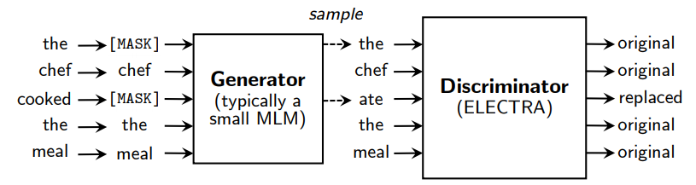
Part 1
Introduction
As an alternative, we propose replaced token detection, a pre-training task in which the model learns to distinguish real input tokens from plausible but synthetically generated replacements.
Instead of masking, our method corrupts the input by replacing some tokens with samples from a proposal distribution, which is typically the output of a small masked language model.
This corruption procedure solves a mismatch in BERT where the network sees artiﬁcial [MASK] tokens during pre-training but not when being ﬁne-tuned on downstream tasks.
2

Slide 5
Part 1
Introduction
We then pre-train the network as a discriminator that predicts for every token whether it is an original or a replacement.
A key advantage of our discriminative task is that the model learns from all input tokens instead of just the small masked-out subset, making it more computationally efﬁcient.
Although our approach is reminiscent of training the discriminator of a GAN, our method is not adversarial in that the generator producing corrupted tokens is trained with maximum likelihood due to the difﬁculty of applying GANs to text (Caccia et al., 2018).
We call our approach ELECTRA for “Efﬁciently Learning an Encoder that Classiﬁes Token Replacements Accurately”
3

Slide 6
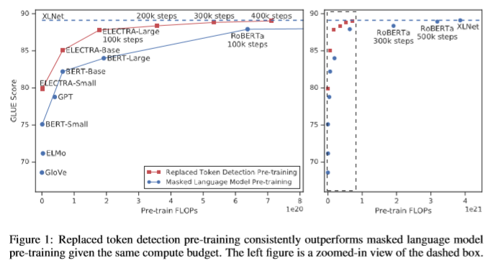
Part 1
Introduction
We build an ELECTRA-Small model that can be trained on 1 GPU in 4 days. ELECTRA-Small outperforms a comparably small BERT model by 5 points on GLUE, and even outperforms the much larger GPT model (Radford et al., 2018).
Our approach also works well at large scale, where we train an ELECTRA-Large model that performs comparably to RoBERTa (Liu et al., 2019) and XLNet (Yang et al., 2019), despite having fewer parameters and using ¼ of the compute for training.
4

Slide 7
Method
김봉민

Slide 8
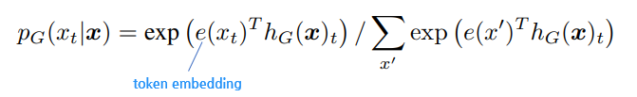

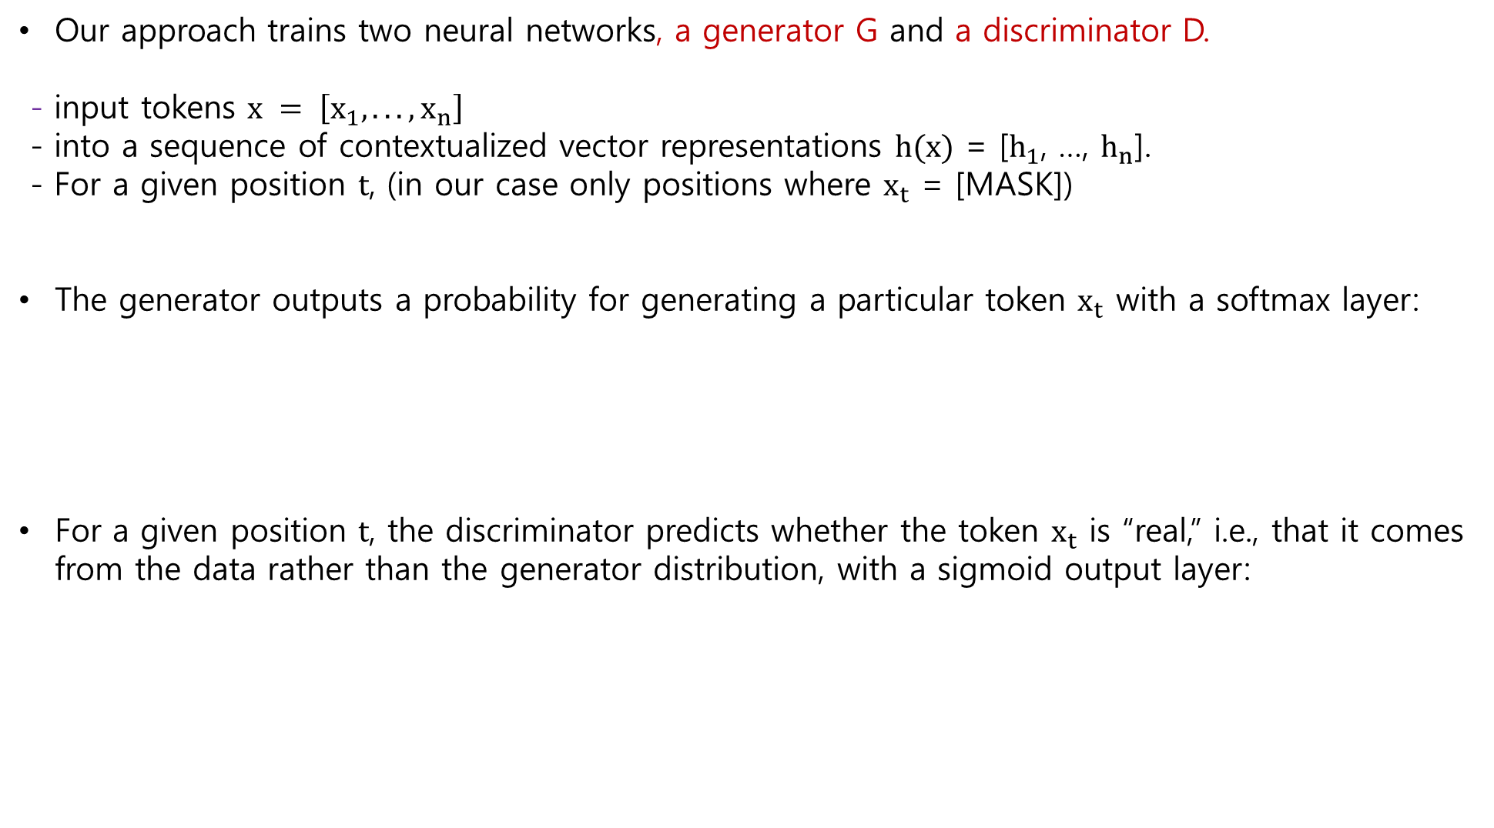
Part 2
Method
Our approach trains two neural networks, a generator G and a discriminator D.
- input tokens $x = \left[x_{1}, ..., x_{n}\right]$
- into a sequence of contextualized vector representations $h(x)$ = [$h_{1}$, …, $h_{n}$].
- For a given position $t$, (in our case only positions where $x_{t}$ = [MASK])
The generator outputs a probability for generating a particular token $x_{t}$ with a softmax layer:
For a given position $t$, the discriminator predicts whether the token $x_{t}$ is “real,” i.e., that it comes from the data rather than the generator distribution, with a sigmoid output layer:
5

Slide 9
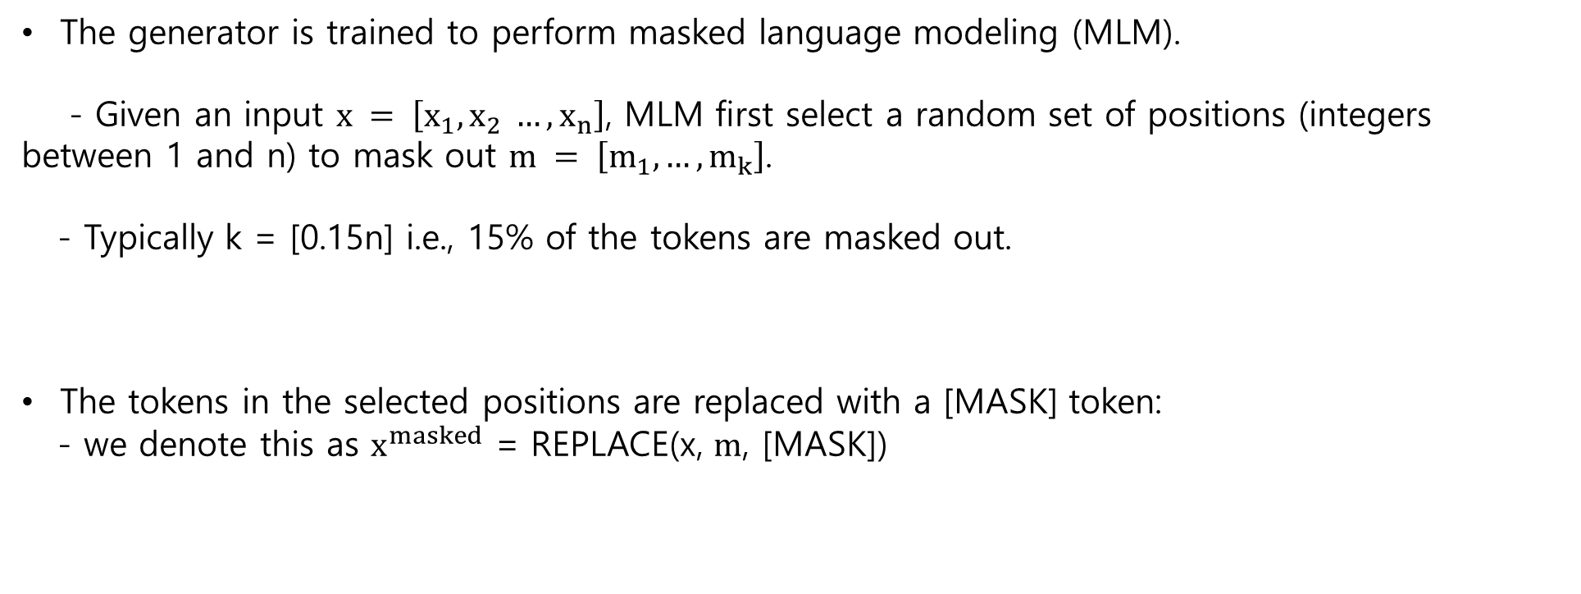
Part 2
Method
The generator is trained to perform masked language modeling (MLM).
- Given an input $x = \left[x_{1}, x_{2} …, x_{n}\right]$, MLM ﬁrst select a random set of positions (integers between 1 and n) to mask out $m = \left[m_{1}, …, m_{k}\right]$.
- Typically k = [0.15n] i.e., 15% of the tokens are masked out.
The tokens in the selected positions are replaced with a [MASK] token:
- we denote this as $x^{masked}$ = REPLACE(x, $m$, [MASK])
6

Slide 10

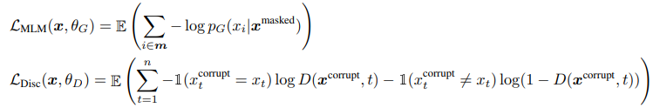
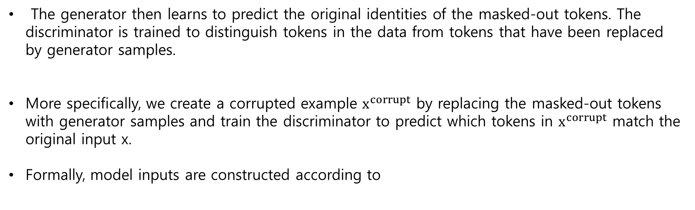
Part 2
Method
The generator then learns to predict the original identities of the masked-out tokens. The discriminator is trained to distinguish tokens in the data from tokens that have been replaced by generator samples.
More speciﬁcally, we create a corrupted example $x^{corrupt}$ by replacing the masked-out tokens with generator samples and train the discriminator to predict which tokens in $x^{corrupt}$ match the original input x.
Formally, model inputs are constructed according to
7

Slide 11

Part 2
Method
After pre-training, we throw out the generator and ﬁne-tune the discriminator on downstream tasks.
8

Slide 12
Experiments
김봉민

Slide 13
Part 3
Experiments – Experimental Setup
We evaluate on the General Language Understanding Evaluation (GLUE) benchmark (Wang et al., 2019) and Stanford Question Answering (SQuAD) dataset (Rajpurkar et al., 2016).
For most experiments we pre-train on the same data as BERT, which consists of 3.3 Billion tokens from Wikipedia and BooksCorpus (Zhu et al., 2015).
However, for our Large model we pre-trained on the data used for XLNet (Yang et al., 2019), which extends the BERT dataset to 33B tokens by including data from ClueWeb (Callan et al., 2009), CommonCrawl, and Gigaword (Parker et al., 2011).
9

Slide 14
Part 3
Experiments – Model Extensions
We improve our method by proposing and evaluating several extensions to the model. Unless stated otherwise, these experiments use the same model size and training data as BERT-Base.
Weight Sharing
- We propose improving the efﬁciency of the pre-training by sharing weights between the
generator and discriminator.
- While the discriminator only updates tokens that are present in the input or are sampled by
the generator, the generator’s softmax over the vocabulary densely updates all token
embeddings.
No weight tying | Tying token embedding | Tying all weights
83.6 | 84.3 | 84.4
10

Slide 15
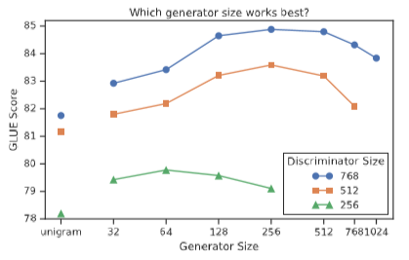
Part 3
Experiments – Model Extensions
2. Smaller Generators
- If the generator and discriminator are the same size, training ELECTRA would take around
twice as much compute per step as training only with masked language modeling.
- We also explore using an extremely simple “unigram” generator that samples fake tokens
according their frequency in the train corpus.
- We ﬁnd that models work best with generators 1/4-1/2
the size of the discriminator.
- We speculate that having too strong of a generator may
pose a too-challenging task for the discriminator, preventing
it from learning as effectively.
11

Slide 16
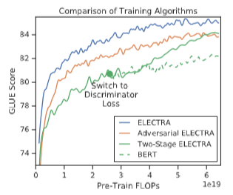
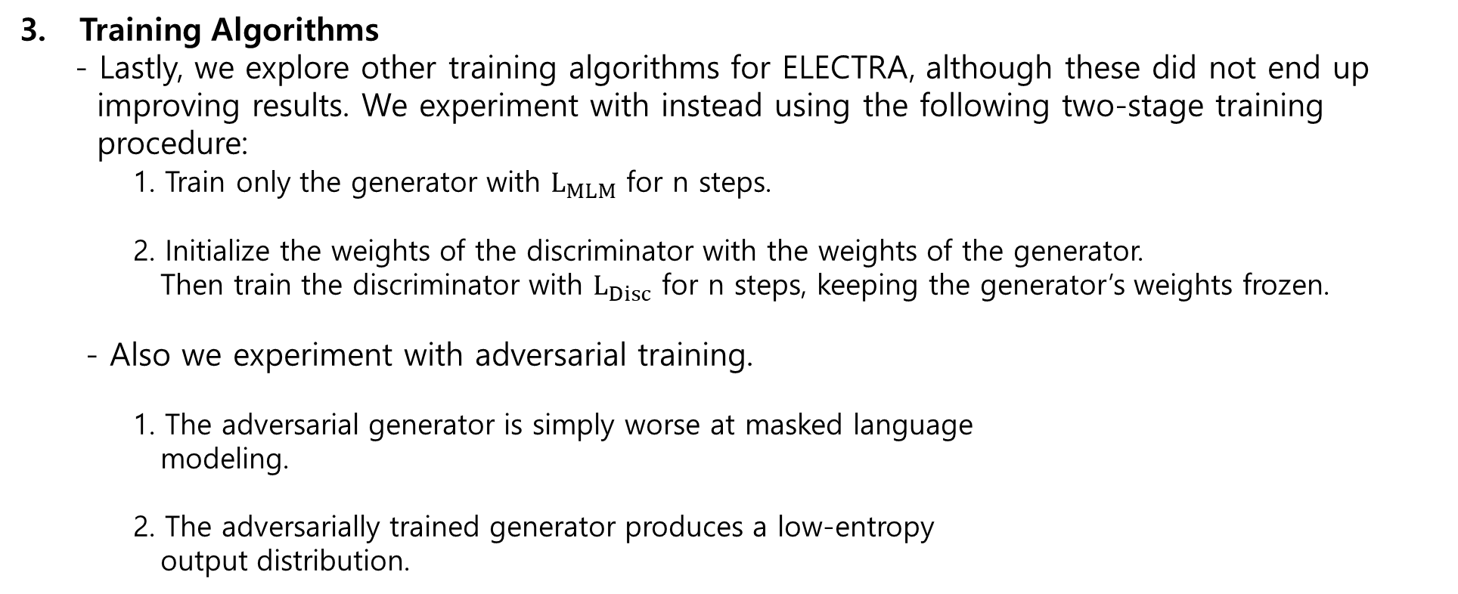
Part 3
Experiments – Model Extensions
3. Training Algorithms
- Lastly, we explore other training algorithms for ELECTRA, although these did not end up
improving results. We experiment with instead using the following two-stage training
procedure:
1. Train only the generator with $L_{MLM}$ for n steps.
2. Initialize the weights of the discriminator with the weights of the generator.
Then train the discriminator with $L_{Disc}$ for n steps, keeping the generator’s weights frozen.
- Also we experiment with adversarial training.
1. The adversarial generator is simply worse at masked language
modeling.
2. The adversarially trained generator produces a low-entropy
output distribution.
12

Slide 17
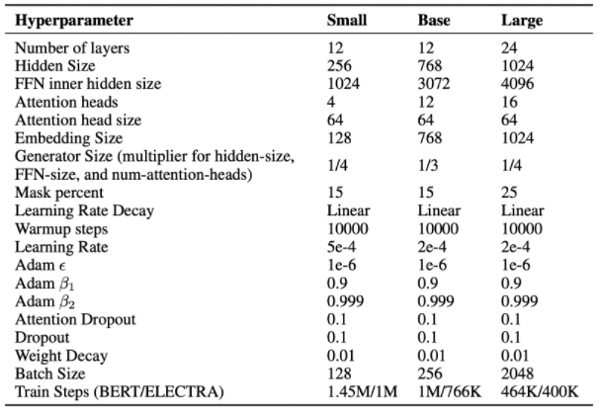
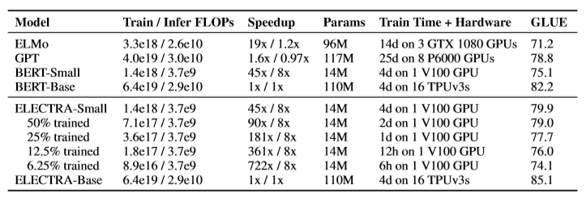
Part 3
Experiments – Small Models
As a goal of this work is to improve the efﬁciency of pre-training, we develop a small model that can be quickly trained on a single GPU.
13

Slide 18
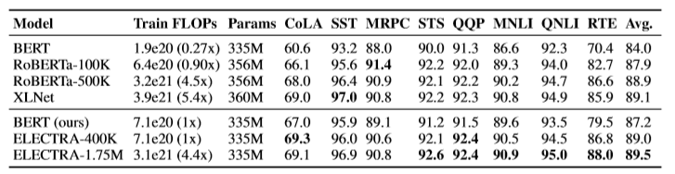
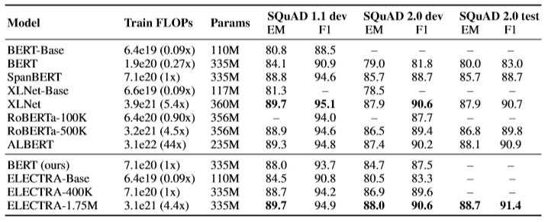
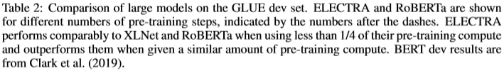
Part 3
Experiments – Large Models
We train big ELECTRA models to measure the effectiveness of the replaced token detection pretraining task at the large scale of current state-of-the-art pre-trained Transformers.
Our ELECTRA Large models are the same size as BERT-Large but are trained for much longer.
14

Slide 19
Part 3
Experiments – Efficiency Analysis
To better understand where the gains from ELECTRA are coming from, we compare a series of other pre-training objectives that are designed to be a set of “stepping stones” between BERT and ELECTRA.
1. ELECTRA 15%
- This model is identical to ELECTRA except the discriminator loss only comes from the 15% of the tokens that were masked out of the input.
2. Replace MLM
- This objective is the same as masked language modeling except instead of replacing masked- out tokens with [MASK], they are replaced with tokens from a generator model.
3. All-Tokens MLM
- Like in Replace MLM, masked tokens are replaced with generator samples. Furthermore, the model predicts the identity of all tokens in the input, not just ones that were masked out.
15

Slide 20

Part 3
Experiments – Efficiency Analysis
1. ELECTRA 15%
- We ﬁnd that ELECTRA is greatly beneﬁting from having a loss deﬁned over all input tokens rather
than just a subset: ELECTRA 15% performs much worse than ELECTRA.
2. Replace MLM
- We ﬁnd that BERT performance is being slightly harmed from the pre-train ﬁne-tune mismatch
from [MASK] tokens, as Replace MLM slightly outperforms BERT.
3. All-Tokens MLM
- We ﬁnd that All-Tokens MLM, the generative model that makes predictions over all tokens instead
of a subset, closes most of the gap between BERT and ELECTRA.
16

Slide 21
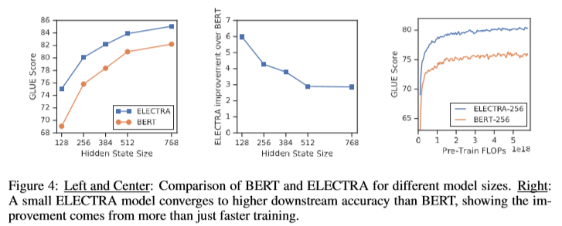
Part 3
Experiments – Efficiency Analysis
17

Slide 22
Part 4
Conclusion
We have proposed replaced token detection, a new self-supervised task for language representation learning.
The key idea is training a text encoder to distinguish input tokens from high-quality negative samples produced by an small generator network.
Compared to masked language modeling, our pre-training objective is more compute-efﬁcient and results in better performance on downstream tasks.
18

