Slide 1

Do NLP Models Know Numbers?
Probing Numeracy in Embeddings
Eric Wallace, Yizhong Wang, Sujian Li, Sameer Singh, Matt Gardener
ICLR 2019
김봉민

Slide 2
Introduction
김봉민

Slide 3

Part 1
Introduction
Neural NLP models have become the de-facto standard tool across language understanding tasks, even solving basic reading comprehension and textual entailment datasets.
Despite this, existing models are incapable of complex forms of reasoning, in particular, we focus on the ability to reason numerically.
Recent datasets such as DROP, EQUATE, or Mathematics Questions test numerical reasoning; they contain examples which require comparing, sorting, and adding numbers in natural language.
We begin by analyzing the state-of-the-art NAQANet(Numerically-Augmented QANet) model for DROP testing it on a subset of questions that evaluate numerical reasoning.
To our surprise, the model exhibits excellent numerical reasoning abilities.
1

Slide 4
Part 1
Introduction
We are especially intrigued by the model’s ability to learn numeracy, i.e., how does the model know the value of a number given its embedding?
To understand how numeracy emerges, we probe token embedding methods (e.g., BERT, GloVe) using synthetic list maximum, number decoding, and addition tasks.
We find that all widely-used pre-trained embeddings, e.g., ELMo, BERT, and GloVe, capture numeracy.
Among all embeddings, character level methods exhibit stronger numeracy than word and sub-word-level methods (e.g., ELMo excels while BERT struggles).
2

Slide 5
Numeracy Case Study : DROP QA
김봉민

Slide 6
Part 2
Numeracy Case Study : DROP QA
This section examines the state-of-the-art model for DROP by investigating its accuracy on questions that require numerical reasoning.
3

Slide 7
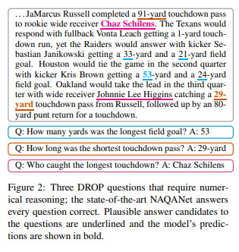
Part 2.1
DROP Dataset
DROP is a reading comprehension dataset that tests numerical reasoning operations such as counting, sorting, and addition.
The only supervision provided is the question-answer pairs, i.e., a model must learn to reason numerically while simultaneously learning to read and comprehend.
4

Slide 8
Part 2.2
NAQANet Model
Modeling approaches for DROP include both semantic parsing and reading comprehension models.
We focus on the latter, specifically on Numerically-augmented QANet, the current state-of-the-art model.
Words and numbers are represented as the concatenation of GloVe embeddings and the output of a character-level CNN.
The model contains no auxiliary components for representing number magnitude or performing explicit comparisons.
5

Slide 9
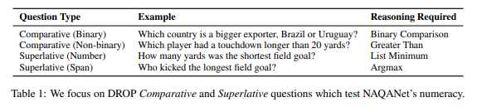
Part 2.3
Comparative and Superlative Questions
We focus on questions that NAQANet requires numeracy to answer, namely Comparative and Superlative questions.
Comparative questions probe a model’s understanding of quantities or events that are “larger”, “smaller”, or “longer” than others.
Superlative questions ask about the “shortest”, “largest”, or “biggest” quantity in a passage.
We filter the validation set to comparative and superlative questions by writing templates to match words in the questions.
6

Slide 10
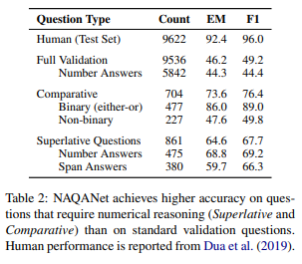
Part 2.4
Emergent Numeracy in NAQANet
NAQANet’s accuracy on comparative and superlative questions is significantly higher than its average accuracy on the validation set.
7

Slide 11
Part 2.5
Stress Testing NAQANet’s Numeracy
Just how far does the numeracy of NAQANet go ??
Here, we stress test the model by automatically modifying DROP validation paragraphs.
We test two phenomena : 1. larger numbers
- We generate a random positive integer and multiply or add that value to the numbers.
2. word-form numbers
- We replace every digit in the paragraph with its word form (e.g., “75” -> "seventy five“)
Since word-form numbers are usually small in magnitude when they occur in DROP, we perform word replacements for integers in the range [0, 100].
We guarantee the ground-truth answer is still valid by only modifying NAQANet’s internal representation.
8

Slide 12
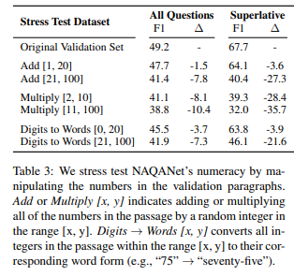
Part 2.5
Stress Testing NAQANet’s Numeracy
Table 3 shows the results for different paragraph modifications.
These results show that NAQANet has a strong understanding of numeracy for numbers in the training range, but, the model can fail to extrapolate to other values.
9

Slide 13
Part 2.6
Whence this behavior?
NAQANet exhibits numerical reasoning capabilities that exceed our expectations. What enables this behavior?
Aside from reading and comprehending the passage/question, this kind of numerical reasoning requires two components :
numeracy (i.e., representing numbers) and comparison algorithms (i.e., computing the maximum of a list)
NAQANet demonstrates that a model can learn comparison algorithms while simultaneously learning to read and comprehend, even with only question-answer supervision.
10

Slide 14
Probing Numeracy of Embeddings
김봉민

Slide 15
Part 3
Probing Numeracy of Embeddings
We use synthetic numerical tasks to probe the numeracy of token embeddings.
11

Slide 16
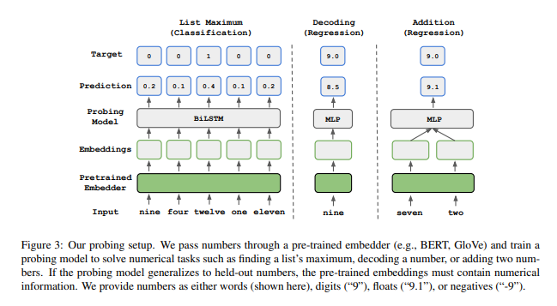
Part 3.1
Probing Tasks
We consider three synthetic tasks to evaluate numeracy.
List Maximum :
∨ Given a list of the embeddings for five numbers, task is to
predict the index of the maximum number.
Decoding :
∨ The decoding task probes whether number magnitude is
captured.
Addition :
∨ The addition task requires number manipulation given the
embeddings of two numbers, the task is to predict their sum.
12

Slide 17
Part 3.1
Probing Tasks
Training and Evaluation :
∨ The model is tested on values that are within the training range.
∨ We first pick a range and randomly shuffle the integers over it.
∨ We then split 80% of the numbers into a training set and 20% into a test set.
∨ Numbers are provided as integers (“75”), single-word form (“seventy-five”), floats (“75.1”), or negatives (“-75”).
13

Slide 18
Part 3.2
Embedding Methods
We evaluate various token embedding methods.
Word Vectors : We use 300D GloVe and word2vec vectors.
Contextualized Embeddings : We use ELMo and BERT embeddings. ELMo uses character-level convolutions of size 1-7 with max pooling. BERT represents tokens via sub-word pieces; we use lower-cased BERT-base with 30k pieces.
NAQANet Embeddings : We extract the GloVe embeddings and Char-CNN from the NAQANet model trained on DROP.
Learned Embeddings : We use a Char-CNN and a Char-LSTM.
Untrained Embeddings : Random token vectors, Untrained Char-CNN and Char-LSTM. These embeddings are useful for measuring the improvement of pre-trained embeddings.
Numbers Value as Embedding : Map a numbers embedding directly to its value (e.g., “seventy-five” embeds to [75]).
14

Slide 19
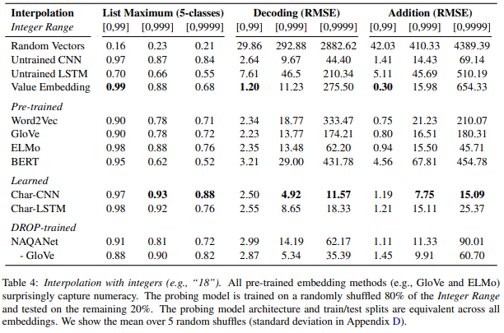
Part 3.3
Result : Embeddings Capture Numeracy
We find that all pre-trained embeddings contain fine-grained information about number magnitude and order.
Word Vectors Succeed :
∨ Both word2vec and GloVe significantly outperform the
random vector baseline and are among the strongest
methods overall.
∨ This is particularly surprising given the training
methodology for these embeddings, e.g., a
continuous bag of words objective can teach fine-
grained number magnitude.
Sub-word Models Struggle :
∨ BERT struggles for large ranges (e.g., 52% accuracy
for list maximum for [0, 9999]).
∨ We suspect this results from sub-word pieces being a
poor method to encode digits.
Character-level Methods Dominate :
∨ Char-CNNs are the best architecture for capturing
numeracy.
∨ The NAQANet model without GloVe (only using its
Char-CNN) and ELMo (uses a Char-CNN) are the
strongest pre-trained methods, and a learned Char-
CNN is the strongest method overall.
∨ The strength of the char level convolutions seems to
lie in the architectural prior ㅡ an untrained Char-CNN
is surprisingly competitive.
Similar results have been shown for images : random
CNNs are powerful feature extractors.
15

Slide 20
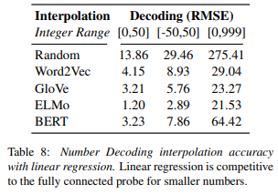
Part 3.3
Result : Embeddings Capture Numeracy
A Linear Subspace Exists :
∨ For small ranges on the decoding task (e.g., [0, 99]),
a linear model is competitive, i.e., a linear subspace
captures number magnitude.
∨ For larger ranges (e.g., [0, 999]), the linear model’s
performance degrades, especially for BERT.
Value Embedding Fails :
∨ The Value Embedding method fails for large ranges.
This is surprising as the embedding directly provides
a number’s value, thus, the synthetic tasks should be
easy to solve.
∨ However, we had difficulty training models for large
ranges, even when using numerous architecture
variants and hyperparameters.
16

Slide 21
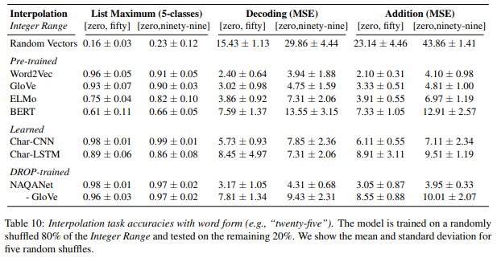
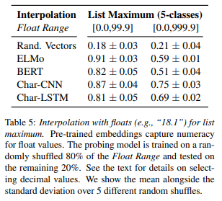
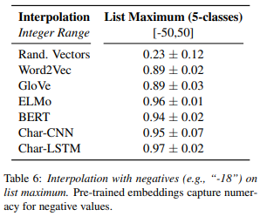
Part 3.3
Result : Embeddings Capture Numeracy
Words, Floats, and Negatives are Captured :
∨ We probe the embeddings on word-form
numbers, floats, and negatives.
∨ The ordering of the different embedding
methods according to performance is
also relatively consistent across the
different input types.
∨ One notable exception is that BERT
struggles on floats, which is likely a result
of its sub-word pieces.
17

Slide 22
Part 3.4
Probing Models Struggle to Extrapolate
We found that NAQANet struggles to extrapolate to values outside the training range.
Is this an idiosyncrasy of NAQANet or is it a more general problem ??
We train models on a specific integer range and test them on values greater than the largest training number and smaller than the smallest training number.
18

Slide 23
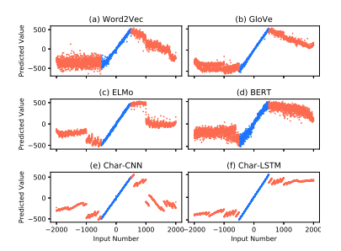
Part 3.4
Probing Models Struggle to Extrapolate
Extrapolation for Decoding and Addition
∨ Figure 1 shows the predictions for models trained on 80% of the values from [-500, 500] and tested on
held-out numbers in the range [-2000, 2000] for six embedding types.
19

Slide 24
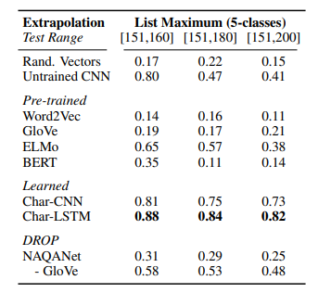
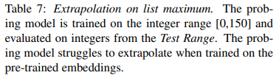
Part 3.4
Probing Models Struggle to Extrapolate
Extrapolation for List Maximum
∨ For the list maximum task, accuracies are closer to those in the interpolation setting, however, they still
fall short.
∨ Table 7 shows the accuracy for models trained on the integer range [0, 150] and tested on the ranges
[151, 160], [151, 180], and [151, 200]; all methods struggle, especially token vectors.
20

Slide 25
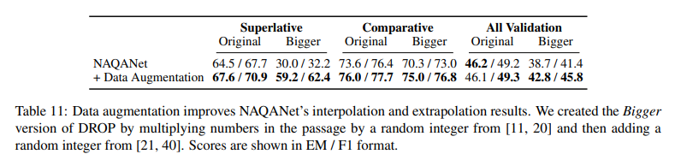
Part 3.4
Probing Models Struggle to Extrapolate
Augmenting Data to Aid Extrapolation
∨ Of course, in many real-word tasks it is possible to ameliorate these extrapolation failures by
augmenting the training data.
∨ We apply this idea to aid in training NAQANet for DROP.
∨ For each superlative and comparative example, we duplicate the example and modify the numbers in its
paragraph using the Add and Multiply techniques described in Section 2.5.
21

Slide 26
Conclusion
김봉민

Slide 27
Part 4
Conclusion
How much do NLP models know about numbers?
By digging into a surprisingly successful model on a numerical reasoning dataset (DROP), we discover that pre-trained token representations naturally encode numeracy.
We analyze the limits of this numeracy, finding that CNNs are a particularly good prior and that it is difficult for neural models to extrapolate beyond the values seen during training.
There are still many fruitful areas for future research, including discovering why numeracy naturally emerges in embeddings, and what other properties are similarly emergent.
22

