Slide 1
Prosodic Features in Emotional Speech of Chinese Patients with Parkinson’s Disease
ZHANG Bomiao
University of Manchester

Slide 2
Introduction
Parkinson's disease (PD) is a progressive disorder that is caused by neuronal loss in the part of the brain called the substantia nigra, which controls movement.
Approximately 70%- 90% of patients diagnosed with PD have some form of vocal disorder, showing
Noticeable impairment in phonation, articulation and prosody (Rusz et al., 2011).
A decreasing pitch range, smaller intensity variations, and various changes in speech rate (Canter, 1963; Rusz et al., 2011; Pettorino et al., 2016).
Notes:
频率范围 强度变化小 语速上的变化

Slide 3
Introduction
These features all come with contrastive findings.
A significant higher mean fundamental frequency, with lower range and variation compared to healthy comparisons (Canter, 1963).
Not observed in Fan (2018).
Higher speech rate and propensity of acceleration (Schlegel, 2008).
A significantly lower syllable rate compared to the normal comparisons (Chenausky et al., 2011).
High inter-subject variability in PD patients (Flint et al., 1992)
Different speech tasks and materials (Fan, 2017).

Slide 4
Introduction
Consequences of dyprosody in PD speakers
Affected ability to convey specific affective or linguistic meanings in their speech brought impairment in social and affective interactions (McNamara & Durso, 2003).
Emotional speech were poorly sounded from listeners’ perspective (Cheang & Pell 2006).
Little evidence suggesting the relationship between impairment in affective prosody production and aging (Orbelo et al. 2003).

Slide 5
Introduction
Studies on prosodic features of Chinese PD speakers
More complicated compared to those on American and European speakers since Chinese is a tonal language.
Previous findings
Decreases in pitch range and higher speech rates (Fan, 2017).
Having problems producing questioning intonations (Jian, 2019).

Slide 6
Research Aim
The current study collects the proverbial sound of Chinese PD speakers in different emotional contexts.
By comparing with healthy speakers, we take a closer look on the prosodic features of the speech of Chinese PD speakers.
This might be indicated through different pitch range or varied speech rate (time duration of length-controlled speech).

Slide 7
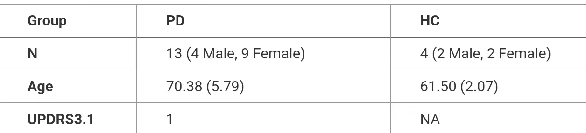
Methods
Participants
15 native Chinese-speaking adults diagnosed with PD and 6 healthy control subjects.
All participants speak a dialect of Mandarin Chinese (Dalian dialect).
The PD speakers were marked an above-zero score in the 3.1 section of UPDRS scale, showing that they all have language impairment in a certain degree.
They have not undergone any kind of language therapy and have not been notified with cognition impairment.
The HC group consisted of 3 male and 3 female speakers that do not have articulation disorder.

Slide 8
Methods
Meterials
Scene inducing tasks 场景诱导式 (Zhang & Gu, 2011)
A balance between naturalness and experiment controllability.
In this study, we took a similar approach by designing three dialogues for each of the six target sentences with 4 distinct affective tones: “angry”, “happy”, and “sad” (“natural” was presented by simply showing the target sentence alone).
Four emotions that are “widely encountered in everyday use” and “having more obvious tonal threads in phonetic analysis” (You & Liu, 2018).

Slide 9
Methods
Meterials
The sentences are all made up of seven characters and are semantically neutral in standalone context.
Two of the sentences have neutral tone characters as the last character and the rest four sentences each comes with a sentence-end character with four tones respectively.
(Balancing the possible effects on emotional prosody from tone variations.)
Pseudo-random order.

Slide 10
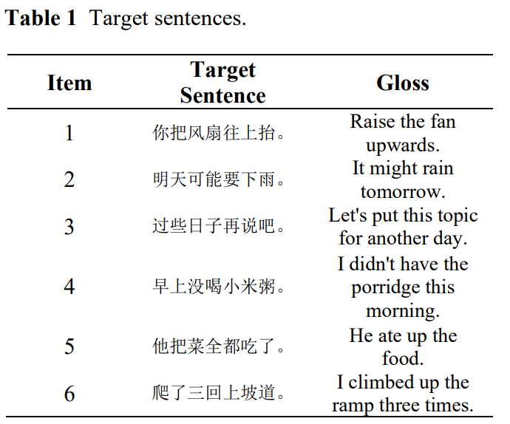

Slide 11
Methods
Recording procedure
The recording was conducted in relatively quiet environment, often wards and offices in Dalian Municipal Friendship Hospital. A Zoom H5 recorder (44.1Khz, 16bit, stereo) was used for the recording sessions.
Dialogues were printed on A4 sized papers and were held and shown to the participants by a researcher.
Prerecorded parts were played through a smartphone, engaging a role-play format between participants and the recordings. Each dialogue was repeated 2-3 times.

Slide 12
Methods
Acoustic Analysis
Acoustic analysis was done in Praat (Boersma & Weenink, 2017) using the ‘prosodypro’ script (Xu, 2013).
The range for extraction was set at 50-500 Hz. In order to model the F0 contours for different groups and emotions, F0 data at 1000 equidistant time points within each sentence were extracted. All F0 values were transformed to semitones relative to 50Hz.
Acoustic Meaurements
Minimal F0
Maximum F0
Mean F0
F0 Range
Standard Deviation of F0 (Rusz et al., 2011; Fan, 2018)
Duration

Slide 13
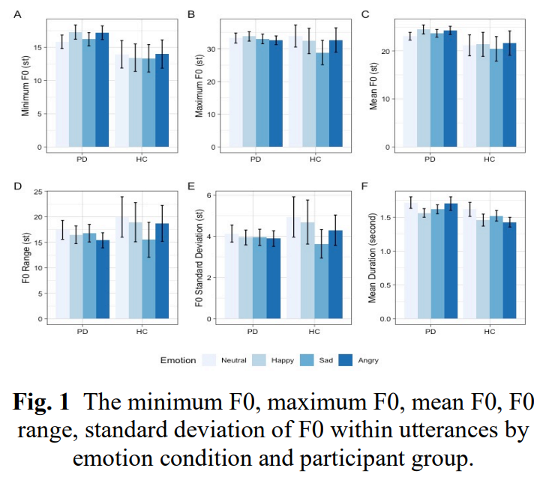
Results

Slide 14
Results
The overall analysis shows no significant difference between PD and HC speakers in all six acoustics features measured.
An effect of emotion on Mean F0 (p=.002) and Standard deviation of F0 (p = 0.055) across groups, where standard deviation of F0 was significantly smaller in the Sad emotion than in the Neural.
An effect of Emotion was found in the aspect of duration (p<.001) and a significant interaction between Group and Emotion was also observed, where utterances in angry emotion produced by PD speakers are longer than that of HC speakers.

Slide 15
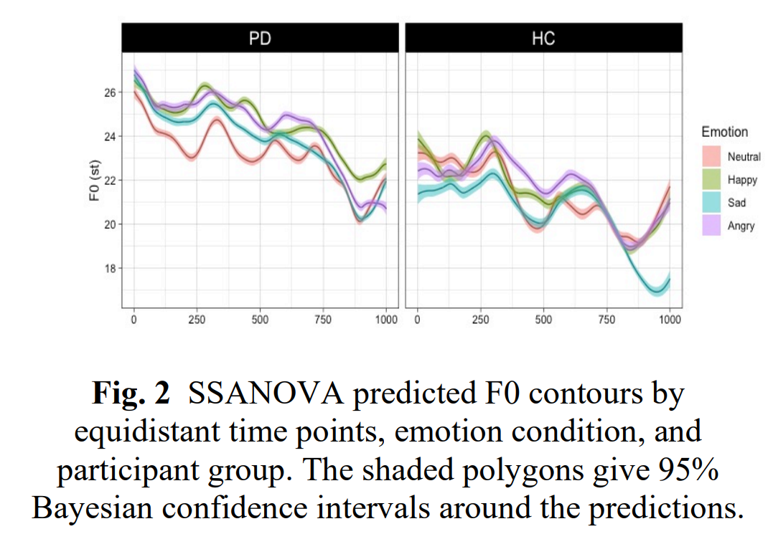
Results

Slide 16
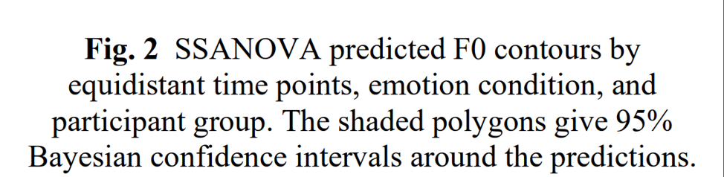
Results
Fig. 2 tells an obvious downdrift towards the end of the utterances was observed for the Sad condition in HC group, but it is not found in PD group.
In PD group, utterances in all emotions except the neutral condition displayed a relatively higher F0 contours in the first half of the utterances. This is not observed in the HC group.

Slide 17
Discussion
Contrasting results to previous findings of emotional prosody in spoken Chinese (Zhang, 2007).
Dialect variation.
Lack of samples and/or an implicit influence on emotional expression in hospital/experimental contexts.
Comparing between PD and HC
No significant differences between them in absolute and range values of F0.
Failed to replicate the major difference in fundamental frequency deviation.

Slide 18
Discussion
A significantly longer duration in angry emotion in PD speakers than HC speakers.
Angry speech have shorter durations in usual conditions as a result of accelerated speech delivery (Wang & Li, 2001).
Gain meaning through relatively radical variations in the speech signal, which might could not be done by PD speakers with their misfunctions of articulatory organs.
An exaggerated downshift in sad utterances is not observed.
Suggesting that PD speakers may have problem producing dramatic pitch contours.

Slide 19
Discussion
A higher F0 contour in the first half of the utterances.
A drop in the second half of the utterances.
Intensions to do pitch contours in emotional contexts but failed to hold the momentum due to articulation disorders.
Making listeners misjudge the emotional meaning conveyed by PD patients.

Slide 20
Discussion
Results are not yet determined due to lack of HC participants and female-majority PD participants.
PD has subtypes that are based an different motor and cognitive features.
Actual feedbacks from listeners’ perspective are needed to see if these factors really hamper the patients’ ability to convey emotions.
Materials designed for this experiment cannot fully represent actual daily-life usage of emotional speech.
Participants unconsciously switching between dialect and Mandarin when they perform reading tasks.

Slide 21
Conclusion
We found evidence in:
Both pitch contour and speech rate showing PD patients do have different emotional prosodic features compared to HC speakers.
Such features might have been the cause for communicative impairments for the PD patients, and can also serve as a kind of evidence in diagnosing the disease from an acoustic perspective.
Studies on much bigger scales are needed in order to get more clear and accurate evidence.

Slide 22
Acknowledgements
This research is supported by Beijing Language and Culture University with the Undergraduate Innovation and Entrepreneurship Project (X202210032030).
The research was carried out with the help of a group of people:
My supervisor, Dr. Feng Ye from Dept. of Linguistics, BLCU.
Fellow teammates Ma Yue and Zhao Hansijia;
Chief Physician Li Xiaohong with her fellow postgrads Chen Liling and Huo Yuan from Department of Neurology, Dalian Municipal Friendship Hospital.
All participants who cooperated with the research.

Slide 23
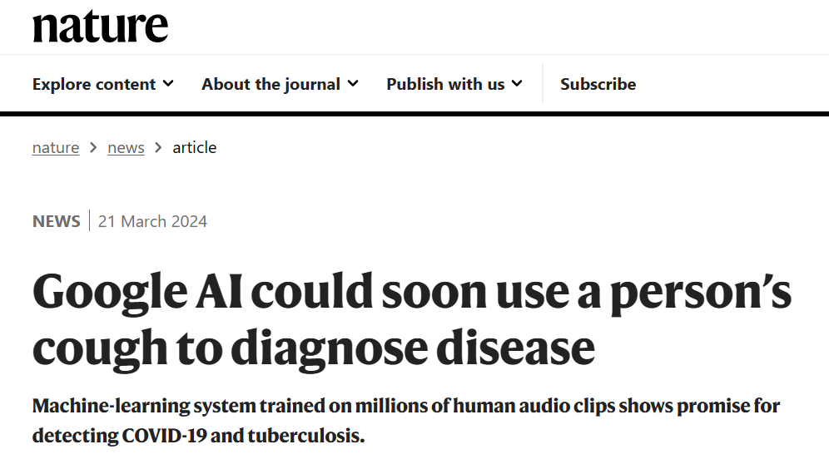

Slide 24
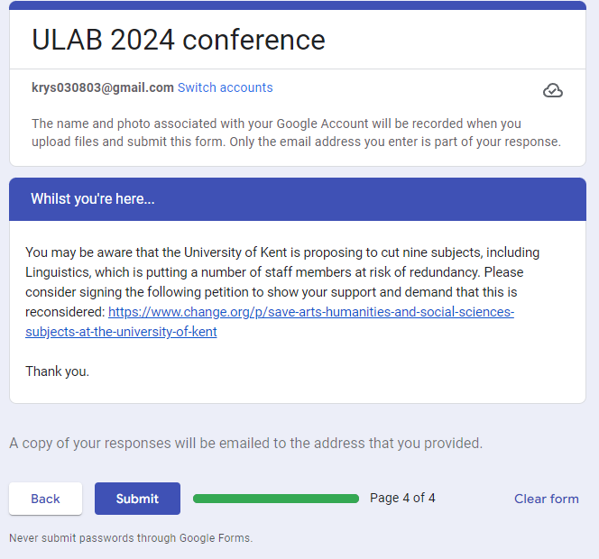

Slide 25


Slide 26

"This open letter is hollow and devoid of substance, likely solidifying the determination of the university to dismantle the linguistics program."

