Slide 1



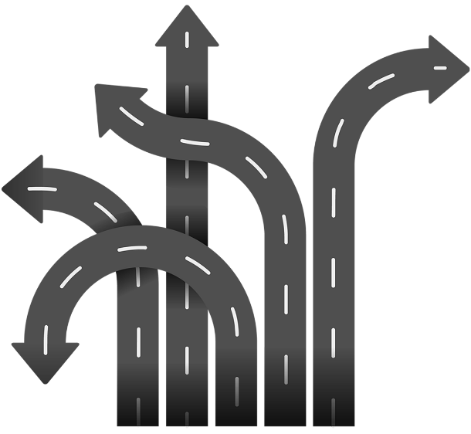
Team 6
Bicycle Safety
Group 6
Dhruv Kandhari
Bharat Modhwadiya
Mufaddal Zulfiquar
Rajeshwari Patidar
Neil Patel

Slide 2
CENTRAL FOCUS
Investigating the critical elements & key reasons behind elevating the risk for bicyclists

Slide 3
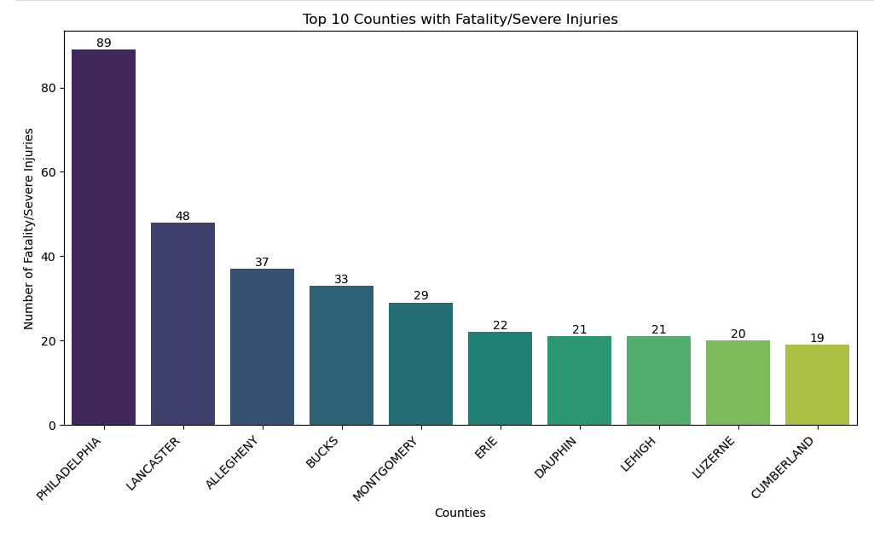
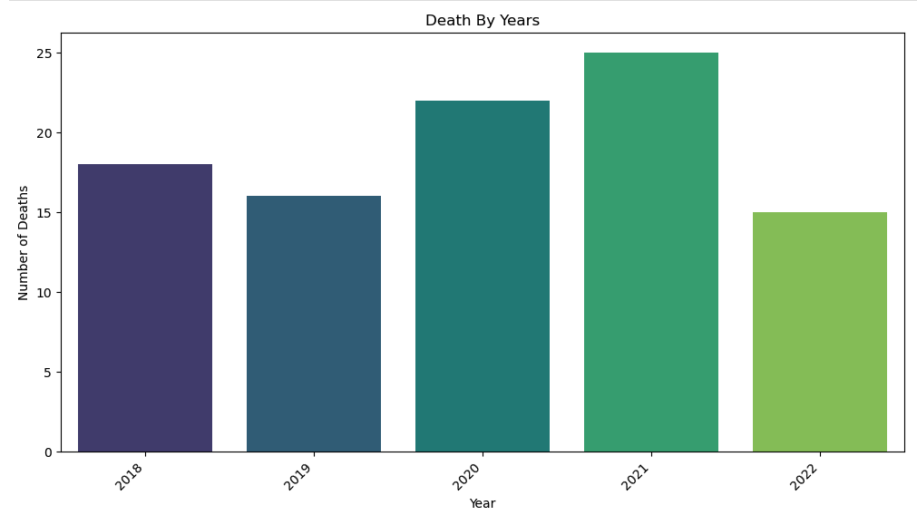
Overview of DATA
Key findings of a report on bicycle safety in Pennsylvania. The report analyzed data from 2018 to 2022 to identify the factors that contribute to bicycle fatalities and severe injuries.

Slide 4
Key Insights
Common Factors
Urban vs. Rural Dynamics
Intersection Dynamics
Signalized Intersections
Stop Signs as Lifesavers

Slide 5
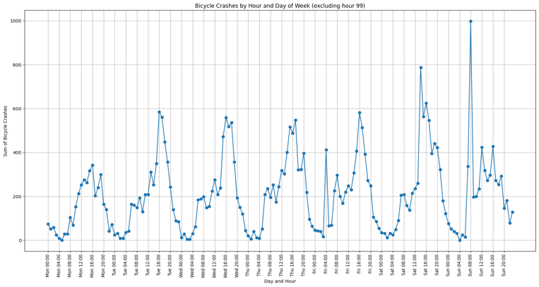
Common Factors don’t work
Speeding, alcohol and drug involvement, mobile phone usage, tailgating, and aggressive driving, while important facets of road safety, do not emerge as primary catalysts for severe injuries or death in the cyclist demographic.

Slide 6
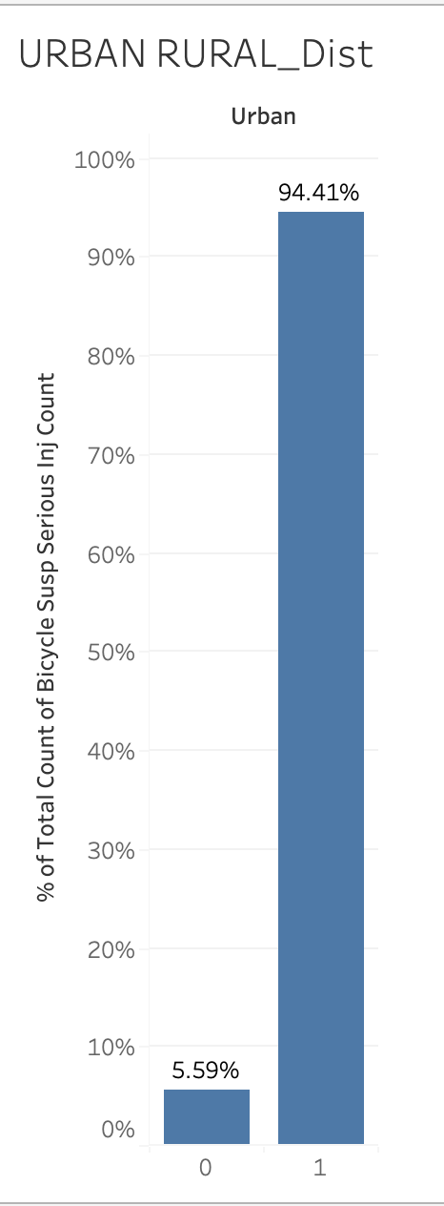
Urban riders at higher risk
94.41% of bicycle fatalities occur in urban settings.
5.59% of bicycle fatalities occur in rural settings.

Slide 7
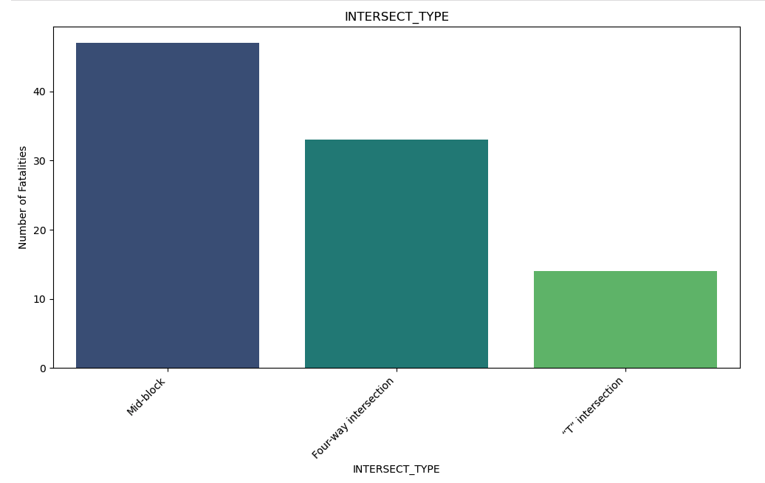
Watch out at mid-blocks
51% of bicycle fatalities occur at Mid-Block locations.
35% of bicycle fatalities occur at Four-Way Intersections.
14% of bicycle fatalities occur at Signalized Intersections.

Slide 8
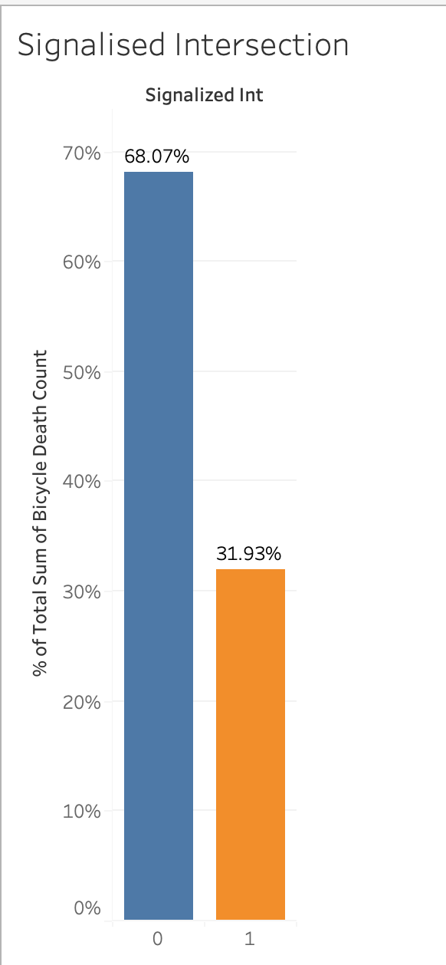
Signals for life
30% of bicycle fatalities occur at signalized intersections.
70% of bicycle fatalities occur at intersections without signals.

Slide 9
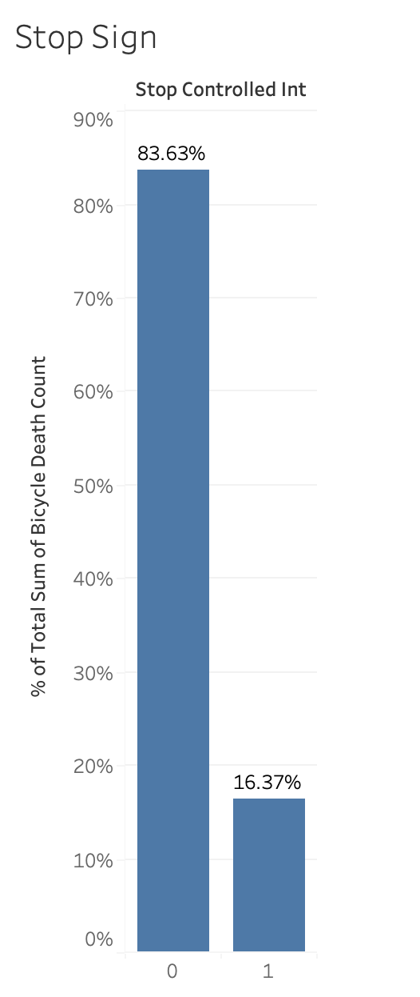
Stop Signs as Lifesavers
A compelling revelation unfolds as we observe an 84% reduction in the likelihood of severe injuries or death for cyclists at intersections equipped with stop signs.

Slide 10
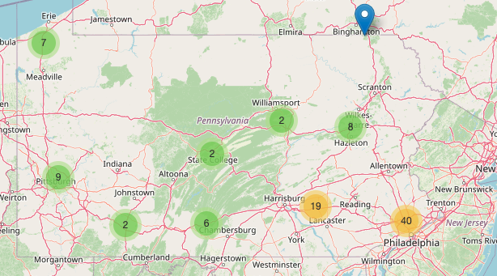
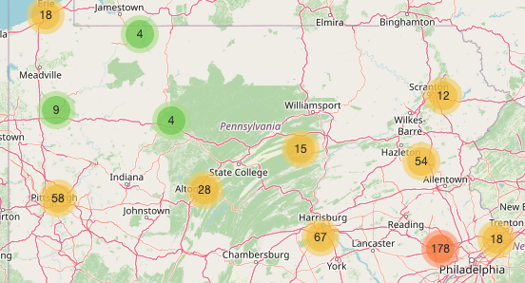
Cluster MAP
Fatal incidents
Severe incidents

Slide 11
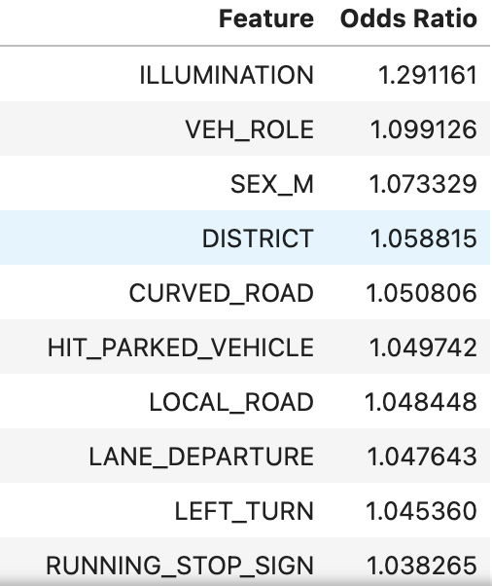
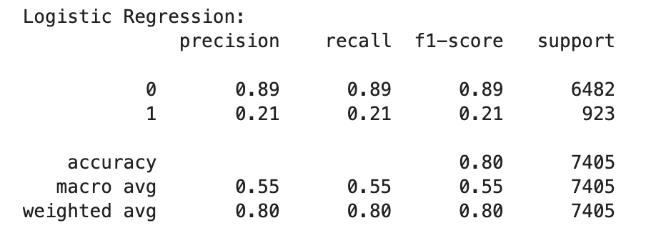
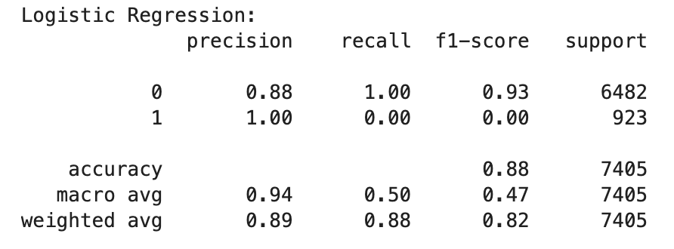
Logistic Regression
Odds Ratio:
Ex: A bicycle-related incident increases by approximately 29.12% for each one-unit increase in the ILLUMINATION feature.
Two models created
Model 1: Balanced Precision and Recall
Model 2: Precision Optimization

Slide 12
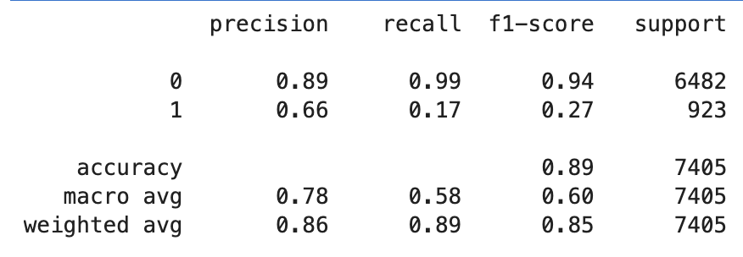
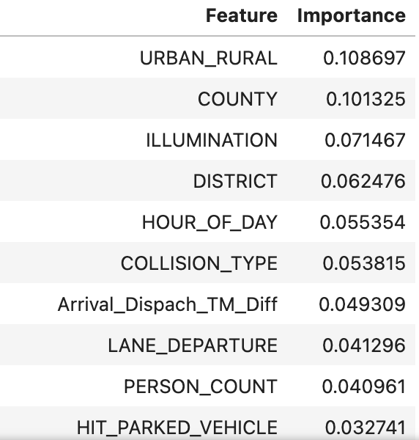
Random Forest
Model 1:
Feature Importance:
Urban and County features have the most impact on the model predictive power.

Slide 13
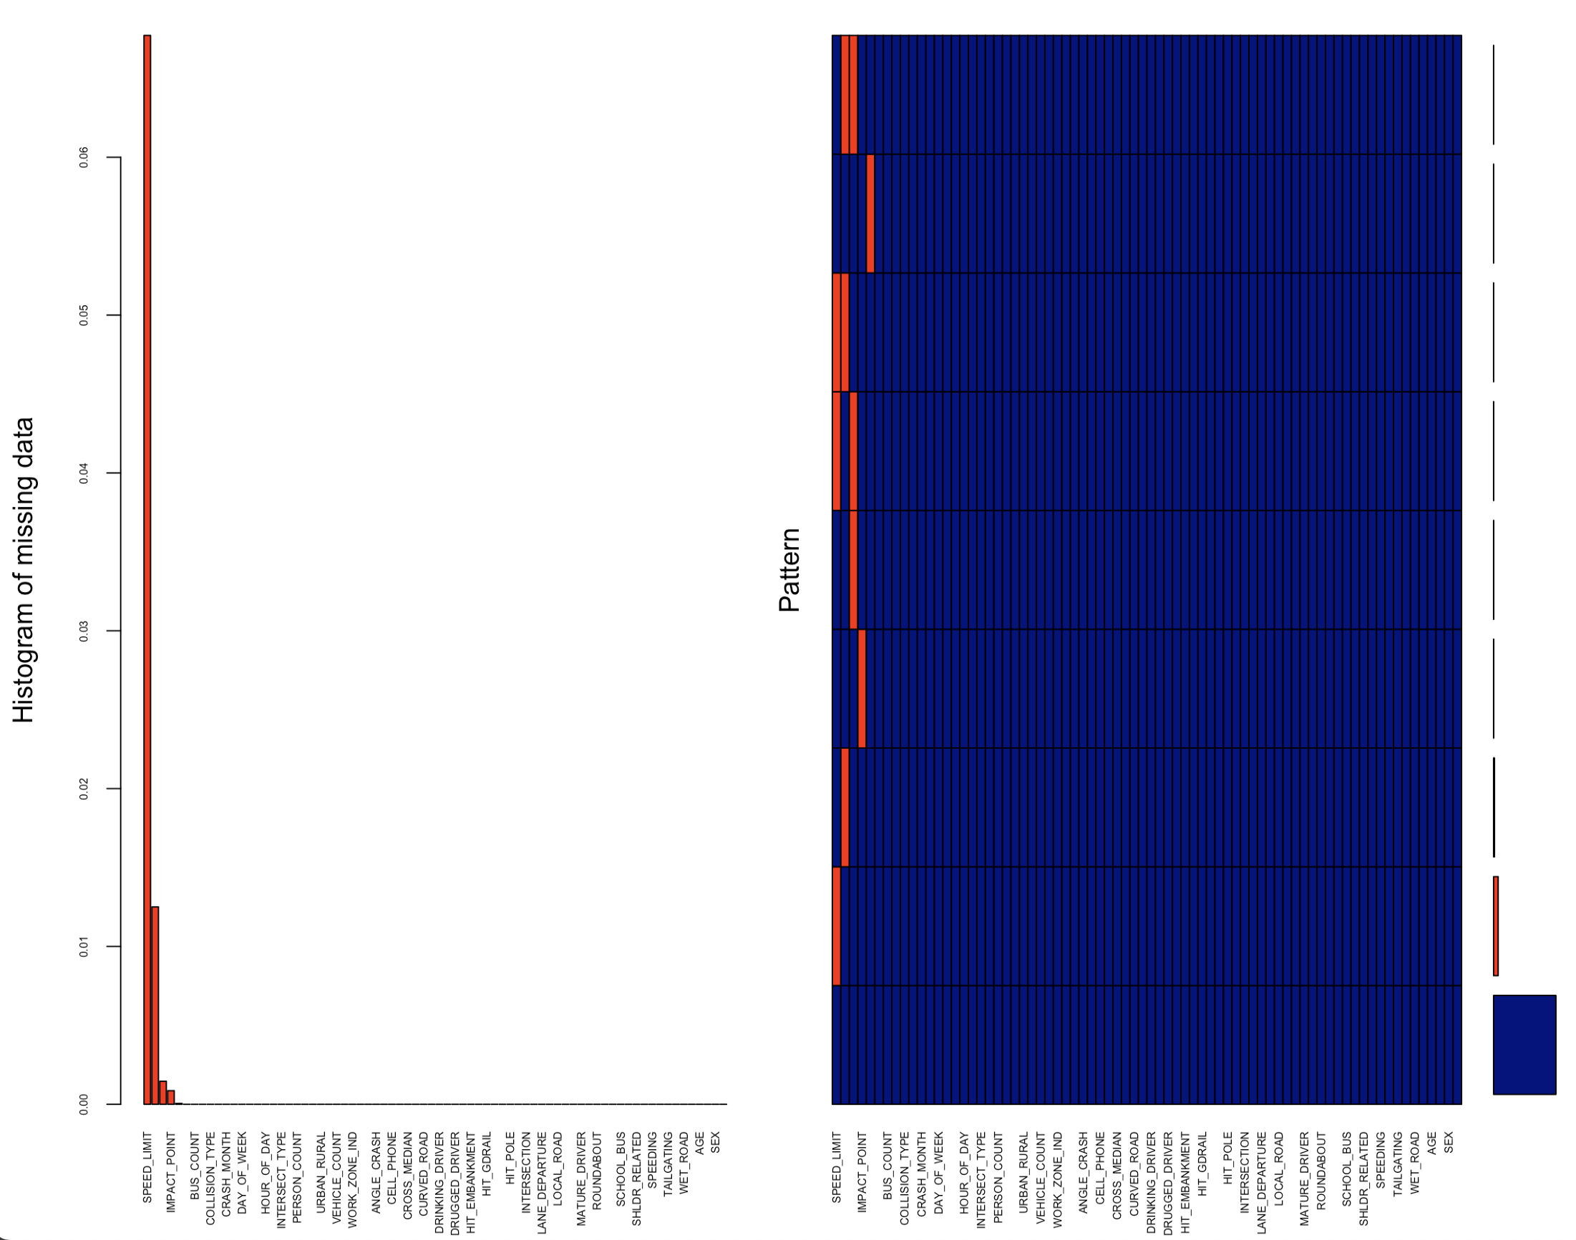
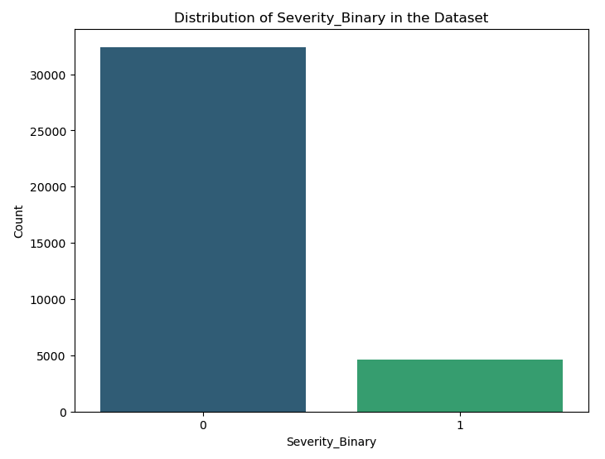
MODEL Limitations
Temporal Scope:
Data collected from 2018-2022
External Variables:
Economy
Covid
Data Quality and Completeness
Imbalanced dataset

Slide 14
Key Findings & RECCOMONDATIONS
Random Forest is the model of choice
89% accuracy with high precision
Urban are the most influential
RESTRAINT_HELMET feature was not influential
51% of death occurs on Mid-block locations
94.41% of severe/fatal incidents occur in Urban settings
70% of death occur in absence of signalization
Majority of severe/fatal incidents occur between 4-6pm.
Surprisingly speeding, alcohol, aggressive driving, and phone features are not leading contributors for cyclist incidents.
INSTALL MORE STOP SIGNS OR SINGALS AT MID-BLOCK & FOUR WAY INTERSECTION

Slide 15


THANK YOU

