Slide 1
SIMD in C++
Presented January, 2017
Doc ID:

Slide 2
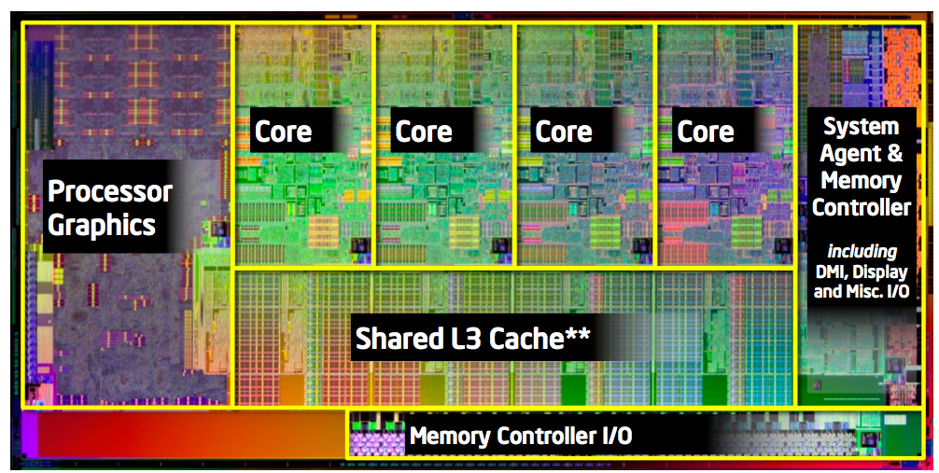
Why C++?
Notes:
Performance!
Multi-threading
Multi-core

Slide 3
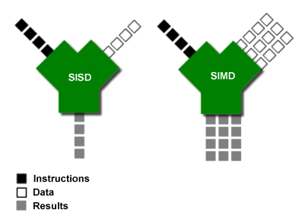
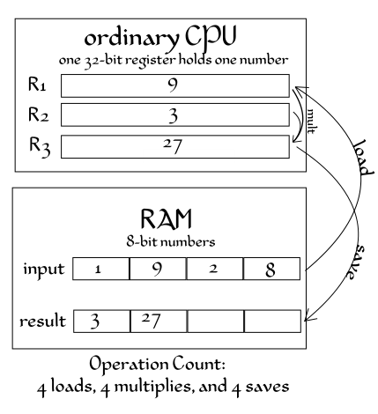
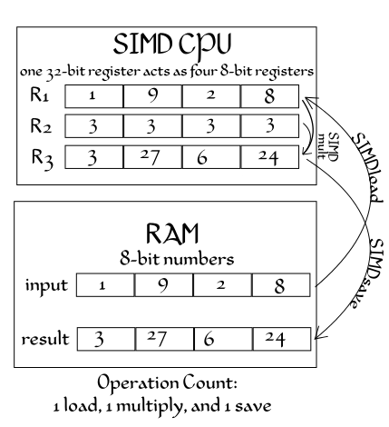
What is SIMD
Notes:
Mention Flynn’s classification
Single Instruction – Single Data
Single Instruction – Multiple Data
Multiple Instruction – Single Data
Multiple Instruction – Multiple Data

Slide 4
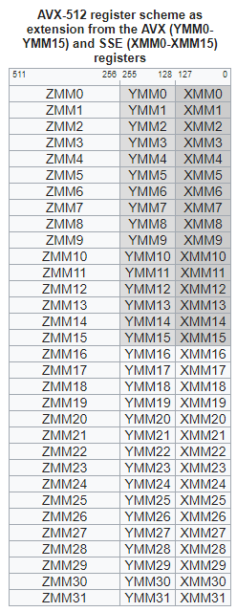
History
Intel
SSE – Streaming SIMD Extensions
128 bit registers, XMM
1999 – Version1
2001 – Version2
2003 – Version3
2006 – Version4
AVX - Advanced Vector Extensions
256 bit registers, YMM
2011 – Version1
2013 – Version2
AVX-512
2015 – AVX 512
…
Notes:
Mention
Risc:Neon, AltiVec, …

Slide 5
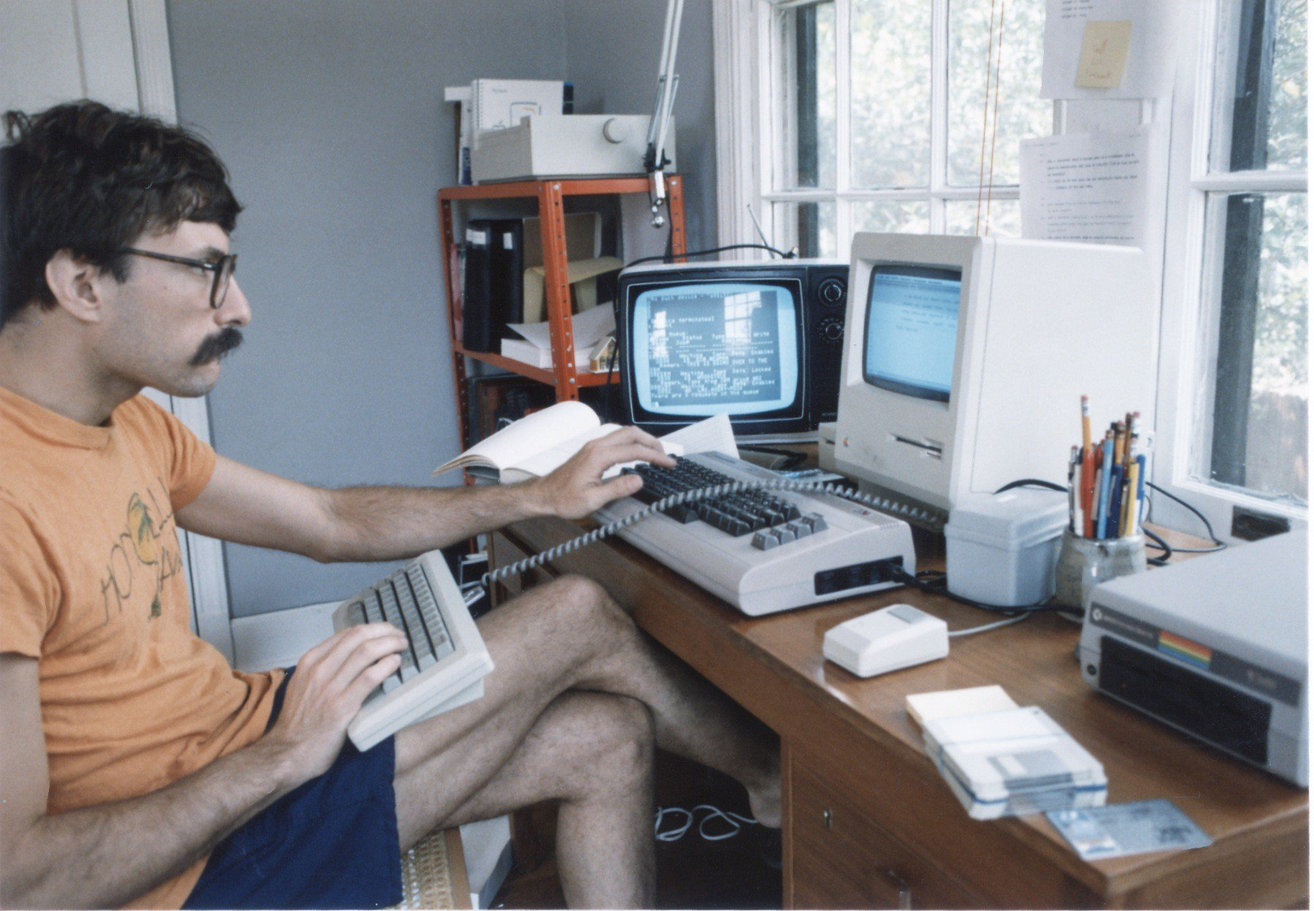
Intro

Slide 6
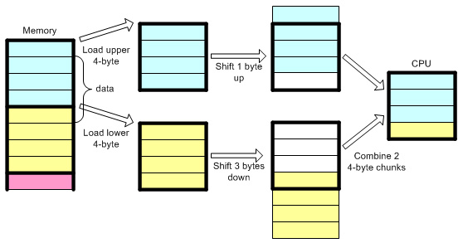
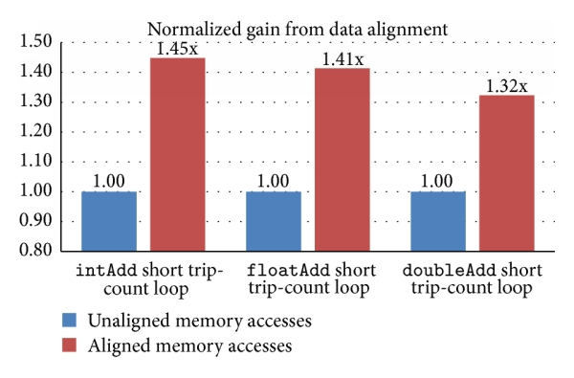
Issues
Data alignment
For optimal performance SIMD data needs to be aligned in memory
In order to load to a register of size 128, the data needs to be aligned to 128
It’s possible to load/store unaligned data, you might pay performance penalty, depending on hardware
http://en.cppreference.com/w/cpp/language/alignof
http://en.cppreference.com/w/cpp/language/alignas

Slide 7
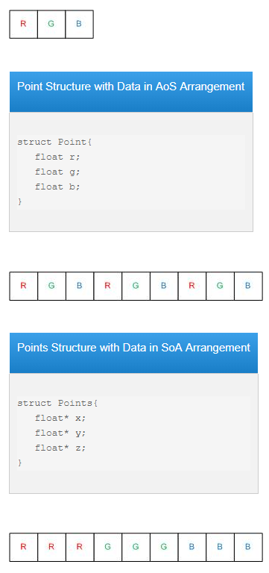
Issues - continued
Data arranging, reorg
In order for SIMD to be efficient you might want to arrange the data “by properties”
Not so good (Array of Structures):
std::vector<Point3> points
Better (Structure of Arrays)
struct Points { std::vector<float> Xs, Ys, Zs; }
Though there are operations you can do within the register…

Slide 8
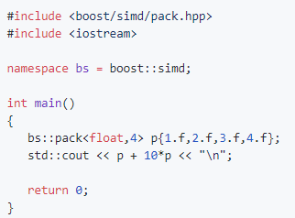
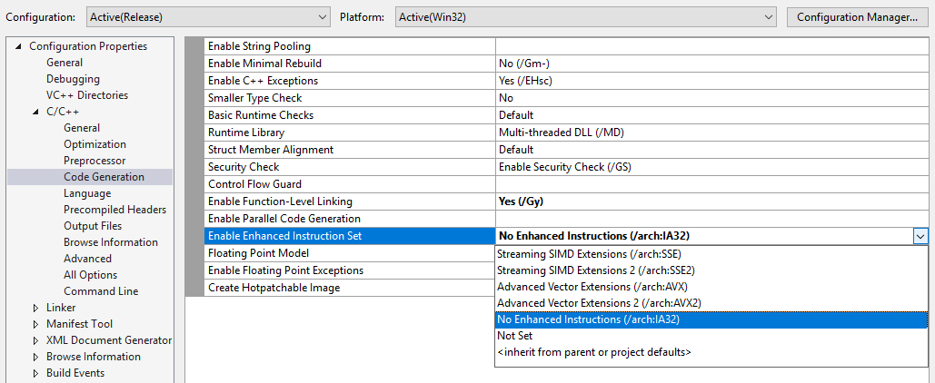
Don’t do it yourself
We have libraries!
Some are Low level:
https://github.com/NumScale/boost.simd
http://ermig1979.github.io/Simd/help/index.html
https://software.intel.com/en-us/intel-ipp
Some are High level
http://eigen.tuxfamily.org/
https://opencv.org/
Compilers usually do some of it for you, familiarize yourself with it:

Slide 9
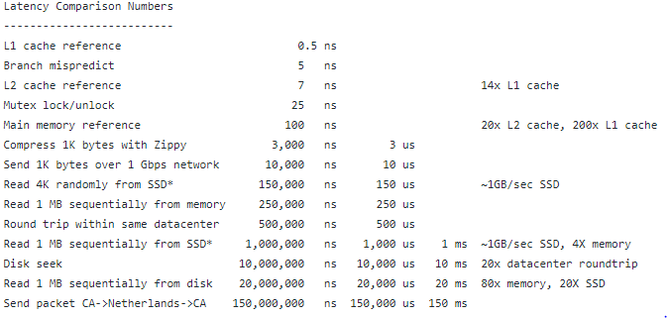
Is your software compute or data bound?
http://www.overbyte.com.au/misc/Lesson3/CacheFun.html
https://gist.github.com/jboner/2841832

Slide 10
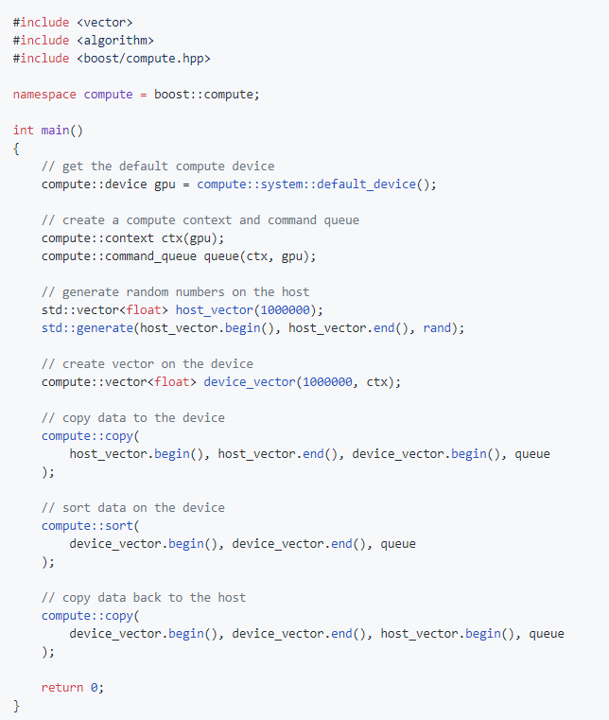
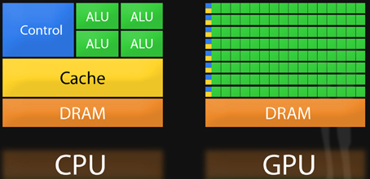
GP-GPU Parallelization Alternative
Another option to gain performance on dedicated hardware is using the GPU processor abilities for General Purpose
Very low level, separate area of expertise
High latency for data transfer to/from GPU
Lots of primitive CPUs
https://github.com/boostorg/compute

