Slide 1
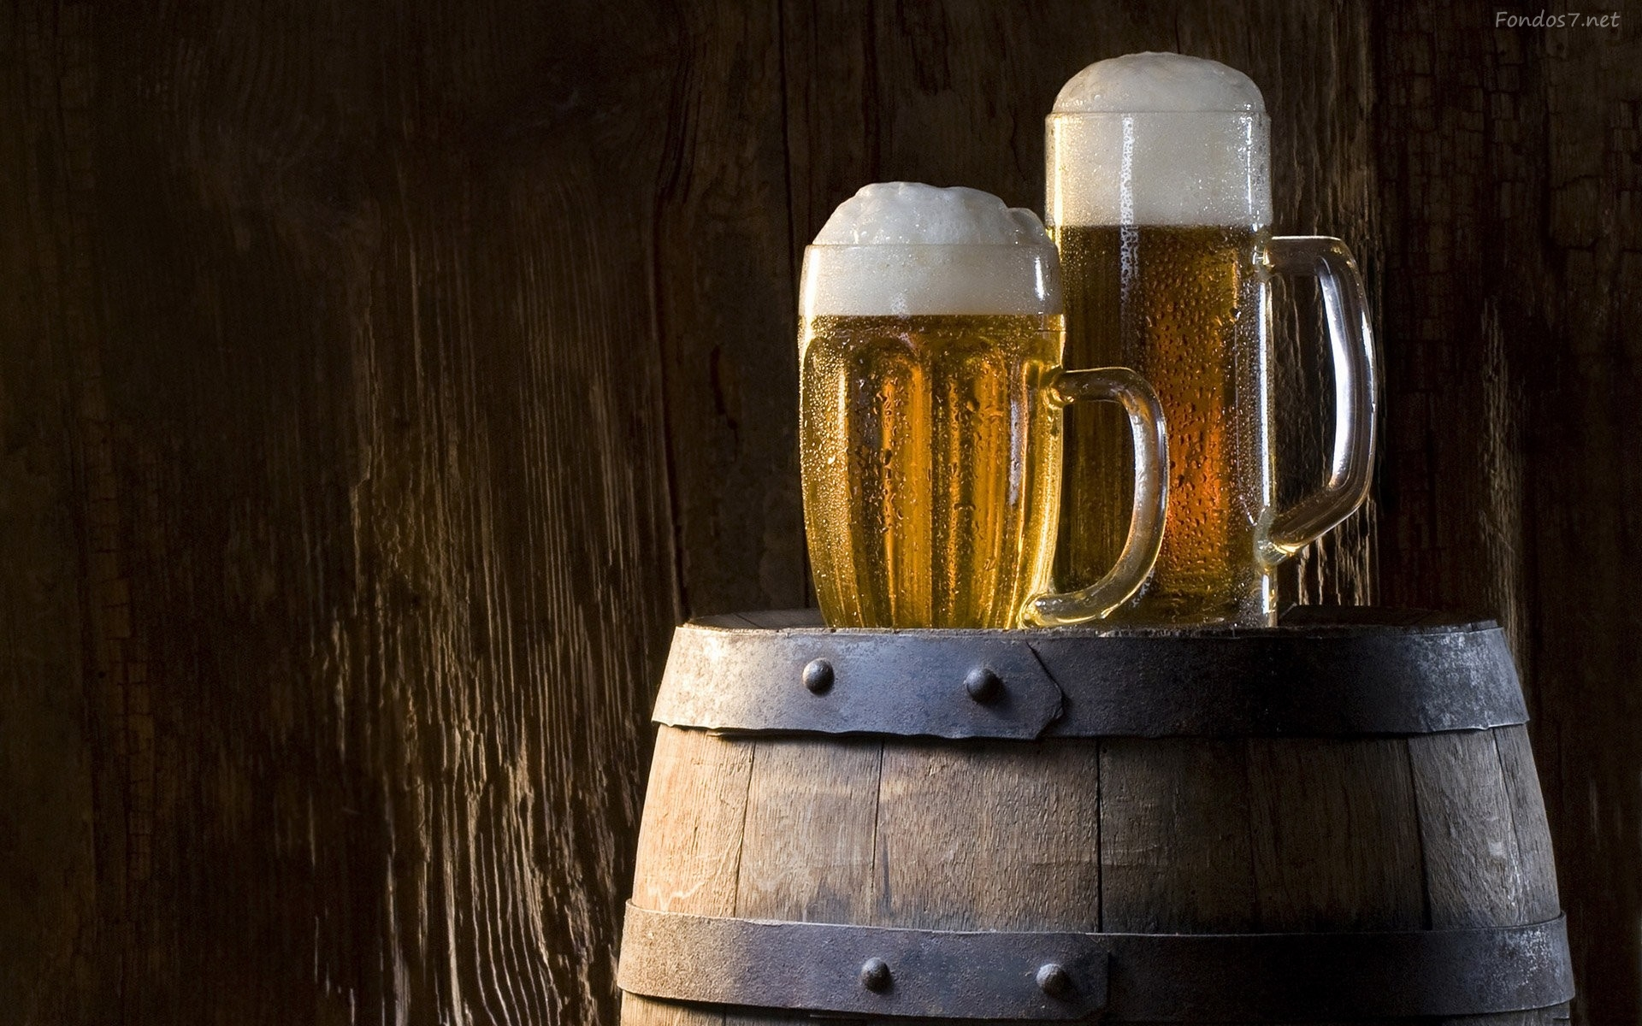
Beer Corporation

Slide 2
Beer Corporation

Slide 3
Beer Corporation

Slide 4
Beer Corporation

Slide 5
Beer Corporation

Slide 6
Beer Corporation

