Slide 1

Constructing an Optimized Hyperparameter Model for Early Fatty Liver Detection Based on NASRL
TSBME2024
Hong-Kun Lin¹, Hao-Jen Wang², Shao-Pu Lu³, Chia-Yen Lee^{3*}
Presenter: Hong-Kun Lin
¹Department of Biomedical Engineering, National Yang Ming Chiao Tung University, Taiwan
²Department of Biomedical Engineering, National Taiwan University, Taiwan
³Department of Electrical Engineering, National United University, Taiwan
Paper ID:G3-019
Author Email: windspeak122@gmail.com
National United University
Notes:
hello I’m Lin Hong-Kun from National Yang Ming Chiao Tung University in Taiwan ，and I glad to present Constructing an Optimized Hyperparameter Model for Early Fatty Liver Detection Based on Neural Architecture Search with Reinforcement Learning

Slide 2
Outline
Introduction
Materials & Method
Result
Future works
Notes:
In this talk, I’m going to discuss the motivation and goal of this study, explain what Neural Architecture Search methods are, and present the Neural Architecture Search methods results.
-----------------------
在這次談話 我將說到 本研究的 動機跟目標 以及 何謂NAS 方法 並將NAS實踐後得到的成果

Slide 3
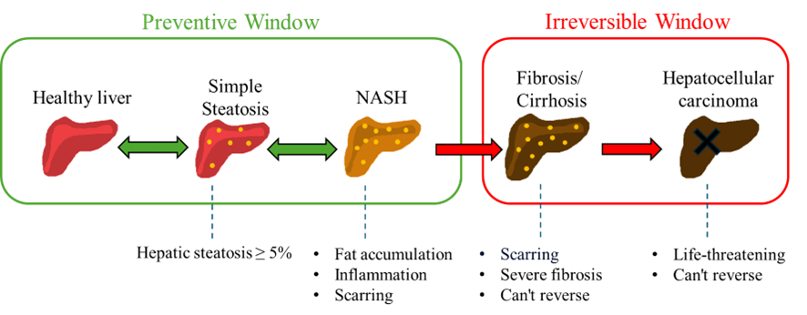
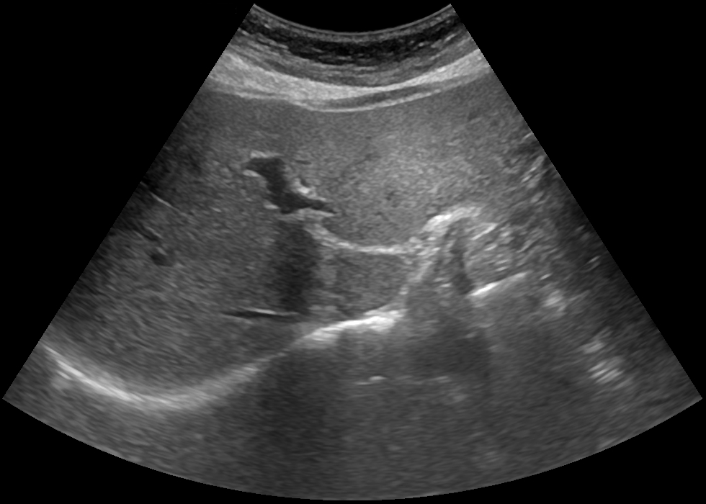
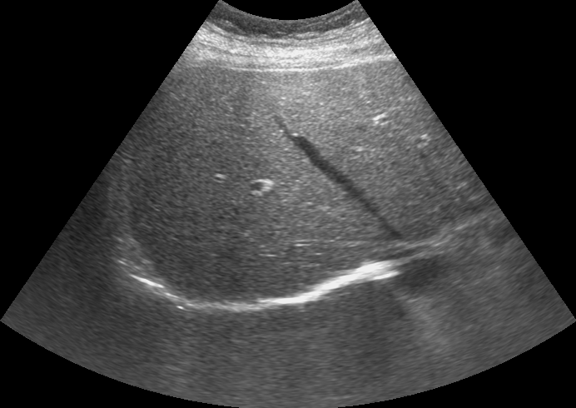
1. Introduction
Fatty liver
Healthy liver
Motivation:
Early diagnosis of fatty liver is crucial, as early treatment can significantly reduce the cost of patient recovery.
Goal:
To provide an objective and efficient model that reduces doctors' time costs and effectively detects fatty liver disease, helping patients identify and treat it early.
Notes:
Non-alcoholic fatty liver disease is currently the most common liver disease
In 2019, 25.2% of the global population was affected by Non-alcoholic fatty liver disease, and by 2023, this number has grown to 32.4%.
If Non-alcoholic fatty liver disease remains uncontrolled and continues to worsen over time, it can cause irreversible damage to the liver, and in more severe cases, it may progress to liver cancer.
The common preliminary diagnosis for fatty liver is using ultrasound. However, doctors need to spend time observing various liver characteristics to diagnose fatty liver, and the diagnosis may vary depending on the doctor's experience.
Therefore, Our goal is to provide an objective and efficient model to assist doctors in diagnosing fatty liver.
----------------------
非酒精性脂肪肝疾病（Non-alcoholic fatty liver disease, NAFLD）是目前全球最常見的肝臟疾病
在2019年時全球約有25.2%的人口患有NAFLD[1]，而到近年2023年已成長到32.4%[2]
若NAFLD長期未受控制持續惡化，則會對肝臟造成不可逆的傷害，更嚴重則發展為肝癌影響到生命安全
常見的脂肪肝初步診斷方式使用超音波，然而診斷時Doctors need to spend time observing various liver characteristics to diagnose fatty liver, and the diagnosis may vary depending on the doctor's experience.
因此本研究目標為 To provide an objective and efficient model 輔助醫生進行脂肪肝診斷

Slide 4
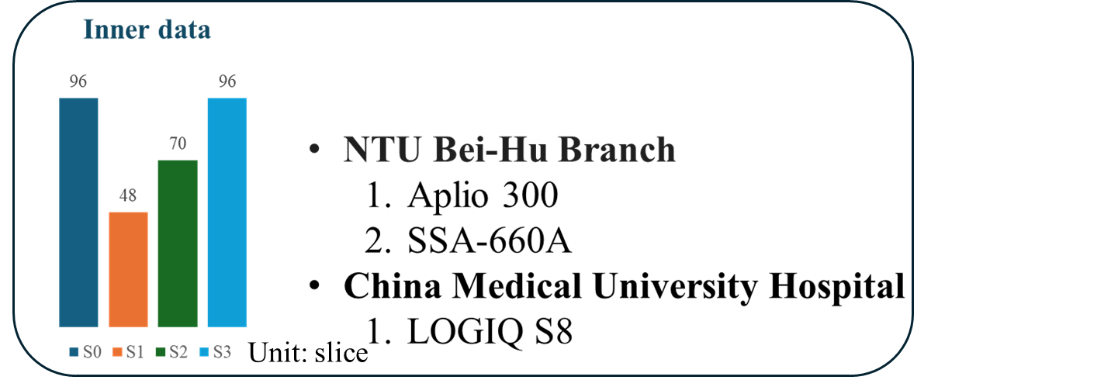
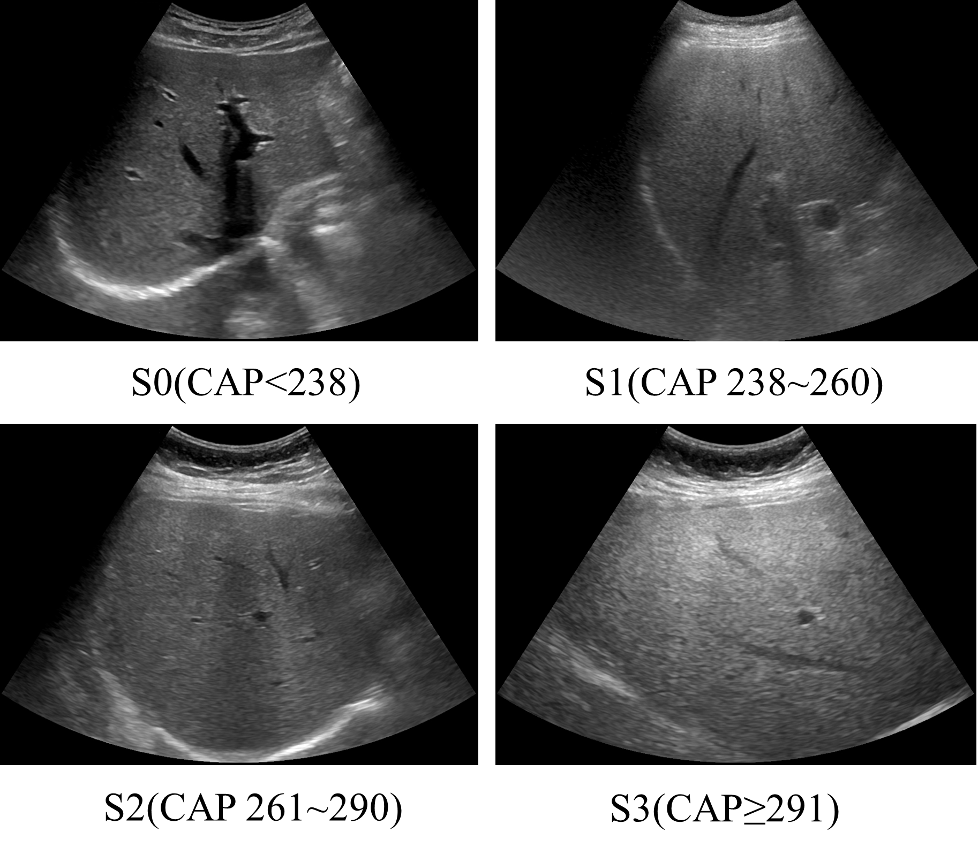
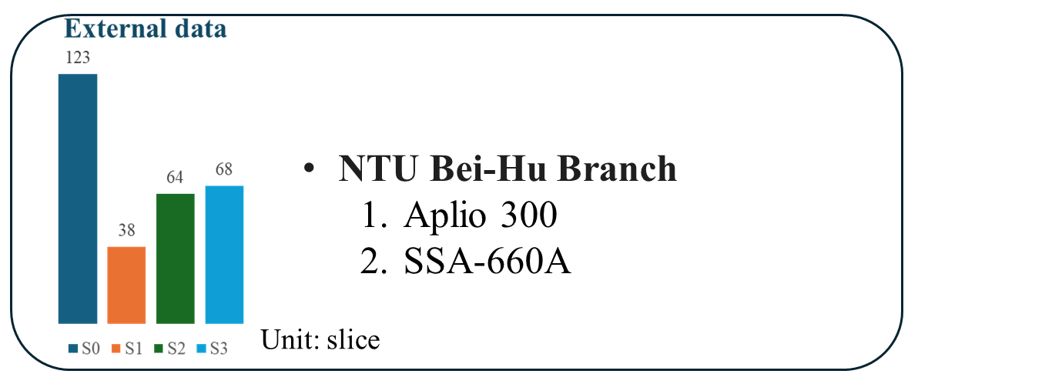
2. Materials
Data acquisition
Notes:
Our materials acquire from NTU BeiHu Branch and China Medical University Hospital.
Ultrasound Liver images were obtained using different ultrasound scans, and the severity of fatty liver was classified using the Controlled Attenuation Parameter measured by FibroScan.
The data consists of two parts: one part is the inner data, which is split into 80%training, 10%validation, and 10%test , and is used for 10-fold cross-validation. The other part serves as external test data to evaluate the robustness of the model.
--------------------------------------------------
本研究的實驗材料來自於 北護、中國醫 使用不同的超音波機台 取得肝臟影像並 使用Fibroscan 所量測的Controlled Attenuation Parameter ,CAP 進行脂肪肝嚴重程度分級
資料有兩個部分一部份是Inner data 用於做 8:1:1 10fold交叉驗證
另一部做為外部測試資料 測試模型的穩定程度

Slide 5
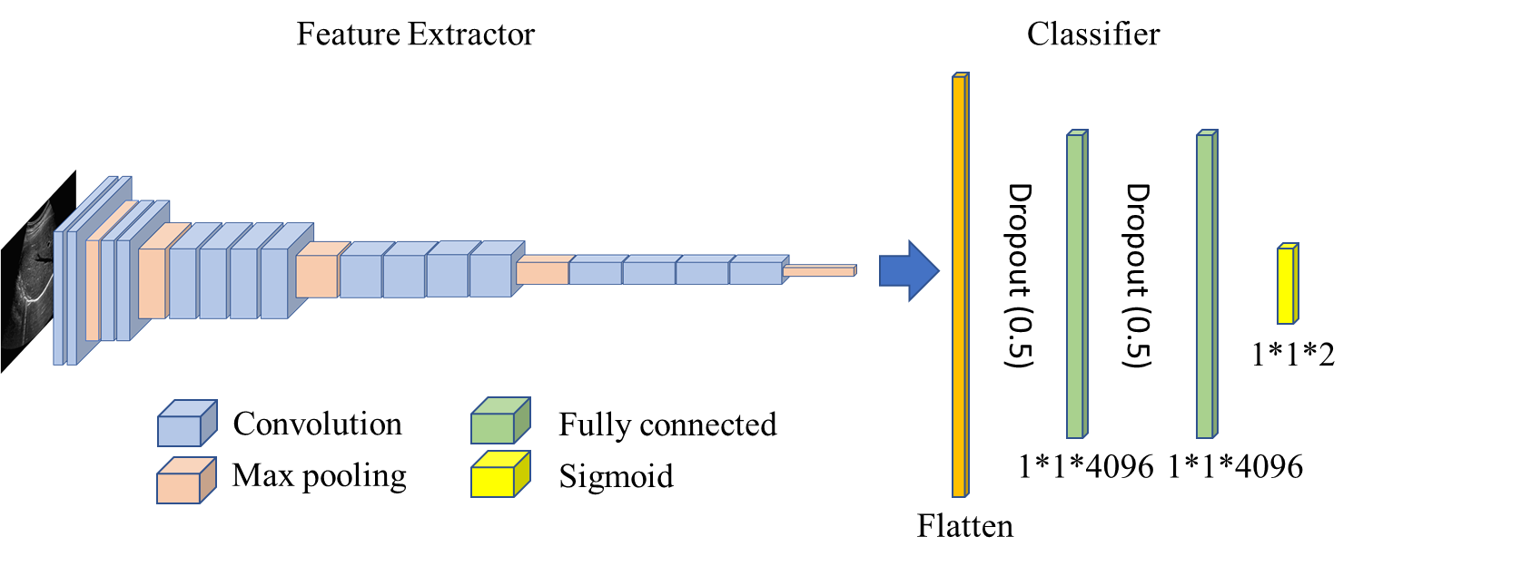
2. Method - Visual Geometry Group (Baseline model)
VGGNet
Notes:
We choose VGGNet as the baseline model.
However, the VGG architecture was designed for natural image classification tasks.
Therefore, this study attempts to use Neural Architecture Search to explore the optimal model architecture, specifically designed for the ultrasound-based fatty liver classification task.
----------------------------------------------------------------------
本研究使用VGGNet作為 baseline model
然而VGG的架構 是基於處理自然影像分類問題而設計
因此本研究嘗試 使用Neural Architecture Search 搜索 最佳模型架構 專門處理超音波脂肪肝分類任務
#Why we choose VGG as baseline model : 有許多論文研究表明使用VGG 於脂肪肝分類有良好的表現

Slide 6
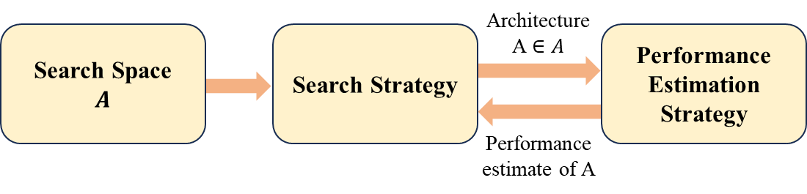
2. Method - Neural Architecture Search with Reinforcement Learning
NASRL
Recurrent Neural Networks
Kernel size、 Filters…
Val_ACC
Notes:
The method used in this study is Neural Architecture Search (NAS) with Reinforcement Learning. This approach effectively addresses the challenge of requiring specialized knowledge to design neural networks, allowing non-expert researchers to search for well-performing neural network architectures.
NAS can be divided into three stages: 1. Search Space, 2. Search Strategy, and 3. Performance Estimation Strategy.
Search Space is defined as the set of operations the model can use. These operations can include different kernel sizes, filter numbers, and so on.
Search Strategy refers to the method used to select operations and combine them into a sub-neural network. In this study, a Recurrent Neural Network (RNN) is used as the search strategy.
Performance Estimation Strategy: used to evaluate the performance of sub-neural network. and update the Search Strategy parameters based on their performance.
---------------------------------------
本研究的方法是使用Neural Architecture Search with Reinforcement Learning 的方法
這種方法有效解決了設計神經網路所需的專業知識問題，使非專業研究人員也可搜索出好的神經網路架構
NAS可區分為三個階段 1.Search Space、2.Search Strategy、3.Performance Estimation Strategy
Search Space定義為模型可以使用的Operations的集合 Operations 可以為不同的、Kernel Size、Filters numbers等
Search Srategy定義為 選擇Operations的方法 並將這些Operations組合成一個子網 在本研究採用了Recurrent Neural Networks 作為Search Srategy
而子網會進行分任務的訓練取得Val_acc 後 Val_acc會作為reward signal回傳至Search Strategy更新其參數 產生下一個子網 直到擁有最好的子網出現

Slide 7
2. Method - Neural Architecture Search with Reinforcement Learning
NASRL – Search space
Selecting an appropriate search space is crucial
In this study, the following common parameters are set as the search space.
Conv layer:
Kernel size: 1,3,5,11、Filters: 64,128,256,512
Large search space
Low search efficiency
Small search space
difficult to discover novel architectures
Notes:
Selecting an appropriate search space is crucial—if it is too large, it can lead to low search efficiency, and if it is too small, it becomes difficult to discover novel architectures.
Therefore, we chose commonly used parameters as the search space.
------------------------------------------------
Evolving Search space for NAS
Selecting an appropriate search space is crucial，如果太大會造成 Low search efficiency，如果太小difficult to discover novel architectures
因此我們選擇常見的 parameters 作為 search space
Low search efficiency: 可能需要更多epoch找出架構

Slide 8
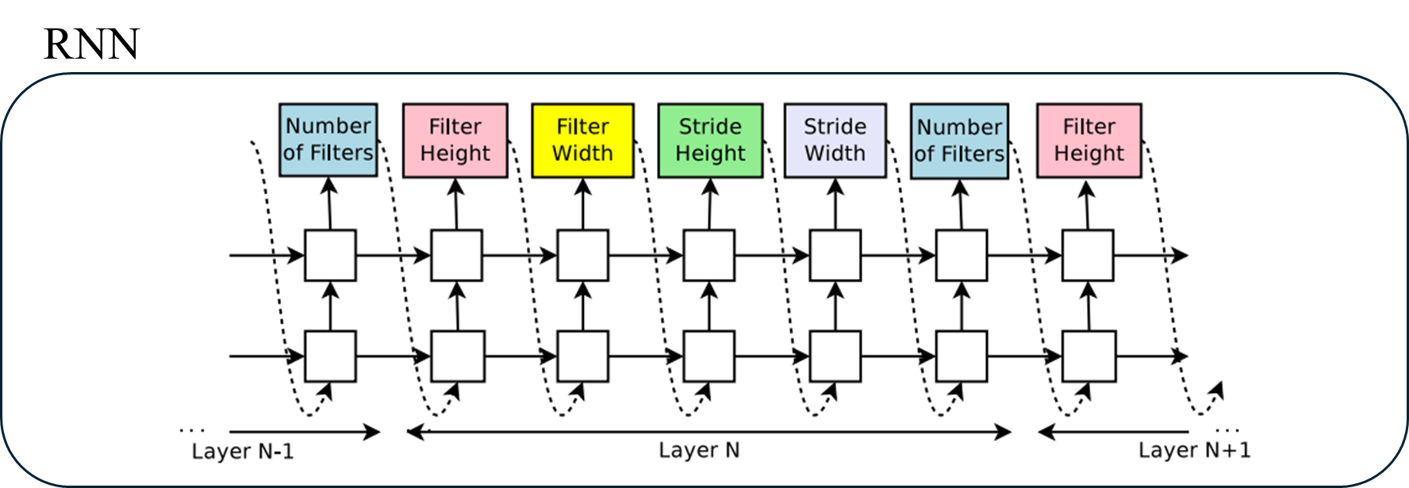
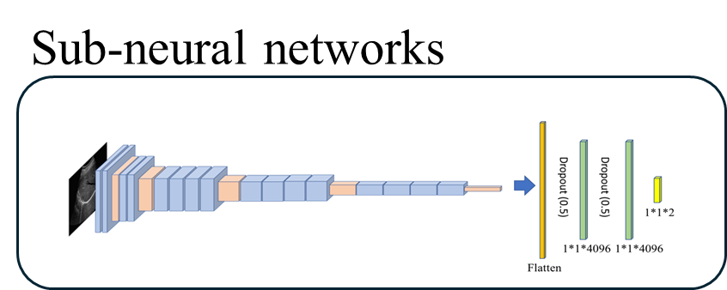
2. Method - Neural Architecture Search with Reinforcement Learning
NASRL - Search Strategy
Generate
Notes:
The search strategy in this study uses a Recurrent Neural Network (RNN). At each step, the RNN is tasked with determining hyper parameters such as the number of filters in convolutional layers, filter height, and filter width. These are then sequentially connected to form a sub-neural network.
-------------------------------------------------
本研究所採用的搜索策略，為Controller 循環神經網路(Recurrent neural network, RNN)搜索operations並組成子神經網路，預測每一層的Filter數量、卷積核大小並重複。每個預測都由 Softmax 分類器執行，然後輸入到下一個時間步作為輸入。
這裡的Action定義為 RNN所採用的operation

Slide 9
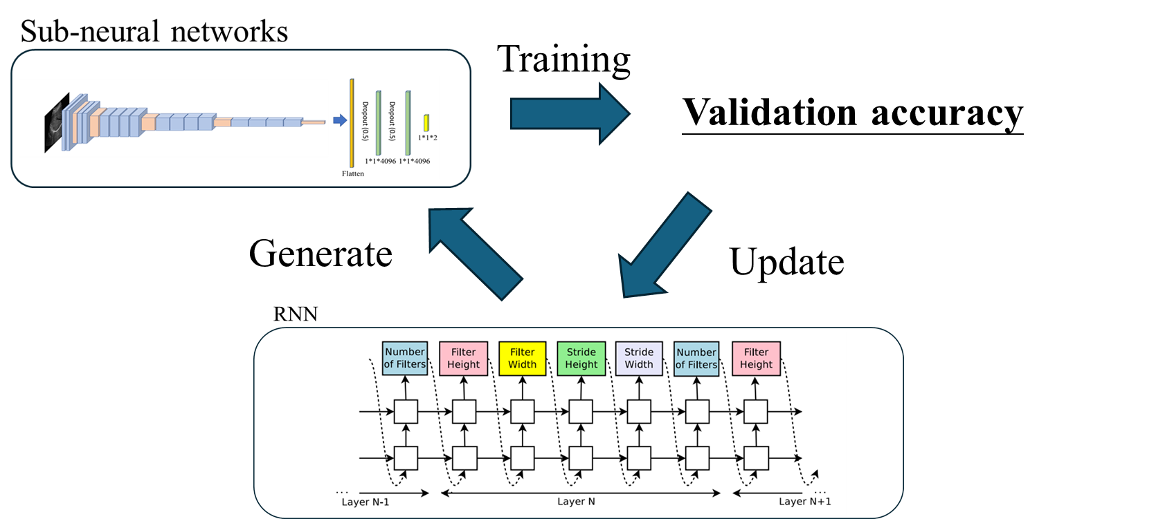
2. Method - Neural Architecture Search with Reinforcement Learning
NASRL - Performance Estimation Strategy
Notes:
In this study, the best validation accuracy of the sub-neural networks is used as the reward signal to update the RNN.
The updated RNN then generates new sub-neural network, and this process continues until the optimal model is produced.
-----------------
𝜃𝑐 refers to the parameters of the controller.

Slide 10
3. Results - Inner data
Performance
Inner test performance
Model | Sensitivity | Specificity | Accuracy | Parameters | AUROC
VGG19 | 0.69±0.13 | 0.78±0.19 | 0.72±0.06 | 139,577,282 | 0.83±0.04
NASRL | 0.76±0.10 | 0.77±0.08 | 0.77±0.07 | 31,164,674 | 0.83±0.04
The number of parameters used in NASRL is reduced by approximately 78% compared to the VGG19
Notes:
After 10-fold cross-validation, Neural Architecture Search with Reinforcement Learning method improved the ability to predict fatty liver and increased the accuracy of the model. Additionally, it significantly reduced the number of model parameters, making the model more efficient.

Slide 11
3. Results - External data
Performance
External test performance
Model | Sensitivity | Specificity | Accuracy | Parameters | AUROC
VGG19 | 0.72±0.10 | 0.71±0.17 | 0.71±0.04 | 139,577,282 | 0.80±0.04
NASRL | 0.83±0.12 | 0.66±0.13 | 0.76±0.02 | 31,164,674 | 0.83±0.02
The model's performance on external test datasets remains consistent, demonstrating its robust.
Notes:
The performance on external testing showed that Neural Architecture Search with Reinforcement Learning method maintained its AUROC performance, and the overall model performance remained stable.
------------------------------------------------------------------------------
在外部測試的表現顯示出 NASRL維持了AUROC的表現， 整體模型效能表現穩定

Slide 12
4. Future works
Collect data from other institutions or ultrasound machines to enhance the generalization ability of the model.
Further classification of the severity of fatty liver into grades S0~S3.
Continue research on applying the NAS method to fatty liver imaging classification tasks.
Notes:
Next, we will continue to collect data from different medical institutions and further enhance the application of NAS in developing fatty liver grading models.

Slide 13



Thank you for your attention!
Author Email: windspeak122@gmail.com
Notes:
Finally ,Thank you for your attention!

Slide 14
Reference:
Zoph, B. (2016). Neural architecture search with reinforcement learning.
Ci, Y., Lin, C., Sun, M., Chen, B., Zhang, H., & Ouyang, W. (2021). Evolving search space for neural architecture search. In Proceedings of the IEEE/CVF International Conference on Computer Vision (pp. 6659-6669).

