Slide 1
jQuery Introduction

Slide 2
Disclaimer
Some of the contents given in this slides were taken form the internet recourses.

Slide 3
Why Study JavaScript?
JavaScript is one of the 3 languages all web developers must learn.
1. HTML to define the content of web pages
2. CSS to specify the layout of web pages
3. JavaScript to program the behavior of web pages
Notes:
Why Study JavaScript?
JavaScript is one of the 3 languages all web developers must learn:
1. HTML to define the content of web pages
2. CSS to specify the layout of web pages
3. JavaScript to program the behavior of web pages

Slide 4
What can JavaScript do ?
JavaScript can change HTML content
JavaScript can change CSS style
JavaScript can validate input
JavaScript can change HTML attributes

Slide 5
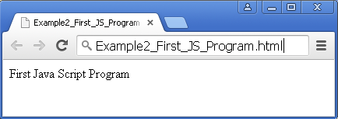
First JavaScript Program
Example2_First_JS_Program.html
<!DOCTYPE html>
<html>
<body>
<script type="text/javascript">
document.write("First Java Script Program");
</script>
</body>
</html>

Slide 6
What is jQuery ?
jQuery is a lightweight, "write less, do more", JavaScript library.
The purpose of jQuery is to make it much easier to use JavaScript on your website.
For Example, Changing the background color of a body tag
function changeBackground(color) {
document.body.style.background = color;
}
onload="changeBackground('red');"
Using JavaScript
Using jQuery
('body').css('background', ‘red');

Slide 7
Why jQuery ?
jQuery is fast, small and feature-rich JavaScript Library.
jQuery is cross-browser
It makes things like HTML document traversal and manipulation, event handling, animation and Ajax much simpler with easy-to-use API that works across a multitude of browsers.

Slide 8
Who uses jQuery ?
Microsoft, Google, Mozilla, IBM, Amazon, HP, Intel.
Ruby on Rails, Wordpress, Django, Drupal, CakePHP, ASP.NET MVC.
Everyone can agree that jQuery is awesome.

Slide 9
Adding jQuery to Your Web Pages
Two Popular Ways
Download the jQuery library from jQuery.com
Include jQuery from a CDN (Content Delivery Network), like Google or Microsoft

Slide 10
Downloading jQuery
There are two versions of jQuery available for downloading:
Production version - this is for live website because it has been minified and compressed (jquery-3.0.0.min.js)
Development version - this is for testing and development (uncompressed and readable code) (jquery-3.0.0.js)
The jQuery library is a single JavaScript file, and we reference it with the HTML <script> tag
<head> <script src=" jquery-3.0.0.min.js "></script> </head>

Slide 11
jQuery CDN
If you don't want to download and host jQuery yourself, you can include it from a CDN (Content Delivery Network).
Both Google and Microsoft host jQuery.
To use jQuery from Google use the following:
<head> <script src="https://ajax.googleapis.com/ajax/libs/jquery/1.12.4/jquery.min.js">
</script> </head>
To use jQuery from Microsoft use the following:
<head> <script src="http://ajax.aspnetcdn.com/ajax/jQuery/jquery-1.12.4.min.js">
</script> </head>
Notes:
One big advantage of using the hosted jQuery from Google or Microsoft: Many users already have downloaded jQuery from Google or Microsoft when visiting another site. As a result, it will be loaded from cache when they visit your site, which leads to faster loading time. Also, most CDN's will make sure that once a user requests a file from it, it will be served from the server closest to them, which also leads to faster loading time.

Slide 12
jQuery Syntax
The jQuery syntax is tailor-made for selecting HTML elements and performing some action on the element(s).
Basic syntax is: $(selector).action()
A $ sign to define/access jQuery
A (selector) to "query (or find)" HTML elements
A jQuery action() to be performed on the element(s)
Examples:
$("p").hide() - hides all <p> elements.
$(".test").hide() - hides all elements with class="test".
$("#test").hide() - hides the element with id="test".
Notes:
$(this).hide() - hides the current element.

Slide 13
The Document Ready Event
All jQuery methods will be inside a document ready event:
$(document).ready(function(){
// jQuery methods go here...
});
This is to prevent any jQuery code from running before the document is finished loading (is ready).
Notes:
It is good practice to wait for the document to be fully loaded and ready before working with it. This also allows you to have your JavaScript code before the body of your document, in the head section.
Here are some examples of actions that can fail if methods are run before the document is fully loaded:
Trying to hide an element that is not created yet
Trying to get the size of an image that is not loaded yet

Slide 14
The Document Ready Event
All jQuery methods will be inside a document ready event:
$(document).ready(function(){
// jQuery methods go here...
});
Even shorter method for the document ready event:
$(function(){
// jQuery methods go here...
});
Notes:
It is good practice to wait for the document to be fully loaded and ready before working with it. This also allows you to have your JavaScript code before the body of your document, in the head section.
Here are some examples of actions that can fail if methods are run before the document is fully loaded:
Trying to hide an element that is not created yet
Trying to get the size of an image that is not loaded yet

Slide 15
Raw JavaScript and jQuery
Example program to Differentiate between JavaScript and jQuery

Slide 16
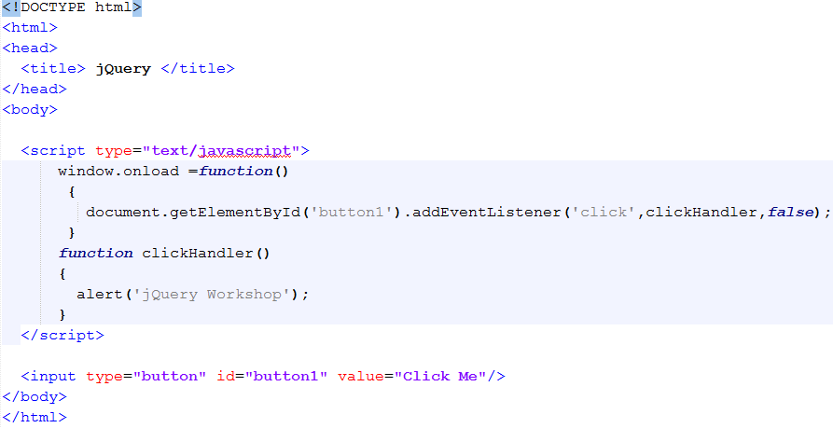
Raw javaScript

Slide 17
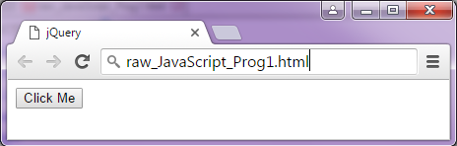
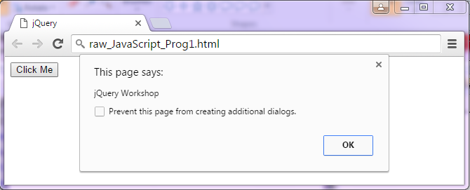
Output

Slide 18
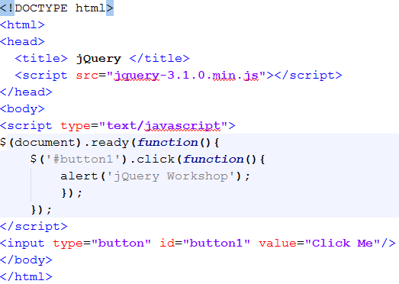
jQuery

Slide 19
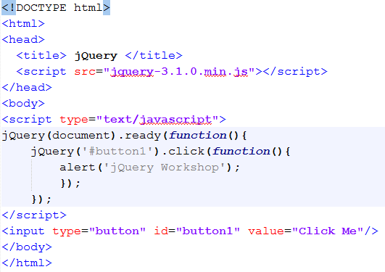
jQuery

Slide 20
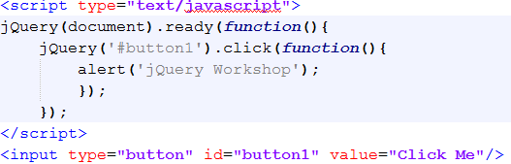
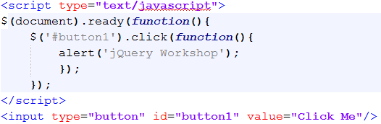
jQuery
jQuery or $

Slide 21
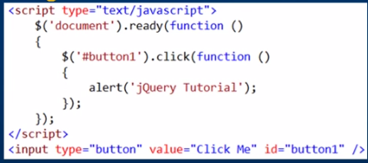
What is jQuery ?
Adding Click Event Handler for a button control using jQuery
With jQuery we have less code to achieve the same thing. We do not have to worry about cross-browser issues, as all this is taken care by jQuery

Slide 22
To Do
Open the program ‘jQuery_Prog2.html’ in the Notepad++ editor
Modify this program to do the following
Add two Button controls
Name this buttons as “Phase Shift 2016” and “Utsav 2016”
We the user clicks on “Phase Shift 2016” button the alert message should be displayed as “Welcome to Phase Shift 2016”. Similarly for the “Utsav 2016” button

Slide 23
Next we learn
What is $(document).ready(function() in jQuery and when to use it
Difference between $(window).load and $(document).ready

Slide 24
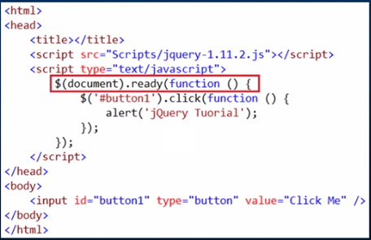
$(document).ready(function() in jQuery
$(document).ready is a jQuery event. It fires as soon as the DOM is loaded and ready to be manipulated by script. This is the earliest point in the page load process where the script can safely access elements in the page’s html dom. This event is fired before all the images, css etc.. Are fully loaded
Notes:
$(document).ready is a jQuery event. It fires as soon as the DOM is loaded and ready to be manipulated
by script. This is the earliest point in the page load process where the script can safely access elements in the page’s html dom. This event is fired before all the images, css etc.. Are fully loaded

Slide 25
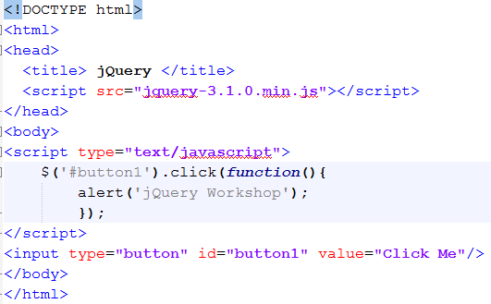
What will happen if we remove $(document).ready(function()

Slide 26
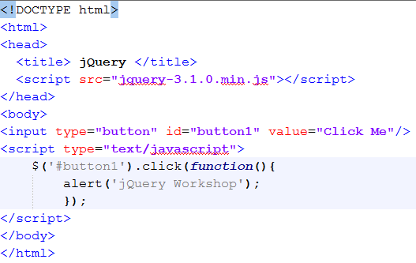
What will be output of the following program

Slide 27
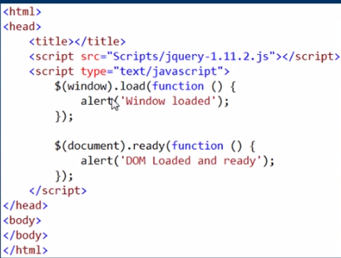
$(window).load
$(window).load event fires when the DOM and all the content on the page(images, css, etc) is fully loaded. Since the window load event waits for images, css etc to be fully loaded, this event fires after ready event.
When you run the page with the below script, notice that the alert in ready function is displayed before the alert in the load function.
Notes:
$(window).load event fires when the DOM and all the content on the page(images, css, etc) is fully loaded. Since the window load event waits for images, css etc to be fully loaded, this event fires after ready event.
When you run the page with the below script, notice that the alert in ready function is displayed before the alert in the load function.

Slide 28
jQuery Selectors

Slide 29
jQuery Selectors
jQuery selectors allow you to select and manipulate HTML element(s).
jQuery selectors are used to "find" (or select) HTML elements based on their name, id, classes, types, attributes, values of attributes and much more. It's based on the existing CSS Selectors.
All selectors in jQuery start with the dollar sign and parentheses: $().
The element Selector
The #id Selector
The class selector

Slide 30
jQuery Selectors
jQuery selectors allow you to select and manipulate HTML element(s).
jQuery selectors are used to "find" (or select) HTML elements based on their name, id, classes, types, attributes, values of attributes and much more. It's based on the existing CSS Selectors.
All selectors in jQuery start with the dollar sign and parentheses: $().
1. The element Selector
The jQuery element selector selects elements based on the element name.
To select all <p> elements on a page: $("p")

Slide 31
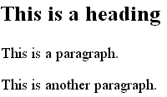
jQuery Element Selector: Example
<!DOCTYPE html>
<html>
<head>
<script src="https://ajax.googleapis.com/ajax/libs/jquery/1.12.4/jquery.min.js">
</script>
<script>
$(document).ready(function(){
$("selector").hide();
});
</script>
</head>
<body>
<h2>This is a heading</h2>
<p>This is a paragraph.</p>
<p>This is another paragraph.</p>
</body> </html>
OutPut

Slide 32

jQuery Element Selector: Example
<!DOCTYPE html>
<html>
<head>
<script src="https://ajax.googleapis.com/ajax/libs/jquery/1.12.4/jquery.min.js">
</script>
<script>
$(document).ready(function(){
$("p").hide();
});
</script>
</head>
<body>
<h2>This is a heading</h2>
<p>This is a paragraph.</p>
<p>This is another paragraph.</p>
</body> </html>
OutPut

Slide 33
jQuery Selectors
All selectors in jQuery start with the dollar sign and parentheses: $().
2. The #id Selector
The jQuery #id selector uses the id attribute of an HTML tag to find the specific element.
To find an element with a specific id, write a hash character, followed by the id of the HTML element:
$("#test")

Slide 34

jQuery #id Selector: Example
<!DOCTYPE html>
<html>
<head>
<script src="https://ajax.googleapis.com/ajax/libs/jquery/1.12.4/jquery.min.js">
</script>
<script>
$(document).ready(function(){
$("selector").hide();
});
</script>
</head>
<body>
<p>This is a paragraph.</p>
<p id="test">This is a paragraph with id="test".</p>
</body>
</html>
OutPut

Slide 35
jQuery #id Selector: Example
<!DOCTYPE html>
<html>
<head>
<script src="https://ajax.googleapis.com/ajax/libs/jquery/1.12.4/jquery.min.js">
</script>
<script>
$(document).ready(function(){
$("#test").hide();
});
</script>
</head>
<body>
<p>This is a paragraph.</p>
<p id="test">This is a paragraph with id="test".</p>
</body>
</html>
OutPut

Slide 36
jQuery Selectors
All selectors in jQuery start with the dollar sign and parentheses: $().
3. The jQuery class selector
The jQuery class selector finds elements with a specific class.
To find elements with a specific class, write a period character, followed by the name of the class: $(".test")

Slide 37
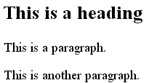
jQuery Class Selector: Example
<!DOCTYPE html>
<html>
<head>
<script src="https://ajax.googleapis.com/ajax/libs/jquery/1.12.4/jquery.min.js">
</script>
<script>
$(document).ready(function(){
$("selector").hide();
});
</script>
</head>
<body>
<h2 class="test">This is a heading</h2>
<p class="test">This is a paragraph.</p>
<p>This is another paragraph.</p>
</body> </html>
OutPut

Slide 38
jQuery Class Selector: Example
<!DOCTYPE html>
<html>
<head>
<script src="https://ajax.googleapis.com/ajax/libs/jquery/1.12.4/jquery.min.js">
</script>
<script>
$(document).ready(function(){
$(".test").hide();
});
</script>
</head>
<body>
<h2 class="test">This is a heading</h2>
<p class="test">This is a paragraph.</p>
<p>This is another paragraph.</p>
</body> </html>
OutPut

Slide 39
Summarizing jQuery Selectors
Element Selector | $(“p”)
Id Selector | $(“#test”)
Class Slector | $(“.test”)

Slide 40
Practice Programs To Do
Go through the file ”jQuery-Selectors-Practicse-Program” and
Complete writing the programs

Slide 41
Thanks for Listening

