Slide 1
Creating and Connecting to Database on Hostinger

Slide 2
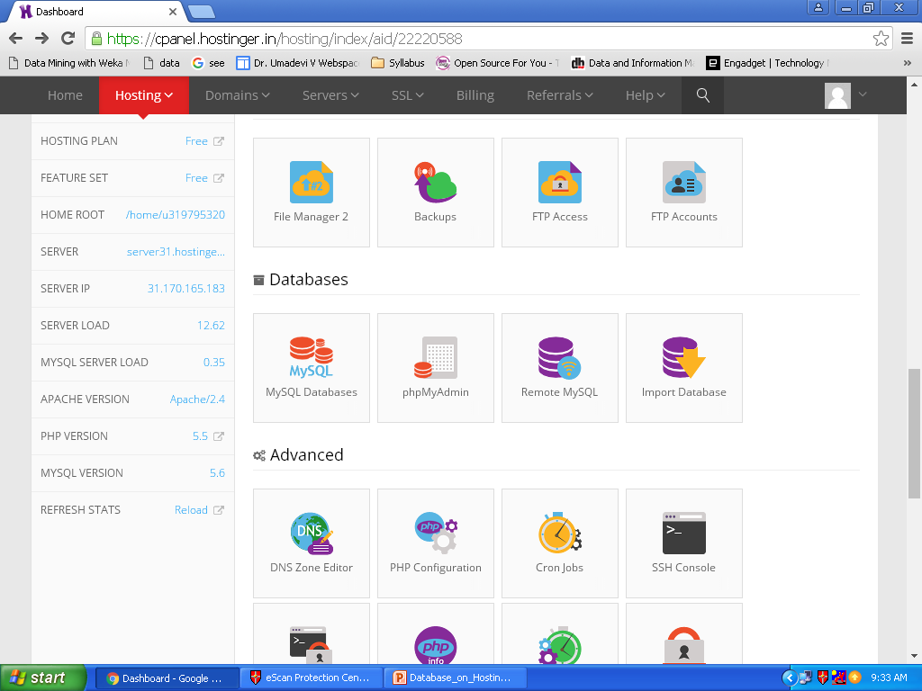
Click on MySQL Database

Slide 3
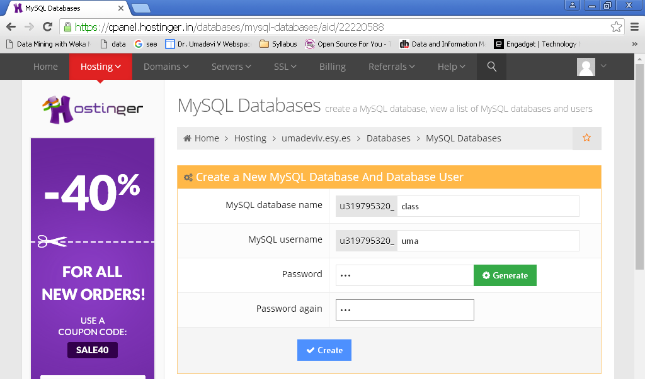
Provide database name, Username and Password. Example: class, uma, umadevi
Click on Create

Slide 4
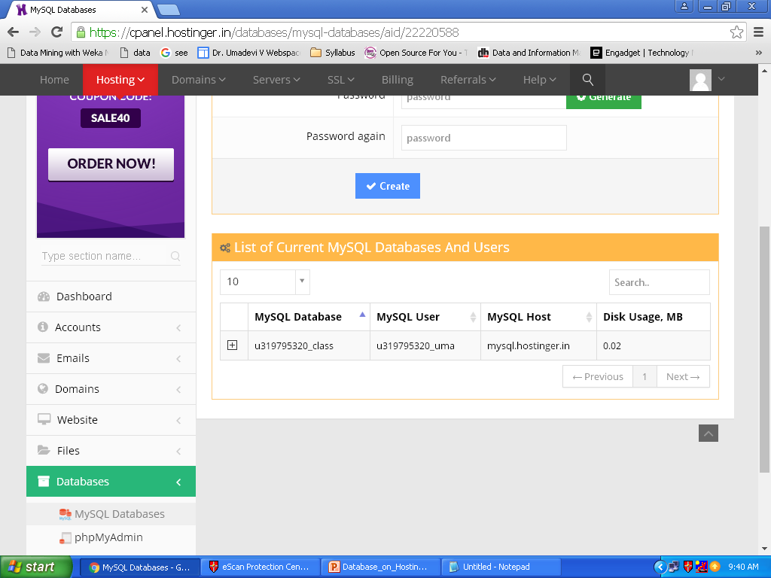
Note down Database Name, Username and Hostname: u319795320_class, u319795320_uma, mysql.hostinger.in

Slide 5
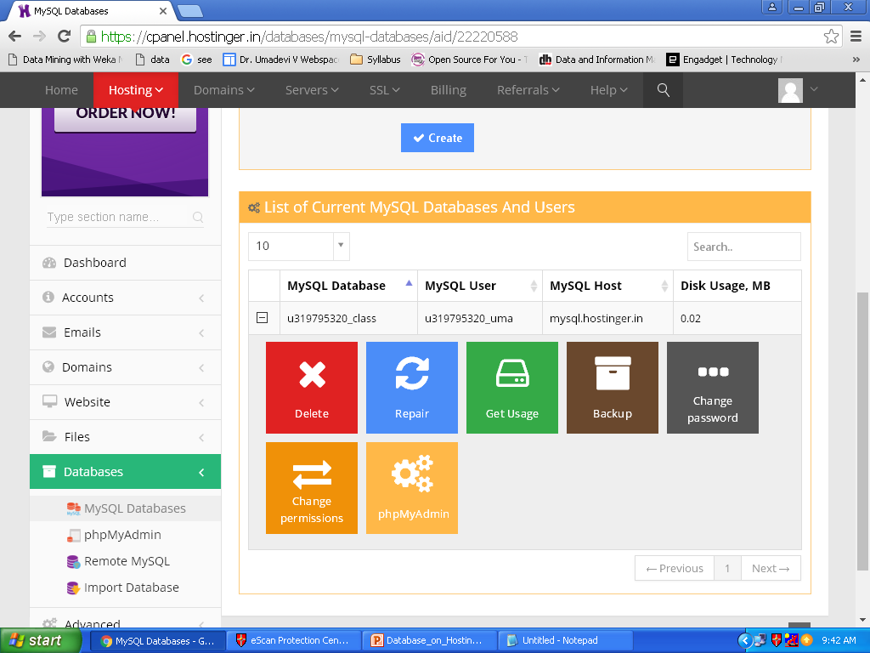
Click on phpMyAdmin

Slide 6
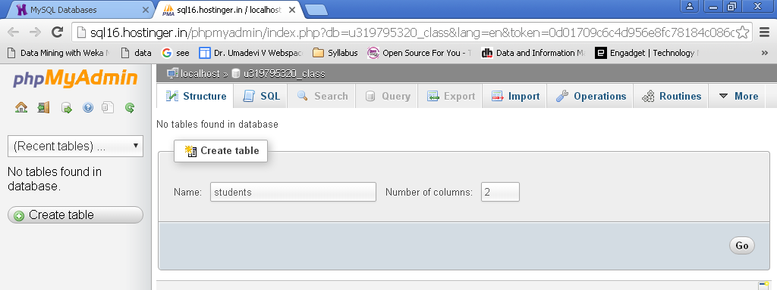
Create new database table: Table name students and Number of Columns 2
Click on Go

Slide 7
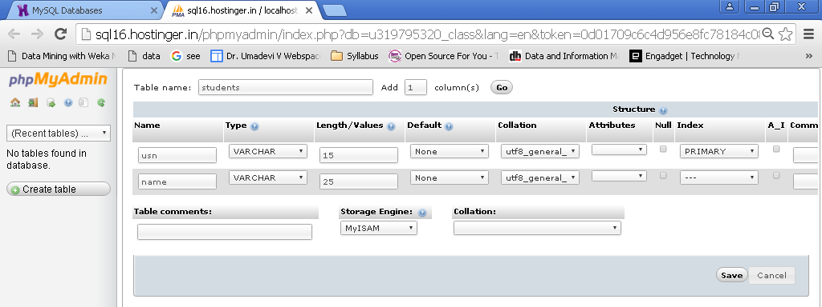
Provide students database table details
Column Name: usn and name
Type: varchar
Length: 15, 25
Collation: utf8_general_ci
Index: for usn column select PRIMARY
Click on Save

Slide 8
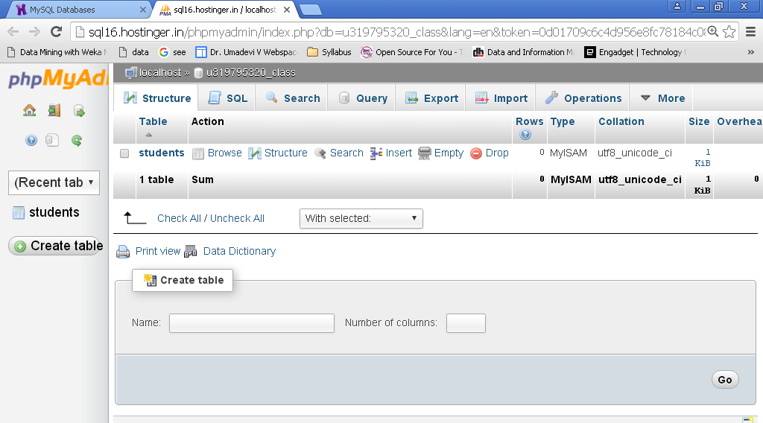
Click on Students Table “Insert”
Click on Insert

Slide 9
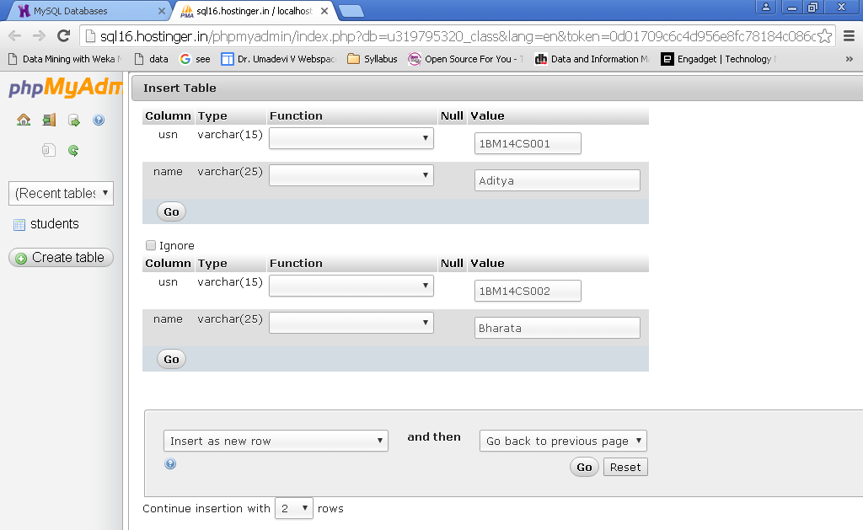
Provide students table column values: 1BM14CS001, Aditya 1BM14CS002, Bharath
Click on Go

Slide 10
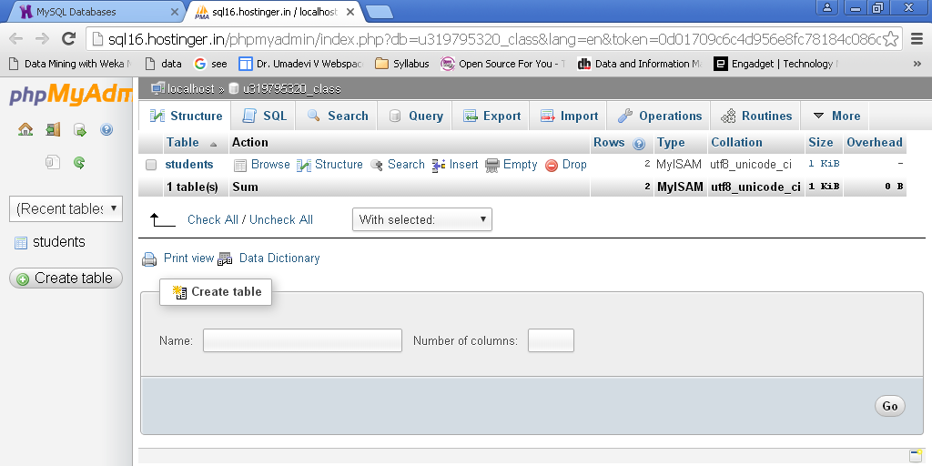
Click on Browse
Click on Browse

Slide 11
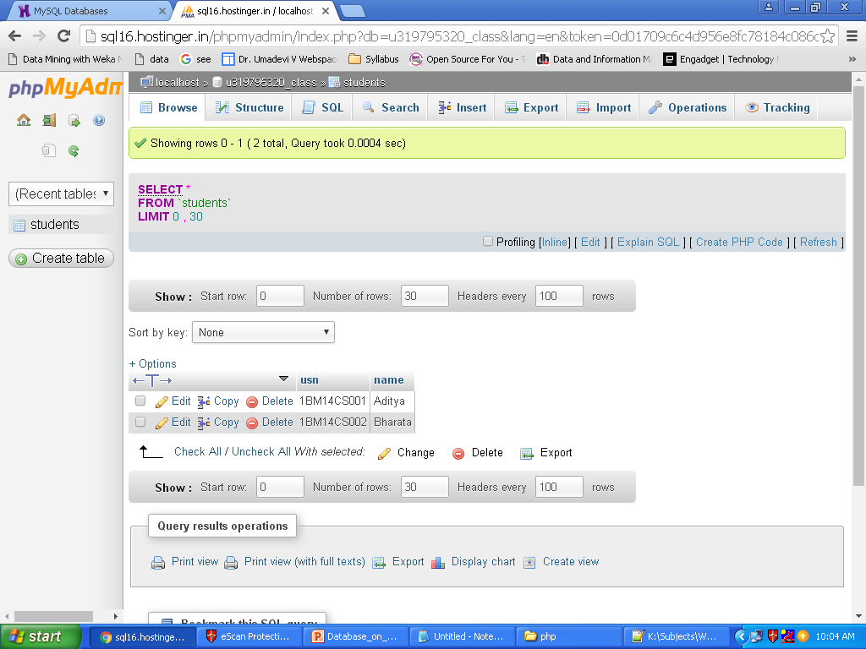
Students table contents

Slide 12
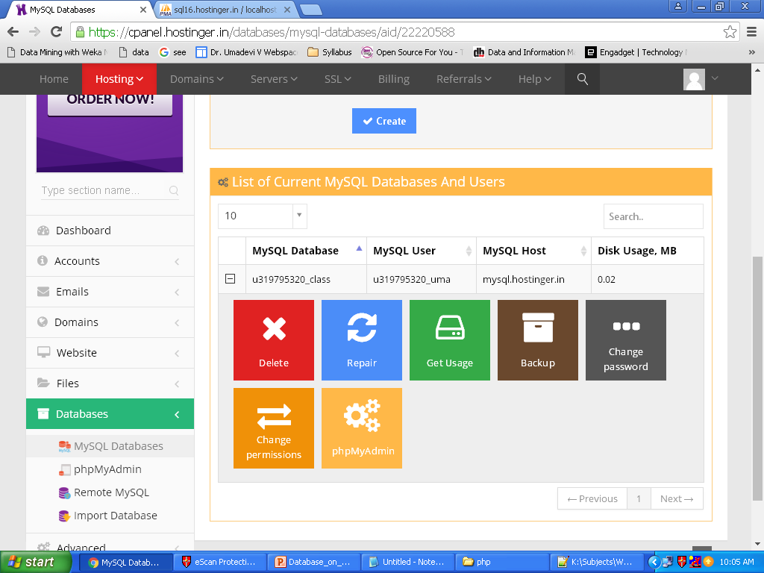
On hostinger account Click on Dashboard

Slide 13
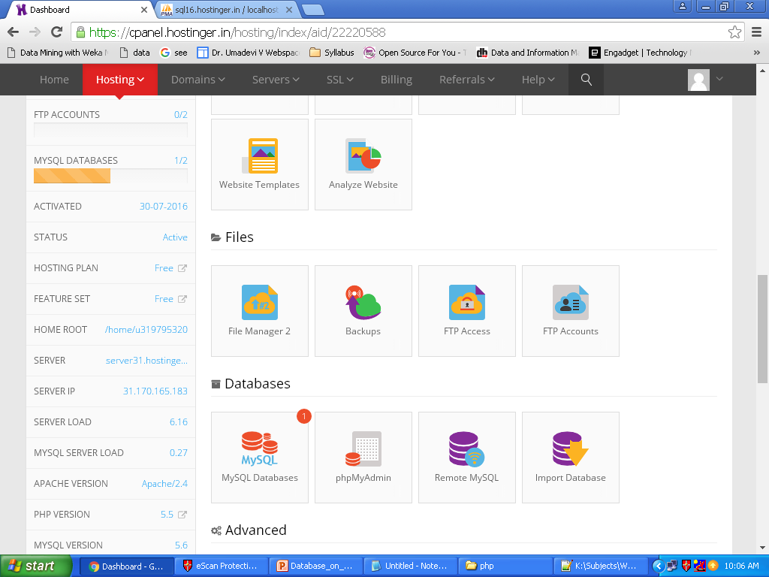
Scrolldown and click on FileManager 2

Slide 14
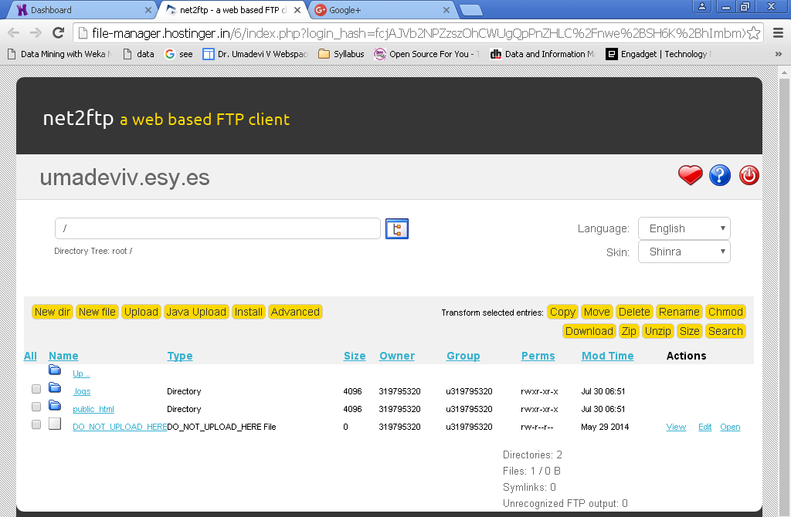
Click on “public_html”
Click on
public_html

Slide 15
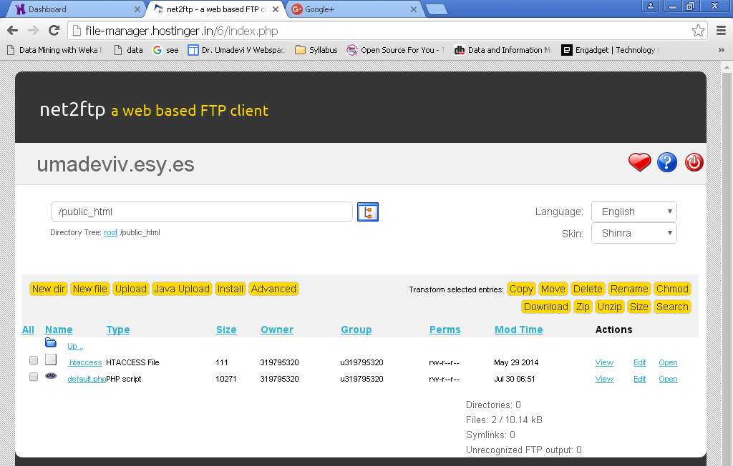
Click on “Upload”
Click
On
Upload

Slide 16
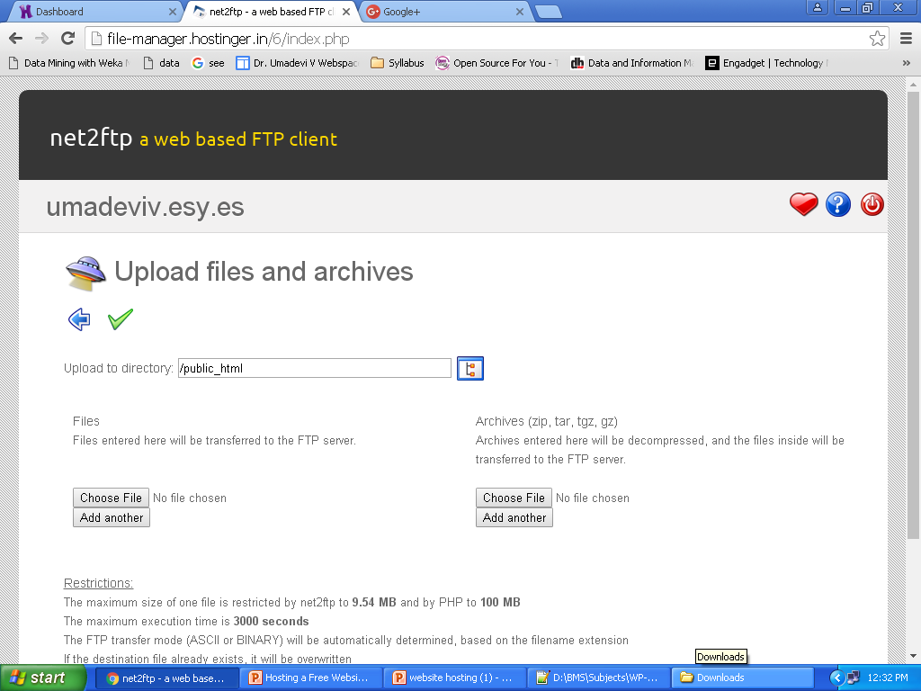
Click on “Choose File”
Click on
Choose file

Slide 17
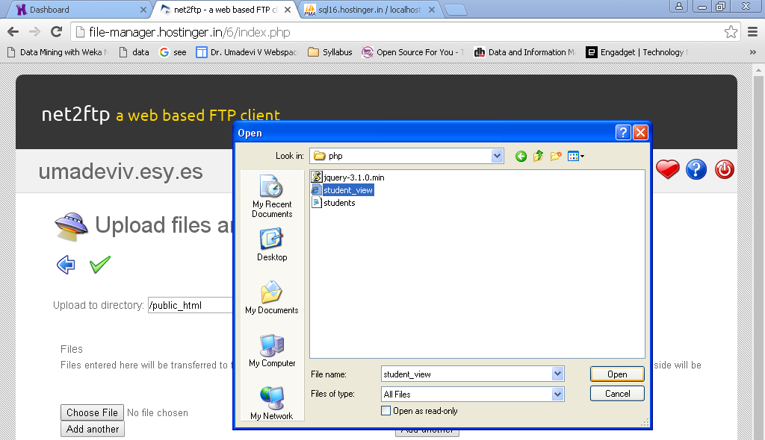
Select the file “student_view.html” and click on Open

Slide 18
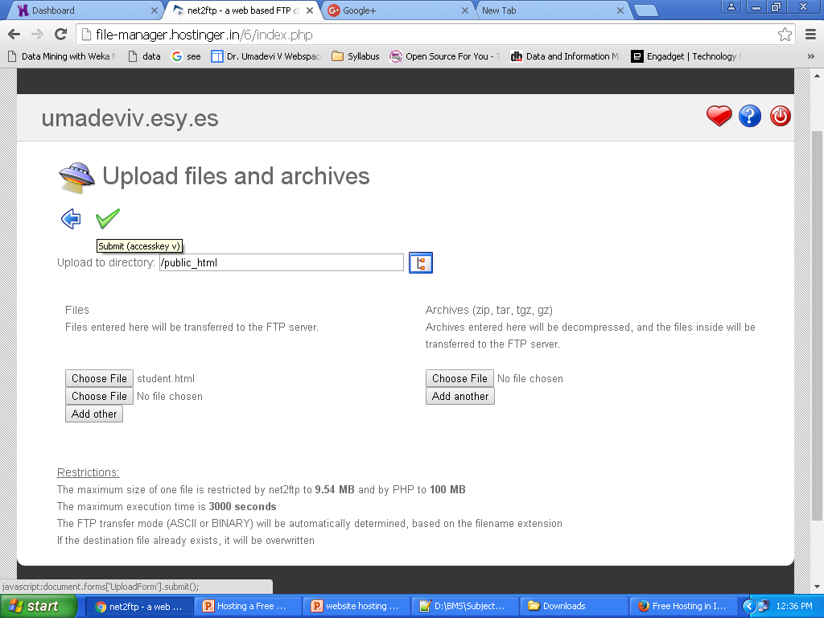
Click on “Submit”
Click on
Submit

Slide 19
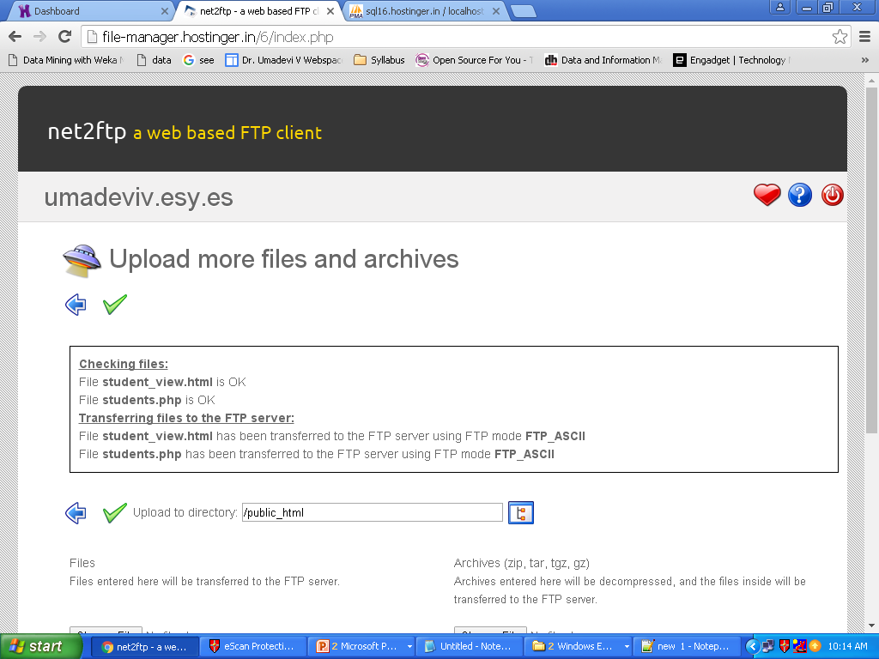
Similarly
Select and upload the file student.php
Click on
On
Blue
Arrow

Slide 20
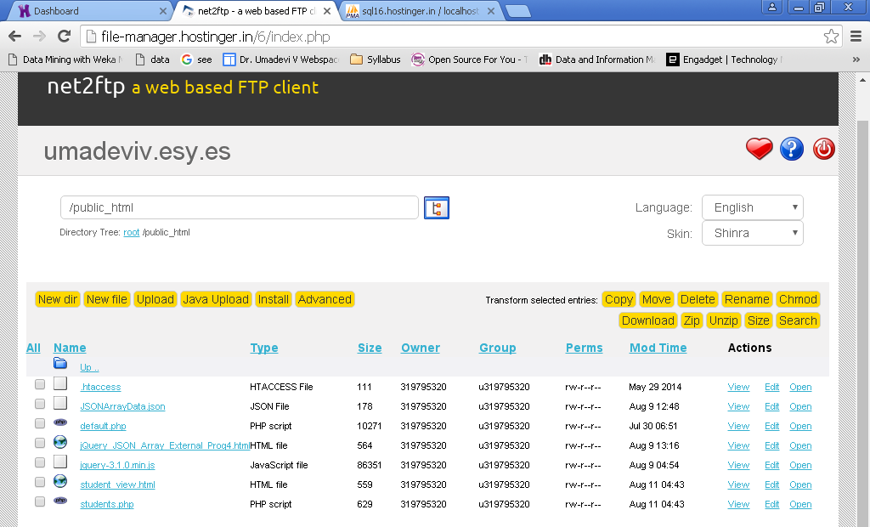
Click on Edit for student.php file

Slide 21
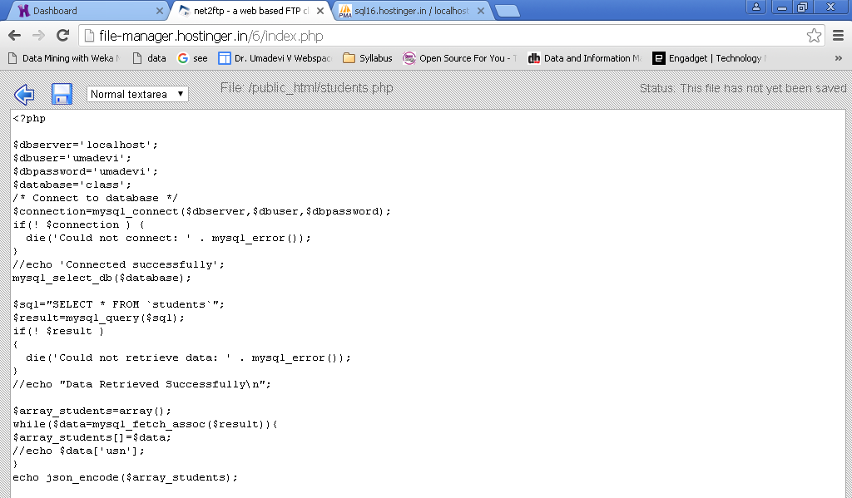
Change dbserver, dbuser , dbpassword, database. Example:mysql.hostinger.in , u319795320_uma, u319795320_class, umadevi

Slide 22
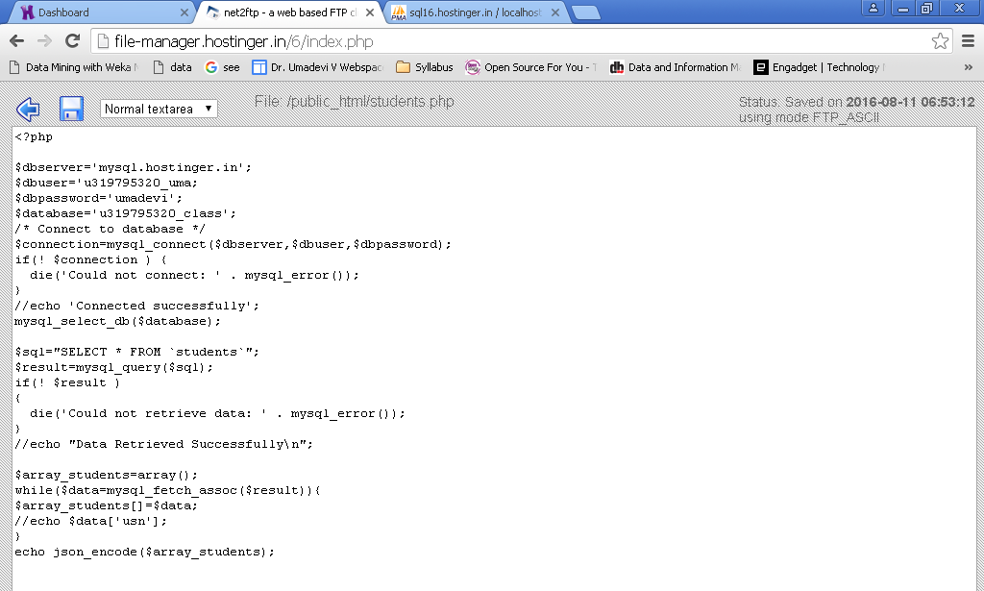
Click on Save and press on Blue arrow

Slide 23
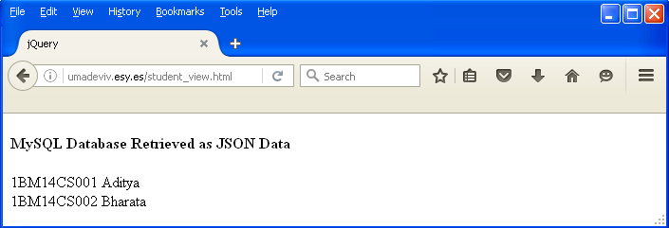
Open Web browser and type the URL “your_domain_name.esy.es/student_view.html” Example: umadeviv.esy.es/student_view.html

