Slide 1
JSON Introduction

Slide 2
What is JSON ?
JSON: JavaScript Object Notation
It is data interchange format based on JavaScript Objects.

Slide 3
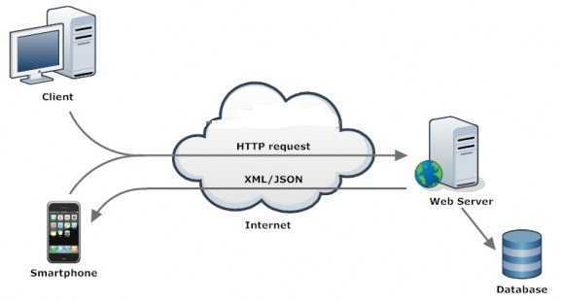
Popular Data Exchange Formats: XML and JSON

Slide 4
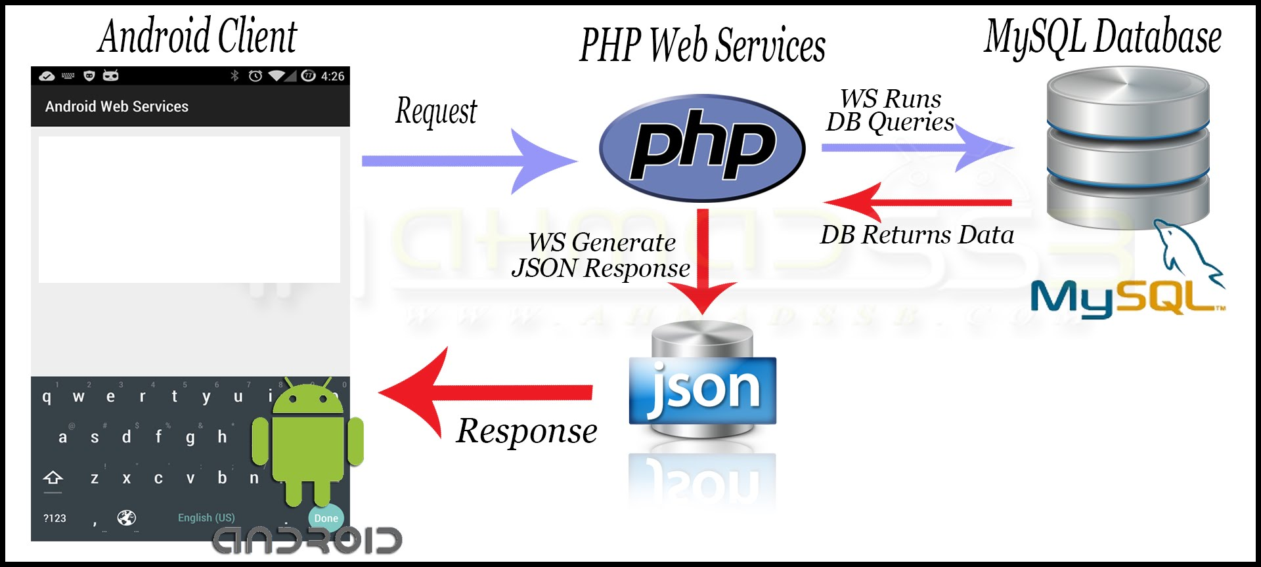
Preferable Data Exchange Format for Mobile devices: JSON
Notes:
Uses of JSON
It is used while writing JavaScript based applications that includes browser extensions and websites.
JSON format is used for serializing and transmitting structured data over network connection.
It is primarily used to transmit data between a server and web applications.
Web services and APIs use JSON format to provide public data.

Slide 5
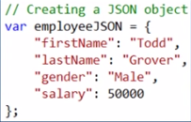
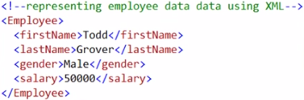
JavaScript Object Notation
JSON is easy to read and write.
JSON is a lightweight text-based interchange format
JSON is an easier-to-use alternative to XML
JSON in language independent
Notes:
Characteristics of JSON
It is a lightweight text-based interchange format.
JSON is language independent.

Slide 6
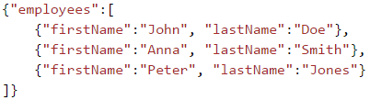
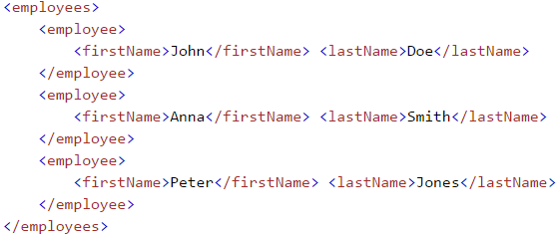
Example of employees object, with an array of 3 employee records:
JSON example
XML example

Slide 7
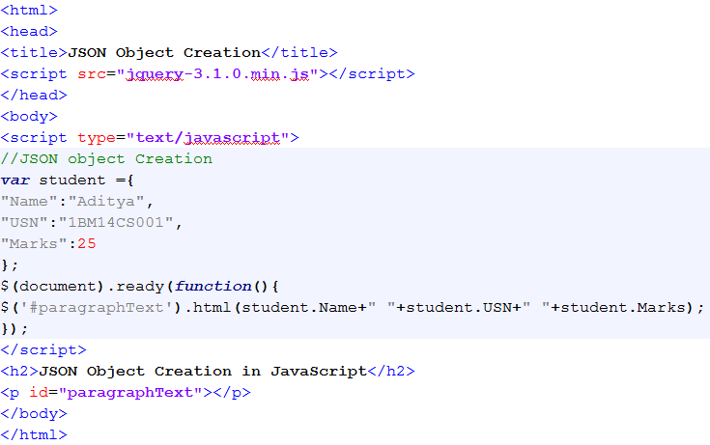
JSON Object Creation and Access: Example

Slide 8
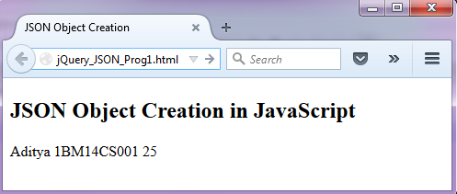
JSON Object Creation and Access: Example

Slide 9
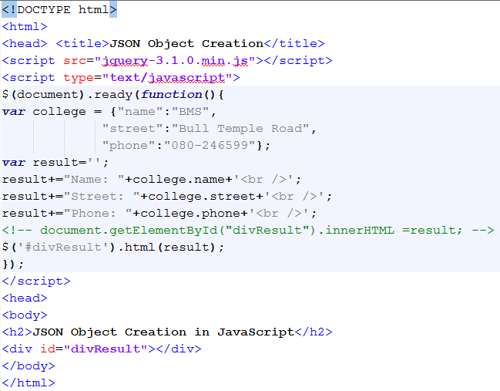
What will be the Output of the Following Program ?

Slide 10
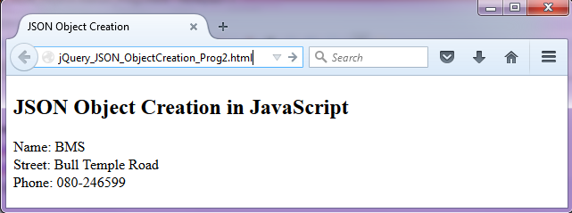
What will be the Output of the Following Program ?

Slide 11

Accessing JSON Objects
Dot Notation or Brackets to Access the JSON object values
student.Name
Or
student[“Name”]

Slide 12
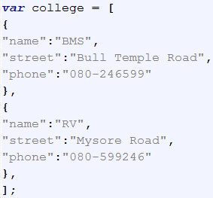
JSON Arrays
A JSON array contains multiple objects
To Create JSON array
1. Wrap the objects in square brackets
2. Each object must be separated by comma
Accessing JSON array object elements
college[0].name
college[0].street
college[0].phone
college[1].name
college[1].street
college[1].phone

Slide 13
Summarizing JSON Syntax Rules
JSON syntax is derived from JavaScript object notation syntax:
Data is in name/value pairs
Data is separated by commas
Curly braces hold objects
Square brackets hold arrays
JSON values can be:
A number (integer or floating point)
A string (in double quotes)
A Boolean (true or false)
An array (in square brackets)
An object (in curly braces)
null

Slide 14

To Do
Open the program ‘jQuery_JSON_ObjectCreation_Prog1.html’ in the Notepad++ editor
Modify this program to do the following
Create two JSON Book Objects to Store following information
Display Book information on the Webpage
id:01 language: "Java“ edition: "third“ author: "Herbert Schildt" | id:07 language: "C++“ edition: "second“ author: "E.Balagurusamy"

Slide 15
JSON Files
The file type for JSON files is ".json“
A common use of JSON is to read data from a web server, and display the data in a web page.

Slide 16
JSON data in External file
external.json
{
"book": [{
"id":"01",
"language": "Java",
"edition": "third",
"author": "Herbert Schildt"
},{
"id":"07",
"language": "C++",
"edition": "second",
"author": "E.Balagurusamy"
}]
}

Slide 17
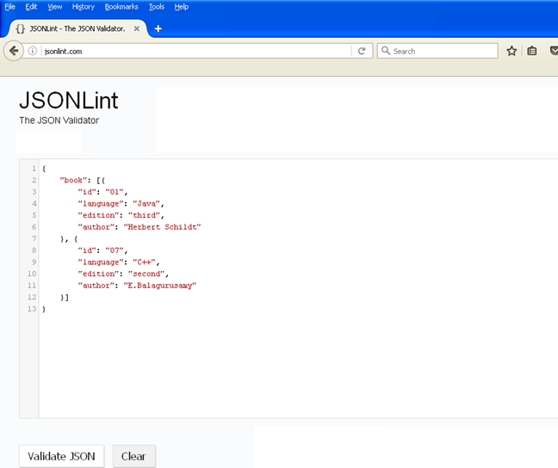
Validating JSON data: http://jsonlint.com/

Slide 18
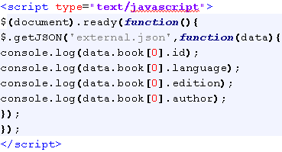
Fetch JSON Array Elements Using jQuery Method: getJSON
Prog.html
external.json
{
"book": [{
"id":"01",
"language": "Java",
"edition": "third",
"author": "Herbert Schildt"
},{
"id":"07",
"language": "C++",
"edition": "second",
"author": "E.Balagurusamy"
}]
}

Slide 19
Fetch JSON Array Elements Using jQuery Method: getJSON
Prog.html
external.json
{
"book": [{
"id":"01",
"language": "Java",
"edition": "third",
"author": "Herbert Schildt"
},{
"id":"07",
"language": "C++",
"edition": "second",
"author": "E.Balagurusamy"
}]
}

Slide 20
Fetch JSON Array Elements Using jQuery Method: getJSON
Prog.html
external.json
{
"book": [{
"id":"01",
"language": "Java",
"edition": "third",
"author": "Herbert Schildt"
},{
"id":"07",
"language": "C++",
"edition": "second",
"author": "E.Balagurusamy"
}]
}

Slide 21

Fetch JSON Array Elements Using jQuery Method: getJSON
Prog.html
external.json
{
"book": [{
"id":"01",
"language": "Java",
"edition": "third",
"author": "Herbert Schildt"
},{
"id":"07",
"language": "C++",
"edition": "second",
"author": "E.Balagurusamy"
}]
}

Slide 22
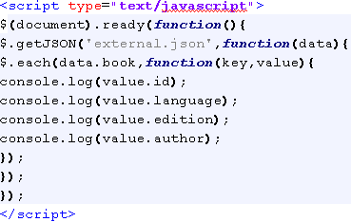
Fetching each element of the array
Prog.html
external.json
{
"book": [{
"id":"01",
"language": "Java",
"edition": "third",
"author": "Herbert Schildt"
},{
"id":"07",
"language": "C++",
"edition": "second",
"author": "E.Balagurusamy"
}]
}

Slide 23

Fetching each element of the array
Prog.html
external.json
{
"book": [{
"id":"01",
"language": "Java",
"edition": "third",
"author": "Herbert Schildt"
},{
"id":"07",
"language": "C++",
"edition": "second",
"author": "E.Balagurusamy"
}]
}

Slide 24

To Do
Open the program ‘jQuery_JSON_External_Array _Loop_Prog5.html’ in the Notepad++ editor
Modify this program to do the following
Create two JSON Student Objects to Store following information
Display Student information on the Webpage
usn: "1BM14CS001", name: "Aditya", marks: 30, address: { street: "Bull Temple Road", city: "Bangalore", pincode: 560001 } | usn: "1BM14CS002", name: “Bharath", marks: 50, address: { street: “Ranga Rao Road", city: “Kalor", pincode: 560115 }

Slide 25
Next We Will Learn
To extract pincode of the Indian Cities using Google maps JSON data

Slide 26
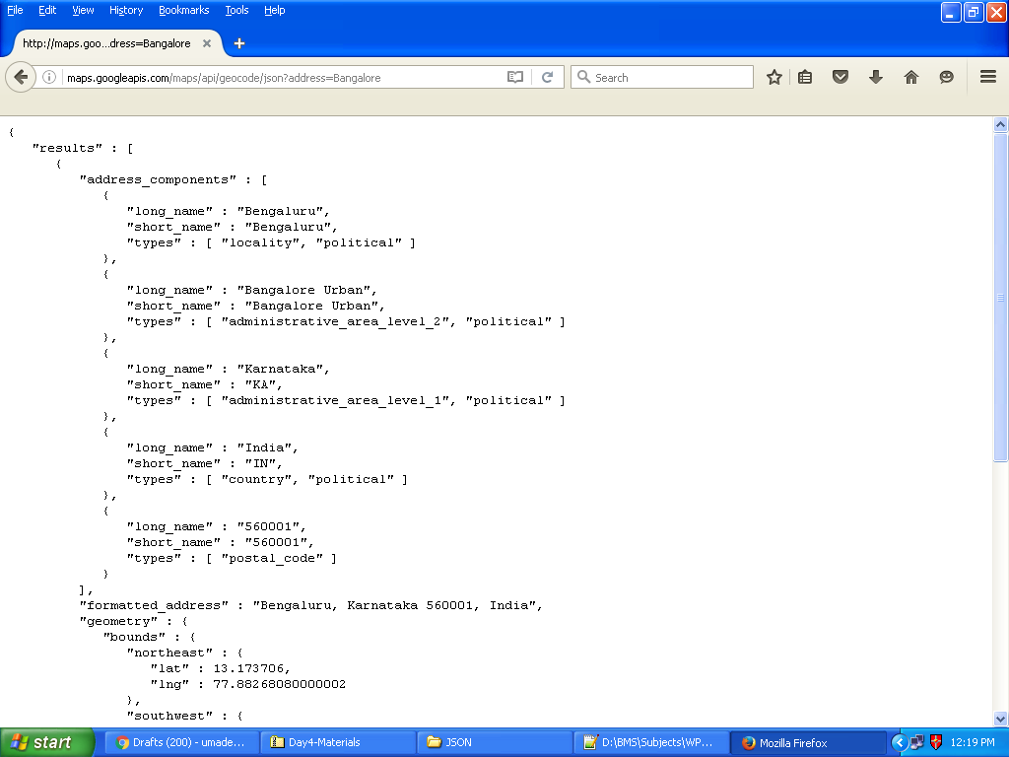
http://maps.googleapis.com/maps/api/geocode/json?address=Bangalore

Slide 27
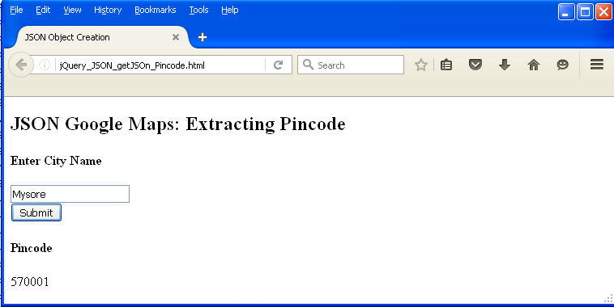
To extract pincode of the Indian Cities using Google maps JSON data

Slide 28
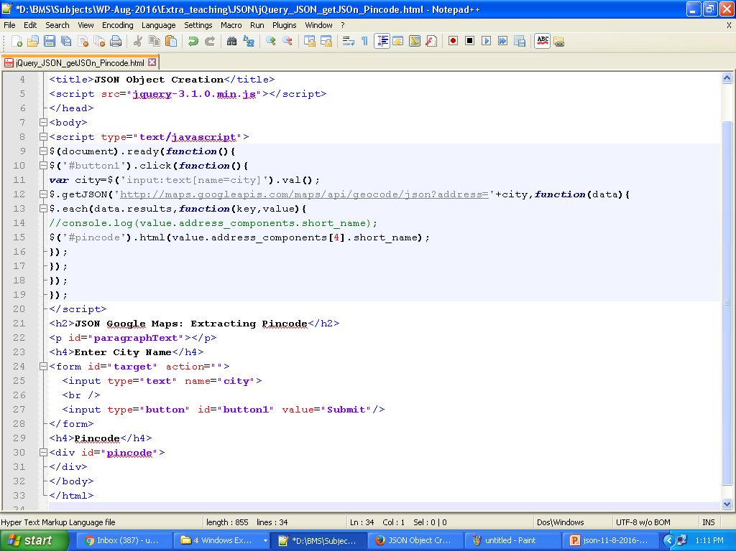
To extract pincode of the Indian Cities using Google maps JSON data

Slide 29
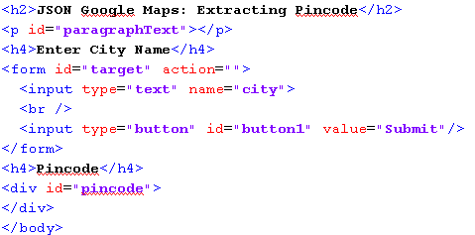
To extract pincode of the Indian Cities using Google maps JSON data

Slide 30
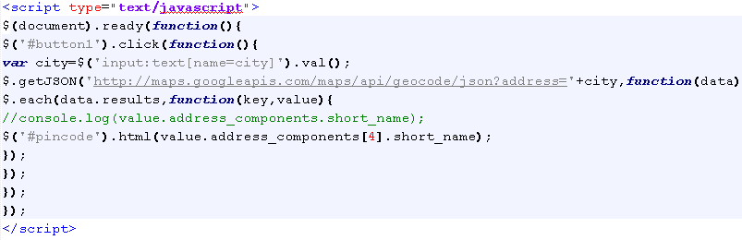
To extract pincode of the Indian Cities using Google maps JSON data

Slide 31
To Do
Open the program ‘jQuery_JSON_getJSOn_Pincode.html’ in the Notepad++ editor
Modify this program to do the following
Display State Name for the given City name

Slide 32
Next We Will Learn
To fetch MySQL database from server to client as JSON data

Slide 33
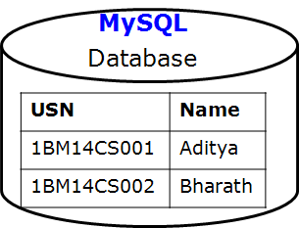
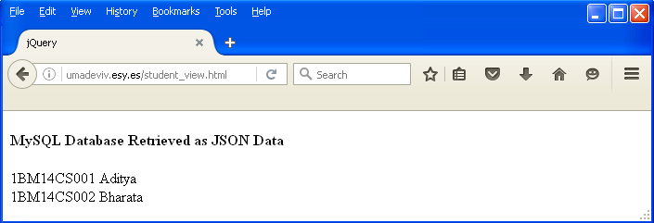
Fetching MySQL database from server to client as JSON data

Slide 34
Fetching MySQL database from server to client as JSON data
Student_view.html
Students.php
<!DOCTYPE html>
<html>
<head>
<title> jQuery </title>
<script src="http://ajax.googleapis.com/ajax/libs/jquery/1.12.4/jquery.min.js"></script>
</head>
<body>
<script type="text/javascript">
$(document).ready(function(){
loadData();
});
var loadData=function(){
$.ajax({type:"POST",url:"students.php"}).done(function(data){console.log(data)
var users=JSON.parse(data);
for(var i in users){
$("#content").append(users[i].usn+" "+users[i].name+"<br />");
}
});
}
</script>
<h4>MySQL Database Retrieved as JSON Data</h4>
<div id="content"></div>
</body>
</html>
<?php
$dbserver='mysql.hostinger.in';
$dbuser='u319795320_uma';
$dbpassword='umadevi';
$database='u319795320_class';
/* Connect to database */
$connection=mysqli_connect($dbserver,$dbuser,$dbpassword,$database);
if(! $connection ) {
die('Could not connect: ' . mysqli_error());
}
/*echo 'Connected successfully';*/
$sql="SELECT * FROM students";
$result=mysqli_query($connection, $sql);
if(! $result )
{
die('Could not retrieve data: ' . mysqli_error($connection));
}
/*echo "Data Retrieved Successfully";*/
$array_students=array();
while($data=mysqli_fetch_assoc($result)){
$array_students[]=$data;
/*echo $data['usn'];*/
}
echo json_encode($array_students);
?>

Slide 35
Next We Will Learn
How to create database on Hostinger account.
Note: Use the ppt slides “Database_on_Hostinger”

Slide 36
To Do
On Hostinger, add to your students database table “marks” column and add five student records as follows
Modify “student_view.html” file to display only those students name whose marks score is less than 50
1BM14CS001 | Aditya | 80
1BM14CS002 | Bharath | 10
1BM14CS003 | Chandan | 75
1BM14CS004 | Dinesh | 60
1BM14CS005 | Eshwar | 20
1BM14CS002 | Bharath | 10
1BM14CS005 | Eshwar | 20

