Slide 1
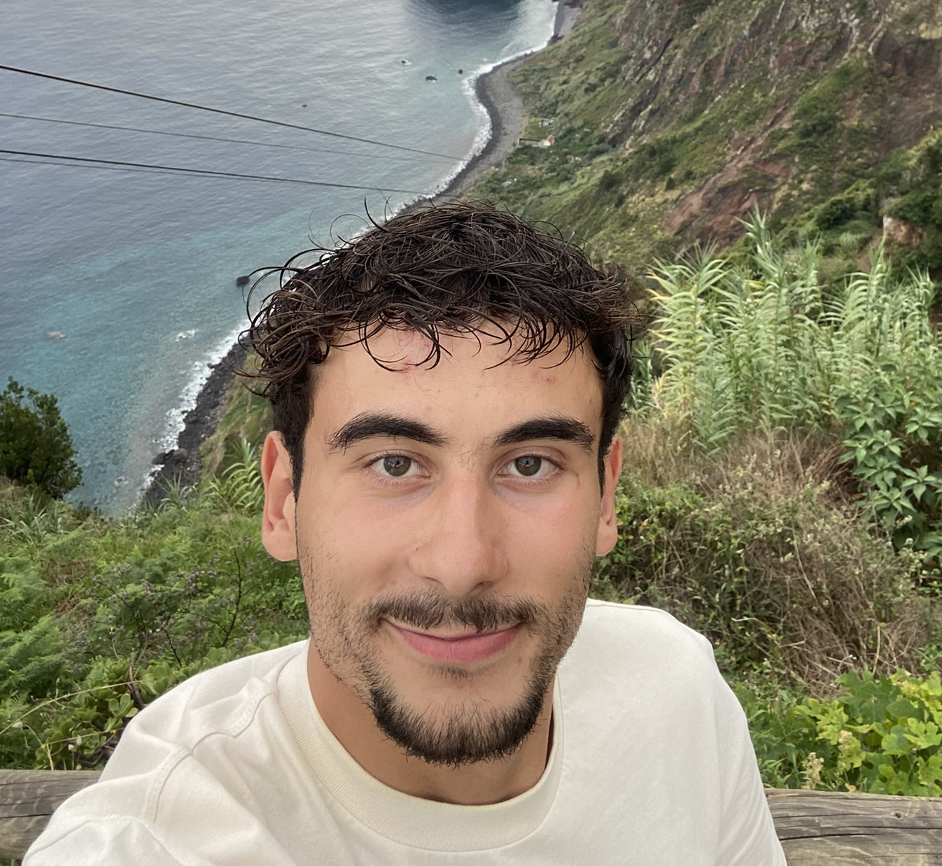

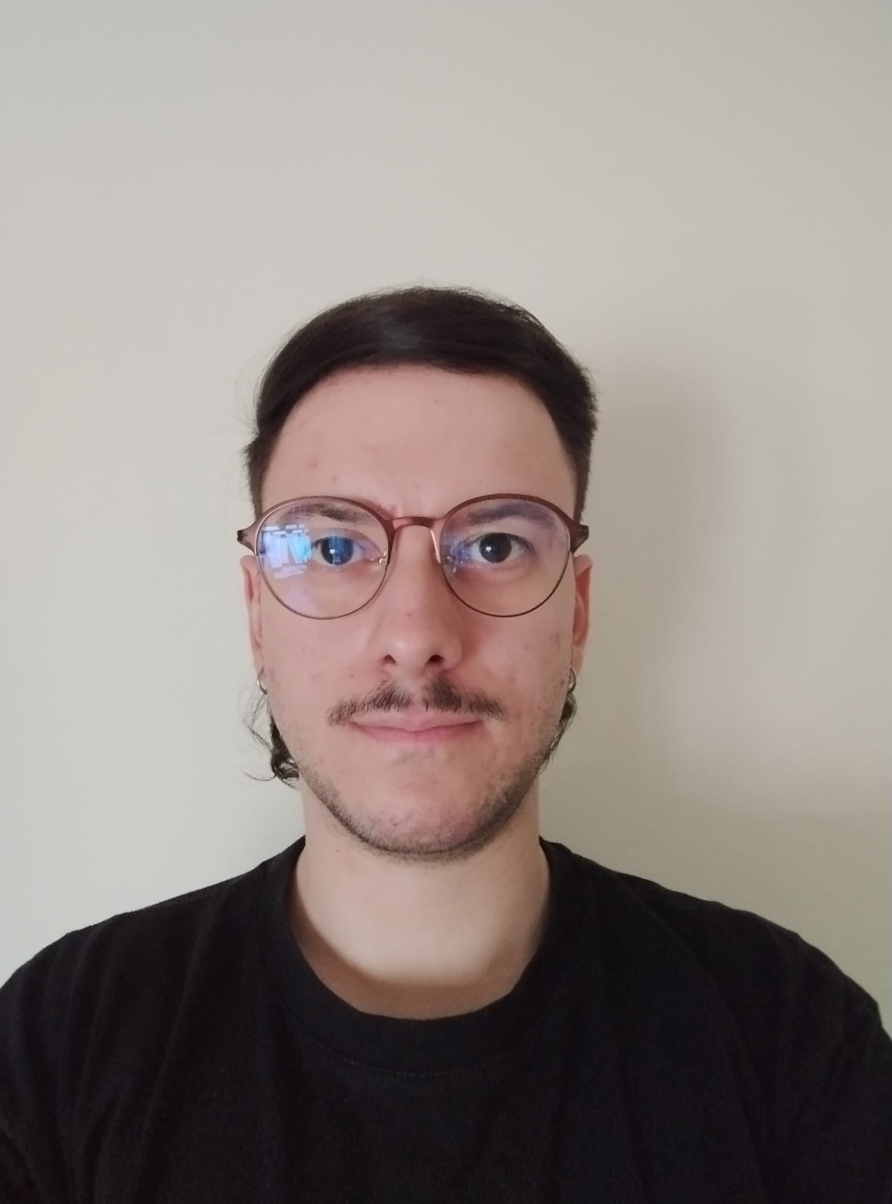
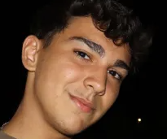

Logistic On Rails - SPRINT 2
G075
LAPR3 2025/2026
Carlos Almeida (1221515) | Bruno Silva (1221514) | Miguel Pinto (1221526) | João Pereira (1230677) | Francisca Paulos (1230993)

Slide 2
Sprint planning – Sprint 2
Planned Start Date: 27/10/2025 Real Start Date: 30/10/2025
Planned End Date: 23/11/2025 Real End Date: 22/11/2025
SPRINT BACKLOG
Number of stories | 27
Number of bugs | 2
Number of tasks | 15
Number of Management Tasks (Scrum) | 13
Number of team members | Planned: 5 Actual: 5
Total planned estimation vs execution | Planned hours: 186,5 Executed hours: 150,5

Slide 3
Sprint 2 planning
Assigned User Stories (as stated in the project assignment) | Commited? Yes / No (according to team planning) | Todo | Doing | Testing | Done | Blocked
USLP05 | Yes |  |  |  | ✅
USLP06 | Yes |  |  |  | ✅
USLP07 | Yes |  |  |  | ✅
USAC01 | Yes |  |  |  | ✅
USAC02 | Yes |  |  |  | ✅
USAC03 | Yes |  |  |  | ✅
USAC04 | Yes |  |  |  | ✅
USAC05 | Yes |  |  |  | ✅
USAC06 | Yes |  |  |  | ✅
USAC07 | Yes |  |  |  | ✅

Slide 4
Sprint 2 planning
Assigned User Stories (as stated in the project assignment) | Commited? Yes / No (according to team planning) | Todo | Doing | Testing | Done | Blocked
USAC08 | Yes |  |  |  | ✅
USAC09 | Yes |  |  |  | ✅
USEI06 | Yes |  |  |  | ✅
USEI07 | Yes |  |  |  | ✅
USEI08 | Yes |  |  |  | ✅
USBD21 | Yes |  |  |  | ✅
USBD22 | Yes |  |  |  | ✅
USBD28 | Yes |  |  |  | ✅
USBD30 | Yes |  |  |  | ✅

Slide 5
Work assigned by team member

Slide 6
Work assigned by type (component)

Slide 7
Issues / Assumptions / unanswered questions
Description | Responsible | Date / sprint | Related issue / item in Git
Assumed the power-to-weight ratio was speed ≈ (total_power_kw / total_weight_tons) * factor | Miguel Pinto 1221526 | 17/11/2025 Sprint 2 | Issue #95
Assumed the default stop time at facilities minutes is 5 | Miguel Pinto 1221526 | 19/11/2025 Sprint 2 | Issue #95
Assumed the time to wait for crossing on single-track is 5 minutes | Miguel Pinto 1221526 | 19/11/2025 Sprint 2 | Issue #95
Assumed the power to speed factor was 8 (kW/ton to km/h conversation factor) | Miguel Pinto 1221526 | 19/11/2025 Sprint 2 | Issue #95

Slide 8
Daily Meetings
Date (of the meeting) | Place / duration | Team member 1 | Team member 2 | Team member 3 | Team member 4 | Team member 5
29/10/2025 | Discord / 15 min | x | x | x | x | x
31/10/2025 | Discord / 15 min | x | x | x | x | x
03/11/2025 | Discord / 15 min | x | x | x | x | x
05/11/2025 | Class / 15 min | x | x | x | x | x
07/11/2025 | Discord / 15 min | x | x | x | x | x
09/11/2025 | Discord / 15 min | x | x | x | x | x
12/11/2025 | Class / 15 min | x | x | x | x | x
14/11/2025 | Discord / 15 min | x | x | x | x | x
17/11/2025 | Discord / 15 min | x | x | x | x | x
19/11/2025 | Class / 15 min | x | x | x | x | x
21/11/2025 | Discord / 15 min | x | x | x | x | x
22/11/2025 | Discord / 15 min | x | x | x | x | x

Slide 9
LLM performance assessment - Input (use ChatGPT or Copilot)
Source file (attach the file you have used): This very own file.
Input (write down the prompt you used to ask for the performance assessment): Given this document rate the performance of each team member individually.

Slide 10
LLM performance assessment - Output
Output file (attach the complete file extracted from the A.I. tool): The output from the LLM was a prompt.
Output (write one line per team member):
João: Contributed directly to ensuring all ARQCP user stories passed unit tests.
Bruno: Delivered all assigned tasks with no reported issues.
Carlos: Carlos demonstrated consistency, responsibility, and solid task execution.
Miguel: Contributed to a sprint where the team reported everything progressing as expected with no setbacks.
Francisca: Reliable and collaborative contributor, helping maintain strong team performance.

Slide 11
LLM performance assessment – Critical Insight
Team Members’ Opinion about the A.I. output
The team believes that the A.I. gave a vague output that can be used in a lot of group projects, the feeling is that the A.I. was only specific about 2 or 3 slides.
Improvement Suggestion from LLM: Improve Collaboration Visibility.
The report only mentions João and Bruno by name.
This doesn’t mean others didn’t work — but it suggests their contributions weren’t documented.
Improvement opportunity:
Ensure all team members have:
Their tasks listed
Their contributions noted in the retrospective
This will also help with evaluation fairness.

Slide 12
Sprint Retrospective Date: 23/11/2025
What went well?
ESINF part was really smooth, and we think we did everything as it was asked
João and Bruno showed satisfaction as they could set all ARQCP US to pass the given unit tests
What went wrong?
Problems with the data source
What we learned?
To read forum answers

Slide 13
Sprint Retrospective Date: 23/11/2025
Action items:
Keep the planning steady
Continue the estimate of hours as it was close to the real hours

Slide 14

Overall Project Performance:
LLM evaluation: 2,5/5
Team evaluation: 4/5
Team feeling: 5/5
✔️
Notes:
Add any slide you consider relevant.

Slide 15


