Slide 1
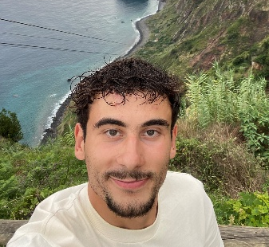

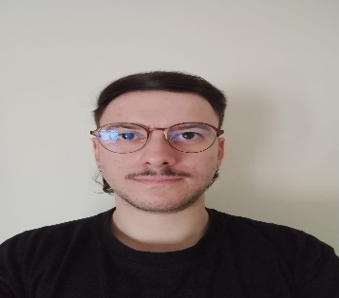
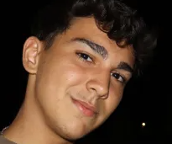

Logistic On Rails - SPRINT 3
G075
LAPR3 2025/2026
Carlos Almeida (1221515) | Bruno Silva (1221514) | Miguel Pinto (1221526) | João Pereira (1230677) | Francisca Paulos (1230993)

Slide 2
Sprint planning – Sprint 3
Planned Start Date: 24/11/2025 Real Start Date: 01/12/2025
Planned End Date: 04/01/2026 Real End Date: 04/01/2026
SPRINT BACKLOG
Number of stories | 19
Number of bugs | 3
Number of tasks | 45
Number of Management Tasks (Scrum) | 19
Number of team members | Planned: 5 Actual: 5
Total planned estimation vs execution | Planned hours: 227,5 Executed hours: 121

Slide 3
Sprint 3 planning
Assigned User Stories (as stated in the project assignment) | Commited? Yes / No (according to team planning) | Todo | Doing | Testing | Done | Blocked
USAC10 | Yes |  |  |  | ✅
USAC11 | Yes |  |  |  | ✅
USAC12 | Yes |  |  |  | ✅
USAC13 | Yes |  |  |  | ✅
USAC14 | Yes |  |  |  | ✅
USAC16 | Yes |  |  |  | ✅
USBD31 | Yes |  |  |  | ✅
USBD32 | Yes |  |  |  | ✅
USBD33 | Yes |  |  |  | ✅
USBD39 | Yes |  |  |  | ✅

Slide 4
Sprint 3 planning
Assigned User Stories (as stated in the project assignment) | Commited? Yes / No (according to team planning) | Todo | Doing | Testing | Done | Blocked
USBD40 | Yes |  |  |  | ✅
USBD41 | Yes |  |  |  | ✅
USBD42 | Yes |  |  |  | ✅
USEI11 | Yes |  |  |  | ✅
USEI12 | Yes |  |  |  | ✅
USEI13 | Yes |  |  |  | ✅
USLP08 | Yes |  |  |  | ✅
USLP09 | Yes |  |  |  | ✅
USLP10 | Yes |  |  |  | ✅

Slide 5
Work assigned by team member

Slide 6
Work assigned by type (component)

Slide 7
Issues / Assumptions / unanswered questions
Description | Responsible | Date / sprint | Related issue / item in Git
Assumed the time added when a train waits in a single line is 10 min. | Miguel Pinto 1221526 | 19/12/2025 Sprint 3 | #Issue 160
Assumed the graph is directed and therefore treated as a directed graph for the USEI13 (centrality analysis) | Carlos Almeida 1221515 | 1/01/2025 Sprint 3 | #Issue 154

Slide 8
Daily Meetings
Date (of the meeting) | Place / duration | Bruno Silva | Carlos Almeida | Miguel Pinto | João Pereira | Fransica Paulos
24/11/2025 | Discord / 15 min | x | x | x | x | x
26/11/2025 | Class / 15 min | x | x | x | x | x
28/11/2025 | Discord / 15 min | x | x | x | x | x
01/12/2025 | Discord / 15 min | x | x | x | x | x
03/12/2025 | Class / 15 min | x | x | x | x | x
05/12/2025 | Discord / 15 min | x | x | x | x | x
08/12/2025 | Discord / 15 min | x | x | x | x | x
10/12/2025 | Class / 15 min | x | x | x | x | x
12/12/2025 | Discord / 15 min | x | x | x | x | x
15/12/2025 | Discord / 15 min | x | x | x | x | x
17/12/2025 | Class / 15 min | x | x | x | x | x

Slide 9
Daily Meetings
Date (of the meeting) | Place / duration | Bruno Silva | Carlos Almeida | Miguel Pinto | João Pereira | Fransica Paulos
19/12/2025 | Discord / 15 min | x | x | x | x | x
22/12/2025 | Discord / 15 min | x | x | x | x | x
26/12/2025 | Discord / 15 min | x | x | x | x | x
29/12/2025 | Discord / 15 min | x | x | x | x | x
01/01/2026 | Discord / 15 min | x | x | x | x | x
02/01/2026 | Discord / 15 min | x | x | x | x | x
03/01/2026 | Discord / 15 min | x | x | x | x | x

Slide 10
LLM performance assessment - Input (use ChatGPT or Copilot)
Source file (attach the file you have used): This very own file and the recorded daily meetings.
Input (write down the prompt you used to ask for the performance assessment): Given this documents rate the performance of each team members individually, also evaluate the overall project performance from 1 to 5 (show one only per member), then give us suggestions where to improve.

Slide 11
LLM performance assessment - Output
Output file (attach the complete file extracted from the A.I. tool): The output from the LLM was a prompt.
Output (write one line per team member):
Bruno Silva: Very strong and consistent contributor, completed multiple USs, handled reviews and corrections proactively.
Carlos Almeida: Highly involved in planning and complex USs, provided reviews and support despite dependency and dataset challenges.
Miguel Pinto: Reliable technical contributor, completed, tested, documented Uss and maintained the domain model consistently.
João Pereira: Slow initial engagement but improved later, delivering assigned Uss and contributing in the second half of the sprint.
Francisca Paulos: Limited early participation but completed assigned database Uss successfully towards the end of the sprint.

Slide 12
LLM performance assessment – Critical Insight
Team Members’ Opinion about the A.I. output: The team thinks that this time the AI output was more concise and gave better information thanks to a better input.
Improvement Suggestion from LLM: Improve early sprint engagement and requirement clarification (especially datasets and dependencies) by involving all team members more actively from sprint start and aligning with the client sooner, reducing rework and delays later in the sprint.

Slide 13
Sprint Retrospective Date: 04/01/2026
What went well?
The team successfully completed the sprint within the planeed end date despite a delayed real start.
Strong collaboration and peer reviews improved the quality of delivered USs.
Key contributors maintained momentum and supported others when difficulties arose.
What went wrong?
Some team members had low engagement at the beginning of the sprint, slowing initial progress.
Sprint planning extended longer than expected due to requirement uncertainty.
What we learned?
Early clarification of requirements and datasets is critical to avoid rework later.
Continuous communication and peer support help mitigate blockers effectively.

Slide 14
Sprint Retrospective Date: 04/01/2026
Action items:
Involve all team members actively from the start of the sprint.
Clarify datasets, schemas, and dependencies with the client during sprint planning.
Define US ownership earlier and track progress more closely in the first sprint days.
Allocate time for early reviews to detect issues sooner.

Slide 15

Overall Project Performance:
LLM evaluation: 4/5
Team evaluation: 4/5
Team feeling: 4/5
✔️
Notes:
Add any slide you consider relevant.

Slide 16


