Slide 1
Class 2DO Group 152 SPRINT 1
LAPR3 2024_2025
Group members:
Bruno Miguel da Silva (1221514) | Miguel Gonçalves (1221119) | Vitor Carneiro (1240580) | Tomás Teixeira Silva (1240590) | Tiago Silva (1241707) | Jorge Almeida (1220838) | Leonardo Coelho (1171317)
Foto 1 | Foto 2

Slide 2
Sprint planning – Sprint 1
Planned Start Date: 1Week Real Start Date: 5week
Planned Finished Date: 6week Real Finish Date: 6week
SPRINT BACKLOG
Number of stories >14
Number of bugs 0
Number of tasks 0
Number of Management Tasks (Scrum)
Number of team members 6 | Planned: 6 Actual: 6
Total planned estimation vs execution | Planned hours: 84 Executed hours: 42

Slide 3
Sprint planning
Assignment US (as stated on project assignment) | Commited? (Yes / no according to team planning) | Todo | Doing | Testing | Done | Blocked
USBD01 | yes |  |  |  | x
USBD02 | yes |  |  |  | x
USBD03 | yes |  |  |  | x
USBD04 | yes |  |  |  | x
USBD05 | yes |  |  |  | x
USBD06 | yes |  |  |  | x
USBD07 | yes |  |  |  | x
USBD08 | yes |  |  |  | x
USBD09 | yes |  |  |  | x
USEI01 | yes |  |  |  | x

Slide 4
Sprint planning
Assignment US (as stated on project assignment) | Commited? (Yes / no according to team planning) | Todo | Doing | Testing | Done | Blocked
USEI02 | yes |  |  |  | x
USEI05 | yes |  |  |  | x
USLP01 | yes |  |  |  | X
USLP02 | yes |  |  |  | x

Slide 5
Work by team member

Slide 6
Work by type

Slide 7
Sprint Burndown Chart
Print do JIRA após fecho da sprint

Slide 8
Sprint Retrospective
Date: 28/10/2024
What went well?
Boa gestão de tempo
Boa distribuição de US
Trabalho em equipa
What went wrong?
Ter entrado no curso no final do sprint 1
Dificuldades para criar grupo
Má gestão de Board(tasks, issues)
Má gestão de Git(branchs, commit “messages”)
A não realização de dailys
What we’ve learned?
Melhorar a gestão de git e board
Diminuir as horas de trabalho instensas
Realizar dailys com todos os membros

Slide 9
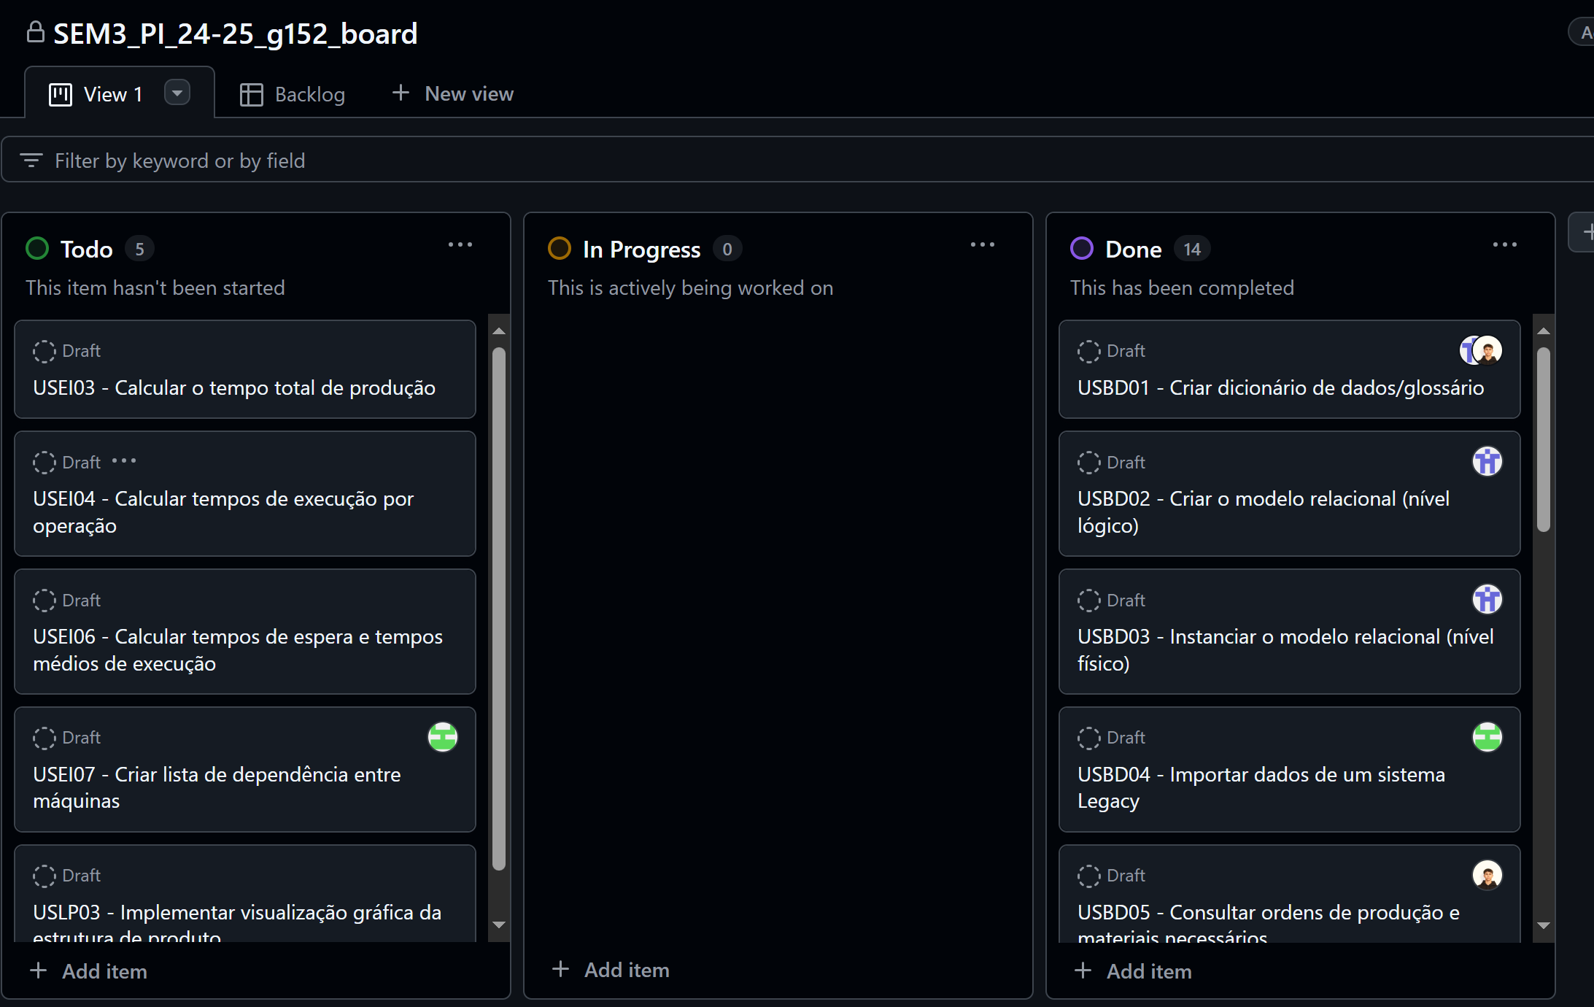
Sprint Retrospective
Date: 28/10/2024
Action items:

Slide 10


