Slide 1
Class 2DO Group 152 SPRINT 2
LAPR3 2024_2025
Group members:
Bruno Miguel da Silva (1221514) | Miguel Gonçalves (1221119) | Vitor Carneiro (1240580) | Tomás Teixeira Silva (1240590) | Tiago Silva (1241707) | Jorge Almeida (1220838) | Eduardo Moreira (1190546)

Slide 2
Sprint planning – Sprint 1
Planned Start Date: Real Start Date:
Planned Finished Date: Real Finish Date:
SPRINT BACKLOG
Number of stories | 36
Number of bugs | 0
Number of tasks | 85
Number of Management Tasks (Scrum) | 12
Number of team members | Planned: 6 Actual: 7
Total planned estimation vs execution | Planned hours: 84 Executed hours: 100

Slide 3
Sprint planning
Assignment US (as stated on project assignment) | Commited? (Yes / no according to team planning) | Todo | Doing | Testing | Done | Blocked
USAC01 | Yes |  |  |  | x
USAC02 | Yes |  |  |  | x
USAC03 | Yes |  |  |  | x
USAC04 | Yes |  |  |  | x
USAC05 | Yes |  |  |  | x
USAC06 | Yes |  |  |  | X
USAC07 | Yes |  |  |  | X
USAC08 | Yes |  |  |  | X
USAC09 | Yes |  |  |  | X
USAC10 | Yes |  |  |  | X
Notes:
Não colocar screenshots! Preencher manualmente os valores.

Slide 4
Sprint planning
Assignment US (as stated on project assignment) | Commited? (Yes / no according to team planning) | Todo | Doing | Testing | Done | Blocked
USBD10 | Yes |  |  |  | x
USBD11 | Yes |  |  |  | x
USBD12 | Yes |  |  |  | X
USBD13 | yes |  |  |  | X
USBD14 | Yes |  |  |  | X
USBD15 | Yes |  |  |  | X
USBD16 | Yes |  |  |  | X
USBD17 | Yes |  |  |  | X
USBD18 | Yes |  |  |  | X
USBD19 | Yes |  |  |  | x
Notes:
Não colocar screenshots! Preencher manualmente os valores.

Slide 5
Sprint planning
Assignment US (as stated on project assignment) | Commited? (Yes / no according to team planning) | Todo | Doing | Testing | Done | Blocked
USEI02 | Yes |  |  |  | x
USEI05 | Yes |  |  |  | x
USEI07 | Yes |  |  |  | x
USEI07.2 | Yes |  |  |  | X
USEI08 | Yes |  |  |  | x
USEI12 | Yes |  |  |  | x
USEI14 | Yes |  |  |  | x
USEI15 | No |  |  |  | x
Notes:
Não colocar screenshots! Preencher manualmente os valores.

Slide 6
Sprint planning
Assignment US (as stated on project assignment) | Commited? (Yes / no according to team planning) | Todo | Doing | Testing | Done | Blocked
USFA01 | Yes |  |  |  | x
USFA02 | Yes |  |  |  | x
USLP03 | Yes |  |  |  | X
USLP04 | Yes |  |  |  | X
USLP05 | No | x
USBD34 | Yes |  |  |  | x
USBD38 | No | x
USBD41 | Yes |  |  |  | x
USBD45 | Yes |  |  |  | x
Notes:
Não colocar screenshots! Preencher manualmente os valores.

Slide 7
Work by team member
Notes:
Se compilaram o registo de horas colocar as horas de trabalho, caso contrario utilizar o numero de tarefas ou algo que reflita a distribuição de trabalho.

Slide 8
Work by type

Slide 9
Issues / Assumptions / unanswered questions
Description | Responsible | Date / sprint | Related issue / item in Git

Slide 10
Daily Meetings
Date | Place / duration | Bruno 1221514 | Miguel 1221119 | Vitor 1240580 | Tomás 1240590 | Tiago 1241707 | Jorge 1220838 | Eduardo1190546
05/11/2024 | Class / 15 min | x |  |  |  | x
06/11/2024 | Class / 15 min | x | x | x | x |  | X | X
07/11/2024 | Class / 15 min | x | x |  | x
08/11/2024 | Class / 15 min | X | X | X | X |  | x
12/11/2024 | Class / 15 min | x |  |  |  | x
13/11/2024 | Class / 15 min | x | x | x | x |  | x | x
14/11/2024 | Class / 15 min | x | x |  | x
15/11/2024 | Class / 15 min | x | x | x | x |  | x
Notes:
Podem criar mais páginas se estas não forem suficientes

Slide 11
Daily Meetings
Date | Place / duration | Bruno 1221514 | Miguel 1221119 | Vitor 1240580 | Tomás 1240590 | Tiago 1241707 | Jorge 1220838 | Eduardo1190546
19/11/2024 | Class / 15 min | x |  |  |  | x
20/11/2024 | Class / 15 min | x | x | x | x |  | x | x
21/11/2024 | Class / 15 min | x | x |  | x
22/11/2024 | Class / 15 min | x | x | x | x |  | x
Notes:
Podem criar mais páginas se estas não forem suficientes

Slide 12
Sprint Retrospective
Date:25/11/2024
What went well?
Group performance
Good practice of git
Comunication
What went wrong?
Don’ write dailys
Better planning of the sprint to manage time for task
Wrong using of board and milestones
What we’ve learned?
Improve sprint planning
Improve time management
Write dailys and better using of board and milestones

Slide 13
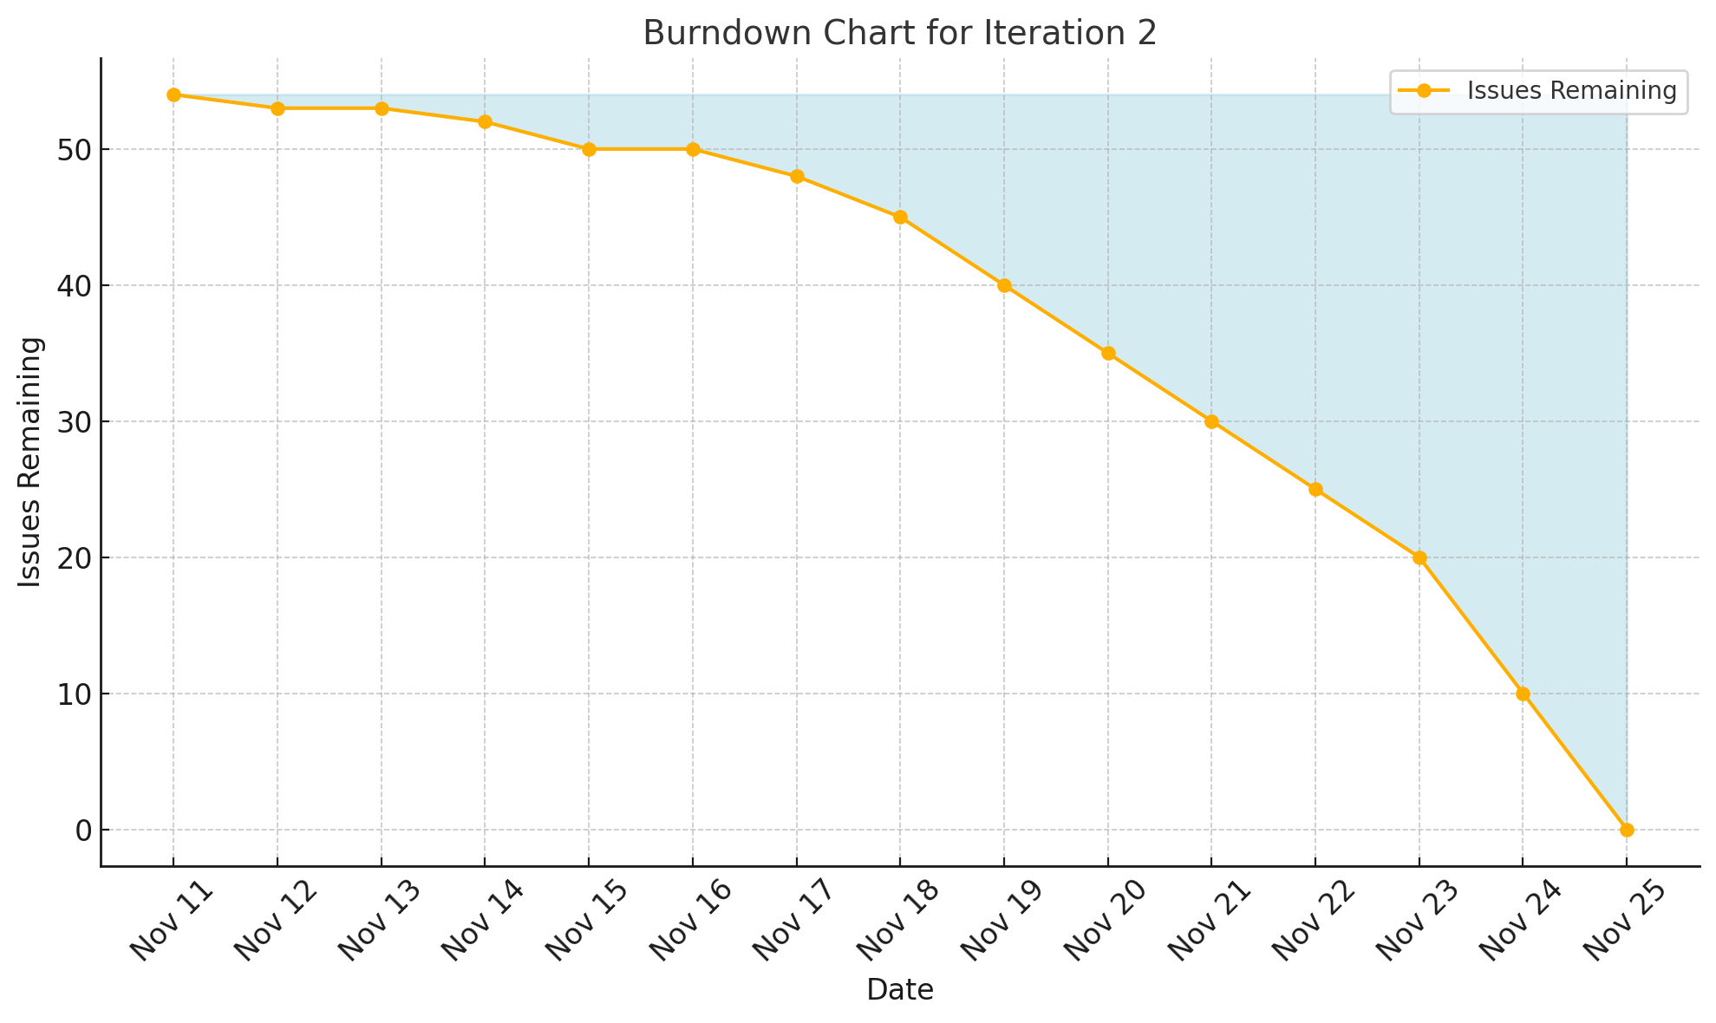
Sprint Retrospective
Date:
Action items:

Slide 14


