Slide 1
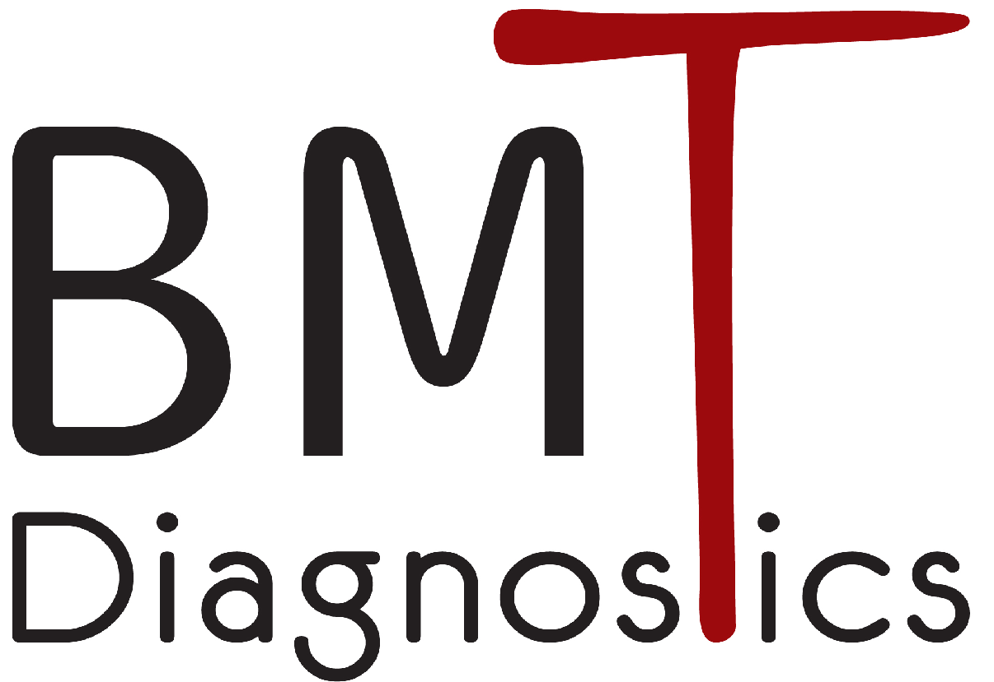

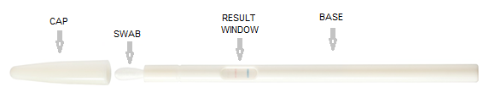
Intelligent, Convenient
Rapid Diagnostic Testing
Introducing:
TM

Slide 2
Rapid diagnostic tests (RDT) developer since 2005
Multiple CE - marked products
ISO 13845:2016 – certified
ISO5 aseptic manufacturing space
Based in Israel
Privately owned company
Our Vision
Smart, innovative and convenient RDT solution.
Shifting patient testing from centralized labs to point-of-care and self-use, thereby improving healthcare provision.
About Us

Slide 3
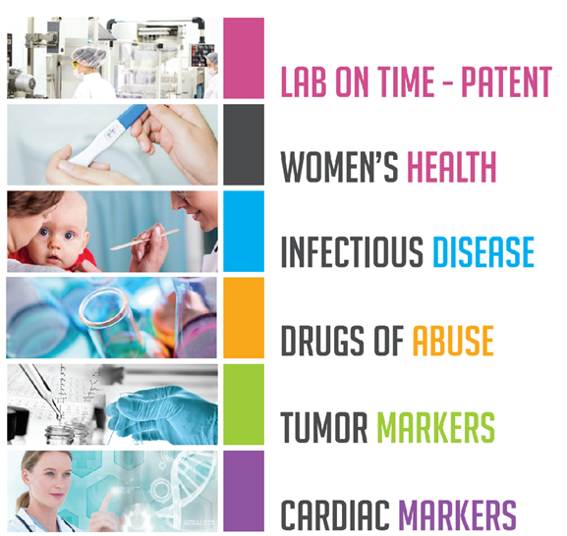
Product Catalog

Slide 4
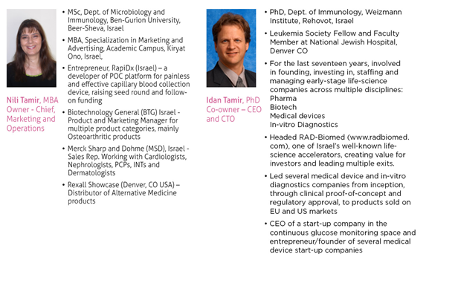
Experienced Management Team

Slide 5
TM
Main Advantages:
Proprietary swab for improved sample collection and higher pathogen recovery efficacies
No Step operation
Improved usability by untrained healthcare providers
Results available during in-patient visit
Enhanced accuracy
Minimal liquid and plastic waste disposal
Swab-based Test Platform

Slide 6
Swab-based Test Platform
TM
Proprietary, Innovative Platform for Multiple Swab-Based Rapid Diagnostic Indications:
Streptococcus A
COVID-19 Antigen
Influenza A+B
Streptococcus B
Multiple additional indications such as different Combos Candida Chlamydia and more
Patents granted in the USA, EU, Japan, China & Israel,
with several approved Continuation Applications

Slide 7
Application – FOB Test
What is the test?
Occult blood in the stool is The second most common cancer in Israel and may indicate the presence of polyps or cancerous cells in the colon (polyps may later turn into cancerous tumours);
A positive result for occult blood in the stool requires further investigation.
How It Works?
The test detects occult bleeding that is not visible to the eye and may indicate polyps or tumours, which tend to bleed. In case of a positive result, it is recommended to undergo a colonoscopy.
When is it recommended to do the test?
From the age of 50 to the age of 74 (approximately 1M patients in Israel - once a year).
The test is in the health basket.
very high lack of responsiveness from patients - (approximately 50%)

Slide 8
R&D Activity Application – Our Test
An accurate, reliable and Ministry of Health approved test
Immunological test (antibody-based)
capable of reliably detecting human hemoglobin
from a concentration of 50 ng/ml and in a stool amount of 6μg.
Clinical data of our kit:
Sensitivity - 95%;
Specificity - 99.5%;
98.6% accuracy

Slide 9
Available Rapid Diagnostic Tests (RDT) for most infectious diseases are:
Difficult to perform
Time and attention consuming
Non-intuitive
Operator-dependent accuracy
Unbiased reading of test results
No recording or informing of the test results
Our Solution - ™
Patented Platform that allows No Step Convenient, Accurate and Reported RDT Performance
R&D Activity Application
The Unmet Need

Slide 10


RDT Computer Vision Application Development for Mobile Devices:
Computer Vision Application - Patent granted in US
Comprehensive and Organized Data
CE Mark & AMAR Approval for FOB self test
Selling the test in the Israeli market since 2019
Understanding of the market and business potential
High Level Architecture (HLA) on a cloud solution supported by AWS
No need to download an application or sign-up for our service
R&D Activity - Application

Slide 11
Performants of the test using our Application
Logging in to the application is done by logging in through the HMO apps.
The patient will receive an encrypted number from the cash register
to identify himself in front of the application without using his personal details.
Step-by-step action instructions of the test will be presented to the patient.
At the end of the execution and waiting phases, the patient will move to a camera screen.
The camera will automatically detect the test and analyze the result.
The result will be sent to the HMO system for further monitoring.
The result will be shown to the customer with a message designed by the HMO.

Slide 12
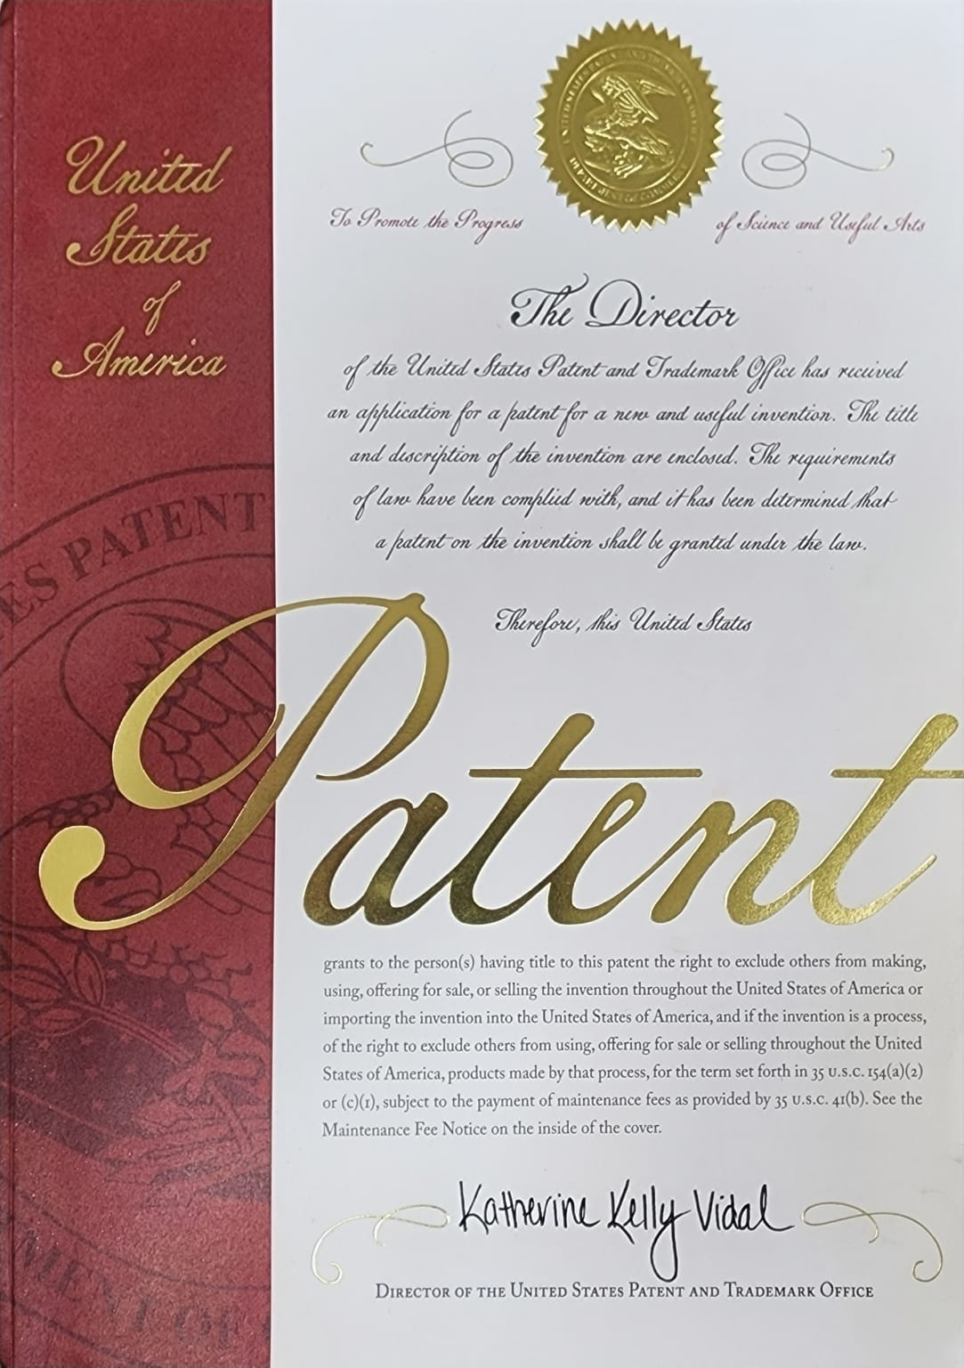
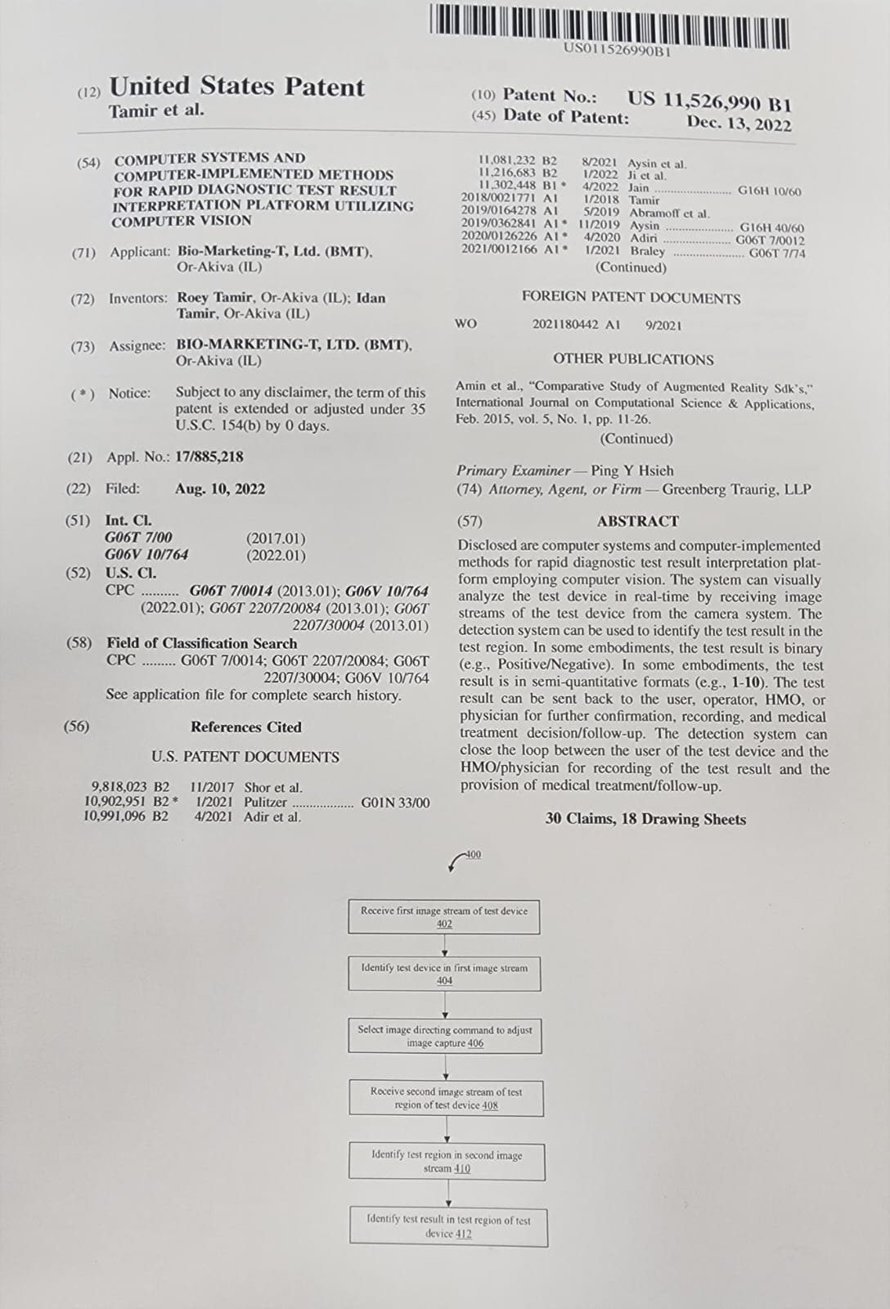
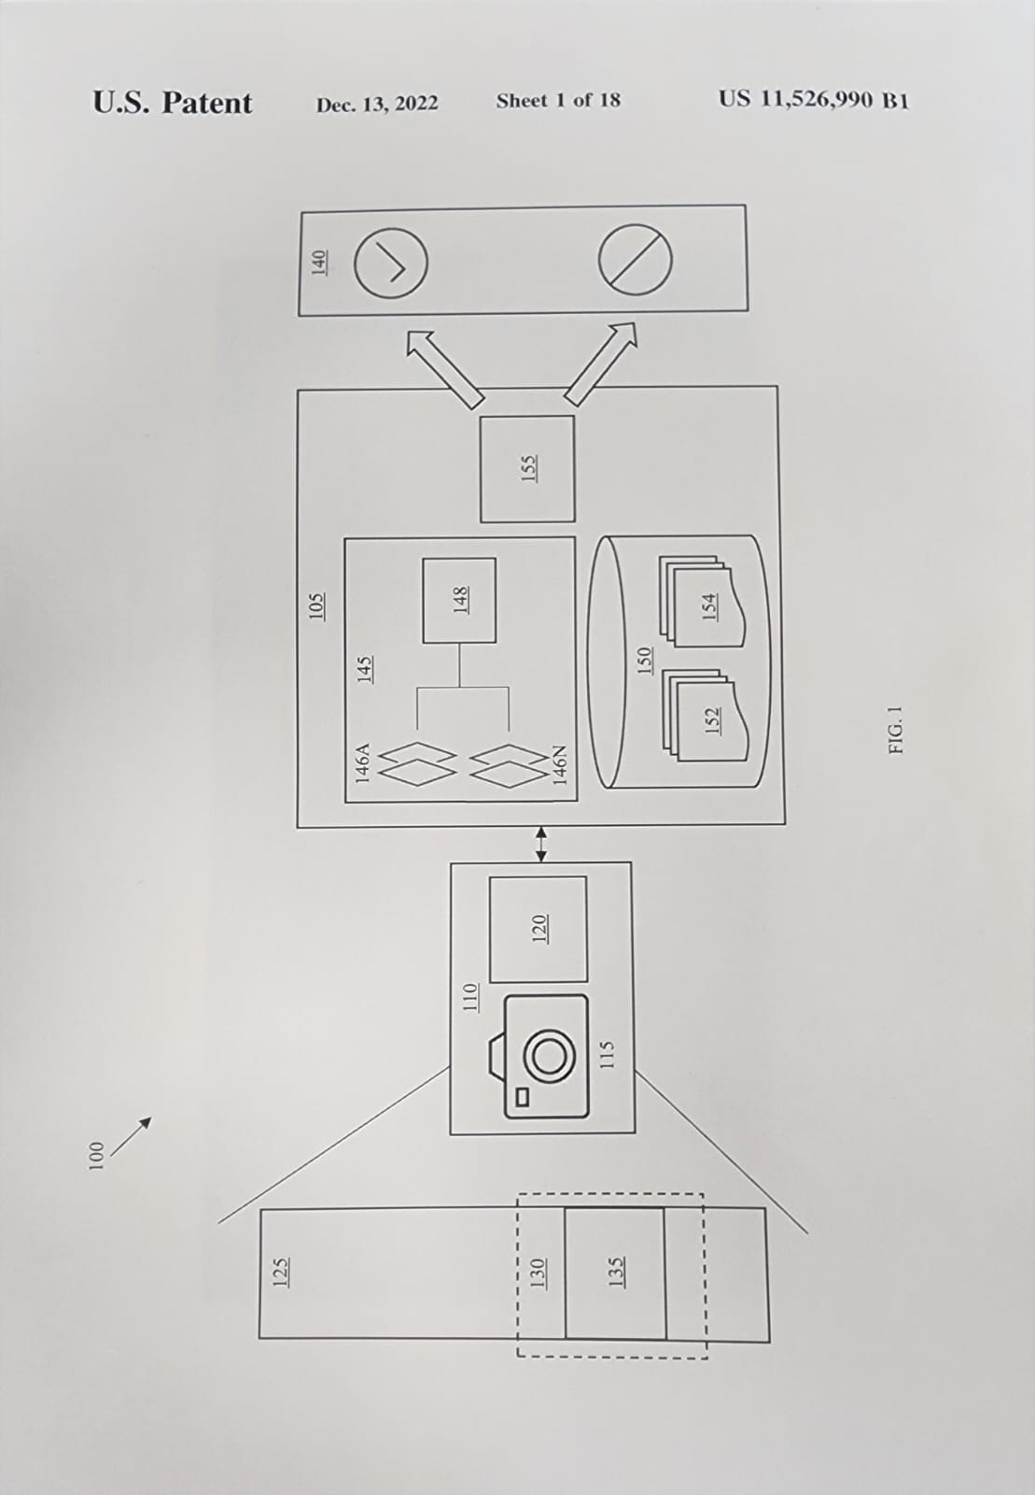
Computer Vision Application Patent

Slide 13
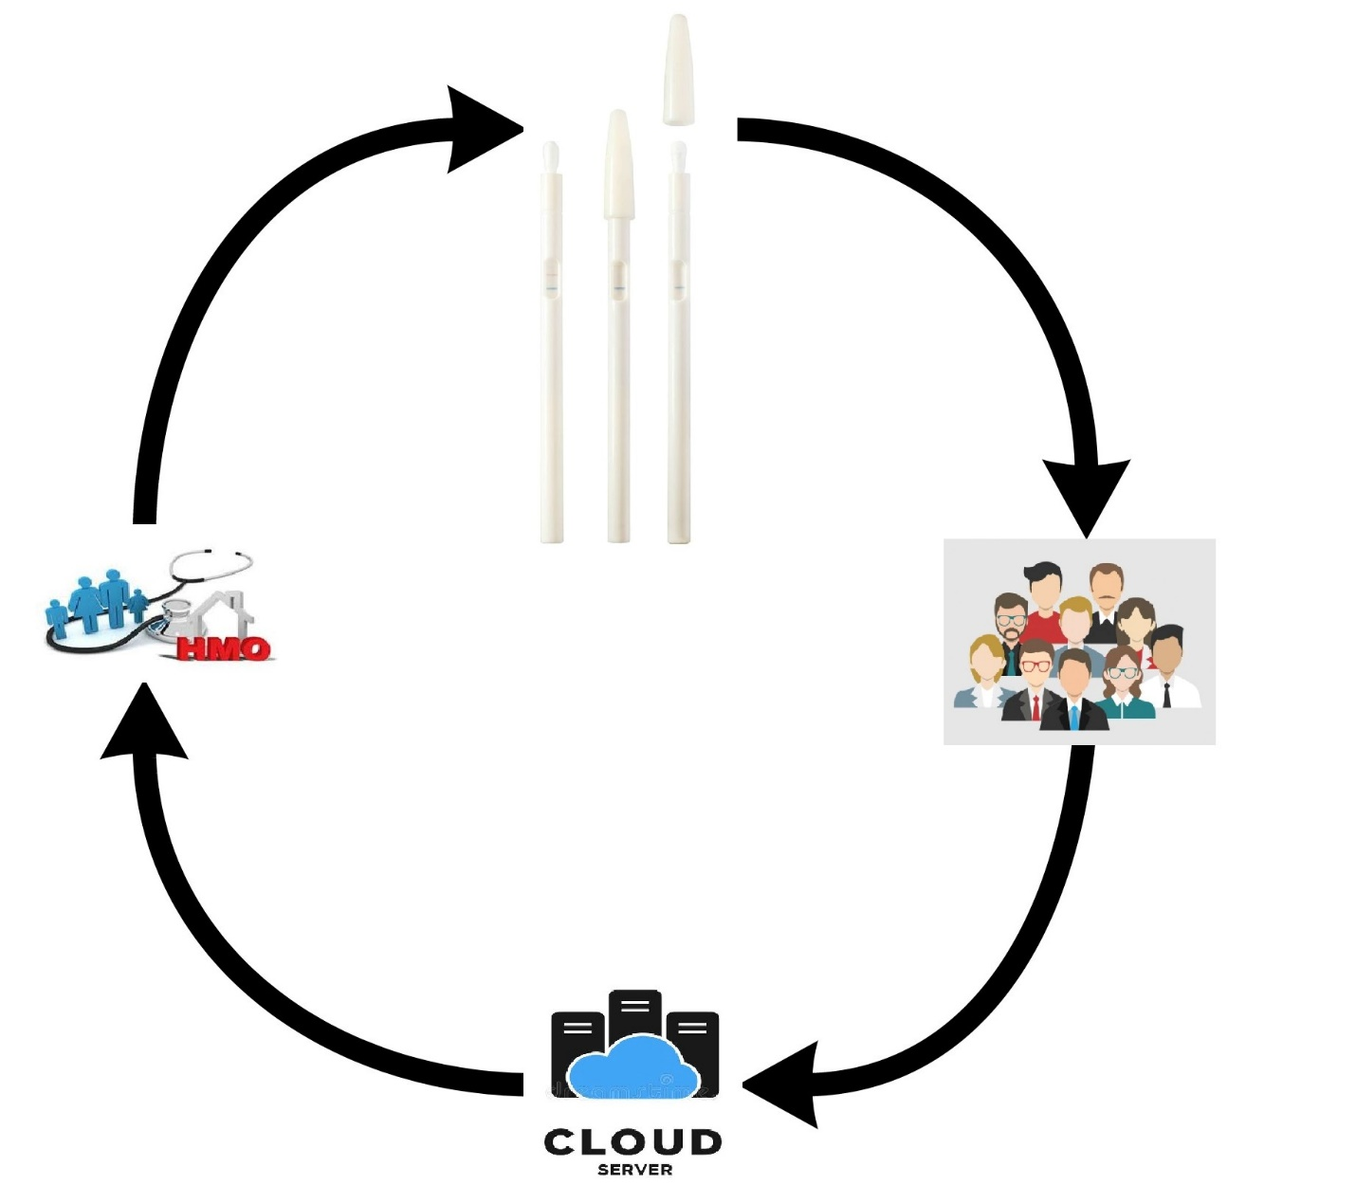
Closing the loop &
Capturing the Entire Value Chain

Slide 14

Thank You!

