Slide 1
Biomedical modeling and visualization
LMFAO group
m5261131 XIUHENG LIAO
m5262116 WU ZIANG
m5261188 TIANJI ZHOU
m5261179 XIANZHENG WANG
m5261189 XINHAO ZOU

Slide 2
Content of projects
1.Fundamental experiment
((Python lib:Numpy and Pandas) based data anlysis)
2.Further experiment
(LR/DT based data prediction)

Slide 3
1.Fundamental experiment
1.((Python lib:Numpy and Pandas) based data anlysis)
1-1:NumPy is a Python library used for working with arrays.
It also has functions for working in domain of linear algebra, fourier transform, and matrices.
1-2:Pandas is a Python library used for working with data sets.
It has functions for analyzing, cleaning, exploring, and manipulating data.

Slide 4
1.Fundamental experiment-SEER :Breast Cancer
This dataset of breast cancer patients was obtained from the 2017 November update of the SEER Program of the NCI, which provides information on population-based cancer statistics. The dataset involved female patients with infiltrating duct and lobular carcinoma breast cancer (SEER primary cites recode NOS histology codes 8522/3) diagnosed in 2006-2010. Patients with unknown tumour size, examined regional LNs, positive regional LNs, and patients whose survival months were less than 1 month were excluded; thus, 4024 patients were ultimately included.
LNs:regional lymph nodes

Slide 5
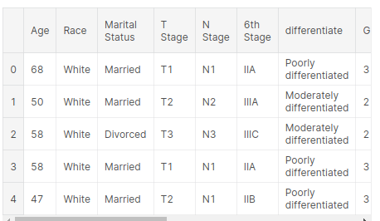
1.Fundamental experiment:Basic data information
Age | Age
Race | Race: White, Black, Other (American Indian/Alaska Native, Asian/Pacific Islander)
Marital Status | Marital status: married, single, divorced, separated, widowed
T Stage | T-stage: based on tumor diameter
N Stage | N stage: based on local lymph node metastasis
6th Stage | AJCC 6th edition staging: based on carcinoma in situ, tumor size, local lymph node metastasis and organ metastasis
differentiate | degree of differentiation: undifferentiated, poorly differentiated, moderately differentiated, highly differentiated
Grade | Grade: Higher grade means the cancer grows faster and spreads more easily
A Stage | A stage: local (non-metastatic), distant (metastatic)
Tumor Size | Tumor size
Estrogen Status | Estrogen Status: ER-positive breast cancer
Progesterone Status | Progesterone Status: PR-positive breast cancer
Regional Node Examined | Regional Node Examined: Total number of local lymph nodes recorded for pathological examination
Reginol Node Positive | Regional Node Positive: Record the number of local positive lymph nodes examined
Survival Months | Survival time (months)
Status | Node status: Survival, death

Slide 6
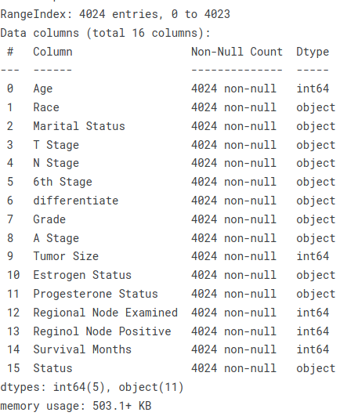
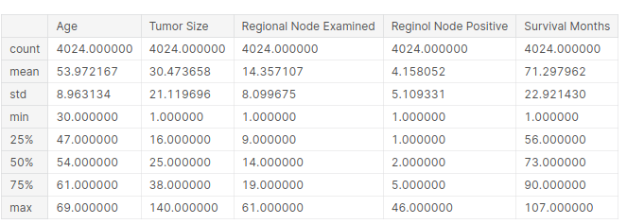
1.Fundamental experiment
Statistical description of quantitative information
Overall data information

Slide 7
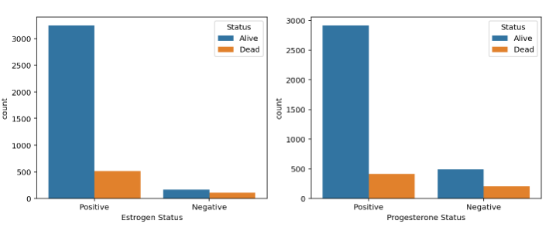
1.Fundamental experiment
Here we got x-axis for Extrogen Status and count for y-axis.
We could define the X as the Race and Y to be the Status

Slide 8
1.Fundamental experiment
Linear relationship.
(1) The existence of a primary functional relationship between two variables (a function whose first-order derivative is a constant), y = kx + b (k, b are constants), is said to be a linear relationship between them.
(2) proportional relationship is a special case of linear relationship, inverse proportional relationship is not a linear relationship.
Positive proportional relationship: the ratio of two variables is certain, k = x/y.
Inverse proportional relationship: the product of two variables is certain, xy = k (certain) (k ≠ 0).
3) In more general terms, if the two variables are taken as the horizontal and vertical coordinates of a point whose graph is a straight line in the plane, the relationship between these two variables is linear.
(4) If a binary equation can be used to express the relationship between two variables, the relationship between these two variables is called a linear relationship, and thus, the binary equation is also called a linear equation.
(5) By extension, a primary equation containing n variables is also called an n-element linear equation.

Slide 9
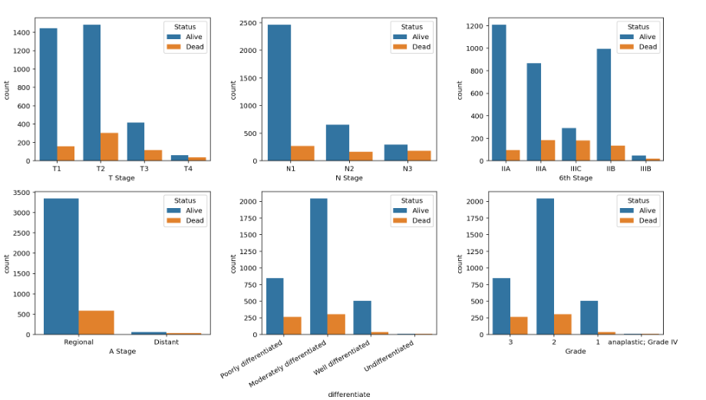
1.Fundamental experiment

Slide 10
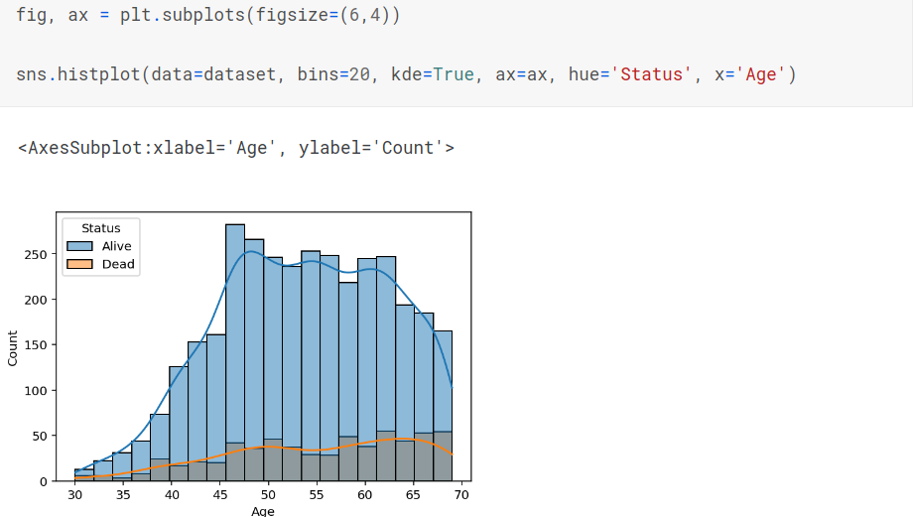
1.Fundamental experiment

Slide 11
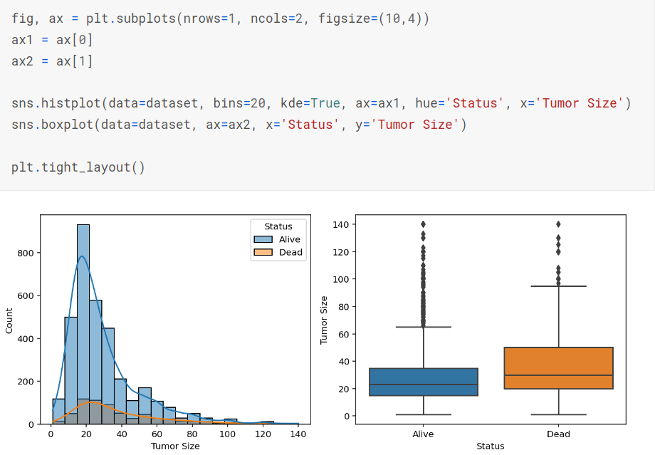
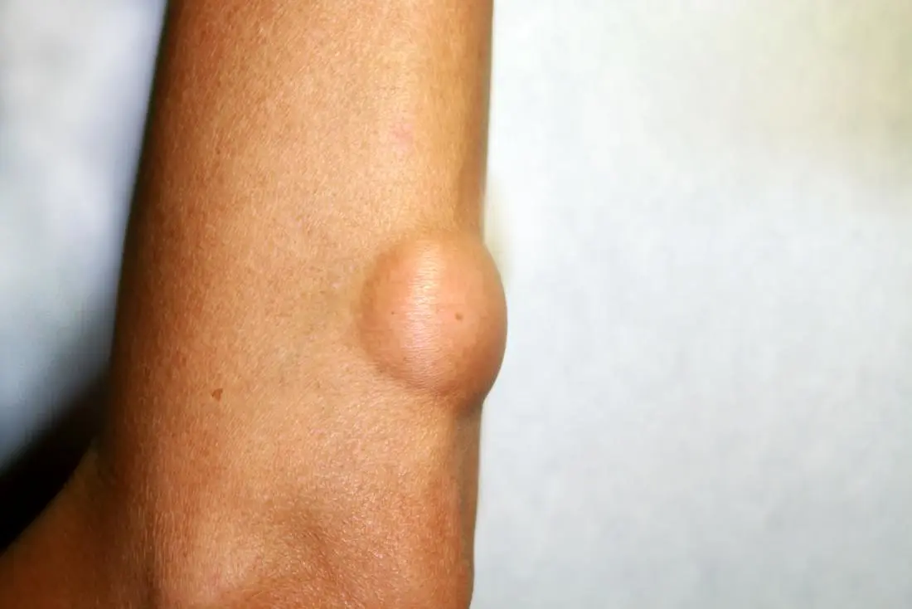
1.Fundamental experiment
Relationship between different data with feature labels

Slide 12
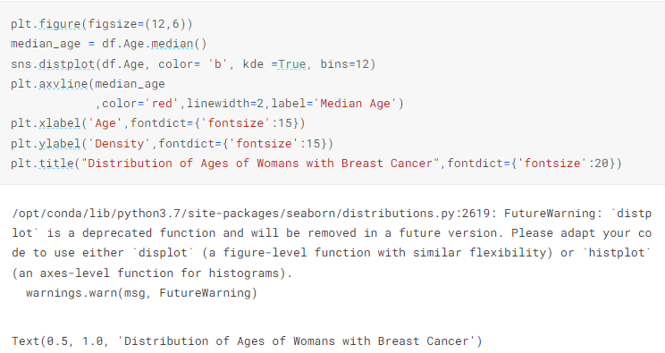
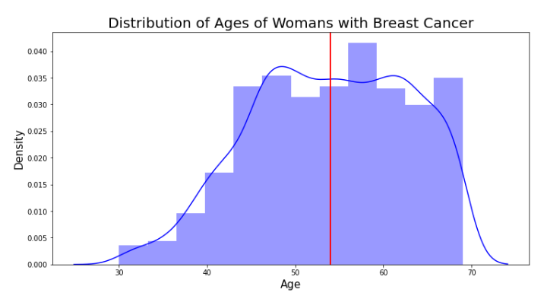
1.Fundamental experiment
Distribution of ages of woman with breast cancer

Slide 13
2.Further experiment
Some machine learning approaches for analyzing Breastcancer.csv(SEER)
Linear data relationship for predicting the results.
For example:
Tumor size for predicting the death/live results
Regional Node Examined for predicting the death/live results

Slide 14
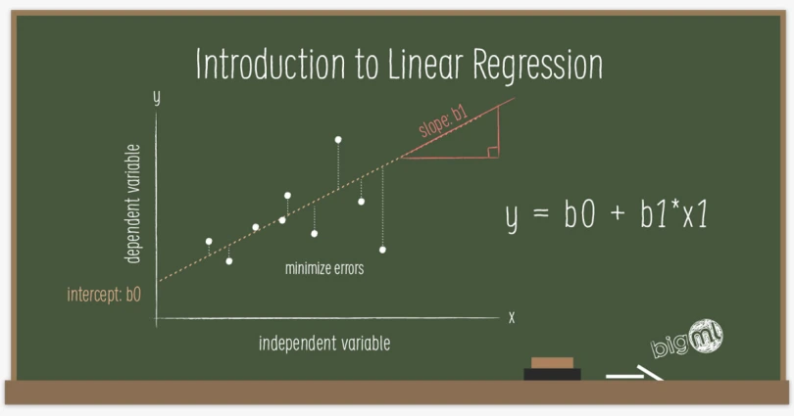
2.Further experiment
LR:Linear Regression
Linear regression is one of the most widely known time series forecasting techniques which is used for predictive modeling

Slide 15
2.Further experiment
LR:Linear Regression model
Linear and Non-Linear
Linear: A relationship between two variables that is a primary functional relationship - where the graph is a straight line - is called linear.
Note: Linear means linear in a broad sense, that is, the relationship between the data and the data.
Nonlinear: A relationship between two variables that is not a primary functional relationship - the graph is not a straight line - is called nonlinear.
The reason why we use LR Model for predicting is because we would like to predict the result(death/live) due to several
linear features like male/female,age,tumor size,Regional Nodes(RNs).

Slide 16

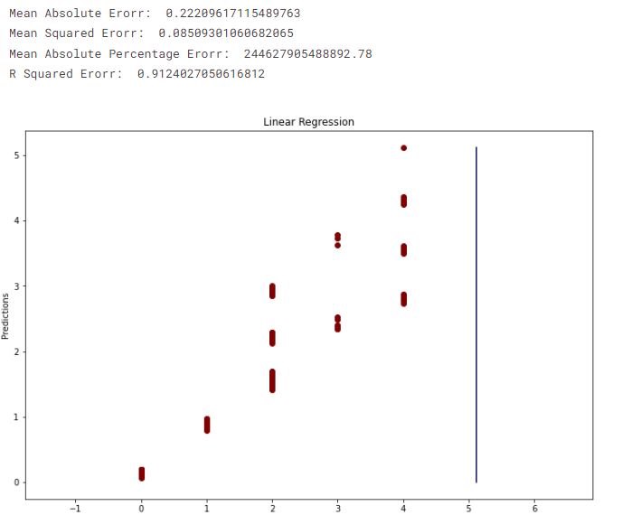
2.Further experiment
LR results

Slide 17

2.Further experiment
Specifically, the FPR (False Positive Rate) value is taken on the horizontal axis and the TPR (True Positive Rate) value on the vertical axis from the discrimination results of a certain model and plotted. The AUC value is then calculated by integrating the area under the curve.

Slide 18
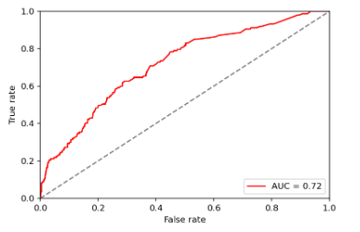
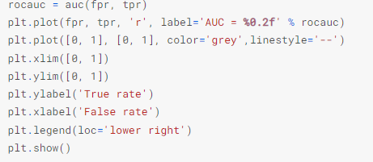
2.Further experiment
The evaluation function AUC designed by sklearn lib

Slide 19
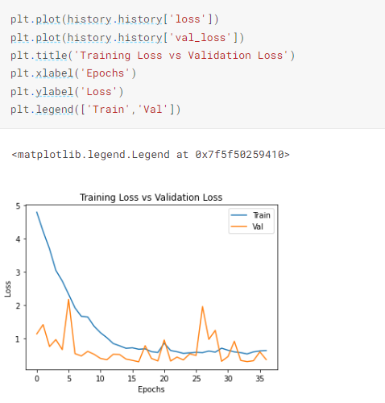
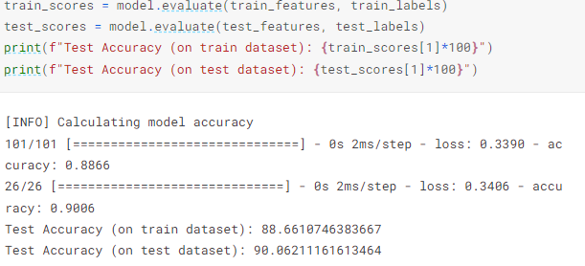
2.Further experiment(Results)

Slide 20
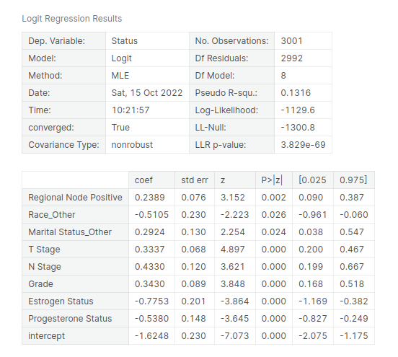
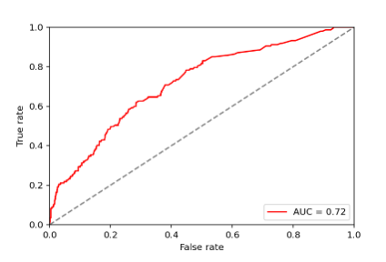
2.Further experiment
Results
Linear Regression

Slide 21
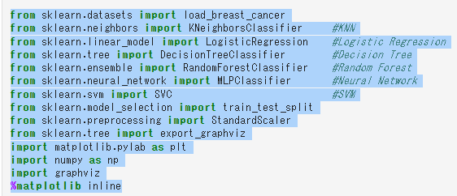
Further experiment
Open lib

Slide 22
Final
1.We finish our project by inference the existing project
https://www.kaggle.com/code/elmajoadriel/breast-cancer-eda-prediction-lr-dt-rf-nb
2.We discussed our results based on different models
3.Thanks for listening,because time is limited,we would like to do more experiments for more models

