Slide 1
End-to-End Swiggy Restaurants Data Analysis
Business-Focused Case Study with Python, SQL, and Power BI
Vishnu B M
B.Tech CSE | MBA in Business Intelligence & Analytics

Slide 2
1. Executive Summary
Purpose: Analyze Swiggy restaurant marketplace performance to support growth, customer satisfaction, and operational decisions.
Dataset: Kaggle Swiggy Restaurants data covering location, ratings, pricing, cuisines, and delivery-related attributes.
Tools: Python for preparation and EDA, SQL for business-question analysis, Power BI for decision dashboards.
Key outcomes: city-level supply insights, pricing-value patterns, delivery impact on ratings, and high-value restaurant identification.
Business value: actionable strategy recommendations for city expansion, quality governance, and portfolio optimization.

Slide 3
2. Business Problem and Objectives
Platforms like Swiggy must manage quality consistency, delivery efficiency, pricing competitiveness, and cuisine relevance simultaneously.
Inconsistent ratings and delivery delays directly impact trust, repeat orders, and customer retention.
The objective was to transform restaurant-level data into practical decisions for operations, marketing, and category strategy.
Core business questions: Where are we under-served? Which segments are underperforming? What drives higher perceived value?

Slide 4
3. Dataset and Business Context
Source: Kaggle Swiggy Restaurants Dataset; each row represents a restaurant record on the platform.
Key columns: city, restaurant name, rating, rating count, cost for two, cuisine, and delivery time.
Business interpretation: these fields map demand potential, service quality, value perception, and operational performance.
Data suitability: strong foundation for market benchmarking, segmentation, and KPI-driven dashboarding.

Slide 5
4. End-to-End Analytics Workflow
Step 1: Dataset understanding and business framing to align analysis with decision-making goals.
Step 2: Data cleaning and validation in Python to ensure reliable results.
Step 3: Feature engineering to create rating bands, price categories, delivery groups, and high-value flags.
Step 4: EDA to identify patterns across cities, cuisines, pricing, and ratings.
Step 5: SQL analysis to answer prioritized business questions with measurable outcomes.
Step 6: Power BI dashboard development for interactive, stakeholder-friendly insight consumption.

Slide 6
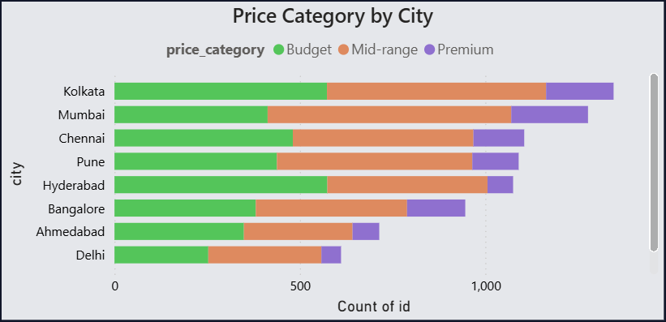
5. City-Wise Restaurant Supply Analysis
Insight Focus
Analysis: restaurant counts by city and locality concentration.
Key insight: supply is concentrated in metro markets while several cities remain under-penetrated.
Business implication: expansion strategy should prioritize high-demand, low-supply clusters.

Slide 7
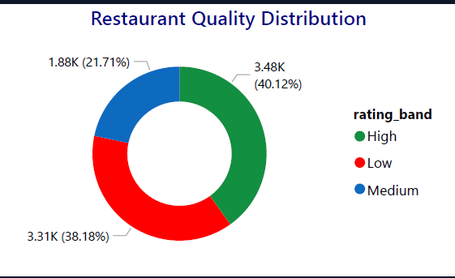
6. Rating Distribution and Quality Landscape
Insight Focus
Analysis: rating bands and city-level quality variation.
Key insight: rating consistency differs by market, indicating uneven customer experience.
Business implication: quality interventions must be localized by city and segment.

Slide 8
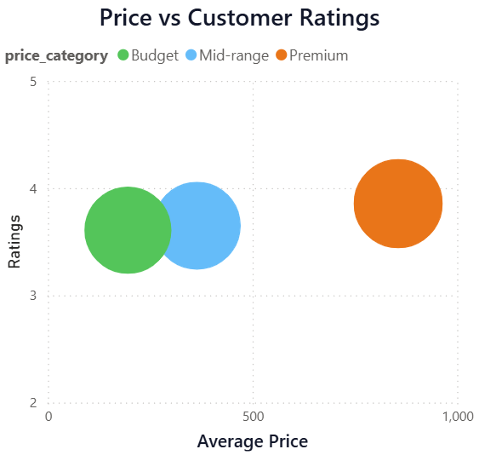
7. Pricing Mix and Value Positioning
Insight Focus
Analysis: budget, mid-range, and premium category composition.
Key insight: mid-range dominates while budget quality variability remains high.
Business implication: value-segment optimization can increase conversion and retention.

Slide 9
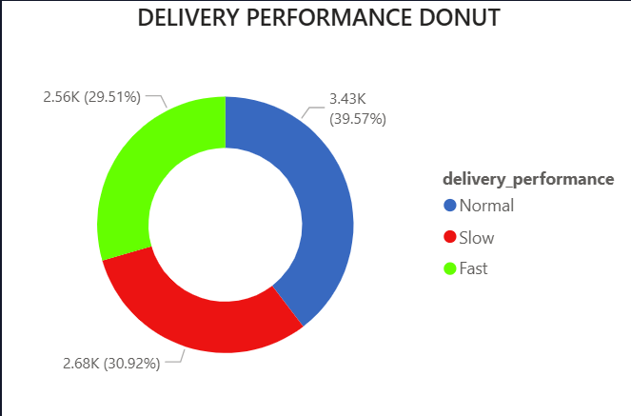
8. Delivery Performance and Customer Ratings
Insight Focus
Analysis: delivery-time groups against rating outcomes.
Key insight: slower delivery correlates with weaker rating performance.
Business implication: improving delivery efficiency is a direct customer-satisfaction lever.

Slide 10
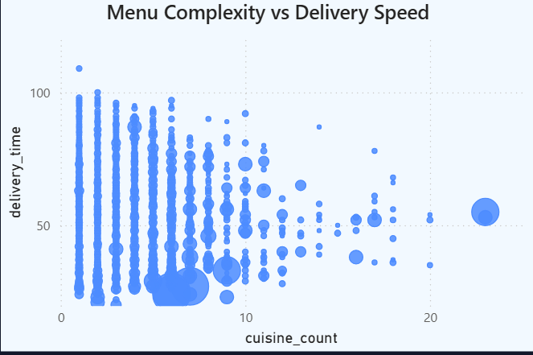
9. Cuisine Portfolio and Demand Insights
Insight Focus
Analysis: cuisine popularity, quality signal, and market spread.
Key insight: mainstream cuisines drive volume while niche cuisines show quality opportunity.
Business implication: balance high-volume categories with curated niche expansion.

Slide 11
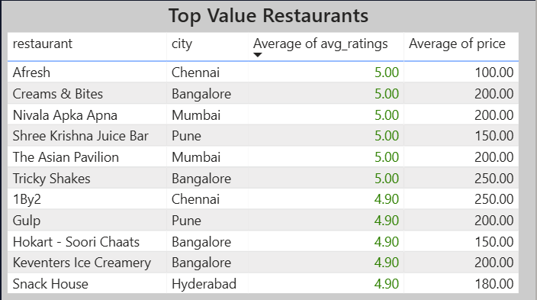
10. High-Value Restaurant Identification
Insight Focus
Analysis: restaurants with strong ratings, sufficient review volume, and attractive pricing.
Key insight: high-value restaurants are unevenly distributed across cities.
Business implication: prioritize these restaurants for visibility, offers, and partnerships.

Slide 12
11. SQL Business Analysis Highlights
Overall platform benchmarking: city-wise restaurant supply, average ratings, and average cost for two.
Pricing vs rating analysis: identified where perceived value is weak despite higher pricing.
Delivery impact analysis: measured quality deterioration in slower service segments.
Cuisine performance analysis: separated high-volume categories from high-quality growth categories.
High-value cohort extraction: supported targeted marketing and recommendation strategy.

Slide 13
12. Power BI Dashboard Design for Decision-Making
KPI cards: total restaurants, average rating, high-rated share, average delivery time, and average cost for two.
Interactive pages designed for city managers, operations teams, and category leads.
Filters and slicers: city, cuisine, rating band, price category, and delivery group.
Outcome: fast drill-down from platform-level trends to actionable local insights.

Slide 14
13. Key Business Insights (Consolidated)
Restaurant supply concentration in metros indicates untapped potential in selected growing markets.
Quality inconsistency is not uniform; city-level governance is required.
Delivery speed is strongly tied to satisfaction and should remain a core operating KPI.
Mid-range pricing performs as the strongest balance of demand and quality perception.
Niche high-rated cuisines create premium differentiation opportunities.
High-value restaurants can be leveraged to improve platform trust and repeat behavior.

Slide 15
14. Strategic Recommendations and Roadmap
Improve slow-delivery clusters with SLA controls, rider planning, and prep-time collaboration.
Run city-specific acquisition programs for under-served zones and missing cuisine categories.
Create quality-uplift initiatives for low-performing budget-heavy segments.
Promote high-value restaurants using badges, curated lists, and targeted campaigns.
Institutionalize monthly scorecards for ratings, delivery speed, and value-segment performance.

Slide 16
15. Conclusion and Portfolio Value
This project demonstrates end-to-end analytics capability: from raw data preparation to strategic business recommendations.
The approach reflects not only technical competence but also practical decision-making and business interpretation.
The final outputs are suitable for recruiter review, portfolio presentation, and interview case discussion.
Thank you.

