Slide 1
Programming Your
Own World
Peaks and Potentials 2024

Slide 2
day 1
day 2
day 3
day 4
day 5
Intro to coding and MakeCode
Intro to circuits and Arduino
Make a Game
Make a Controller
Demo your Project

Slide 3
Let’s get to know each other
💬
🙋

Slide 4
Demonstration
🎮👾

Slide 5
Intro to programming

Slide 6
What is programming?

Slide 7
Rock, paper, scissors
🪨📜✂️

Slide 8
Microsoft MakeCode tutorial

Slide 9
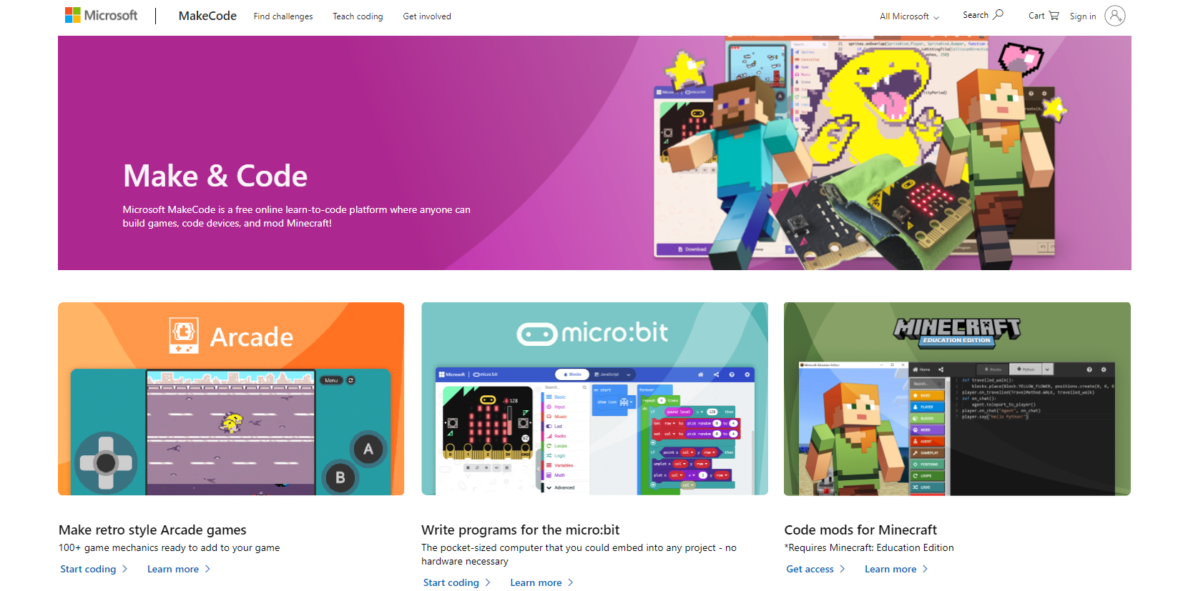
How to start MakeCode
Step 1
Open browser
Go to
  https://www.microsoft.com/en-us/makecode

Slide 10
Step 2
Click start coding > on Make Arcade games

Slide 11
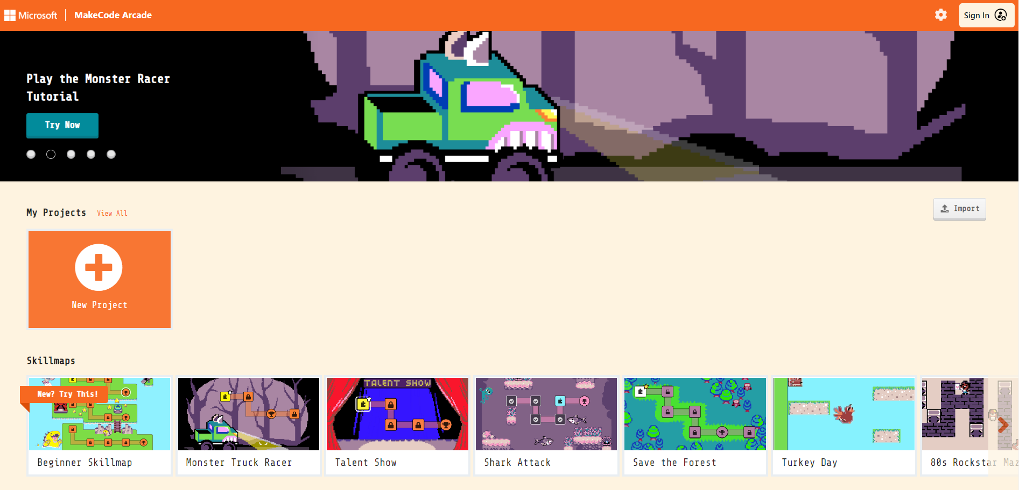
Step 3
Optional : You can sign in with your Microsoft account
Click Beginner Skillmap

Slide 12
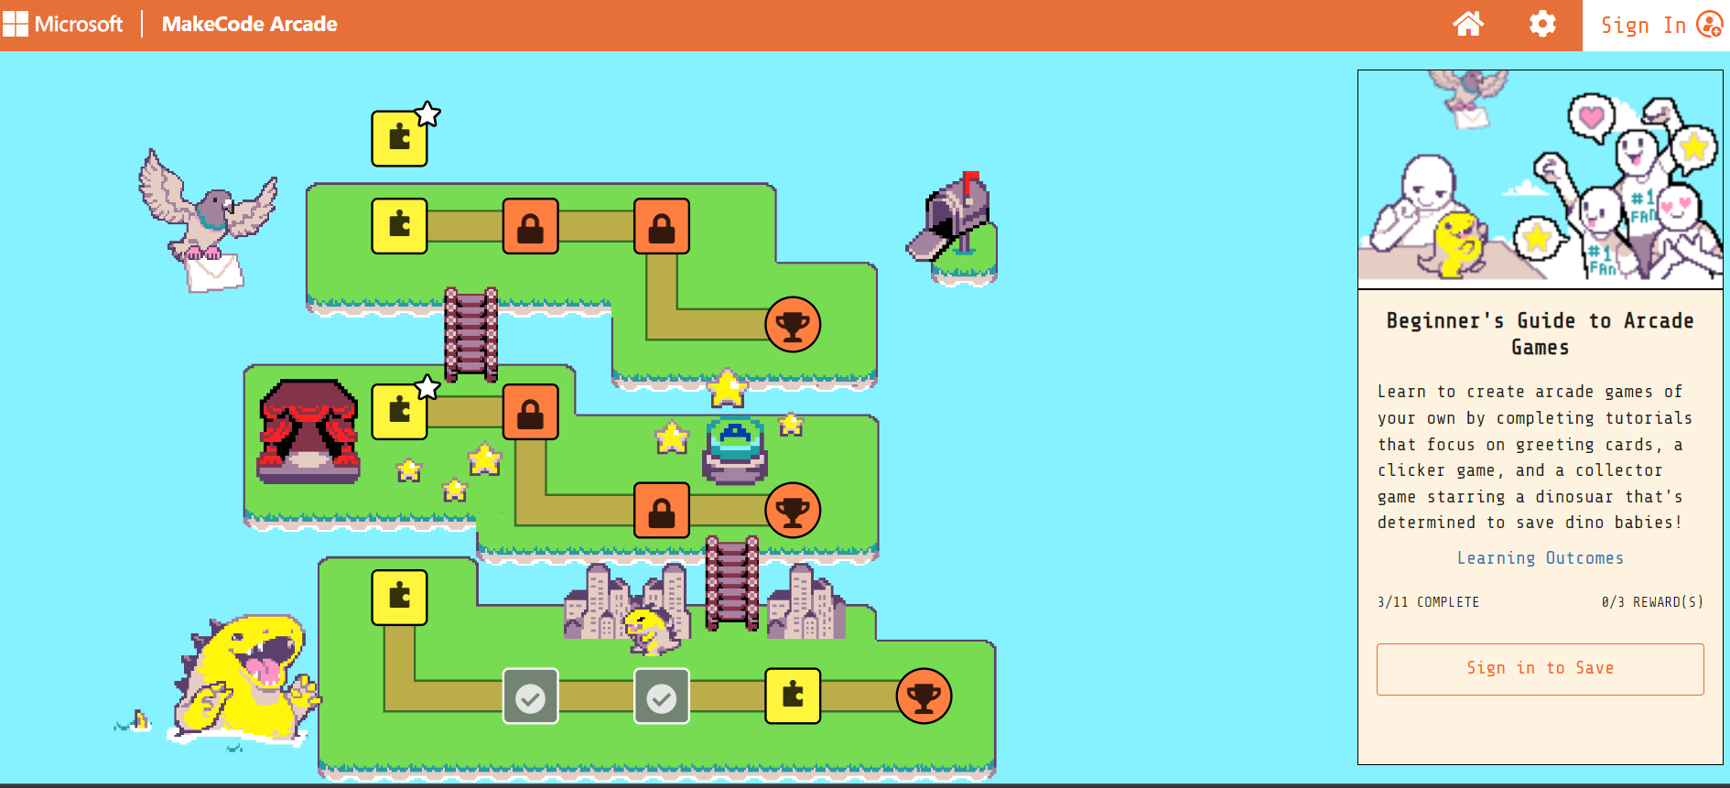
Step 4
Click Dinosaur game

Slide 13
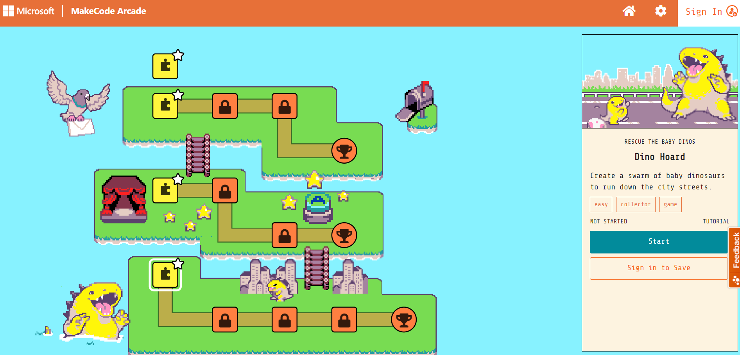
Step 5
Click Start

Slide 14
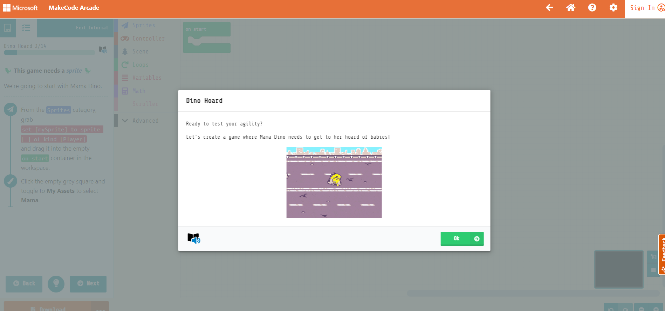
Step 6
Click OK

Slide 15
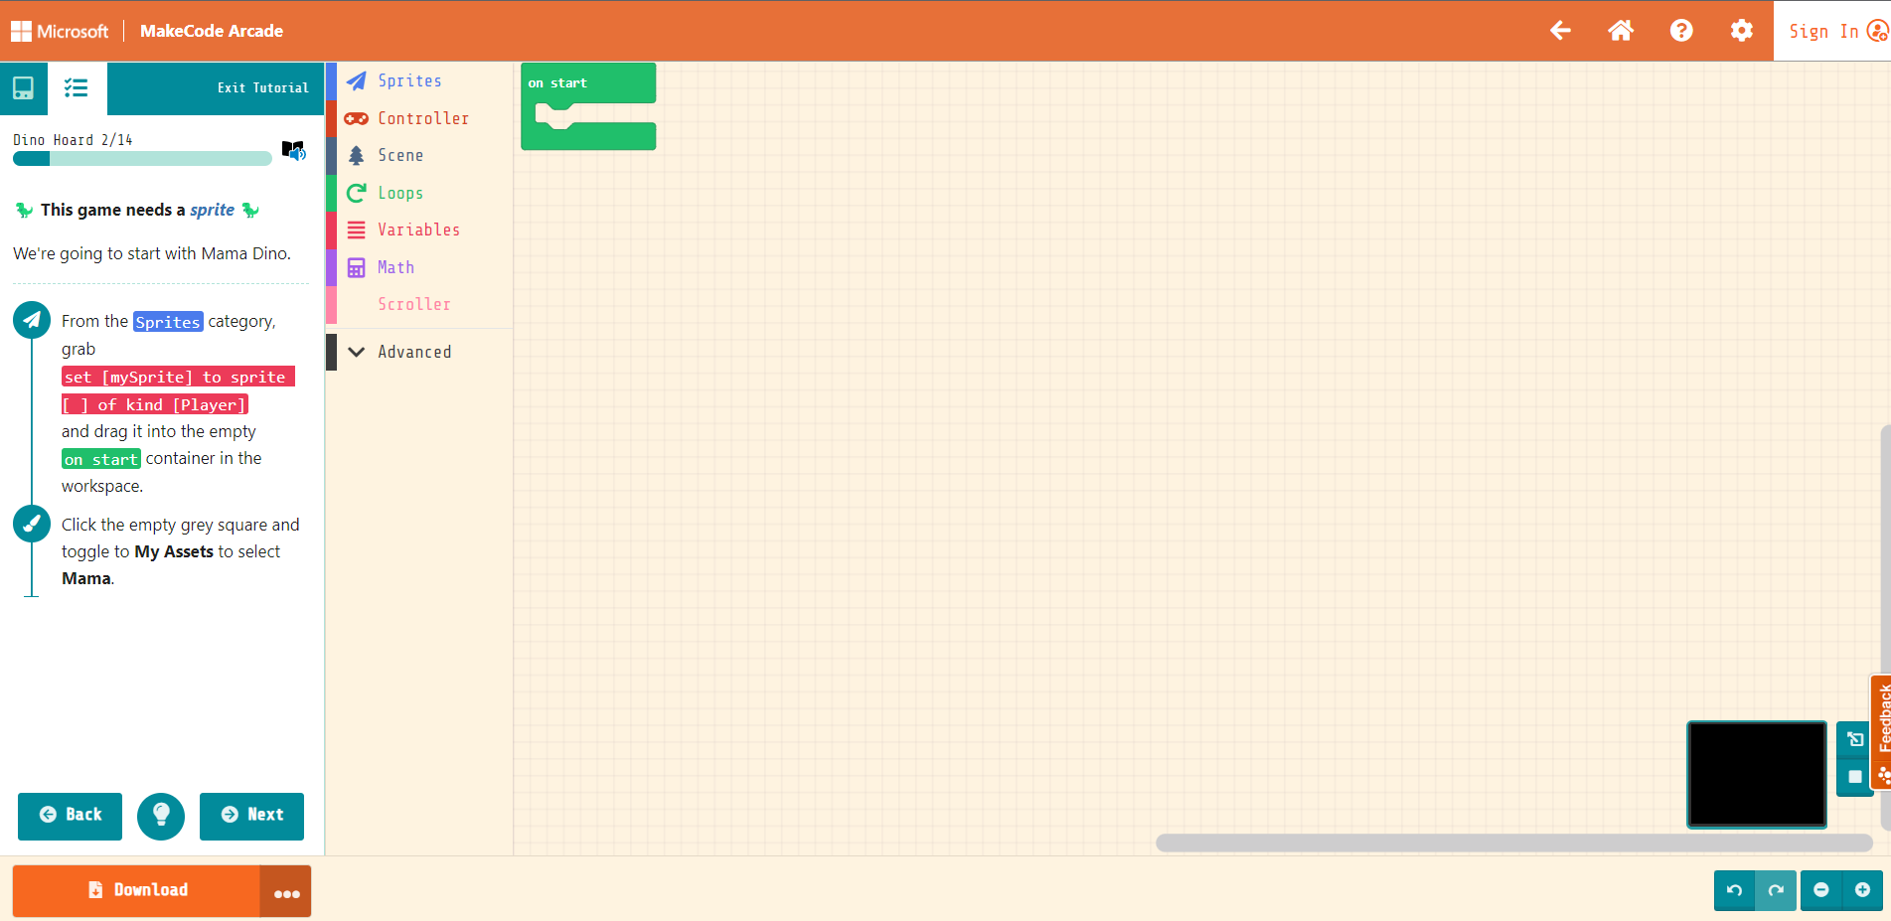
Follow the instructions
Click Next once you are finished

Slide 16
Saving and resuming without a Microsoft account

Slide 17
To download the program
Click Download when you are ready to save

Slide 18
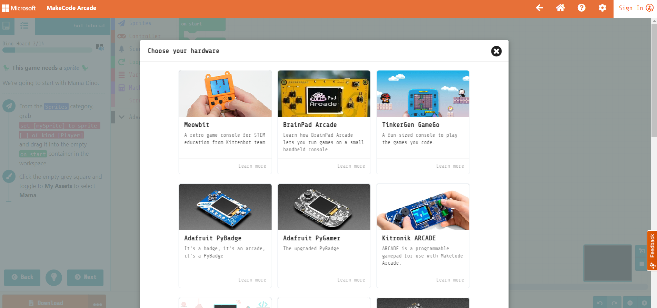
To download the program
Click Meowbit hardware and choose a place to save as

Slide 19
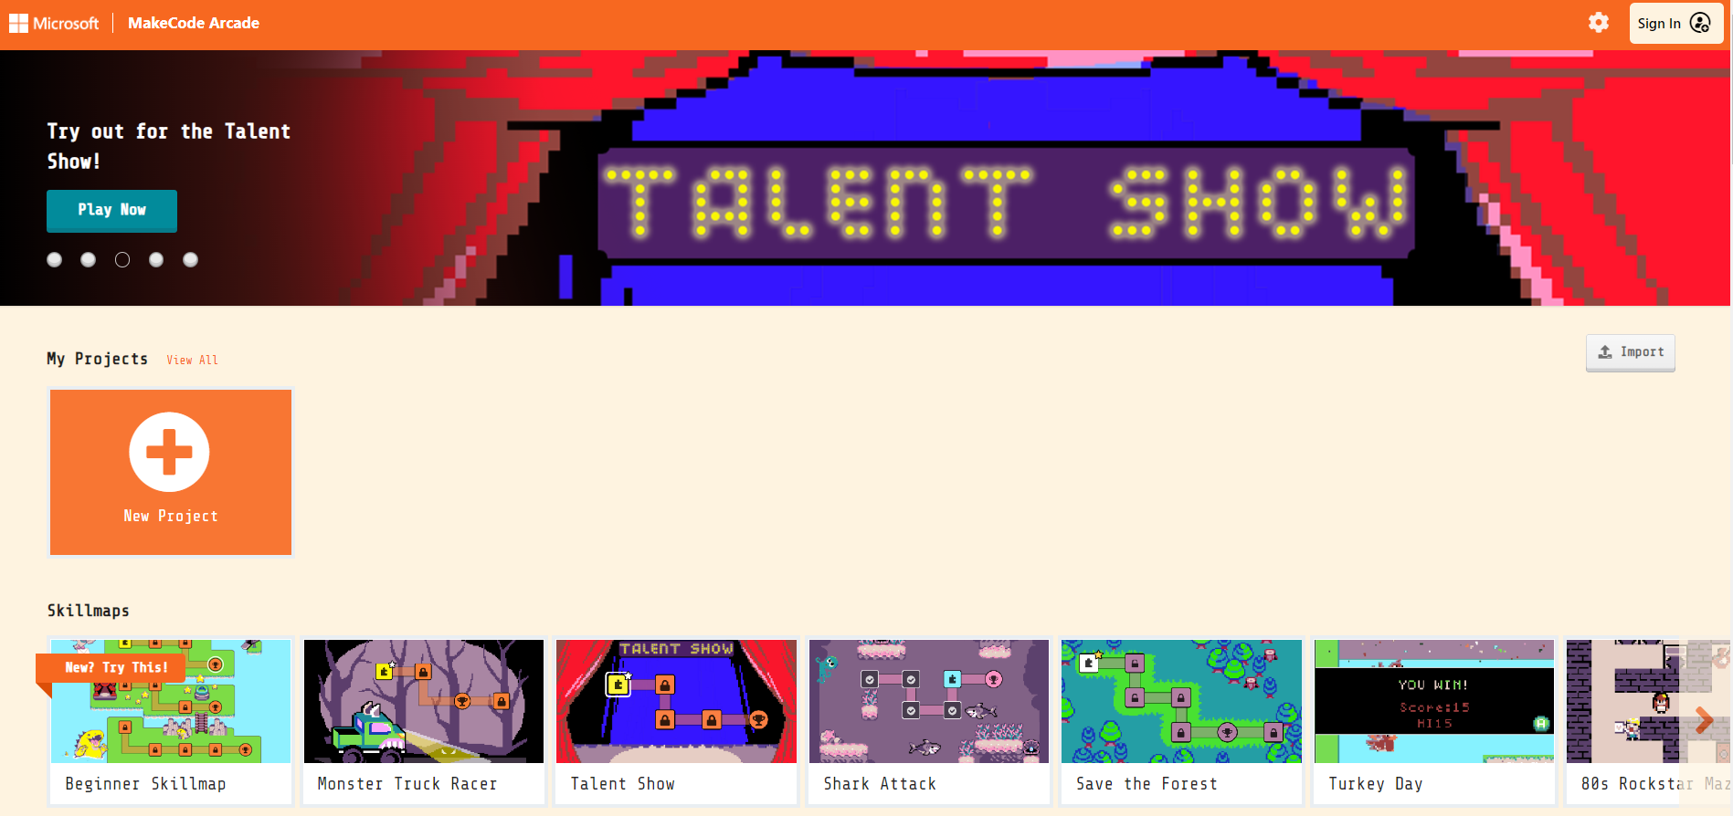
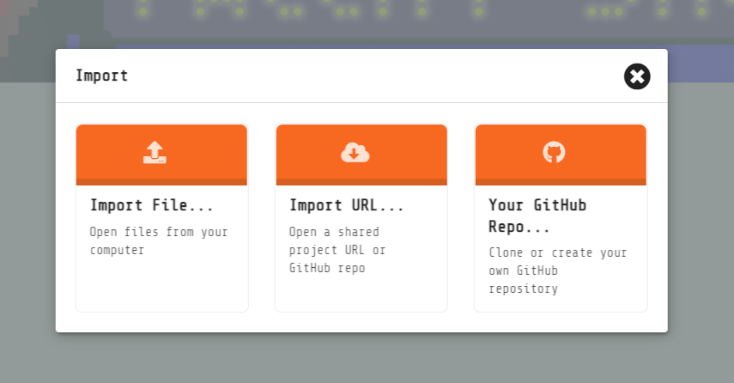
To start working on the game again
Repeat Step 1 and Step 2
Click import and select import file then choose the saved file

Slide 20
Day 2: Intro to circuits and Arduino coding

Slide 21
Intro to circuits: resistors and LEDs

Slide 22
Intro to Arduino coding

Slide 23
C syntax

Slide 24
Arduino IDE setup

Slide 25
Demo: turning on an LED

Slide 26
Demo: blinking on an LED

Slide 27
Activity: turning on multiple LEDs

Slide 28
Activity: traffic light circuit

Slide 29
Demo: printing and serial communication

Slide 30
Demo: serial input

Slide 31
Activity: turn LED on and off via serial input

