Slide 1
A problem from Computational Biology

Slide 2
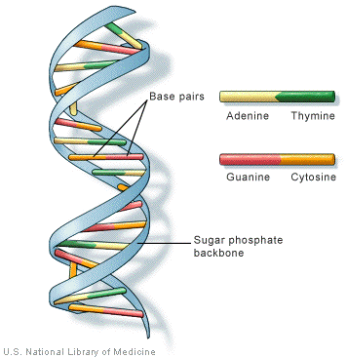
Basic Biology
Watson and Crick gave the double stranded DNA model where two strands are zipped together by complementary base-pairing
Bases {A,C, G, T}
Pairing A-T, C-G
Courtesy: ttp://www.chemguide.co.uk/organicprops/aminoacids/dna1.html

Slide 3
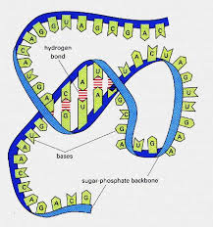
RNA
RNA is a basic biological molecule. It is single stranded.
RNA molecules fold into complex secondary structures.
Secondary structure often governs the behaviour of an RNA molecule.
Various rules govern secondary structure formation:

Slide 4
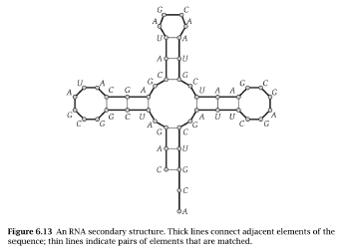
Problem
Pairs of bases match up; each base matches with 1 other base.
Adenine always matches with Uracil.
Cytosine always matches with Guanine.
There are no kinks in the folded molecule.
Structures are knot-free.
Problem: given an RNA molecule, predict its secondary structure.

Slide 5
Formulation
An RNA molecule is a string B = b₁b₂ … b_{n}; each
An secondary structure on B is a set of pairs S = {(i , j)}, where 1 ≤ i , j ≤ n and satisfies the following rules.

Slide 6
Rules
(No sharp turns) The ends of each pair are separated by at least 4 intervening bases i.e. if (i , j) ε S, then i < j - 4.
The elements in each pair in S consist of either {A,U} or {C,G} (in either order).
S is a matching: no base appears in more than one pair.
(No knots) If (i,j) and (k,l) are two pairs in S, then we cannot have i < k < j < l .

Slide 7
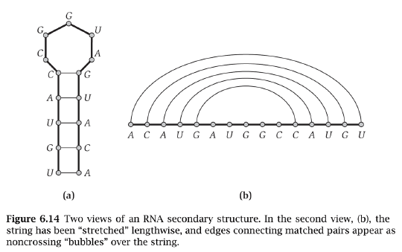
The energy of a secondary structure is proportional to the number of base pairs in it.

Slide 8
First approach
OPT(j) is the maximum number of base pairs in a secondary structure for b₁b₂ … b_{j}. OPT(j) = 0, if j ≤ 5.
In the optimal secondary structure on b₁b₂ … b_{j}
if j is not a member of any pair, use OPT(j-1).
if j pairs with some t < j - 4, knot condition yields two independent sub-problems! OPT(t -1) and ???

Slide 9
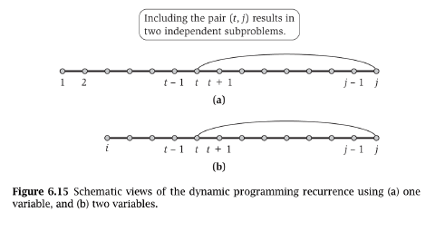
Pictorially

Slide 10
Correct approach
OPT(i,j) is the maximum number of base pairs in a secondary structure for b_{i}b_{i+1} … b_{j}. OPT(i,j) = 0, if i≥j-4.
In the optimal secondary structure on b_{i}b_{i+1} … b_{j}
if j is not a member of any pair, use OPT(i,j-1).
if j pairs with some t < j - 4, knot condition yields two independent sub-problems! OPT(i,t -1) and OPT(t+1,j-1)

Slide 11
Recurrence
t ranges from I to j-5 such that it is allowed to pair with j
There are O(n²) sub-problems.
How do we order them from “smallest" to “largest"?
Note that computing OPT(i , j) involves sub-problems OPT(l ,m) where m - l < j - i .

Slide 12
Recurrence
There are O(n²) sub-problems.
How do we order them from “smallest" to “largest"?
Note that computing OPT(i , j) involves sub-problems OPT(l ,m) where m - l < j - i .

Slide 13
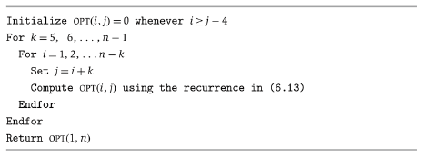
Algorithm

Slide 14
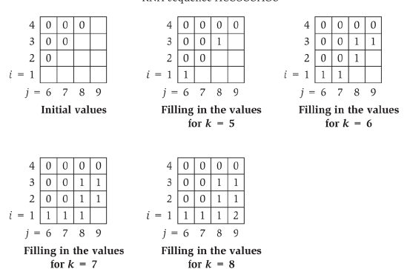
Lets do an example
Input ACCGGUAGU

Slide 15
Reference
Algorithm Design by Eva Tardos and Jon Kleinberg.

