Slide 1
NATURAL LANGUAGE PROCESSING
WITH DISASTER TWEETS
TEAM MEMBERS
-Manasa Reddy
- Yashika Chopra
-A.S Navya
-A.S.N Rishika

Slide 2
PROBLEM DEFINITION - goals and objectives
To build a machine learning model that predicts whether a tweet is about a real disaster or not.
To try different word embeddings and compare them using suitable metrics.
Trying to compare supervised and unsupervised techniques for determining whether a tweet is about a real disaster or not.
Try to explore recently developed models like BerTweet and see if it yields better results than the existing ones
To explore whether the subjectivity score improves accuracy of the model or not.
To explore other textual features to see if there is a dependence on these features.

Slide 3
Literature Survey
Singh, J.P., Dwivedi, Y.K., Rana, N.P. et al. Event classification and location prediction from tweets during disasters. Ann Oper Res 283, 737–757 (2019). https://doi.org/10.1007/s10479-017-2522-3
https://link.springer.com/article/10.1007/s10479-017-2522-3
This paper is about classifying tweets about flood related disasters into low priority and high priority and then finding the location of the disaster for high priority tweets.
For classifying, 3 techniques were tried - SVM, random forest and gradient boosting. SVM performed poorer than the other 2.
For finding the location, the 3 methods used were - address given in the tweet, geo tagging and Markov chain.
They got a classification accuracy and location accuracy of 81% both.
However, these models were trained specifically for flood related disasters and classifying those into high priority or low priority.

Slide 4
Identifying and Categorizing Disaster-Related Tweets by Kevin Stowe, Michael Paul, Martha Palmer, Leysia Palen, Ken Anderson at Proceedings of The Fourth International Workshop on Natural Language Processing for Social Media
https://aclanthology.org/W16-6201.pdf
This paper focuses on the 2012 Hurricane Sandy event, and presents classification methods for categorizing tweets relevant to the hurricane into fine-grained categories such as preparation and evacuation.
Count of unigrams with full feature set as well as truncated set using standard selection technique was used. Feature selection proved to be substantially better than using all unigrams.
3 classification models were tried - SVM, MaxEnt and Naive Bayes of which SVM gave better results with feature selection.
Only supervised classification techniques were used here.

Slide 5
Real or Not? NLP with Disaster Tweets by Chandan Mannem, Mahalavanya Sriram, Aparajitha Sriram
Distinguished if a tweet talks about a real disaster or not. They tried out a variety of different models, and found that the BERT model with a K-fold cross validation worked best.
They got a classification accuracy of 79%.
But, this was done without taking into consideration the topic of sentiment analysis.

Slide 6
Need of the Project
The research done in the area of natural language processing with disaster tweets has mostly focused on classifying tweets which are already known to refer to a real disaster. But sometimes, it’s not always clear whether a person’s words are actually announcing a disaster or they are being metaphorical. In such cases, tweets can be misleading.

Slide 7
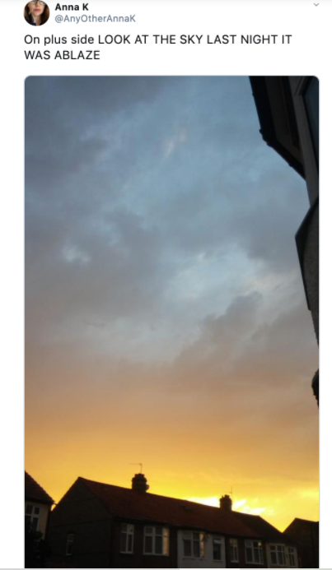
For example:
Though ablaze means on fire, here it is being used metaphorically by the author. This might be clear to a human but to a machine it is not so clear.

Slide 8
2. The research work done in the area of classifying disaster tweets into real or not real, most of the work has been done using supervised classification techniques. Unsupervised techniques have not been explored much.
3. Also, while determining if the disaster tweet is about a real one or not, sentiment analysis has not been used.

Slide 9
Purpose of the Project
To help disaster relief organizations, NGOs etc. to get real time information about the help required by the victims using the data from social media because social media is a platform to express one’s view in real time. And in the recent times, twitter has become an important communication channel during emergencies because of the omnipresence of smartphones.
To understand how unsupervised topic models perform as compared to supervised classification models.
To understand how sentiment analysis may or may not improve the accuracy of detecting if a disaster tweet is about a real disaster or not.

Slide 10
Project Schedule and Distribution of work
Collecting the data - done
Pre-processing - by 31st October
Word representations - try out the following
Word2Vec
TF-IDF
Bert
Bertweet
Glove
FastText
Understanding and implementing the above word representations, exploring other word representations and comparing all of them using suitable metrics - by 7th Nov (Manasa, Rishika)

Slide 11
Try out the following topic modelling (unsupervised) techniques:
LDA (with BERT, Word2Vec) (Navya)
LSA (with TF-IDF) (Yashika)
By 10th Nov
Try out the following text classification (supervised) techniques:
Fine tuning BERT - by 12th Nov (Manasa)
Multilayer Perceptron (MLP) classifier - by 14th Nov (Rishika)
Long short-term memory (LSTM) classifier - by 16th Nov (Navya)
Extreme Gradient Boosting (XGBoost) - by 18th Nov (Yashika)
Support Vector Machine (SVM) - by 20th Nov (Manasa)

Slide 12
Comparing different models - Using suitable metrics like F1 score etc,
Comparison of the 2 unsupervised techniques
Comparison of the supervised techniques
Comparison between the unsupervised and supervised techniques
By 22nd Nov (All)
Explore whether subjectivity score improves the accuracy or not - by 23rd Nov (Navya, Yashika)
Explore dependency on other textual features - by 25th Nov (All)
Reviewing the entire work and preparing the research paper - by 3rd Dec (All)

Slide 13
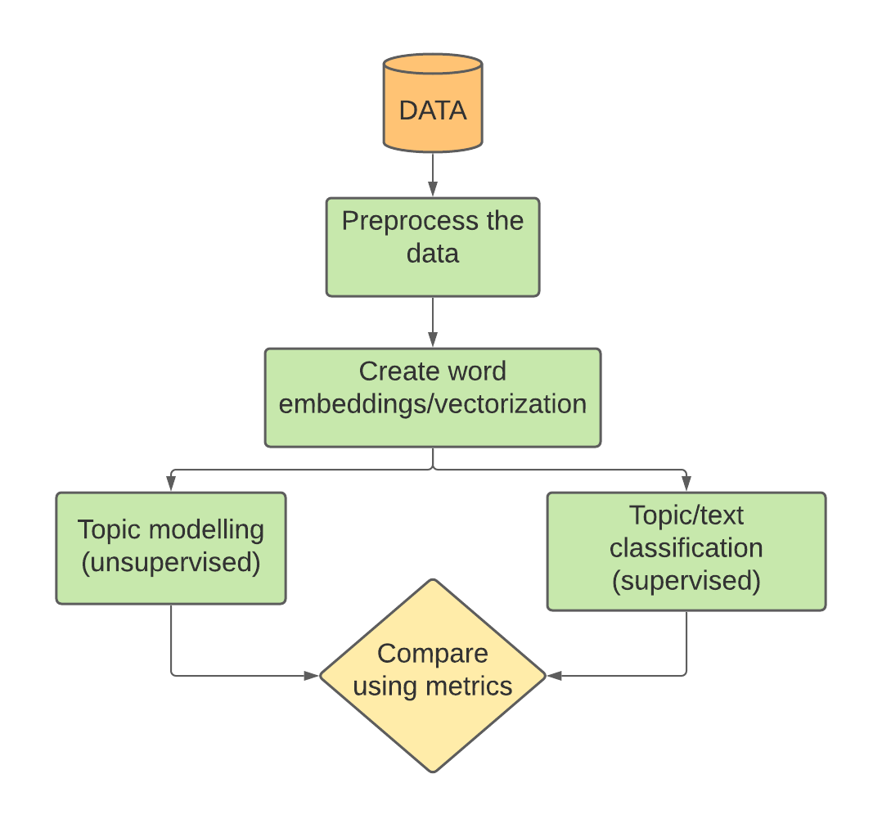

Slide 14
Text Preprocessing and the need for it:
Tweets contain different types of noise and redundancies, such as emoticons, user mentions, hash tags, Internet links etc. A proper data preprocessing is needed in order to convert these tweets into a meaningful sentence.
Removing internet links: The Internet links (starting with http://) need to be deleted from the tweets, as we were concentrating on the tweet text only. It might result in the loss of useful details about the incident but since we are focusing on the textual content of the tweets, the links can be ignored.
Removing emoticons, user mentions, hash tags: since we are focusing on prediction based on the textual content only.
Removing unwanted dots and merging multiple spaces: since we are focusing on predicting based on the textual content only.

Slide 15
4. Removing all non-ASCII characters: as they do not convey any meaningful information
5 Converting the entire text into lowercase: as lowercase conversion is an effective
pre-processing step.
6. Correcting spelling errors: suggests the incorrect word and provides its most possible correct word before feeding it to machine learning algorithms
7. Taking care of abbreviations and slang words
8. Remove stop words: To remove low-level information from our text in order to give more focus to the important information
9. Tokenization: Helps in interpreting the meaning of the text by analyzing the sequence of the words
10. Normalization: to reduce randomness and bring the text closer to a predefined standard

Slide 16
THANK YOU

