Slide 1



KEC HACKATHON 2025
Problem Statement ID - PSA1
Title - Public transport users lack real-time
information about delays or overcrowding.
Domain – Social good and accessibility
Team Name - RouteMasters
Team Lead Name – Kiruthick B
College - Kongu Engineering College
TEAM MEMBERS:
Lakshmi Narayan R
Manojh B
Hari kiruthik G R
MENTOR
Name:N.Aravindhraj
Designation:Assistant Professor
College/Company: Kongu Engineering College

Slide 2
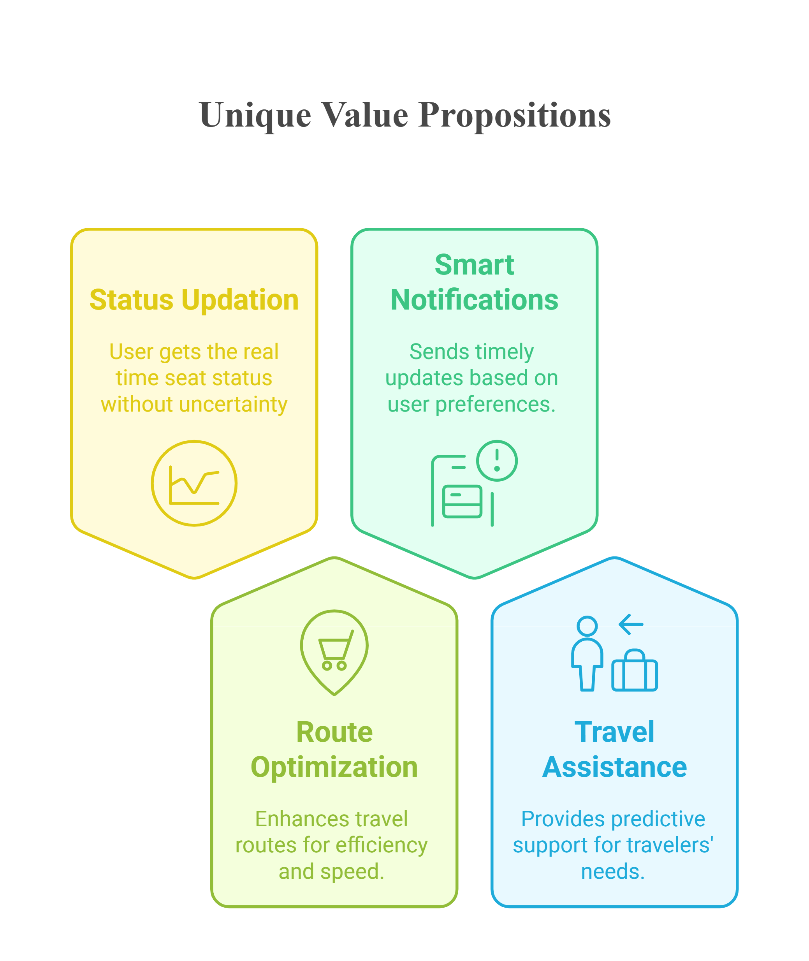
RouteMasters
Public transport users lack real-time information about delays & overcrowding
Proposed Solution
User gets real time seat status
Dynamic route suggestions for delays or traffic.
Push alerts for overcrowding, delays, or schedule changes.
Reducing uncertainty and gives smoother platform experience
2

Slide 3
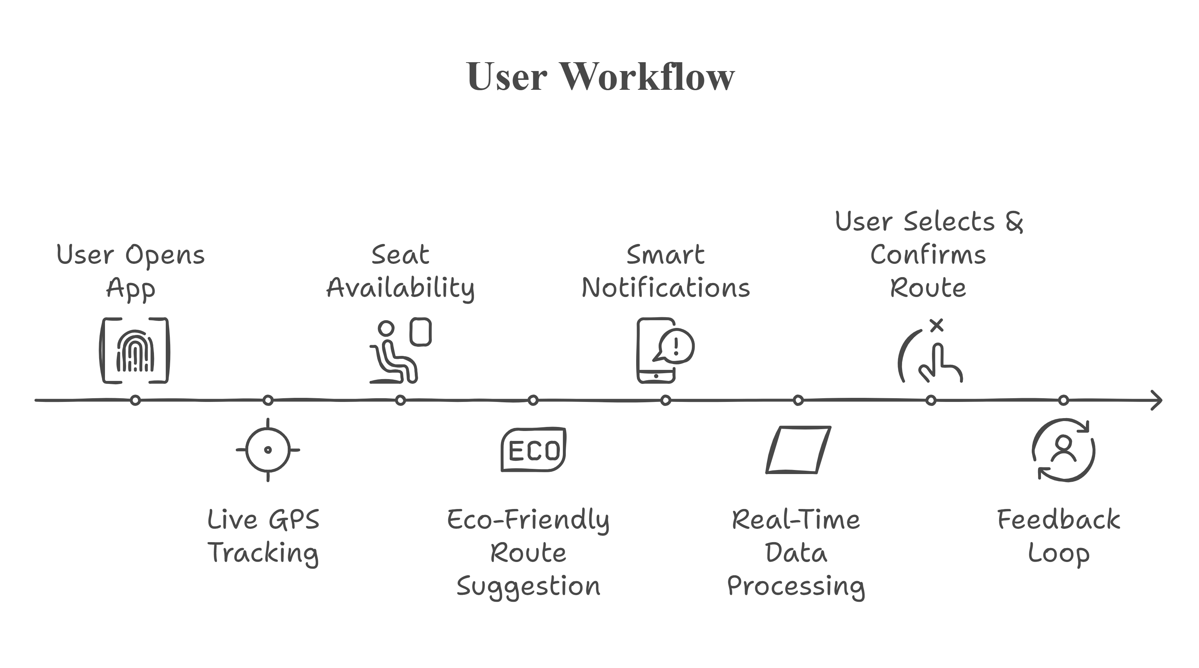
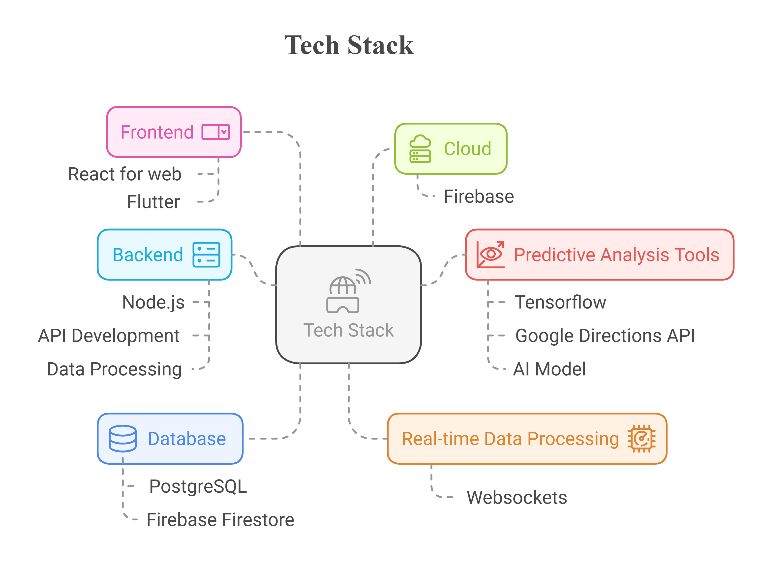
RouteMasters
TECHNICAL APPROACH
3

Slide 4
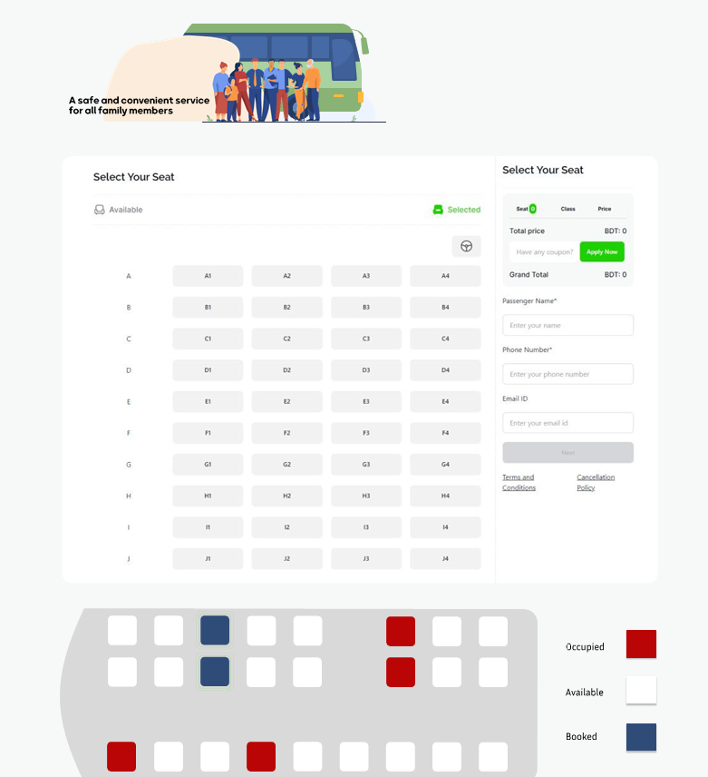
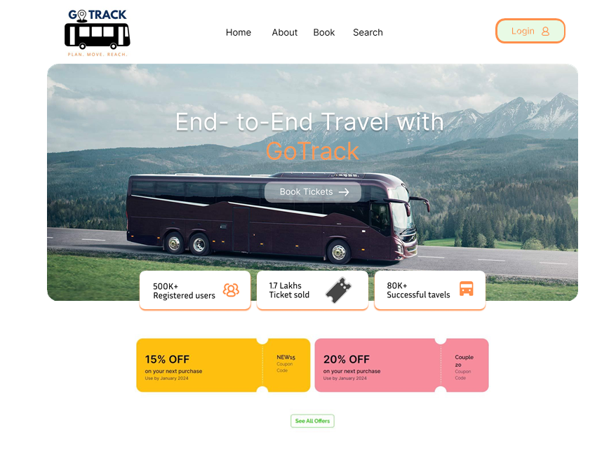

Slide 5
RouteMasters
FEASIBILITY AND VIABILITY
Analysis of the feasibility of the idea
Technical Feasibility – Uses WebSockets for real-time data, GPS APIs for live tracking, and databases for seat availability.
Market Feasibility – Increasing demand for real-time transport tracking and route optimization.
Potential challenges and risks
Data Accuracy – Real-time seat updates and traffic data depend on external APIs and user inputs.
Network Latency – Delays in live updates can impact user experience.
Strategies for overcoming these challenges
Optimized WebSockets Implementation – Ensures fast real-time updates.
Lightweight App Design – Reduces load times and enhances performance.
5

Slide 6
RouteMasters
IMPACT AND BENEFITS
Potential impact on the target audience
Commuters – Reduced waiting time, better journey planning, and real-time seat availability.
Public Transport Operators – Improved passenger distribution, reduced overcrowding, and better resource management.
Benefits of the solution
Real-Time Updates – Live tracking and instant alerts on delays and seat availability.
Dynamic Route Optimization – Avoids congestion and suggests the best possible travel routes.
6

Slide 7
RouteMasters
RESEARCH AND REFERENCE
Details / Links of the reference and research work
https://developer.mozilla.org/en-US/docs/Web/API/WebSockets_API
https://www.tnstc.in/OTRSOnline/
@kechackathon2025
7

