Slide 1
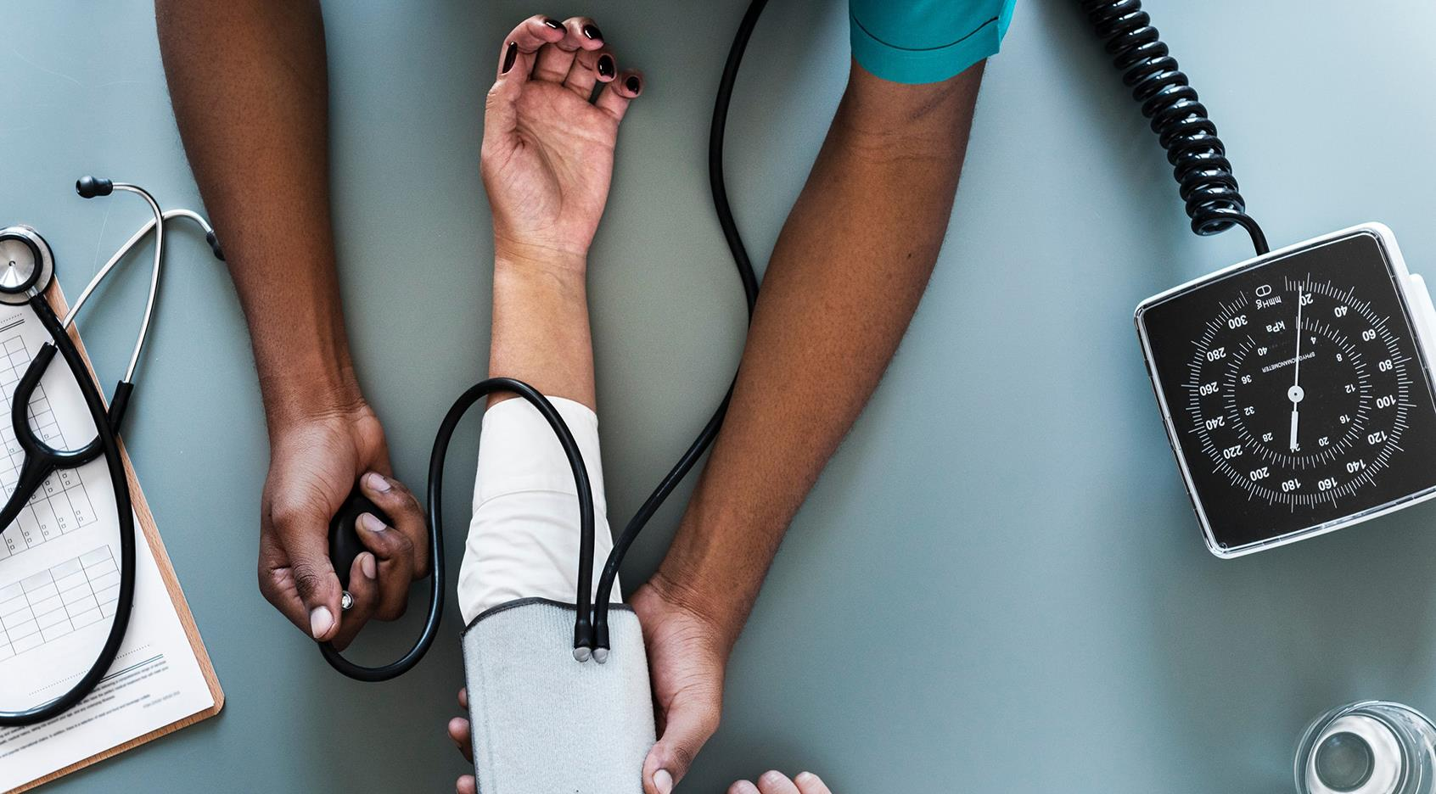
Cancerous Lesion Detection
JAGRAMABI Pharmadaticals
Graciela Lopez Rosson, Maarten Van den Bulcke, Bilal Mesmoudi, Jacques Declercq

Slide 2

The Mission
JAGRAMABI Pharmadaticals
More and more demands from companies for a tool that would be able to detect moles. (proof of concept)
Create a simple web page where the user could upload a picture.
The health care company "skinCare" hired us as freelance data scientists to be able to detect moles that need to be handled by doctors.

Slide 3

TABLE OF CONTENT
THE MISSION
WORKFLOW:
2.1 DATA EXPLORATION
2.2 DATA AUGMENTATION
2.3 MODELS & OUR PREDICTIONS
3. LIVE DEMO
JAGRAMABI Pharmadaticals

Slide 4





Workflow
JAGRAMABI Pharmadaticals
Predicting which type of lesion.
EDA
Pre-process & Augmentation
Model creating & Transfer learning
Hyperparameter tuning
Predictions & review
Exploring the data. Learn the different classes of lesions.
Preparing and balancing the data for the convolutional neural network.
Creating a model & Using an already built model.
Changing and improving the parameters of the model.
Evaluate the models predictions.

Slide 5
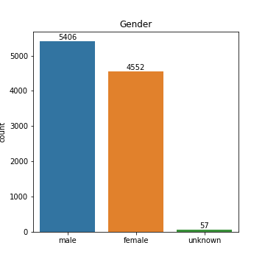
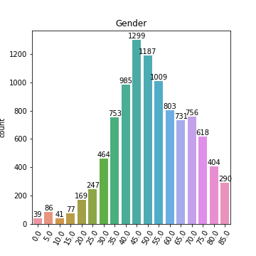
Exploring the Data
JAGRAMABI Pharmadaticals

Slide 6
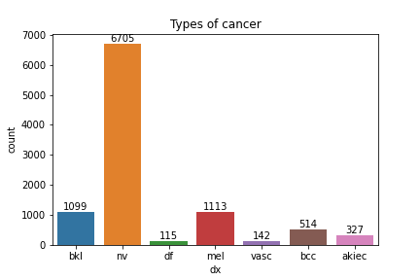
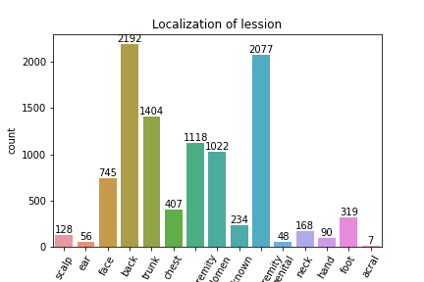

Exploring the Data
JAGRAMABI Pharmadaticals
Insight:
Automatic diagnose of skin lesion

Slide 7
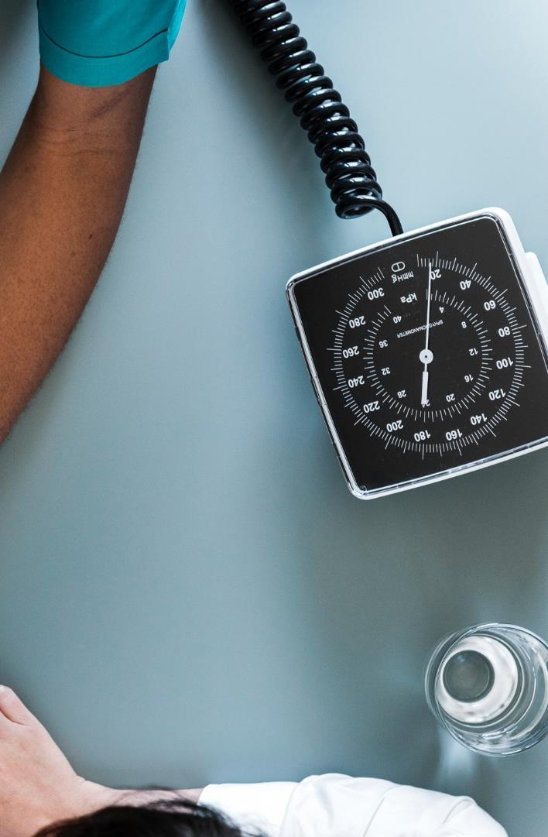



Pre-process & data augmentation
JAGRAMABI Pharmadaticals
Augment Data
Pre-Process
Techniques used to increase the amount of data by adding slightly modified copies
Modify the pictures for better mole recognition e.g. Hair Removal
Scaled
Balancing
Make it more readable for the machine
Make it more readable for the machine

Slide 8
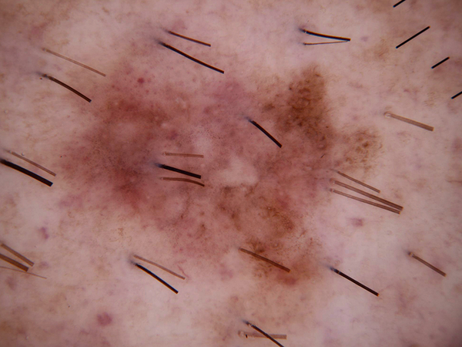
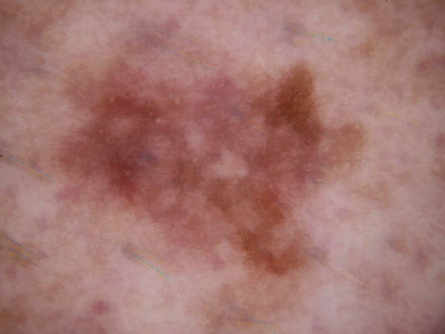
Hair Removal e.g.
JAGRAMABI Pharmadaticals

Slide 9
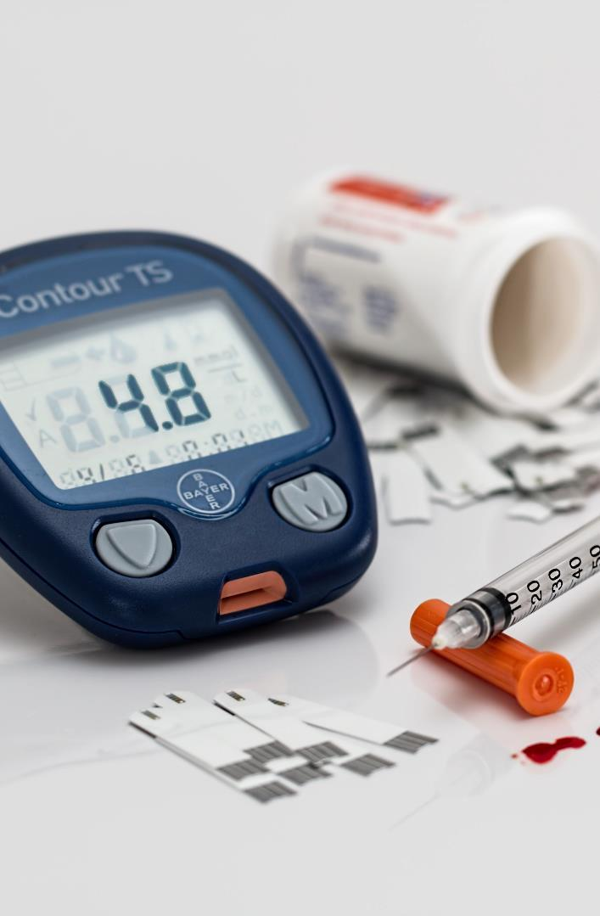



Models & Predictions
JAGRAMABI Pharmadaticals
App Creation
Transfer Learning
Accuracy*
Convolutional Neural Network Model
Binary
Multiclass
Docker
Reusing or transferring information from a model’s learned tasks for the learning of new tasks
Binary = 90% accuracy
Multiclass = 69% accuracy
* MVP first tests

Slide 10

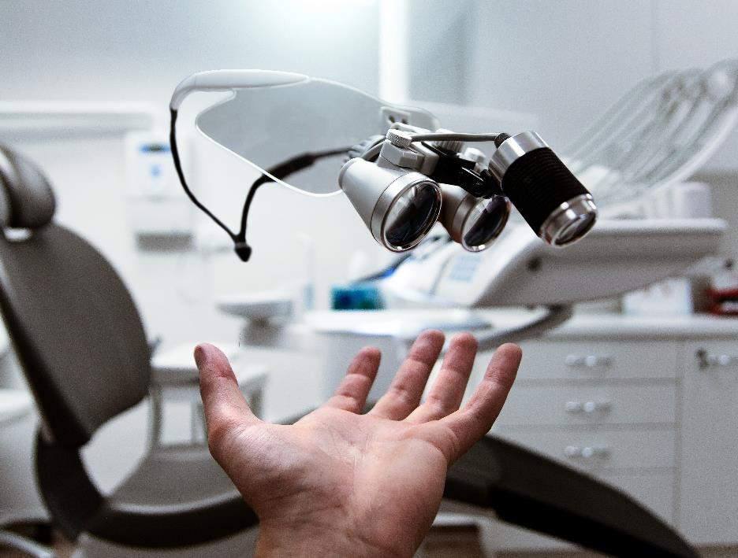
LIVE DEMO
JAGRAMABI Pharmadaticals

Slide 11



Ongoing Improvements
Ongoing Improvements
JAGRAMABI Pharmadaticals
Dataset improvements
Image discrimination
Fine Tune the Model*
Contact professionals for more data.
Improve the app to recognize skin lesion pictures only.
Enhance the accuracy of the model.

Slide 12
Timeline
JAGRAMABI Pharmadaticals
Our 1 year action plan
Trials (MVP)
Beta version
Investment
Launch
Sept, 2021
Feb, 2022
Jun, 2022
MAY, 2022
AUG
SEP
OCT
NOV
DEC
JAN
FEB
MAR
APR
MAY
JUN
JUL
AUG
SEP
OCT
NOV
DEC
JAN
FEB
MAR
APR
MAY
2021
2022
Legislation
Marketing
Procurement
Nov, 2021
Aug, 2022
Dec, 2022

Slide 13



Thank you
JAGRAMABI Pharmadaticals
+44 1239 876 554
info@jagramabi.com
website

