Slide 1

R PROGRAMMING
ARAVALI COLLEGE OF ENGINEERING & MANAGEMENT
(ACEM, FARIDABAD)

Slide 2

Program Name : B.TECH CSE Semester : VII Course Name: R PROGRAMMING Course Code: OEC-CS-701(III) Faculty Name: RASHIKA SINGH Designation: ASSISTANT PROFESSOR Department : __CSE_____

Slide 3
UNIT No.1
INTRODUCTION
Getting R
R Version
32-bit versus 64-bit
The R Environment
Command Line Interface
RStudio
Revolution Analytics
Learning Outcome
Familiarize themselves with R and the RStudio IDE

Slide 4
R PROGRAMMING
R is a software environment which is used to analyze statistical information and graphical representation.
R allows us to do modular programming using functions.
This programming language was named R, based on the first name letter of the two authors (Robert Gentleman and Ross Ihaka).

Slide 5
"R is an interpreted computer programming language which was created by Ross Ihaka and Robert Gentleman at the University of Auckland, New Zealand."
The R Development Core Team currently develops R. It is also a software environment used to analyze statistical information, graphical representation, reporting, and data modeling.
R is the implementation of the S programming language, which is combined with lexical scoping semantics.
R not only allows us to do branching and looping but also allows to do modular programming using functions. R allows integration with the procedures written in the C, C++, .Net, Python, and FORTRAN languages to improve efficiency.
In the present era, R is one of the most important tool which is used by researchers, data analyst, statisticians, and marketers for retrieving, cleaning, analyzing, visualizing, and presenting data.

Slide 6
History of R Programming
The history of R goes back about 20-30 years ago. R was developed by Ross lhaka and Robert Gentleman in the University of Auckland, New Zealand, and the R Development Core Team currently develops it.
This programming language name is taken from the name of both the developers.
The first project was considered in 1992. The initial version was released in 1995, and in 2000, a stable beta version was released.

Slide 7
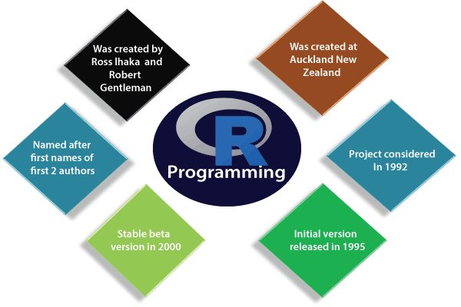

Slide 8
The following table shows the release date, version, and description of R language:
Version-Release | Date | Description
0.49 | 1997-04-23 | First time R's source was released, and CRAN (Comprehensive R Archive Network) was started.
0.60 | 1997-12-05 | R officially gets the GNU license.
0.65.1 | 1999-10-07 | update.packages and install.packages both are included.
1.0 | 2000-02-29 | The first production-ready version was released.

Slide 9
1.4 | 2001-12-19 | First version for Mac OS is made available.
2.0 | 2004-10-04 | The first version for Mac OS is made available.
2.1 | 2005-04-18 | Add support for UTF-8encoding, internationalization, localization etc.
2.11 | 2010-04-22 | Add support for Windows 64-bit systems.
2.13 | 2011-04-14 | Added a function that rapidly converts code to byte code.

Slide 10
2.14 | 2011-10-31 | Added some new packages.
2.15 | 2012-03-30 | Improved serialization speed for long vectors.
3.0 | 2013-04-03 | Support for larger numeric values on 64-bit systems.
3.4 | 2017-04-21 | The just-in-time compilation (JIT) is enabled by default.
3.5 | 2018-04-23 | Added new features such as compact internal representation of integer sequences, serialization format etc.

Slide 11
Features of R programming
It is a simple and effective programming language which has been well developed.
It is data analysis software.
It is a well-designed, easy, and effective language which has the concepts of user-defined, looping, conditional, and various I/O facilities.
It has a consistent and incorporated set of tools which are used for data analysis.
For different types of calculation on arrays, lists and vectors, R contains a suite of operators.
It provides effective data handling and storage facility.
It is an open-source, powerful, and highly extensible software.
It provides highly extensible graphical techniques.
It allows us to perform multiple calculations using vectors.
R is an interpreted language.

Slide 12
Interesting, right?
This is just a sneak preview of the full presentation. We hope you like it! To see the rest of it, just click here to view it in full on PowerShow.com. Then, if you’d like, you can also log in to PowerShow.com to download the entire presentation for free.

