Slide 1
Network
Construction
Network
Analysis
Acquisition
(BOLD signal)
Preprocessing
Further
Research...
GPU Acceleration：
Single or Multi-thread CPU：
Unweighted
Adjacency Matrix
Characteristic Length path
Global Metrics
Clustering coefficient
Y
Correlation Matrix
Average&Binarize
Modularity
GPU
Correlation Calculation
Nodal Efficiency
N
Nodal Metrics
Participation Coefficient
Degree Centrality
Unweighted
Adjacency Matrix
Centrality
Betweenness Centrality
Eigenvector Centrality
Notes:
对齐

Slide 2
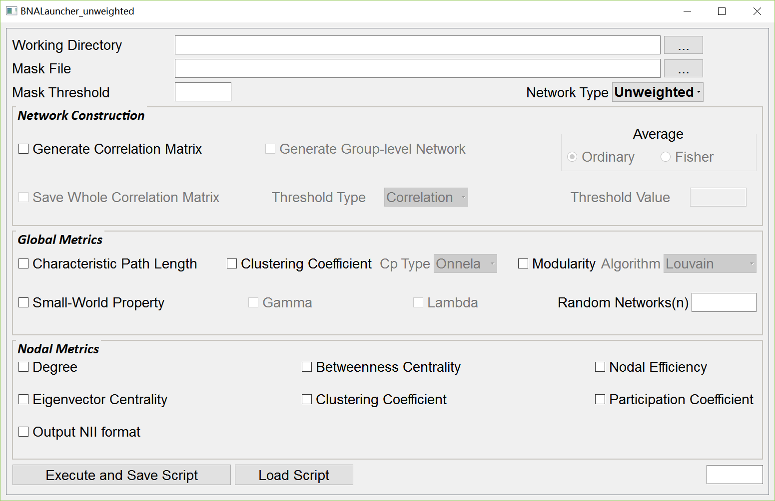

Slide 3
Algorithm | Unweighted Networks |  |  | Weighted Networks
 | CPU-based time(s) | GPU-based time(s) | Speedup
Correlation Matrix |  | 2.596 |  | 2.807
Blocked FW |  | 140.299 |  | 152.526
Modular Detection | 414.963 | 106.298 | 3.904 | 77.3299
Betweenness Centrality |  | 261.844 |  | \
Eigenvector Centrality | 3.13038 | 3.01145 | 1.039 | 2.82647
The sparsity of network that listed algorithms deal with is 1.0%. Note that unweighted and weighted network respectively adopt different modularity methods.

Slide 4
 | Unweighted Network |  |  | Weighted Network
Sparsity | 1% | 2% | 3% | 1% | 2% | 3%
Correlation Matrix
GPU | 2.596 |  |  | 2.807
1-thread CPU | 64.573 |  |  | 65.747
Speedup | 24.874 |  |  | 23.422
All-Pairs-Shortest-Path
GPU BFW | 145.255 | 203.635 | 147.775 | 144.069 | 166.695 | 144.902
1-thread CPU BFW
Speedup | >200 |  |  | >200
8-thread BFS | 93.4959 | 175.526 | 253.841 | \
1-thread CPU BFS | 236.763 | 395.694 | 554.712
Speedup | 2.532 | 2.254 | 2.185
Modular Detection
GPU | 108.979 | 308.444 | 518.911 | 47.1865 | 57.8658 | 66.5942
1-thread CPU | 596.249 | 1093.03 | 1741.51
Speedup | 3.904 | 3.544 | 3.356
Betweenness Centrality
GPU | 266.067 | 553.251 | 781.897 | \
1-thread CPU |  | 1548.132
Speedup |  | 2.798
Notes:
使用的显卡类型不同！，也要标注!要标注有权网采用了louvain法；以秒为单位
以前的：The sparsity of network that listed algorithms deal with is 1.0%. Note that unweighted and weighted network respectively adopt different modularity methods.

