Slide 1
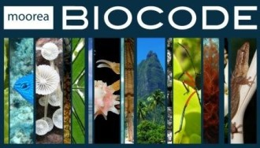

Berkeley 3Bi: Biocode, BiSciCol, BigData
UC Berkeley, August 13, 2012
The Merritt Curation Repository
Features, Uses, and Benefits
University of California Curation Center
California Digital Library

Slide 2
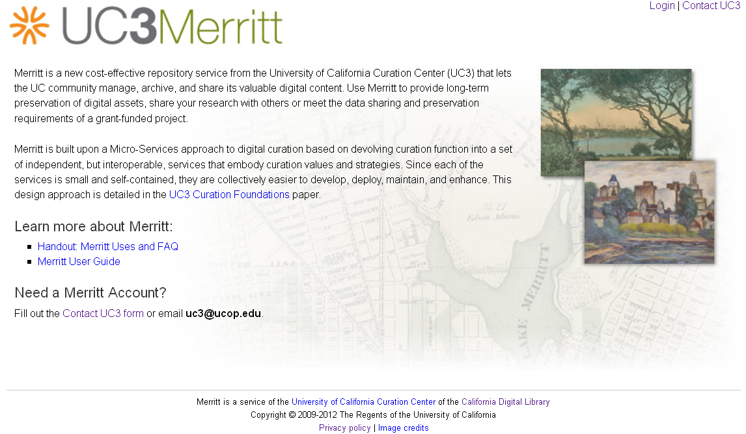
What is Merritt?
Merritt is a comprehensive repository service available to the UC community for both long-term preservation of and access to its important digital content

Slide 3
Merritt preservation features
Digital preservation is the set of policies and practices that ensure the continued viability and availability of digital content over time
No prescriptive requirements regarding content genre, format, or metadata for low-barrier submission
Curatorially-defined collections for content management
Strong versioning to maintain change history over time
Geographic storage replication and fixity verification for preservation assurance
Technology watch to respond to potential obsolescence
Intuitive UI and API for ease of use in manual or automated operation
UC3 hosting

Slide 4
Merritt access features
Preservation and access are complementary activities: preservation ensures access over time; access depends upon preservation up to a point in time
Curatorially-specified public or restricted access visibility
Keyword search and browse for discovery – soon with fielded and faceted search
Data use agreements for enforceable terms of use
ARK and DOI identifiers for persistent citation and retrieval
EZID/DataCite integration for high-level discovery – soon with indexing in Web of Science and Primo for global discovery
Atom feeds for notification of new content availability

Slide 5
Why use Merritt?
Take control of your content
Merritt is configurable to conform to your curation decisions
Share your content
Control access to your content by collaborators and colleagues
Publish your content
Public access through persistent citations and indexing for global discovery
Preserve your content
Professional management to ensure uninterrupted access to content over time
Fulfill new data management requirements
http://dmptool.org/

Slide 6




Relevant Merritt initiatives
DataShare – “open data for the global scientific community”
Collaboration with UCSF Libraries, CIND, and CTSI
Use of the new Merritt faceted discovery environment to provide public access to neurophysiological imagery
DataONE – “enabling new science through universal access to data about life on Earth”
Distributed cyberinfrastructure network on which Merritt is a member node
DataUp / ONEshare – “helping you describe and share your data”
Open source Excel add-in and web service for the curation of tabular scientific data
Public spreadsheet hosting site using a dedicated Merritt/DataONE member node

Slide 7
For more information
Merritt
http://merritt.cdlib.org/
http://www.cdlib.org/uc3/merritt
DataShare
http://datashare.ucsf.edu/
DataONE
http://www.dataone.org/
DataUp / ONEshare
http://dataup.cdlib.org/
UC3
http://www.cdlib.org/uc3
uc3@ucop.edu
Stephen Abrams David Loy
Patricia Cruse Mark Reyes
Scott Fisher Abhishek Salve
Erik Hetzner Joan Starr
Greg Janée Marisa Strong
John Kunze Adrian Turner
Rosalie Lack Perry Willett

