Slide 1
Biocode Commons / GSC14- bioCollections Ontology Hackathon Sep 19-20, 2012 OERC, Oxford, UK
John Deck, Norman Morrison, Sujeevan Ratnasingham , Phillipe Rocca-Serra, Barry Smith, Ramona Walls, Trish Whetzel, John Wieczorek, Jai Rideout, Matthew Bietz , Steve Stones-Havas, Gabi Droege, Éamonn O’Tuama, Peter Sterk, Robert Robbins, Pier Buttigieg, Reed Beaman, Michelle Koo

Slide 2
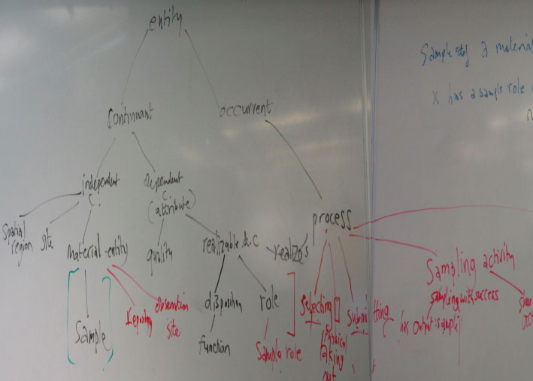
Our whiteboard - Diagramming samples
and sample processes

Slide 3
What is a Sample
A sample is a material entity that is taken out of its normal environment and is submitted to an institution or a measurement device.
Processes involving sampling or samples:
Collecting process
Data Sampling Process
Identification Process
Material Sampling Process
Observing Process
Physical Extraction Process
Process that yields a material representation of a material entity
Process that yields an information artifact that is a representation of a material entity
Selecting process
Statistical sampling process
Submitting process

Slide 4
Linking Samples and Sampling Processes
The sampling process can be characterized by a chain of distinct stages involving samples and processes. For example, assume we are studying the metagenome from a fish gut. The following steps could be identified as distinct samples and associated processes in this chain:
ProcessX (removing Fish from a reef by method at location) to derive sampleX
ProcessY (remove goop from sampleX stomach by methodA) to derive sampleY
ProcessZ (remove DNA extract from sampleY) to derive sampleZ
ProcessA runs sequencing on sampleZ to derive sequenceA

Slide 5
What we accomplished
bioCollections/Sample OWL output: http://biocode-commons.googlecode.com/svn/trunk/ontologies/biocollections/biocode.owl
Proposed Darwin Core minor clarifications: Expand Basis of Record to include DNAExtract, Subsampled Tissue
Action Items
GOs Registry (John D/ Eamonn utilize GBIF registry? will bring up w/ Gos)
Explore Integration with OBI (Rocca-Serra/ Deck/Morrison)
Invite feedback from community via bioPortal (Whetzel/ bioPortal)
Propose DwC Minor Clarifications at TDWG12 (Wieczorek)
Whitepaper: SOB, Biocode Commons Hackathon, Darwin Core DNA Extension (Deck/Bob R leading, Gabi, Ramona)
Darwin Core DNA Extension follow-up with GGBN (Deck, Gabi, Eamonn)
Darwin Core Major clarifications: Build concept of Sample, and clarify other concepts (Deck bring up with TDWG-RDF group at TDWG12)

