Slide 1












Data Curation and Biodiversity Research -- The BiSciCol Project and a look at the “Triplifier Simplifier”
John Deck, University of California, Berkeley
Brian Stucky, University of Colorado, Boulder
Lukasz Ziemba, University of Florida, Gaineseville
Nico Cellinese, University of Florida, Gainesville
Rob Guralnick, University of Colorado, Boulder
BiSciCol Team
Reed Beaman, Nico Cellinese, Jonathan Coddington, Neil Davies, John Deck, Rob
Guralnick, Bryan P. Heidorn, Chris Meyer, Tom Orrell, Rich Pyle, Kate Rachwal, Brian
Stucky, Rob Whitton, Lukasz Ziemba

Slide 2
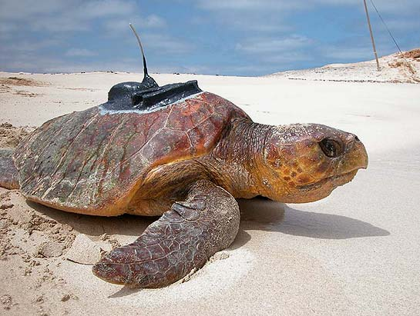
BiSciCol is National Science Foundation funded 2010 – 2014
Infrastructure to tag & track specimens & derivates in cyberspace
Relies on globally unique identifiers (GUIDs) to track objects
Implements a Linked Data approach
Provides support for the Global Names Architecture

Slide 3
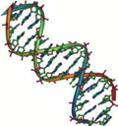





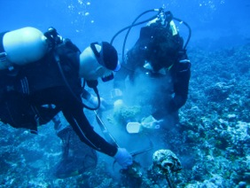






A Biological Relationship Graph …
Taxonomic Type Filter
Class Filter
X
Specimens
Tissues
X
Sequences

Slide 4
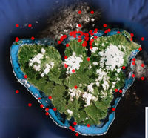
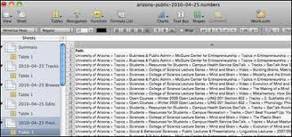


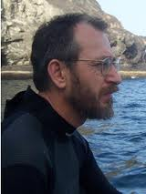






Why Linked Data? Why BiSciCol?
Here is Gustav’s Problem
Generates Lots of Data…
(Prefers to collect stuff)

Slide 5
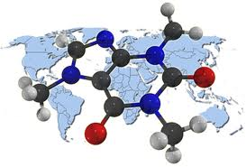
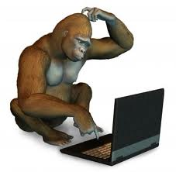

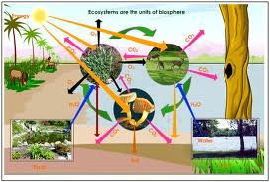
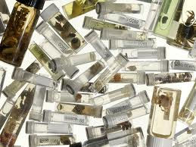
Biodiversity Data Challenges
Data is Distributed
Rapidly Changing Technologies
Covers Multiple Domains

Slide 6


Solving Biodiversity Data Challenges with
BiSciCol and Linked Data
Group data into classes.
Is a dwc:Event
Assign identifiers.
Is a dwc:Event
Link identifiers.
Publish.
[ ] Ocean Sampling Day
[X] Moorea Biocode
[X] SI MSNGR System
[+] Add My Data

Slide 7







The Triplifier
Darwin Core
Archive
Darwin
Core
Archive
PART 1: Loading Data
Spreadsheets
Mysql
KEMU
MySQL

Slide 8
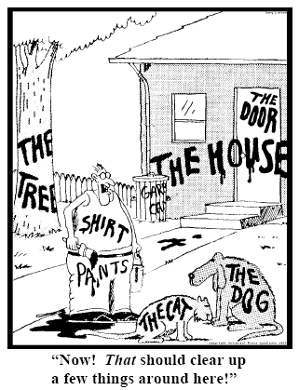
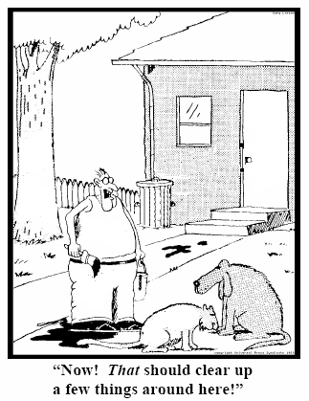
The Triplifier
PART 2: Assigning Entities
78
235
5678
321
322
666
427
From Gary Larsen and adapted by Barry Smith in Referent Tracking
presentation at the Semantics of Biodiversity Workshop, 2012.

Slide 9





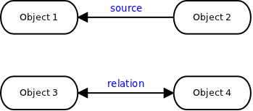




The Triplifier
PART 3: Assign Links

Slide 10

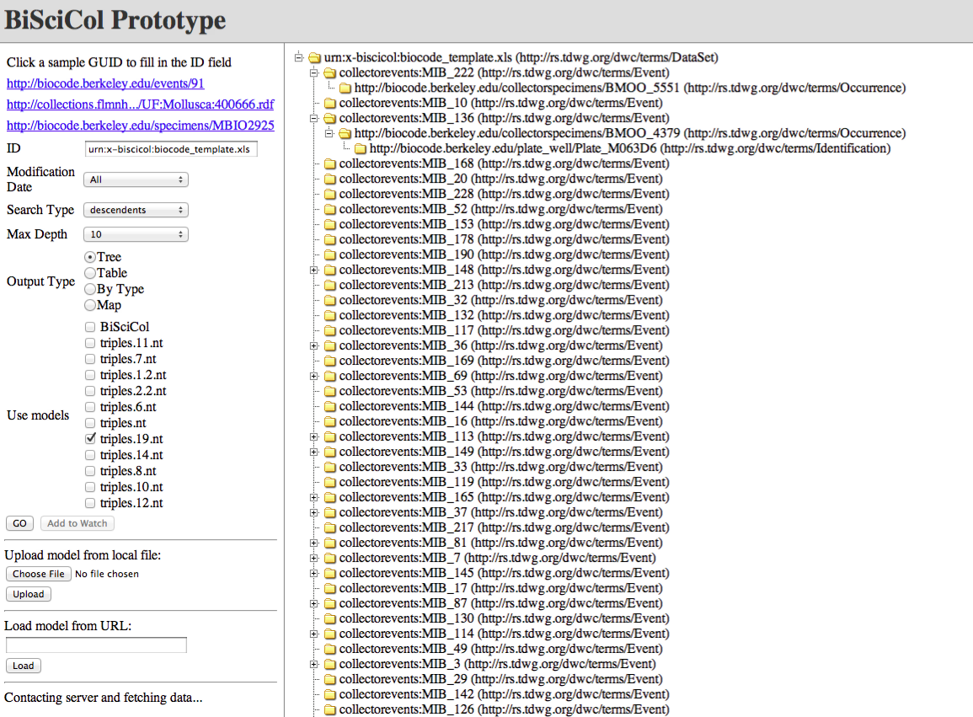
Triplify!: View graph based data
Response
Query

Slide 11
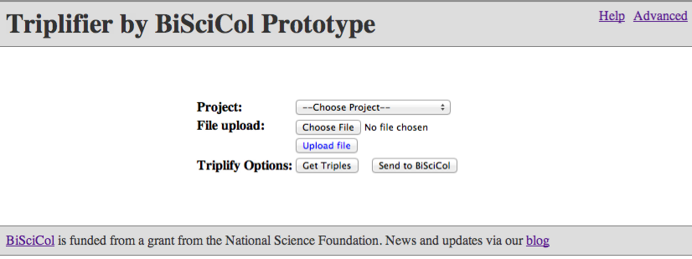
The Triplifier Interface
Publish

Slide 12
What challenges are we facing now?
(for BiSciCol, Linked Data, and data integration
In general)

Slide 13
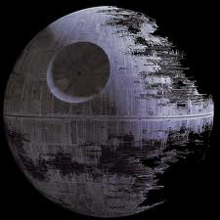
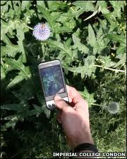
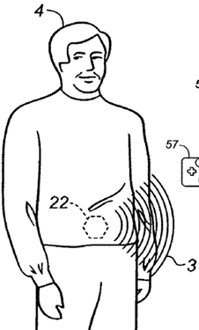
Identifier Issues
Persistence
Solutions:
DOIs (http://doi.org/)
EZIDs (http://ezid.net/)
Assignment at the source is difficult
Solutions:
Calculated namespaces (e.g. geo:lat,lng) via PDAs
UUIDs (randomly unique)
The digestible RFID tag
Semantic web requires URIs but many standards (including
Darwin Core) do not require URIs for identifiers
scheme : string
Solution:
Promote use of URIs for identifiers in all Standards.
URI

Slide 14
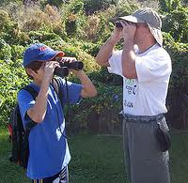
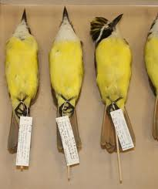
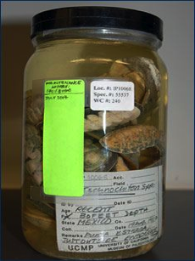
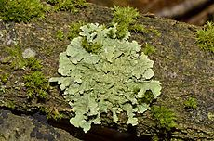
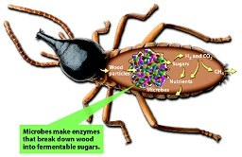

Classification Issues
“Occurrence”
Inadequate representational units
Confusion between representational units
“Sample, Specimen, Individual, Aggregation”
Solutions:
Continue working on clarity in term definitions
Work from upper level ontologies (e.g. Basic Formal Ontology) to derive definitions.

Slide 15
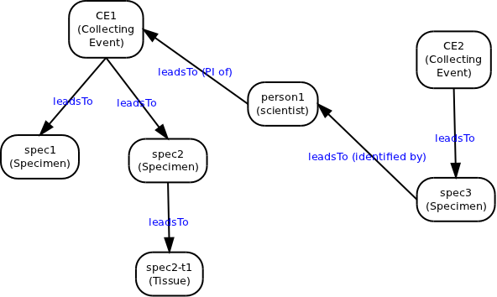
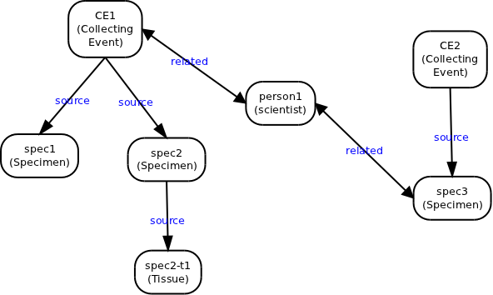
Relation Issues
Non-sensical conclusions are possible!
Solution:
apply directional links only where appropriate.

Slide 16

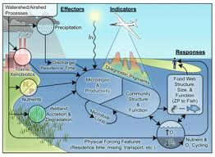
Adoption Issues
Critical mass required for effective utilization
Solutions:
Work with aggregators (GBIF, VertNet, NCBI).
View Triples as a publishable unit
Reality is complicated
Solutions:
Work collaboratively (e.g. BioPortal, hackathons, interdisciplinary workshops)

Slide 17

The BiSciCol Mission
BiSciCol tackles biodiversity data challenges:
Tracking and integration of objects across disciplines
Linking derivatives back to their source
BiSciCol is about community, collaborative practice
Commitment to standards, ontologies
Agreement on permanent, resolvable identifiers
Triplification of data sources to enhance linked data
http://biscicol.blogspot.com/ http://biscicol.org

