Slide 1
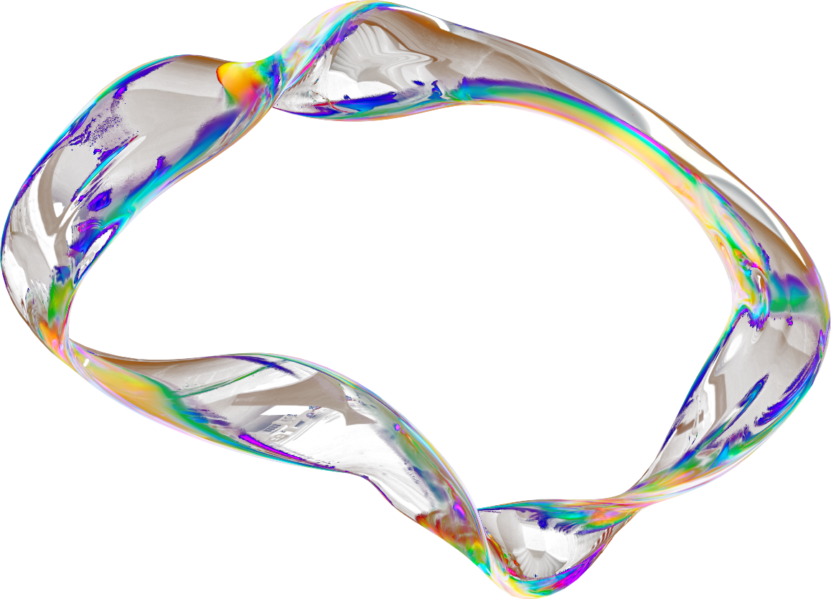

CREDIT CARD FRAUD DETECTION
Present by ML Team 3
Credit-Card-Fraud-Detection
GIZ_AIS5_S1e

Slide 2


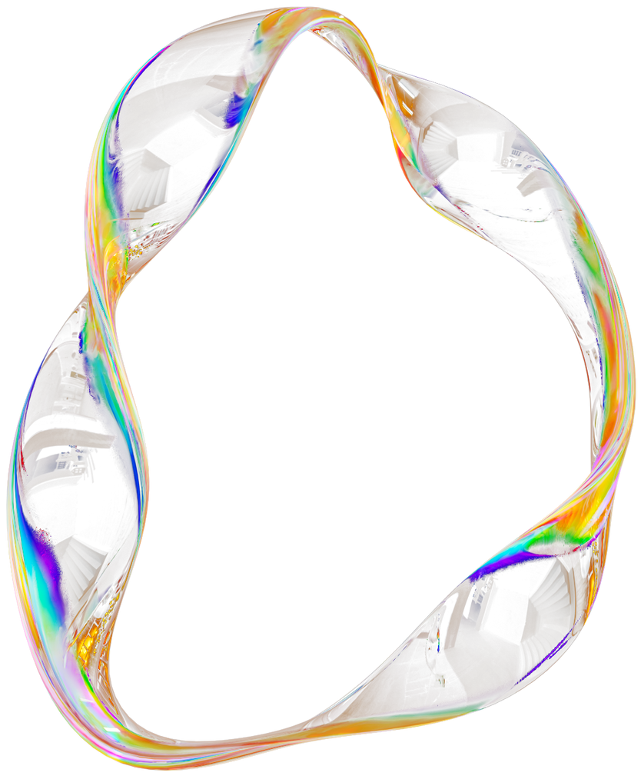
TABLE OF CONTENTS
1
Problem Statement
6
Model Selection and Training
2
7
Tracking The Project workflow using MlFlow
Project Workflow
3
8
Meet our Team
Data Collection
4
Preprocessing

Slide 3

PROBLEM STATEMENT
Credit card fraud is a significant challenge in today's digital economy, with fraudulent transactions causing substantial financial losses each year. The problem arises because detecting fraud is like finding a needle in a haystack, as fraudulent transactions are far less common than legitimate ones. This imbalance between fraud and non-fraud cases presents unique challenges in training machine learning models, as the model tends to be biased towards the majority class (non-fraudulent transactions), leading to poor detection of actual fraud.

Slide 4





PROJECT WORKFLOW
Data Collection
Data Preprocessing
Model Selection
Deployment
Workflow

Slide 5
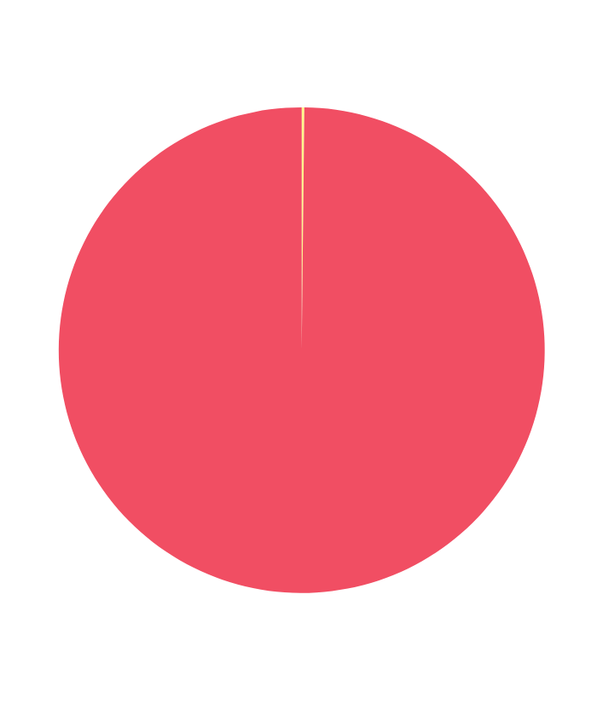
DATA COLLECTION
The dataset was collected from Kaggle here.
The dataset contains transactions made by credit cards in September 2013 by European cardholders.
This dataset presents transactions that occurred in two days, where we have 492 frauds out of 284,807 transactions. The dataset is highly unbalanced, the positive class (frauds) account for 0.172% of all transactions.
It contains only numerical input variables which are the result of a PCA transformation. Unfortunately, due to confidentiality issues, the original features and more background information about the data.
A. 0.172% Fraud Transaction
B. 99.828% Legitimate Transaction

Slide 6

Checking for Null Values
The first step was to check for any null or missing values in the dataset. Ensuring a complete dataset is critical for accurate model training, and any missing data was either filled or discarded accordingly.
Checking Class Imbalance
A key challenge in this problem is the imbalance between fraud and non-fraud transactions. Upon visualizing the class distribution, it was confirmed that the dataset had a significant imbalance, with only 492 fraud cases compared to over 200,000 non-fraud cases. This imbalance would result in bias and insufficient training for fraud detection, so addressing it was crucial.
DATA
PREPROCESSING
Feature Scaling
To normalize the data, we used a Standard Scaler. A Min-Max scaler was deemed unsuitable due to the high dimensionality of the dataset, as many features contained outliers. Given that Principal Component Analysis (PCA) had already been applied to reduce dimensionality, the standard scaling helped stabilize the feature ranges for more effective learning.

Slide 7
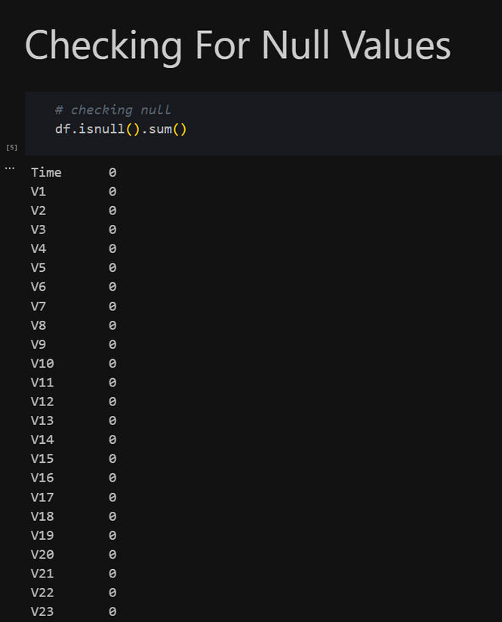
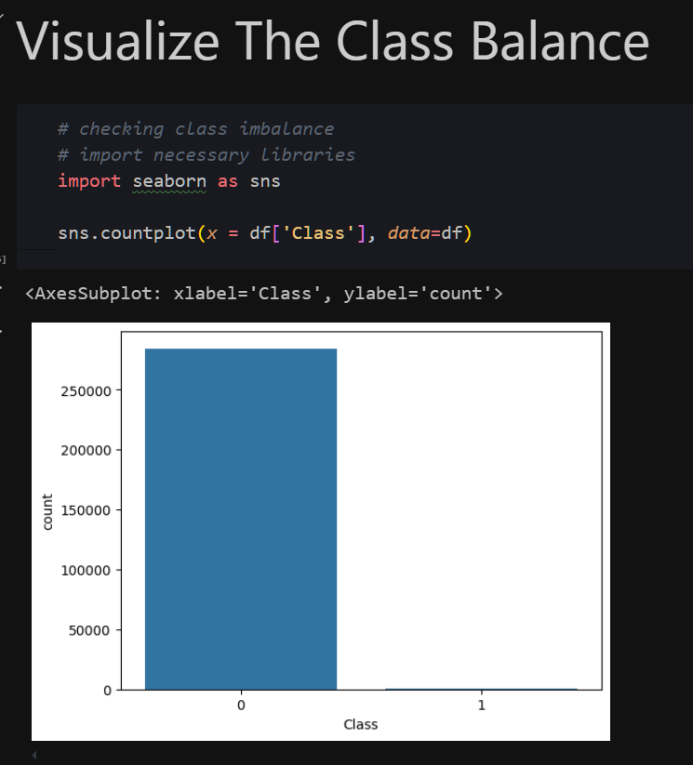
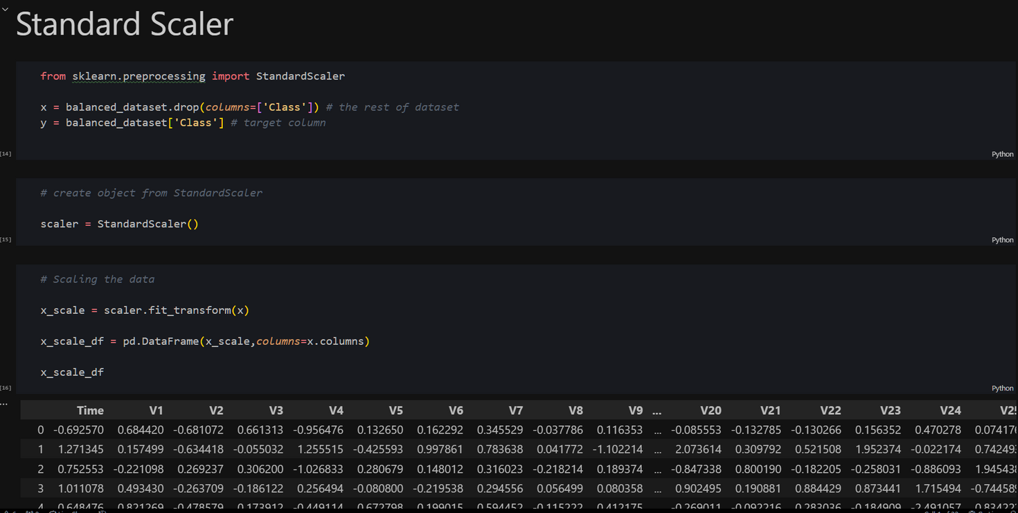
1
2
3
Check the preprocessing notebook from here

Slide 8

OVERCOMING THE CLASS IMBALANCE PROBLEM
SAMPLING TECHNIQUES
GANS
Under-sampling: We reduced the number of non-fraudulent transactions to match the count of fraud transactions (482 examples). This method helps balance the dataset but risks losing valuable information from the legitimate transactions.
Augmentation using GAN: To avoid information loss, we applied Generative Adversarial Networks (GANs) to synthetically generate new fraud examples, thereby increasing the size of the fraud class to match the non-fraudulent transactions. While this technique provided more balanced data, it led to a large dataset, slowing down the computation due to the sheer number of non-fraud cases (over 200k).

Slide 9
GANS
Purpose
How it works
GANs (Generative Adversarial Networks) are used to generate synthetic fraud data, addressing the class imbalance problem. Since fraud cases are rare, the GAN helps create realistic fraudulent transactions for model training.
A GAN consists of two neural networks:
Generator: Creates fake transactions that mimic real fraudulent activity.
Discriminator: Attempts to distinguish between real fraud data and the fake transactions generated by the generator.
These two models work together: the generator creates data, and the discriminator validates it. Over time, this process improves the generator's ability to create realistic fraudulent data.
Check the GAN notebook from here

Slide 10

GANS BUILIDING PROCESS
The GAN architecture is built using two main components:
Generator Model
Discriminator Model
The generator uses several dense layers to process the input noise and generate synthetic transactions. Each layer increases in complexity to capture patterns that mimic real fraud data.
The discriminator is designed to distinguish between real and generated fraud data. It also uses multiple dense layers to improve classification performance
Combined GAN Network
Layer Breakdown:
The generator and discriminator are combined into a composite GAN. The discriminator is used to provide feedback to the generator, allowing it to improve its ability to generate realistic fraud transactions over time
Layer Breakdown:
First Layer: Dense layer with 128 units using a ReLU activation function. Subsequent Layers: 256 and 512 units to capture more complex fraud patterns.
Final Layer: Produces synthetic transactions with 30 features, matching the format of real transaction data.
First Layer: Starts with 512 neurons, reducing to 256 and 128.
Final Layer: One neuron using a sigmoid activation function for binary classification (fraud or non-fraud).

Slide 11
Data Preparation: Feature selection
FEATURE SELECTION
BATCH SIZE DETERMINATION
The 'Class' column, which indicates whether a transaction is fraudulent, is removed from the training data. This leaves only the input features (X_train), which are used to train the Generator and Discriminator.
The batch size is split in half, with half of the batch used to train the Discriminator on real data and the other half on fake data. This approach helps ensure balanced training for both networks.

Slide 12
Real Data Selection
Randomly select half of the batch size from X_train to represent real data.
Generating Fake Data
Create noise vectors from a normal distribution and feed them into the Generator to produce synthetic data. This data is labeled as fake.
labeling
TRAINING THE DISCRIMINATOR
Assign labels 1 for real data and 0 for fake data
The Discriminator is trained on both real and fake data, optimizing its ability to distinguish between the two.

Slide 13
Noise Generation
Create noise vectors from a normal distribution, representing the input to the Generator.
Generator Training
The Generator is trained to produce data that fools the Discriminator into classifying it as real.
GAN Training
TRAINING THE GENERATOR
The Generator is trained within the GAN framework, using the Discriminator's feedback to improve its ability to generate realistic synthetic data.

Slide 14
MONITORING PROGRESS
Epochs
Losses
Model Evaluation
The training process is monitored every 10 epochs to track the performance of the Discriminator and Generator.
The Discriminator loss (d_loss) and Generator loss (g_loss) are recorded and analyzed to assess the progress of the training process.
The losses are used to evaluate the model's performance, indicating its ability to distinguish between real and synthetic data and generate realistic data, respectively.

Slide 15
GENERATING SYNTHETIC FRAUD DATA
Noise Generation
Synthetic Data Generation
Data Structuring
Create noise vectors from a normal distribution to serve as input for the trained Generator.
Use the Generator to produce synthetic fraud data based on the noise input.
Convert the generated synthetic fraud data into a Pandas DataFrame, ensuring proper formatting and feature names.

Slide 16

DATA AUGMENTATION
MERGING DATA
RESULTING DATASET
This creates a balanced dataset with equal numbers of fraud and non-fraud samples, addressing class imbalance and improving model training effectiveness.
The synthetic fraud data is combined with existing non-fraud data.

Slide 17
MODEL TRAINING AND SELECTION
Splitting Data into Training and Testing Sets
Training the Model
•Splitting Data into 80% training and 20% testing data
Types of Model training were used:
• Logistic regression
• Random Forest
Model Testing & Evaluation
Visualization
We used accuracy metrics to evaluate the model performance:
accuracy score
confusion matrix
Classification report
using matplot and seasborn library, we’ve visualized the confusion matrix for better visual evaluation.
Check the model notebook from here

Slide 18
Logistic Regression
TRAINING THE MODEL USING SCIKIT LEARN
WHY LOGISTIC REGRESSION
Simplicity and Interpretability
Speed and Efficiency: Logistic Regression is computationally efficient and trains faster than many other algorithms, especially on large datasets which is our case
Training the model using scikit-learn library:
log_model=LogisticRegression(max_iter=1000)

Slide 19
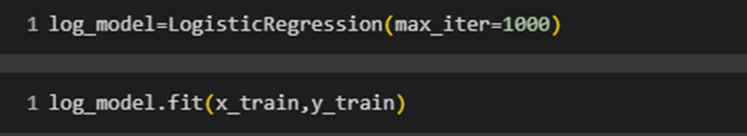
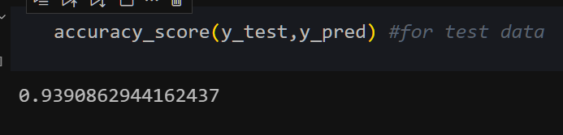
1
2
3
4
Check the model notebook from here

Slide 20

Random Forest
WHY RANDOM FOREST
Handles Complex Relationships
Higher Accuracy
Handles Missing Data Well

Slide 21
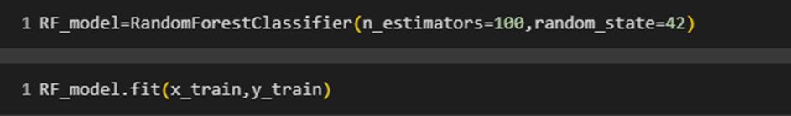
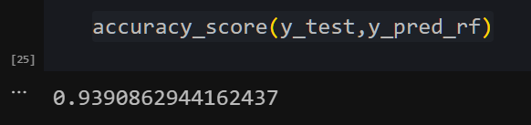
1
2
3

Slide 22
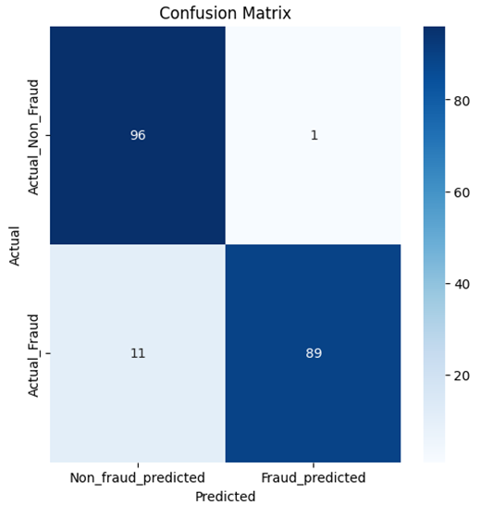
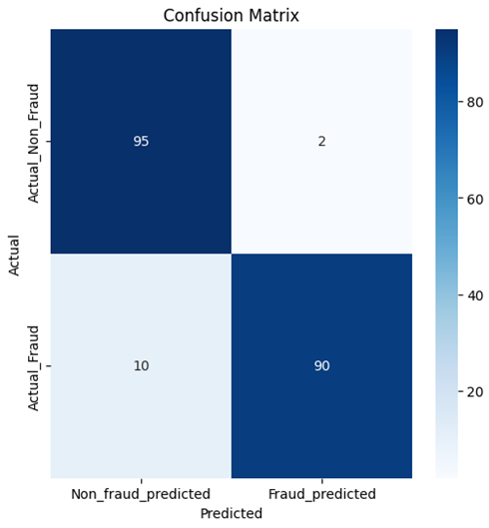
Confusion Matrix - Logistic Regression | Random Forest
Logistic Regression
Random Forest

Slide 23
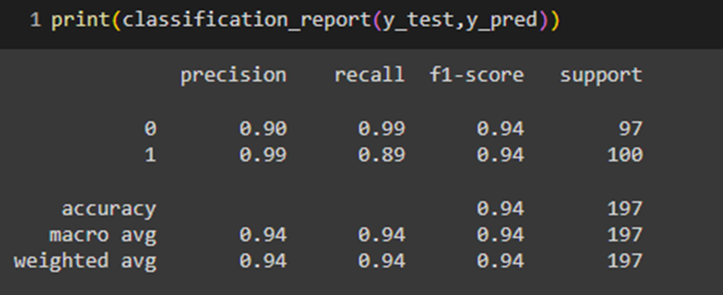
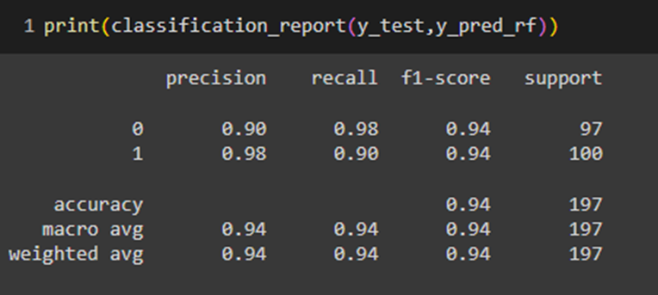
Classification Report - Logistic Regression | Random Forest
Logistic Regression
Random Forest

Slide 24
Cross Validation
WHY USE CROSS-VALIDATION
Improves Model Reliability
Reduces Overfitting and Underfitting
Provides a More Comprehensive Performance Metric

Slide 25
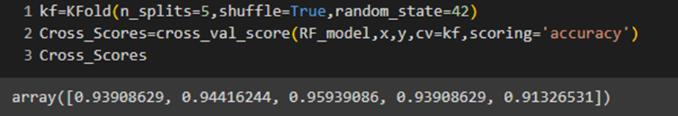
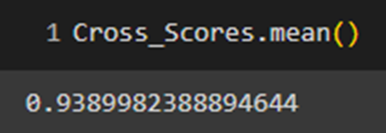
Cross Validation
K-fold cross-validation is a method for assessing a model's generalization ability by dividing the dataset into K equally-sized folds (in this case, 5 folds).
cross_val_score is a function from sklearn.model_selection that simplifies the process of running cross-validation.
The cross_val_score function returns an array of accuracy scores, one for each fold in the cross-validation process.

Slide 26
DEPLOYMENT
For the deployment of the credit card fraud detection model,
We used FastAPI to create a REST API that serves the trained model.
The model was trained using machine learning techniques and saved as a .pkl file.
Below is an overview of the deployment process:
Model Serialization
Testing using Postman
API Development using FastAPI
Exporting Test Data in JSON format
Check the deployment notebook from here
Check the deployment script(FastAPI) from here

Slide 27
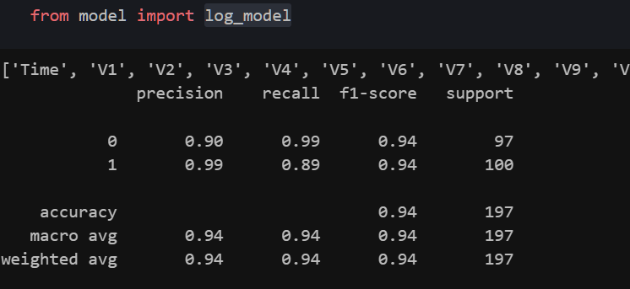
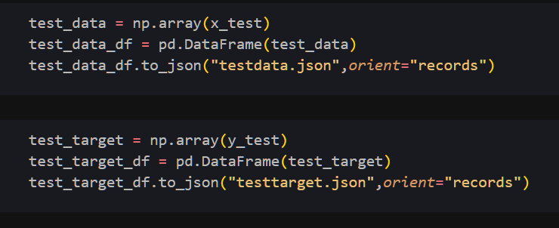
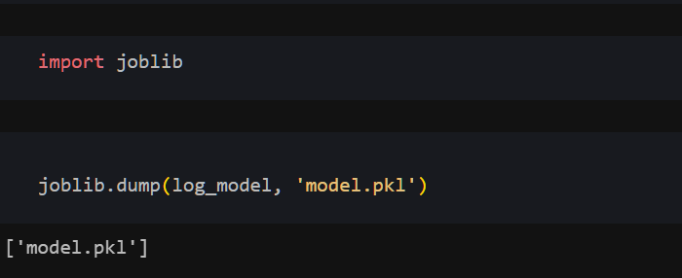
1
2

Slide 28
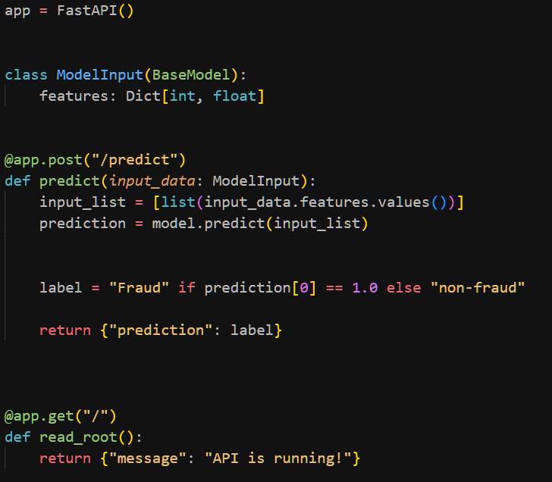
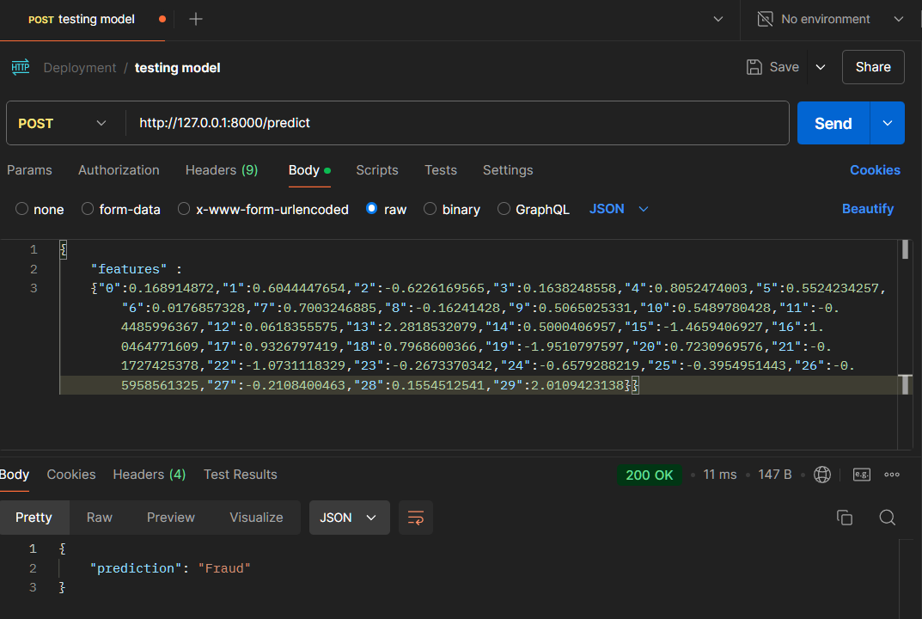
3
4

Slide 29
TRACKING PROJECT WORKFLOW USING MLFLOW
MLflow is an open-source platform that helps manage the lifecycle of machine learning models. It supports:
Experiment Tracking
Model Management
Reproducibility
Recording and querying experiments.
Packaging models and sharing them easily.
Storing parameters, metrics, models, and artifacts for each experiment run.

Slide 30
TRACKING PROJECT WORKFLOW USING MLFLOW
Logistic Regression
Random Forest
Script link
Script link
Implementation Steps:
We built a Logistic Regression model to classify fraud. Multiple experiments were run with varying max_iter values (500 to 5000) to tune the model.
Key MLflow Features:
Parameters: We logged the number of iterations (max_iter).
Metrics: For each run, we logged test_accuracy and train_accuracy to track the performance.
Artifacts: Confusion matrix plots were generated and logged as artifacts to visualize the model's performance.
Model Logging: The model was saved in the MLflow experiment for reproducibility
Results:
Metrics: Accuracy metrics for both training and test sets were logged for comparison.
Artifacts: Confusion matrices helped visualize false positives and negatives across iterations.
Implementation Steps:
A Random Forest Classifier was trained with different n_estimators (50, 100, 200, 500, 1000, 2000). Each run represents an experiment with a specific number of trees.
Key MLflow Features:
Parameters: The number of estimators (n_estimators) was logged for each run.
Metrics: Accuracy scores for both training and test data were logged.
Artifacts: Confusion matrices were logged for each experiment run.
Model Logging: The trained Random Forest models were saved with their respective configurations.
Results:
Metrics: Accuracy metrics were logged for each configuration.
Artifacts: Confusion matrices were generated and stored for further analysis.

Slide 31
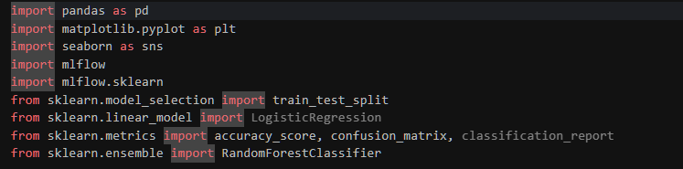
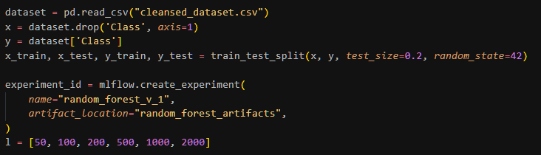
TRACKING PROJECT WORKFLOW USING MLFLOW
1
2

Slide 32
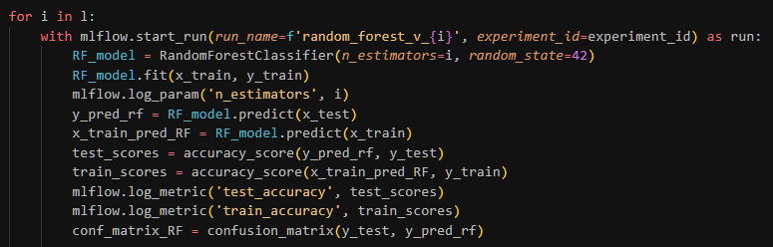
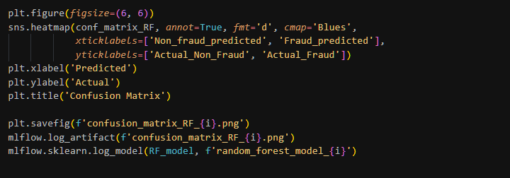
TRACKING PROJECT WORKFLOW USING MLFLOW
3
4

Slide 33

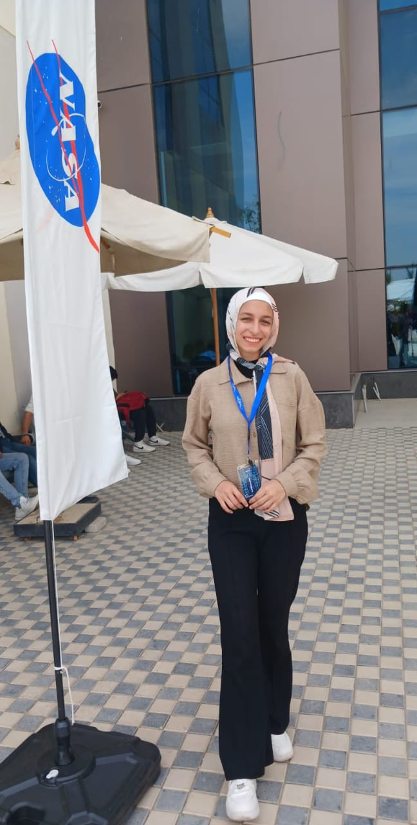

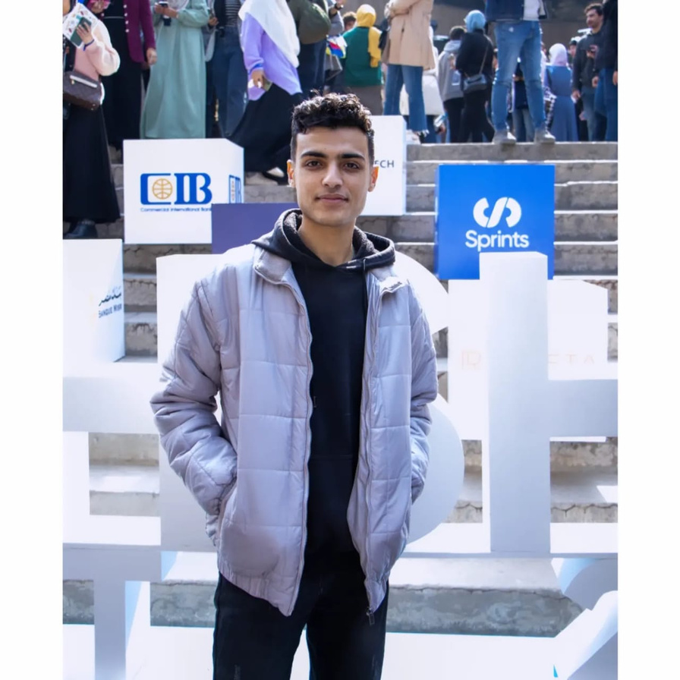



MEET THE TEAM
SARAH SAMEH
RAWAN KHALED
MOSTAFA ABDELFATTAH
ABDEL-AZIZ ESSAM
AHMED ALI
Sarah Sameh
Rawan Khaled
Mostafa Elwishy
Abdel-Aziz Saleh
Ahmed Ali
Sarah627

